Slide 1
CS371m - Mobile Computing
User Interface Basics

Slide 2
Clicker Question
Have you ever implemented a Graphical User Interface (GUI) as part of a program?
Yes, in another class.
Yes, at a job or internship.
Yes, on my own.
No

Slide 3
UI Programming with Widgets
Widgets are an element in a Graphical User Interface (GUI)
not to be confused with app widgets placed on the home screen, mini version of app
Widgets are building blocks
User interacts with a given widget
Often use prebuilt widgets
Advanced developers create their own (Chris Renke, Square)

Slide 4
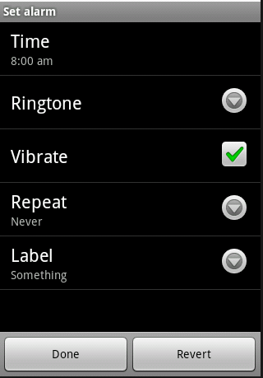
Widgets
Including:
Text Views
Buttons
Check Boxes
Spinners (drop down menus)
and many, many more

Slide 5
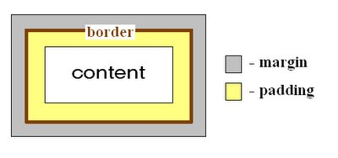
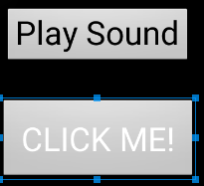
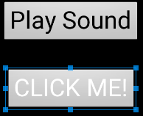
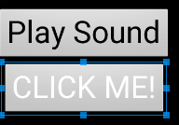
Widget Attributes
Size
layout width
layout height
Margin
Padding
No specified margin or padding
Top Margin of 30dp (density independent pixels)
Top Margin of 30dp,
padding of 20dp

Slide 6
Size
Three options:
Specified (hard coded) size in dp, density independent pixels
wrap_content
widget is just big enough to show content inside the widget (text, icon)
match_parent
match my parent's size
widgets stored in a container or ViewGroup

Slide 7
Containers
Containers are used to organize multiple widgets into a structure
Similar to layout managers in Java
aka ViewGroups
Containers have children
Children can be UI widgets or other containers
Containers have a set of rules governing how it lays out its children in the screen space the container occupies

Slide 8
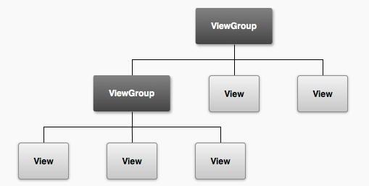
Containers (ViewGroups) and Widgets (Views)
A layout, for example a linear layout
A layout, for example a table layout
TextViews (labels), ImageViews,
Controls such as buttons, etc.

Slide 9
XML UI Configuration
Layouts can contain UI elements (built in Android and programmer created)
res/layout
"Design by Declaration"
why?
tools to parse XML to display result in a graphical way
build drag and drop editors

Slide 10
UI Via XML
Each Screen in your app will likely have an xml layout file
describes the container and widgets on the screen / UI
Edit xml or use drag and drop editor
alter container and layout attributes for the set up you want
we will then access and manipulate the container and widgets in our Java code associated with the UI / screen.

Slide 11
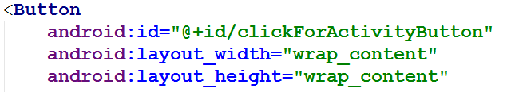
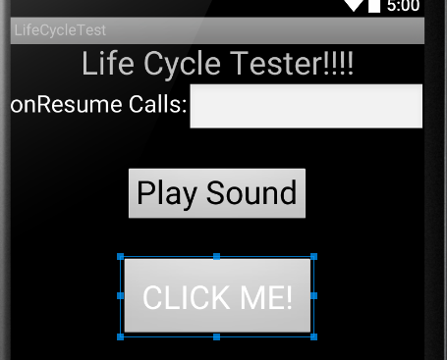
Size - Wrap Content

Slide 12
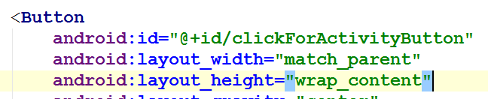
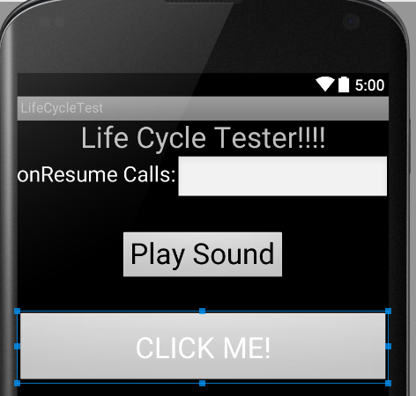
Size - Match Parent

Slide 13
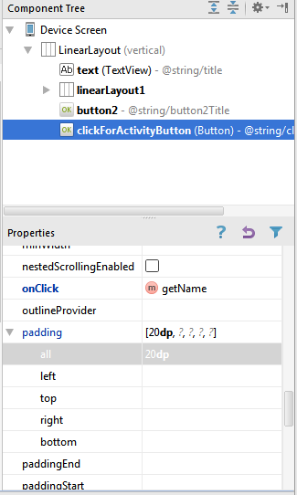
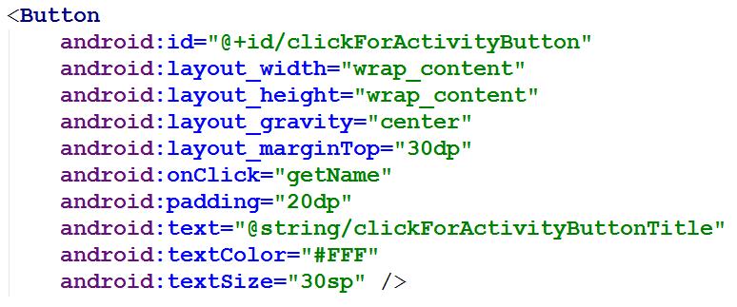
Widgets and Android Studio
GUI for GUI design and XML

Slide 14
Attributes
android:padding="20dp" appears in the xml file for the button and sets the given attribute to the specified value
see the view class or appropriate sub class for attributes
a lot of attributes
http://tinyurl.com/y8jj5eo
attributes can be set in the xml and most can changed programmatically

Slide 15
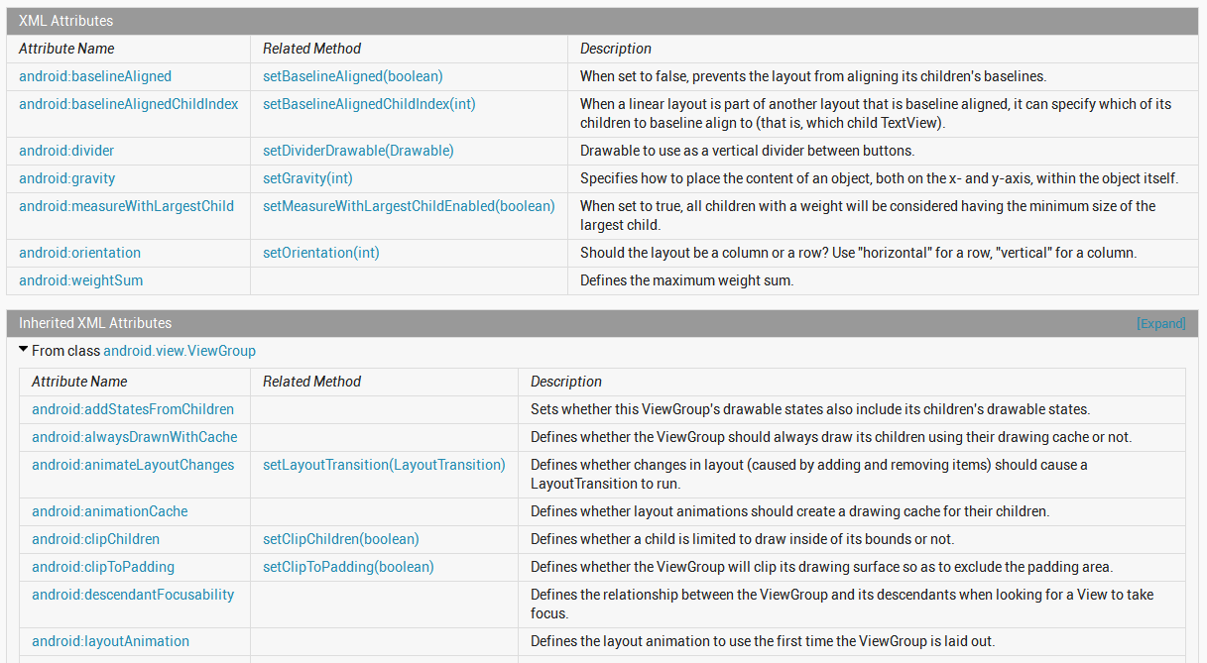
Attributes

Slide 16
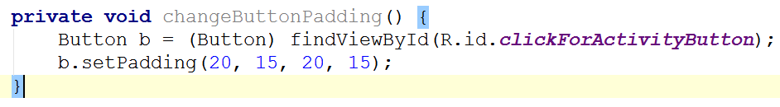
in layout xml file
Programmatically in Activity (Java code)
in program

Slide 17
TYPES OF WIDGETS

Slide 18
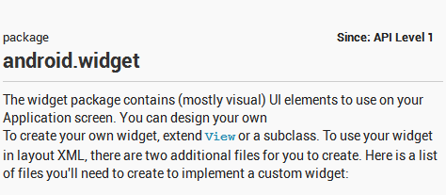
Android Controls
android.widget package
Not to be confused with application widgets, mini versions of applications
Still subclasses of View
interactive components of the UI
layouts are the containers

Slide 19
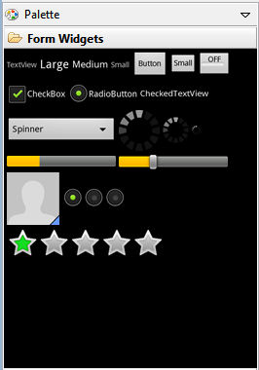
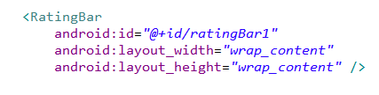
Adding Controls
Widgets can be added to the XML layout or at run time
Add component in visual editor and XML code automatically generated
tweak XML code as desired

Slide 20
Common Controls - TextView
a simple label
display information, not for interaction
common attributes: width, height, padding, visibility, text size, text color, background color
units for width / height: px (pixels), dp or dip (density-independent pixels 160 dpi base), sp (scaled pixels based on preferred font size), in (inches), mm (millimeters)
recommended units: sp for font sizes and dp for everything else
http://developer.android.com/guide/topics/resources/more-resources.html#Dimension

Slide 21
TextView
Other possible attributes:
set number of lines of text that are visible
android:lines="2"
ellipssize attribute to add … instead of simply truncating text
contextual links to email address, url, phone number,
autolink attribute set to none, web, email, phone, map, or all

Slide 22
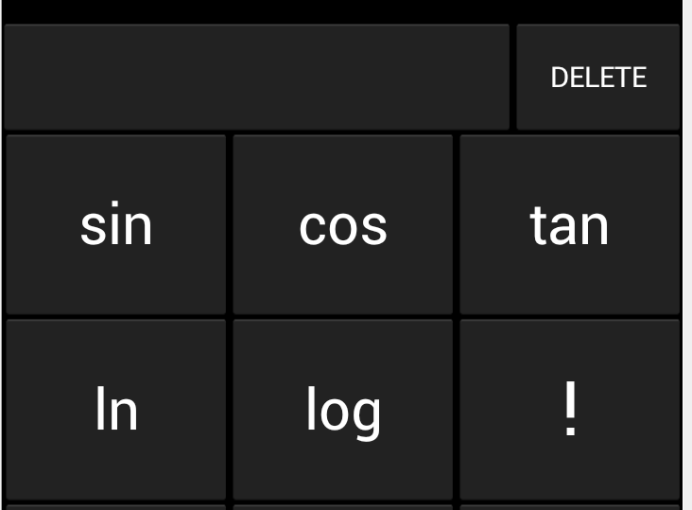
Common Controls - Button
Text or icon or both on View
button press triggers some action
set android:onClick attribute in XML file
OR create a ClickListener object, override onClick method, and register it with the checkbox
typically done with anonymous inner class
possible to customize appearance of buttons http://developer.android.com/guide/topics/ui/ controls/button.html#CustomBackground

Slide 23
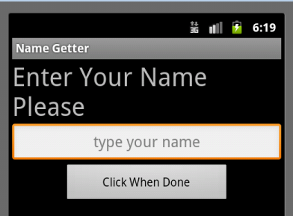
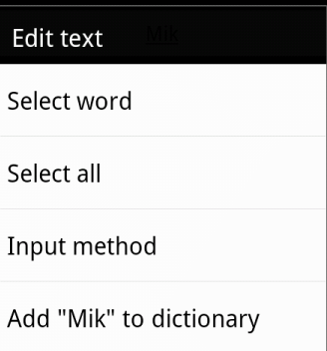
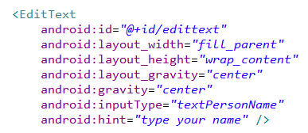
Common Controls - EditText
Common component to get information from the user
long press brings up context menu

Slide 24
EditText
can span multiple lines via android:lines attribute
Text fields can have different input types, such as number, date, password, or email address
android:inputType attribute
affects what type of keyboard pops up for user and behaviors such as is every word capitalized

Slide 25
EditText
Keyboard actions
specify action when input done
ime = input method editor
android:imeOptions attribute
actionNone, actionSearch, actionSend, others
http://developer.android.com/reference/android/widget/TextView.html#attr_android:imeOptions

Slide 26
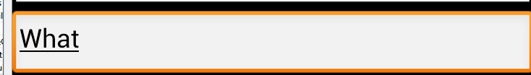

Auto Complete Options
Depending on EditText inputType suggestions can be displayed
works on actual devices
Other classes exist for auto complete from list
AutoCompleteTextView
choose one option
MultiAutoCompleteTextView
choose multiple options (examples tags, colors)

Slide 27
AutoCompleteTextView
Two types
we provide list of choices
user provides list
Developer list
use ArrayAdapter connected to array
best practice: put array in array.xml file

Slide 28
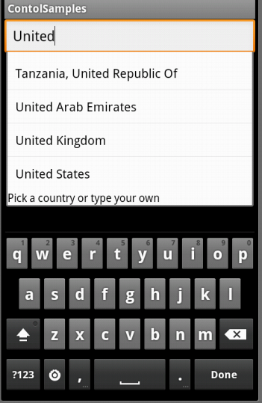
AutoComplete Using Array

Slide 29
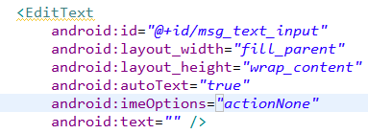
EditText
Auto complete option using device dictionary:
No dictionary on emulator!

Slide 30
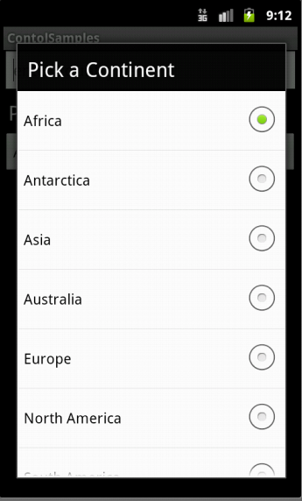
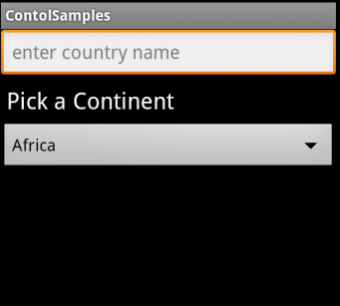
Spinner Controls
Similar to auto complete, but user must select from a set of choices

Slide 31
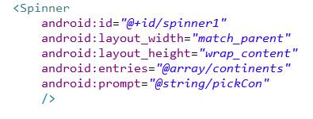
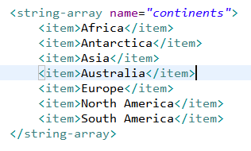
Spinner Control
arrays.xml in res/values

Slide 32
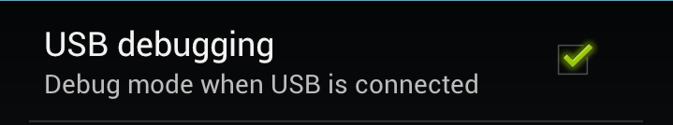
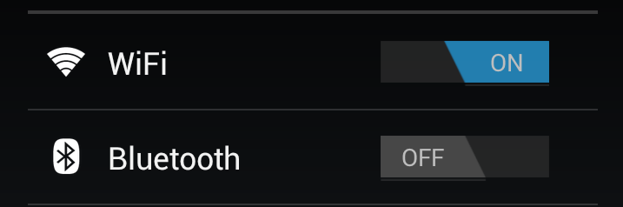

Simple User Selections
CheckBox
set android:onClick attribute or create a ClickListener object, override onClick method, and register it with the checkbox
Switches and ToggleButton
similar to CheckBox with two states, but visually shows states
on and off text

Slide 33
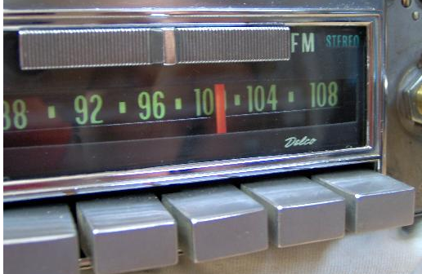
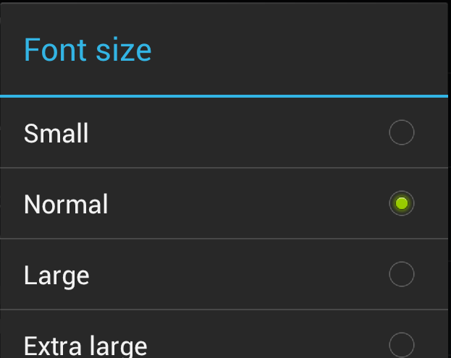
RadioButton and RadioGroup
Select one option from a set
set onClick method for each button
generally same method
Collected in RadioGroup
sub class of LinearLayout
vertical or horizontal orientation

Slide 34
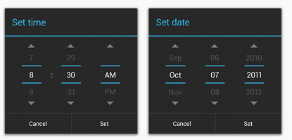
Pickers
TimePicker and DatePicker
Typically displayed in a TimePickerDialog or DatePickerDialog
dialogs are small windows that appear in front of the current activity

Slide 35
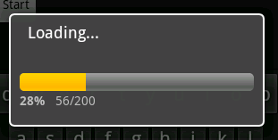
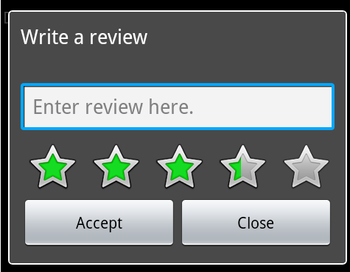
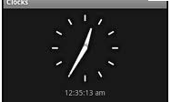
Indicators
Variety of built in indicators in addition to TextView
ProgressBar
RatingBar
Chronometer
DigitalClock
AnalogClock

Slide 36
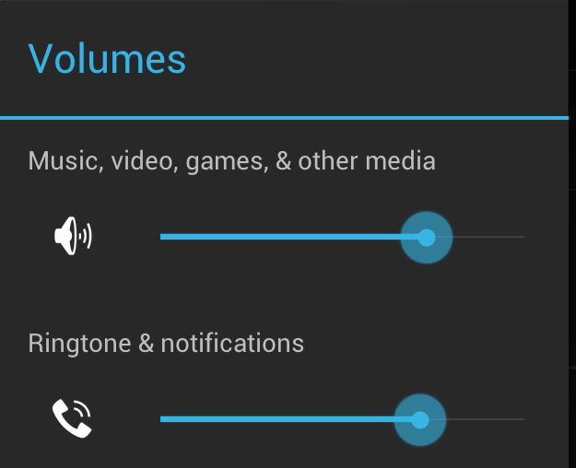
SeekBar
a slider
Subclass of progress bar
implement a SeekBar.OnSeekBarChangeListener to respond to changes in setting

Slide 37
Clicker
What is the purpose of the xml files in the res/layout directory in an Android project?
define all the Java classes in the project
define user interfaces
localize String resources
store graphic image resources such as jpeg and png files
list the permissions the app requests

Slide 38
interacting with widgets

Slide 39
Interacting with Widgets
Some widgets simply display information.
TextView, ImageView
Many widgets respond to the user.
We must implement code to respond to the user action.
Typically we implement a listener and connect to the widget in code.
logic / response in the code

Slide 40
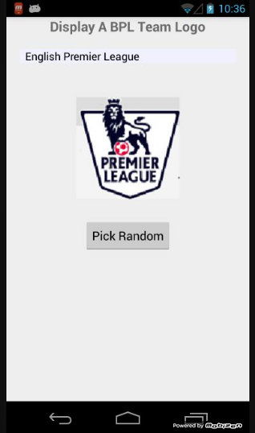
Example - Display Random Image
App to display crests of British Premier League Football teams
Allow user to select team from spinner control
Or, press button to display a random crest
TextView
Spinner
ImageView
Button

Slide 41
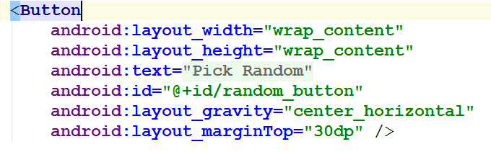
Button in XML layout file
Notice button reacts when pressed, but nothing happens
Possible to disable button so it does not react

Slide 42
Responding to Button Press
Two ways:
Hard way, create a listener and attach to the button
shorter way exists for Views, but this approach is typical for many, many other widgets behaviors besides clicking
Implement an onClickListener and attach to button

Slide 43
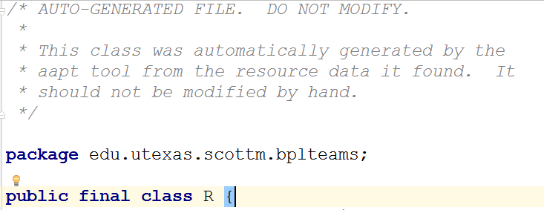
Accessing Button in Code
R.java file automatically generated and creates ids for resources in project folder
if id attribute declared

Slide 44
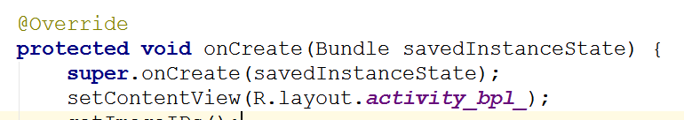
Setting Activity Layout / GUI
Usually the GUI for an Activity is set in the onCreate method.
Typically a layout file is used
set content view will inflate runtime objects for all the widgets in the layout file

Slide 45
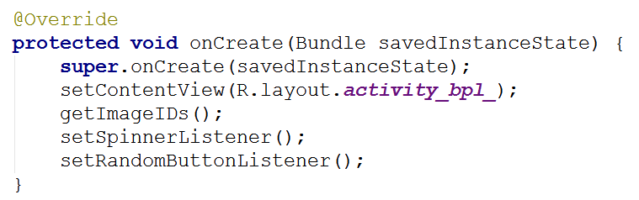
Accessing Layout Widget
To attach a listener we need a handle (reference) to the runtime object for the button (or desired widget)

Slide 46
Accessing Layout Widget
findViewById returns a View object
often necessary to cast to correct type
A whole host of methods to access resources in your /res directory programmatically

Slide 47

Creating and attaching a Listener
setOnClickerListener is method that attaches the listener
View.onClickListener is a Java interface with one method onClick
We are implementing interface with an anonymous inner class

Slide 48
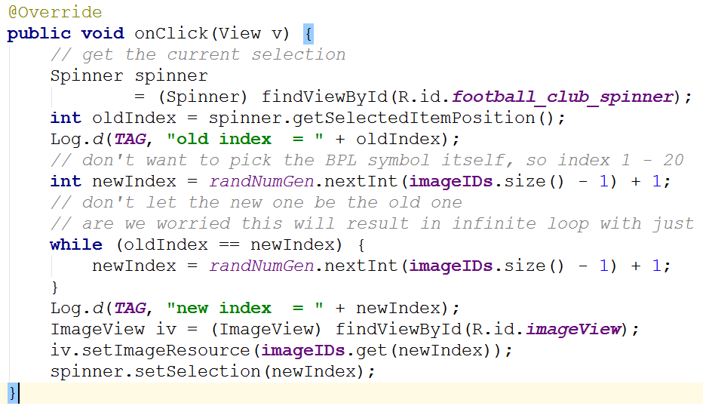
onClick Logic

Slide 49
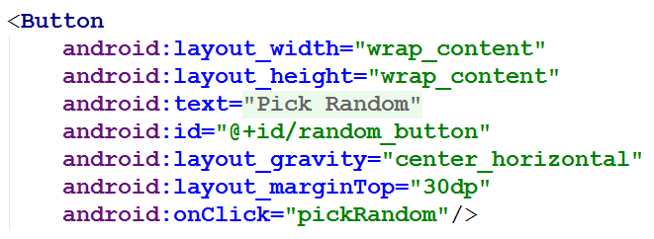
Shortcut for Clicks
All View objects have an onClick attribute
method to call when the View is clicked
Can set onClick attribute to a method in Activity that is called when View is clicked

Slide 50
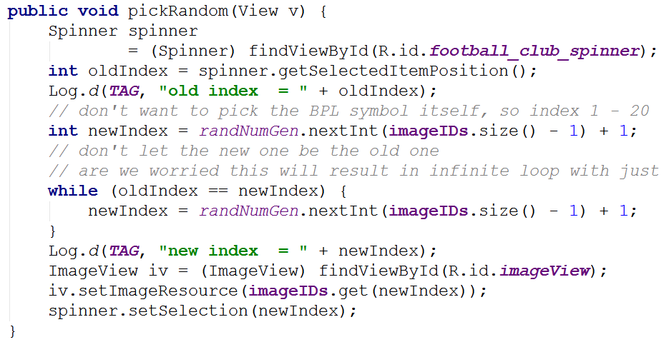
Shortcut for Clicks
In Activity:
demo when method signature wrong

Slide 51
Clicker
What method do we use to associate a variable with the runtime object of a UI component declared in a layout xml file?
setContentView()
startActivity()
onCreate()
a constructor
findViewById()

Slide 52
containers for widgets view groups

Slide 53
ViewGroups - Layouts
Layouts are subclasses of ViewGroup
Still a view but doesn't actually draw anything
serves as a container for other views
similar to Java layout managers
options on how sub views (and view groups) are arranged
Useful Layouts: FrameLayout, LinearLayout, TableLayout, GridLayout, RelativeLayout, ListView, GridView, ScrollView, DrawerLayout, ViewPager

Slide 54
FrameLayout
FrameLayout
simplest type of layout object
fill with a single object (such as a picture) that can be switched in and out
child elements pinned to top left corner of screen and cannot be move
adding a new element / child draws over the last one

Slide 55
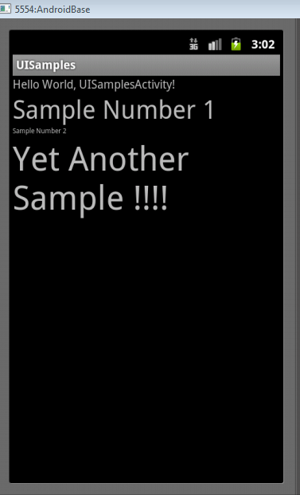
LinearLayout
aligns child elements (such as buttons, edit text boxes, pictures, etc.) in a single direction
orientation attribute defines direction:
android:orientation="vertical"
attribute of View

Slide 56
Activity and Layout
Code on previous slide demonstrates inflating a layout for an Activity
… and programmatically changing an attribute of the layout (or view) during runtime

Slide 57
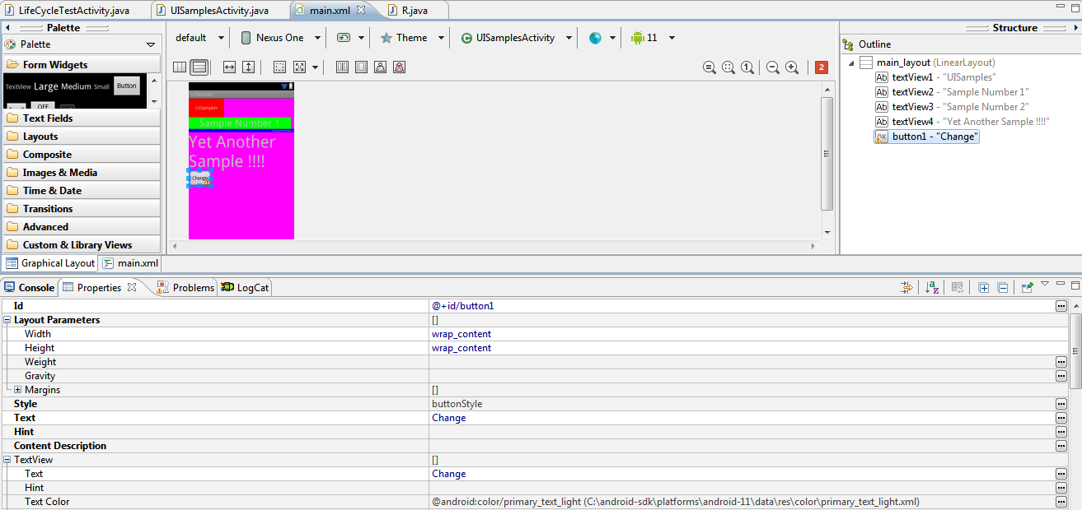
Modifying Attributes
in xml, programmatically, and visual editor

Slide 58
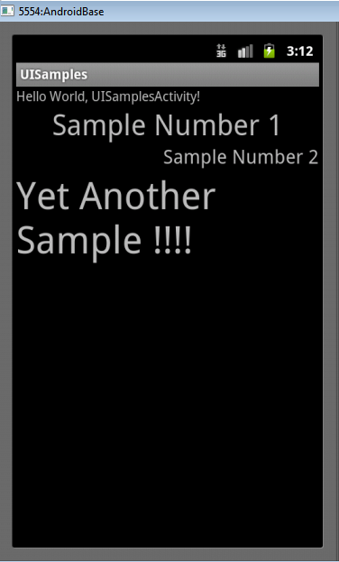
Gravity Attribute
Child element's gravity attribute
where to position in the outer container
center
right

Slide 59
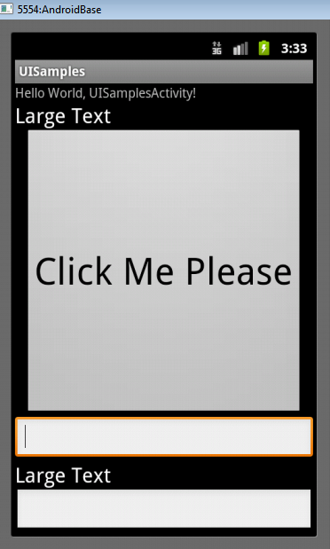
Weight
layout_weight attribute
"importance" of a view
default = 0
if set > 0 takes up more of parent space

Slide 60
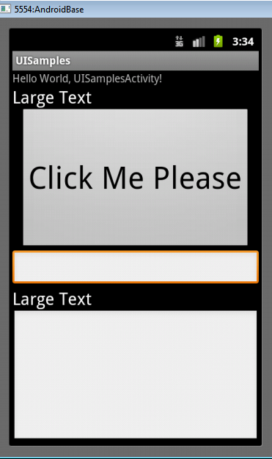

Another Weight Example
button and bottom edit text weight of 2
button weight 1 and bottom edit text weight of 2

Slide 61

LinearLayout - Horizontal Orientation
padding
background color
margins

Slide 62

TableLayout
rows and columns
rows normally TableRows (subclass of LinearLayout)
TableRows contain other elements such as buttons, text, etc.

Slide 63

RelativeLayout
children specify position relative to parent or to each other (specified by ID)
First element listed is placed in "center"
other elements placed based on position to other elements

Slide 64

RelativeLayout XML

Slide 65

RelativeLayout XML

Slide 66
GridLayout
added in Android 4.0
child views / controls can span multiple rows and columns
different than TableLayout
child views specify row and column they are in or what rows and columns they span

Slide 67
Container Control Classes
Layouts shown are useful for positioning UI elements
the layouts themselves are not interactive although the child Views may be
Other available layouts add a level of interactivity between the user and the child Views
ListView, GridView, GalleryView
Tabs with TabHost, TabControl
ScrollView, HorizontalScrollView

Slide 68
Data driven containers ListView and gridview

Slide 69

Data Driven Containers
Containers that display repetitive child Views
ListView
vertical scroll, horizontal row entries, pick item
consider using ListActivity
GridView
specified number of rows and columns
GalleryView
horizontal scrolling list, typically images

Slide 70

AdapterView
ListView, GridView, and GalleryView are all sub classes of AdapterView
Adapter generates child Views from some data source and populates the larger View
Most common Adapters
CursorAdapter used when to read from database
ArrayAdapter to read from resource, typically an XML file

Slide 71
Adapters
When using an Adapter a layout is defined for each child element (View)
The adapter creates Views based on layout for each element in data source and fills the containing View (List, Grid, Gallery) with the created Views
binding
child Views can be as simple as a TextView or more complex layouts / controls
simple ones provided in android.R.layout

Slide 72

Typical Adapter Example

Slide 73

Data Source - countries resource file

Slide 74

TextView for Data
ListView filled with TextViews
TextViews store data from ArrayAdapter

Slide 75


ListView and GridView Results

Slide 76
Selection Events
ListView, GridView, GalleryView
Typically user can select one item of data
Implement the OnItemClickListener class and set it as the listener
we will do this a lot:
create a class that implements some kind of listener
register it with a control

Slide 77
Altering the Data and Display
Previous example read data from resource file
What if we want to update list view as data changes?
add and remove items
Example: remove countries from list and view when selected

Slide 78
Altering Data
ArrayAdapter serves as a bridge between a data source and a ListView
Previous example, data was an array resource file
resource file won't change
Dump data to List (ArrayList) and create ArrayAdapter from that source

Slide 79

Source Code

Slide 80

Create ArrayList

Slide 81

Alter Data on Select

Slide 82


A Toast
"A toast provides simple feedback about an operation in a small popup."

Slide 83

Creating a Toast
Inside the OnItemClickListener anonymous inner class

Slide 84
More Complex List View Items
What if we want each item in a list to have more than simple text?
Let's add a switch to each ListView item to show if the Country listed is "safe" or not?
Each View element in the list will be a horizontal linear layout with a TextView and a switch

Slide 85

Not all of layout file shown

Slide 86

Setting Adapter
Change to use the complex layout for each ListView item

Slide 87

Result
Looks okay.
However...
Scroll the list and notice all safe switches set to Yes!
Flip a couple and scroll

Slide 88


View Recycling
Scroll
UH OH

Slide 89
View Recycling
Imagine a ListView tied to contacts on a phone or some other possibly large data set.
Some people have 1000's of contacts.
Creating a ListView with a distinct object for every list element (the Views) would require a LOT of memory.
So, the rows in a list view get recycled. Enough objects are created for the visible items, but as they scroll off the objects are reused and the data in the widgets is reset to what the user should see.

Slide 90
View Recycling
We set the switch on the row that contains Andorra to
no. The we scrolled down the list. The List View item that
contains Andorra is recycled.
The adapter we are using automatically alters the text, but
the switch is still set to no!

Slide 91
Taking Control of Recycling
We need to track the status of safe for each country and change the switch position as appropriate when a list view item gets recycled
This requires creating two classes:
one to model the data for each row
our own Adapter that extends ArrayAdapter

Slide 92

CountryRowData
Simple nested class to model and track the data in a row

Slide 93

New onCreate Method
Create list of CountryRowData objects and send to our new Adapter class

Slide 94


Extending ArrayAdapter

Slide 95

Listening for Changes to Switches

Slide 96


Set Switch to Correct Value

Slide 97
Explanation of Adapter
Our SafeAdapter class lets ArrayAdapter inflate and recycle the row
call to super.getView
this will set the country name
inflate = take an xml layout and create a runtime object to model it, measure and draw the object
Then we check to see if we have a ViewHolder in the rows tag.

Slide 98
Explanation of Adapter
If we don't have a ViewHolder for the current row we create one and associate it with the row
We add a switch listener for the switch in the row

Slide 99
ViewHolder and Tags
All View objects (all GUI widgets are descendants of View) have a setTag() and getTag() method
These methods allow us to associate an arbitrary object with the View (widget)
The holder pattern uses the widget tag to hold an object which in turn holds each of child widgets of interest

Slide 100
ViewHolder and Tags
The purpose of attaching a holder to the row Views is to avoid calling findViewById() again
can be slow

Slide 101
Recycling of ListView Elements
LOOK HERE FOR intercepting the ListView items:
http://stackoverflow.com/questions/6921462/listview-reusing-views-when-i-dont-want-it-to

Slide 102

Other Layouts - Tabbed Layouts
Uses a TabHost and TabWidget
TabHost consists of TabSpecs
can use a TabActivity to simplify some operations
Tabs can be
predefined View
Activity launched via Intent
generated View from TabContentFactory

Slide 103
Scrolling
ListView supports vertical scrolling
Other views for Scrolling:
ScrollView for vertical scrolling
HorizontalScrollView
Only one child View
but could have children of its own
examples:
scroll through large image
Linear Layout with lots of elements

Slide 104
Concrete UI Example - tip calculator

Slide 105

Concrete Example
Tip Calculator
What kind of layout to use?
Widgets:
TextView
EditText
SeekBar

Slide 106

TextViews

Slide 107
EditText
All but top EditText are
uneditable
Alternative?
TextViews?

Slide 108
SeekBar

Slide 109
Layout
TableLayout
row 0
row 1
row 2
row 3
row 4
row 5

Slide 110

Layout Attributes
android:background
#RGB, #ARGB, #RRGGBB, #AARRGGBB
can place colors in res/values/colors.xml

Slide 111


Color Resources
Good Resource / W3C colors
http://tinyurl.com/6py9huk

Slide 112
StretchColumns
columns 0 indexed
columns 1, 2, 3 stretch to fill layout width
column 0 wide as widest element, plus any padding for that element

Slide 113

Initial UI
Done via some Drag and Drop, Outline view, and editing XML
Demo outline view
properties

Slide 114


Changes to UI
Outline multiple select properties
all TextViews' textColor set to black #000000
change column for %DD labels
use center gravity for components

Slide 115

Changes to UI
change bill total and seekbar to span more columns
gravity and padding for text in column 0
align text with seekBar
set seekBar progress to 18
set seekBar focusable to false - keep keyboard on screen

Slide 116

Changes to UI
Prevent Editing in EditText
focusable, long clickable, and cursor visible properties to false
Set text in EditText to 0.00
Change weights to 1 to spread out

Slide 117

Functionality
onCreate instance variables assigned to components found via ids
update standard percents:

Slide 118

Functionality - Saving State
onSaveInstance
save BillTotal and CustomPercent to the Bundle
check for these in onCreate

Slide 119


Functionality Responding to SeekBar
customSeekBarListener instance variable
Of type OnSeekBarChangeListener

Slide 120

Create an Anonymous Inner Class
Class notified when seek bar changed and program updates custom tip and total amount
must register with the seekBar instance variable in onCreate!

Slide 121


Functionality - Total EditText
Another anonymous inner class
implement onTextChanged to converts to double and call update methods
register with EditText for total in onCreate()!

