Slide 1
CS371m - Mobile Computing
Anatomy of an Android App and the App Lifecycle

Slide 2
Application Components
four primary components (plus one)
different purposes and different lifecycles
Activity
single screen with a user interface, app may have several activities, subclass of Activity
Most of early examples will be activities
Service
Application component that performs long-running operations in background with no UI
example, an application that automatically responds to texts when driving

Slide 3
Application Components
Content Providers
a bridge between applications to share data
for example the devices contacts information
we tend to use these, but not create new ones
Broadcast Receivers
component that responds to system wide announcements
battery low, screen off, date changed
also possible to initiate broadcasts from within an application
Intents
used to pass information between applications

Slide 4
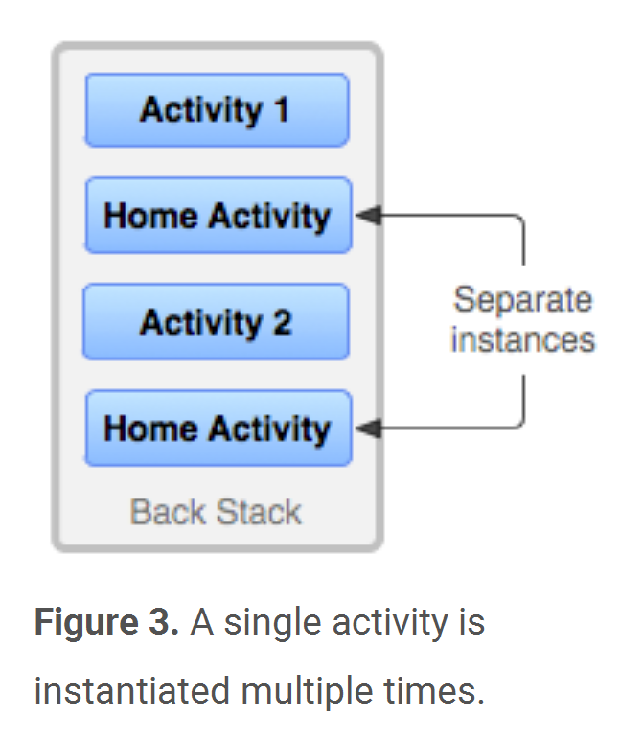
Activity Stack
Most recently created is at Top
Activity 1
User currently interacting with me
Activity 2
Pressing Back or destroying A1 will bring me to the top
Activity 3
Activity N
If Activities above me use too many resources, I’ll be destroyed!
Beware having multiple instance of the same
activity on the stack

Slide 5
Typical Game
High Scores
Activity
Splash Screen
Activity
Main Menu
Activity
Game Play
Activity
Settings
Activity
Conder & Darcey (2010), Fig 4.1, p. 74

Slide 6
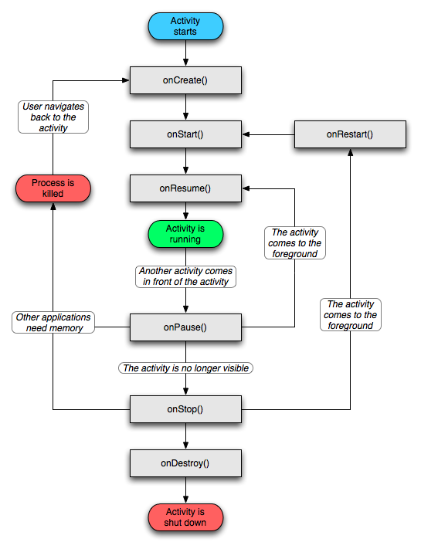
Activity Lifecycle
http://developer.android.com/reference/android/app/Activity.html

Slide 7
Starting Activities
Android applications don't start with a call to main(String[])
instead a series of callback methods are invoked by the Android OS
each corresponds to specific stage of the Activity / application lifecycle
callback methods also used to tear down Activity / application

Slide 8
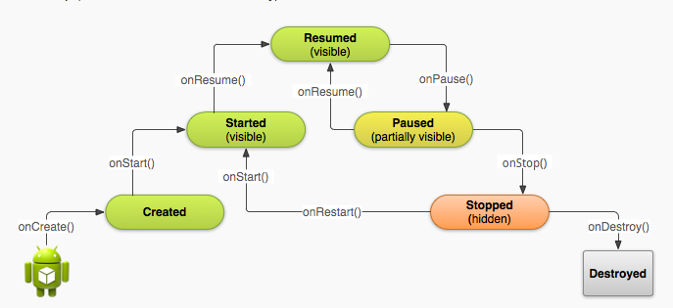
Simplified Lifecycle Diagram
ready to interact with user

Slide 9
Understanding the Lifecycle
Necessary to overload callback methods so your app behaves well:
App should not crash if the user receives a phone call or switches to another app while using your app.
App should not consume valuable system resources when the user is not actively using it.
App should not lose the user's progress if they leave your app and return to it at a later time.
App should not crash or lose the user's progress when the screen rotates between landscape and portrait orientation.
http://developer.android.com/training/basics/activity-lifecycle/starting.html

Slide 10
Primary States
Active
activity is in the foreground and user can interact with it
Paused
activity partially obscured by another activity and user cannot interact with it (for example when working with a menu or dialog)
Stopped
activity completely hidden and not visible to user. It is in the background.
Activity instance and variables are retained but no code is being executed by the activity
Dead, activity terminated (or never started)
Two other states, Created and Started, but they are transitory onCreate -> onStart -> onResume

Slide 11
Clicker
What happens if your app starts an Activity that is not declared in the manifest?
activity starts
dialog asks user if they want to allow Activity
nothing, a no-op
compile error
runtime error

Slide 12
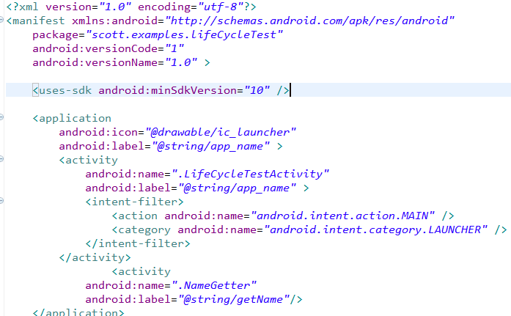
AndroidManifest.xml
All Activities that are part of application must be registered in Manifest
Specify Activity to start with
Notes:
This is the most common IntentFilter seen in Android applications. The action android.intent.action.MAIN indicates that this is the first activity that should be executed when starting this app. The category android.intent.category.LAUNCHER places this Activity in
the launcher window (the window that lists all the available apps).

Slide 13
Purpose of Lifecycle Phases
Entire lifetime: onCreate / onDestroy
Load UI
Could start and stop threads that should always be running
Visible lifetime: onStart / onStop
Access or release resources that influence UI
write info to files if necessary
Foreground lifetime: onResume / onPause
Restore state and save state
Start and stop audio, video, animations

Slide 14
Activity Lifecycle App
overload these methods from Activity:
onCreate(), onStart(), onResume(), onPause(), onStop(), onRestart(), onDestroy()
Use the Log class to log activity
methods: v, d, i, w, e
VERBOSE, DEBUG, INFO, WARN, ERROR
Create a TAG so we can filter
Note, must always call parents method we are overriding first. Anti pattern?

Slide 15
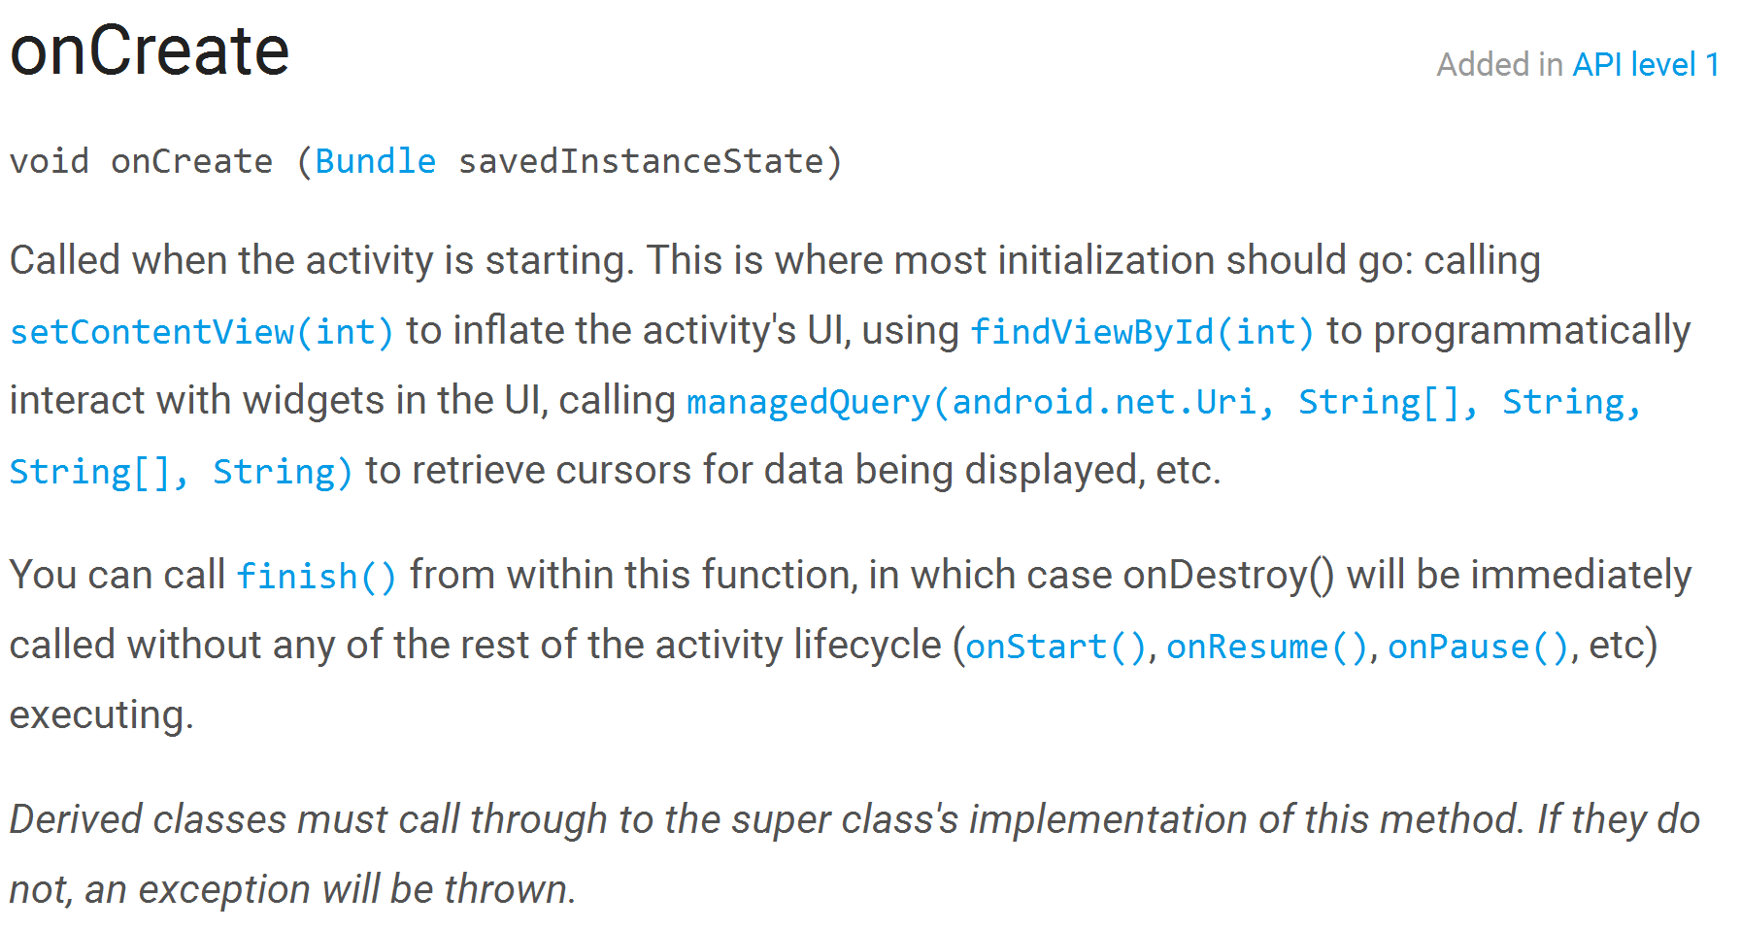
onCreate Documentation

Slide 16
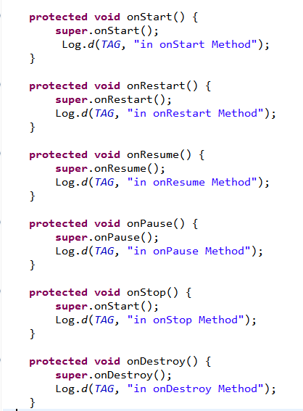
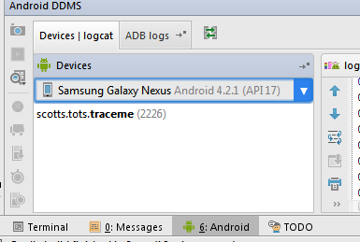
LifeCycleTest
Run the app and open the Logcat view.
Android Studio -> Android button at bottom -> logcat

Slide 17
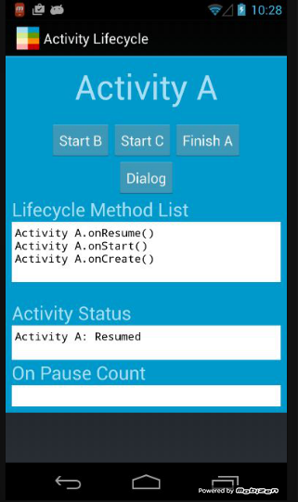
Activity Lifecycle App
examine Logcat
try starting other apps and opening dialog
what happens if we rotate device?
app's activities not fixed in portrait mode

Slide 18
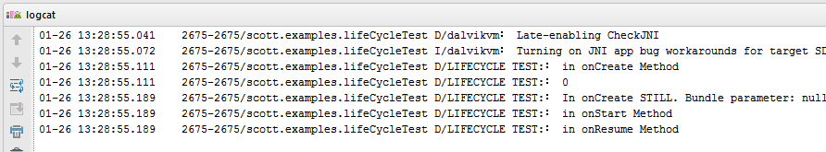
Logcat
After app started

Slide 19
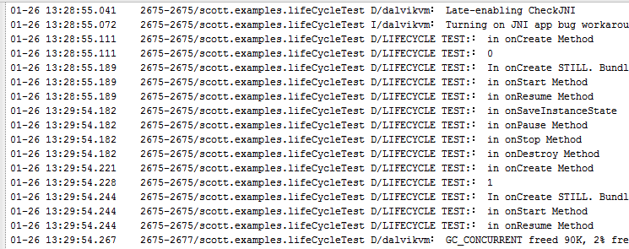
Logcat
Rotate device

Slide 20
Pausing - onPause method
when activity paused you should
stop animations of other CPU intensive tasks
release resources such as broadcast receivers (app stops listening for broadcast info) and handles to sensors such as GPS device or handles to the camera
stop audio and video if appropriate

Slide 21
Stopping - onStop()
Many scenarios cause activity to be stopped
Well behaved apps save progress and restart seamlessly
Activity stopped when:
user performs action in activity that starts another activity in the application
user opens Recent Apps window and starts a new application
user receives phone call
use onStop to release all resources and save information (persistence)

Slide 22
How to stop an Activity yourself?
Generally, don't worry about it!
"Note: In most cases, you should not explicitly finish an activity using these methods. As discussed in the following section about the activity lifecycle, the Android system manages the life of an activity for you, so you do not need to finish your own activities. Calling these methods could adversely affect the expected user experience and should only be used when you absolutely do not want the user to return to this instance of the activity."
methods: finish(), finishActivity()

Slide 23
Saving State
activities that are paused or stopped the state of the activity (instance vars) are retained
even if not in foreground
When activity destroyed the Activity object is destroyed
can save information via onSaveInstanceState method. Write data to Bundle, Bundle given back when restarted

Slide 24
Activity Destruction
app may be destroyed under normal circumstances
on its own by calling finish or user pressing the back button to navigate away from app
normal lifecycle methods handle this onPause() -> onStop() -> onDestroy
If the system must destroy the activity (to recover resources or on an orientation change) must be able to recreate Activity

Slide 25
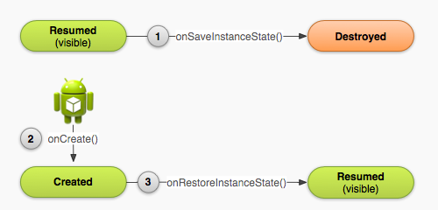
Activity Destruction

Slide 26
Activity Destruction
If Activity destroyed with potential to be recreate later
system calls the onSaveInstanceState (Bundle outState) method
Bundle is a data structure a map
String keys
put methods for primitives, arrays, Strings, Serializables (Java), and Parcels (android)

Slide 27
onSaveInstanceState onRestoreInstanceState()
systems write info about views to Bundle
other information must be added by programmer
example, board state for mastermind
When Activity recreated Bundle sent to onCreate and onRestoreInstanceState()
use either method to restore state data / instance variables

Slide 28
Activity Lifecycle App
How do we keep the onPauseCounter from getting reset to 0 when app is rotated?
Write value to bundle in onSaveInstanceState
override onRestoreInstanceState

Slide 29
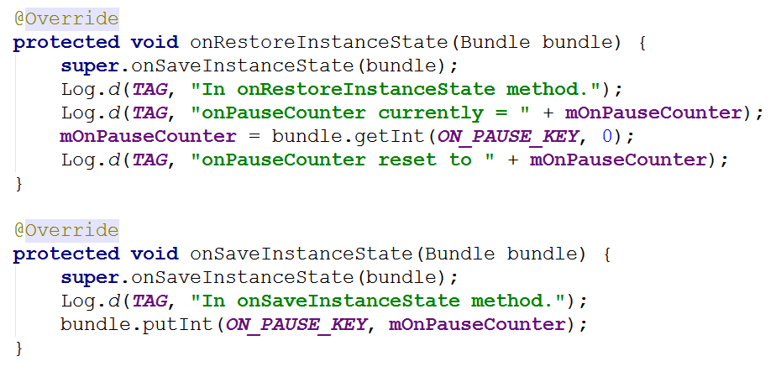
saving and restoring state

Slide 30
Starting You Own Activities
You will often start new Activities within your Activity
accomplish a task
get some data
Click Button to get name
on button click (look at xml)
create an intent
call startActivityForResult
override onActivityResult()
add new Activity to Manifest
add data to intent, setResult, finish
http://developer.android.com/guide/topics/fundamentals/activities.html#StartingAnActivity

Slide 31
Intent Demo
LifeCycle TestActivity
Intent holding constant
Name Getter
startActivityForResult()
Intent holding
Name
setResult()

Slide 32
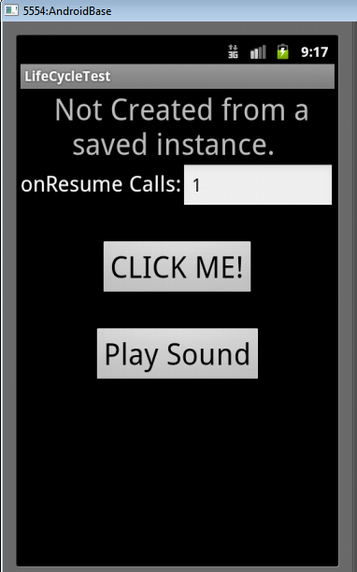
Playing Well (or not) With Others
The Play Sound button causes a MediaPlayer to be created and plays a sound
The Lifecycle app does not clean up after itself
If app destroyed MediaPlayer keeps playing!!

Slide 33
References
http://developer.android.com/guide/components/activities.html
Android Introduction by Marko Gargenta, http://www.lecturemaker.com/2009/10/android-software-platform/
Android Dev Guide http://developer.android.com/guide/topics/fundamentals.html http://developer.android.com/guide/topics/fundamentals/activities.html
Pro Android by Hashimi & Komatineni (2009)
Frank McCown, Harding University

