Slide 1
CS371m - Mobile Computing
Intents

Slide 2
Clicker
What are the four types of components that can serve as entry points from the Android system to your app?
Activity, Broadcast Receiver, Content Provider, Service
Activity, Intent, Layout, Log
Intent, Layout, Log, Service
Activity, Broadcast Receiver, Layout, Manifest

Slide 3
Intents
Allow us to use applications and components that are already part of Android System
start activities
start services
deliver broadcasts
… and allow other applications to use the components of the applications we create
Examples of Google applications: http://developer.android.com/guide/appendix/g-app-intents.html

Slide 4
Common Intents - 1
Alarm Clock (alarms, timers, show alarms)
Calendar (add event)
Camera (capture and return picture or video)
Contacts (select a contact, select specific contact data, view contact, edit contact)
Email (compose email)
File storage (retrieve copy of file, open file)

Slide 5
Common Intents - 2
Local Actions (call a car) I haven't tried this one
Maps (show location)
Music or Video (play a media file, play music based on query)
Notes (create a note)
Phone (initiate call)
Search (web search)
Settings (open section of settings)
Text messaging (compose message)

Slide 6
Intents
"An intent is an abstract description of an operation to be performed"
consist of
Action (what to do, example visit a web page)
Data (to perform operation on, example the url of the web page)
use via these methods: startActivity, startActivityForResult, startService, bindService

Slide 7
Four Primary Application Components
Activity
single screen with a user interface, app may have several activities, subclass of Activity
Service
Application component that performs long-running operations in background with no UI
Content Providers
a bridge between applications to share data
Broadcast Receivers
component that responds to system wide announcements

Slide 8
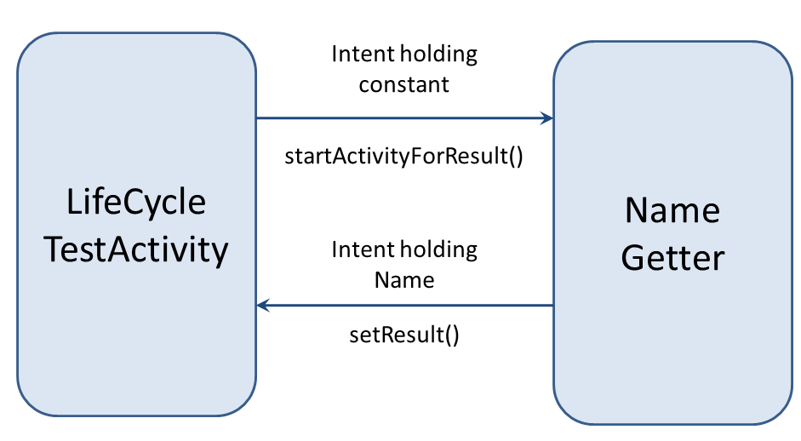
Activation of Components
3 of the 4 core application components (activities, services, and broadcast receivers) are started via intents
intents are a messaging system to activate components in the same application
and to start one application from another

Slide 9
AndroidManifest.xml
Recall the manifest is part of the application project.
The manifest contains important data about the application that is required by the Android system before the system will run any of the application's code
common error: Activity in application that is not included in manifest
runtime error when application tries to start Activity not declared in manifest

Slide 10
AndroidManifest.xml Purpose
contains Java package name of application - unique id for application
describes components of application: activities, services, broadcast receivers, content providers and intent messages each component can handle
declares permissions requested by application
minimum required API level
libraries application links to

Slide 11
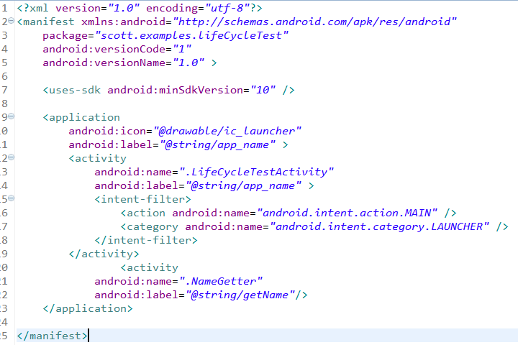
AndroidManifest.xml - Launcher Intent
Declare this as Activity
to start when application
started

Slide 12
Types of Intents
http://developer.android.com/reference/android/content/Intent.html
Categories include:
Action
e.g. VIEW, EDIT, CALL, DIAL, SEARCH
Broadcast Action
e.g. TIMEZONE_CHANGED, POWER_CONNECTED

Slide 13
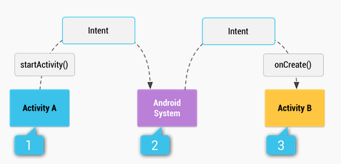
Implicit Intents
http://developer.android.com/guide/components/intents-filters.html

Slide 14
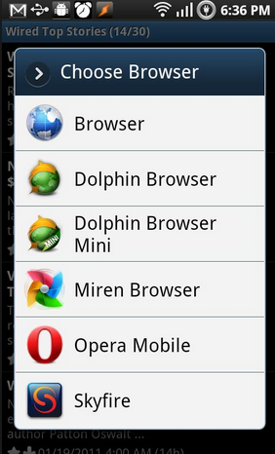
Multiple Apps To Handle Intent
Intent class contains constants for Intents
Applications and activities list intents they can handle in manifest
Intent Filters
If multiple available asked to choose
android.intent.action.WEB_SEARCH

Slide 15
Intent Class and Objects
android.content.Intent
passive data structure
description of action to performed or if created by a broadcast, a description of something that has happened and is being announced to broadcast receivers
Intent objects carry information, but do not perform any actions themselves

Slide 16
Intents and App Components
Context.startActivity() Activity.startActivityForResult() Activity.setResult()
Intent to Launch Activity or change purpose of existing Activity
Context.startService() Context.bindService()
Intent to Initiate Service or give new instructions to existing Service
Intents sent to Broadcast Receivers
Context.sendBroadcast() Context.sendOrderedBroadcast() Context.sendStickyBroadcast()
The Android System finds the right application component to respond to intents, instantiating them if necessary.

Slide 17
Intent Object Information
component name (of desired component)
action (to execute)
category (of action)
data (to work on)
type (of intent data)
extras (a Bundle with more data)
flags (to help control how Intent is handled)

Slide 18
Intent Object Info
data for the component that receives the intent
action to take
data to act on
data for the Android system
category of component to handle intent (activity, service, broadcast receiver)
instructions on how to launch component if necessary

Slide 19
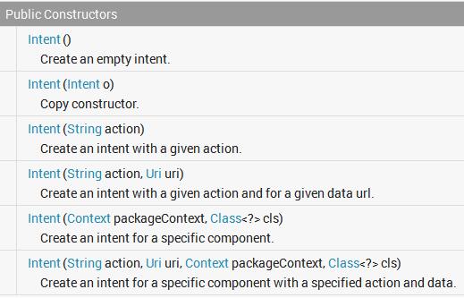
Intent Constructors

Slide 20
Intent Info - Component
Component name that should deal with Intent
fully qualified class name of component and
the package name set in the manifest file of the application where the component resides
optional!
if not provided Android system resolves suitable target
name is set by setComponent(), setClass(), or setClassName()

Slide 21
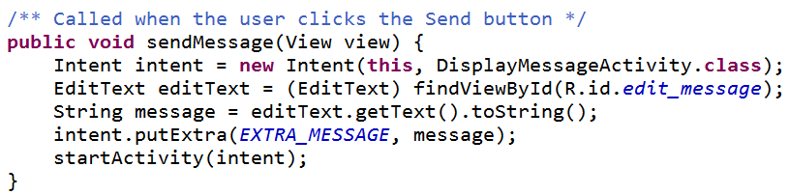

From MyFirstActivity

Slide 22
Intent Info - Action Name
Action desired (or for broadcast intents, the action / event that took place)
None for explicit intents
Many actions defined in Intent class
Other actions defined through the API
example, MediaStore class declares ACTION_IMAGE_CAPTURE and ACTION_VIDEO_CAPTURE
You can define your own Intent Action names so other applications can activate the components in your application

Slide 23
Intent Action Name
Action acts like a method name
determines what rest of data in Intent object is and how it is structured, especially the data and extras
setAction() and getAction() methods from Intent class

Slide 24
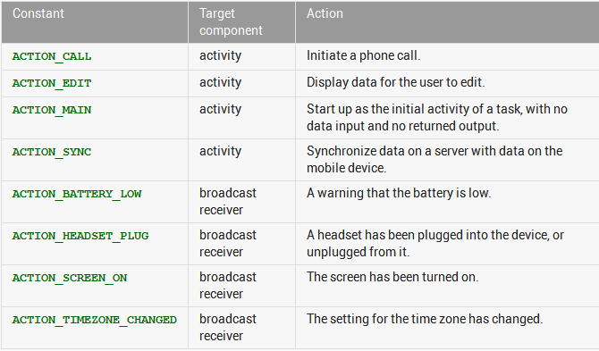
Intent Action

Slide 25
Intent Info - Data
URI (uniform resource identifier) of data to work with / on
for content on device a content provider and identifying information, for example an audio file or image or contact
MIME (Multipurpose Internet Mail Extension, now internet media type) initially for email types, but extended to describe type information in general about data / content
image/png or audio/mpeg

Slide 26
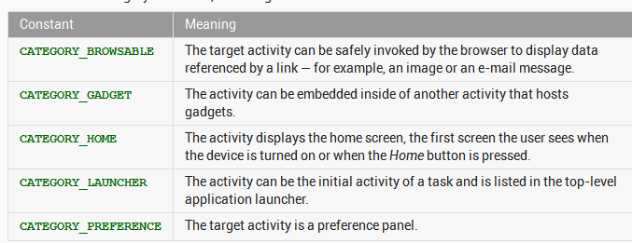
Intent Info - Category
String with more information on what kind of component should handle Intent

Slide 27
Intent - Extras
A Bundle (a map / dictionary, key-value pairs) of additional information to be given to the component handling the Intent
Some Action will have specified extras
ACTION_TIMEZONE_CHANGED will have an extra with key of "time-zone" (documentation is your friend)
Intent method has put methods or put a whole Bundle

Slide 28
Example
Use an Intent so app asks camera to take picture and displays the resulting picture
important details:
permission to write and read (JellyBean) to and from SD card
getting file names correct
reduce size of original image

Slide 29
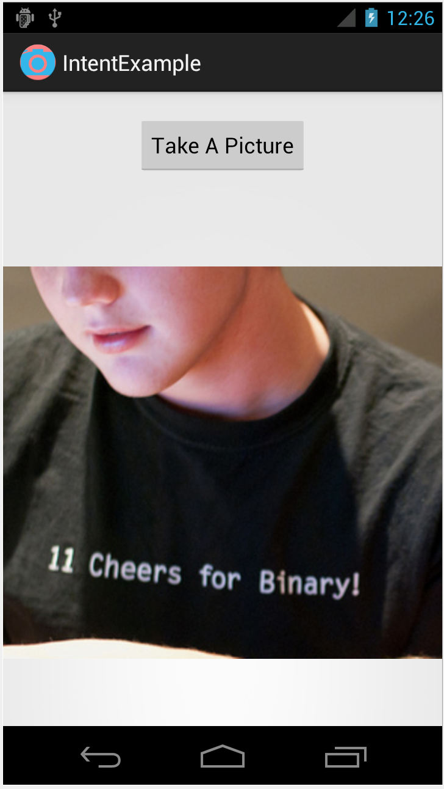

IntentExample

Slide 30
Layout
LinearLayout with
button
ImageView
ImageView initially displays default Image
button click results in call to takePhoto
android:onClick attribute set

Slide 31
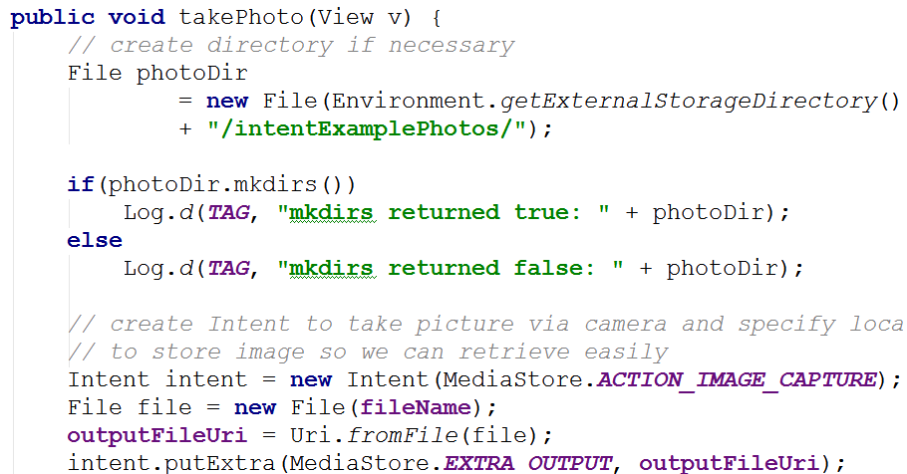
takePhoto in IntentExample Activity

Slide 32
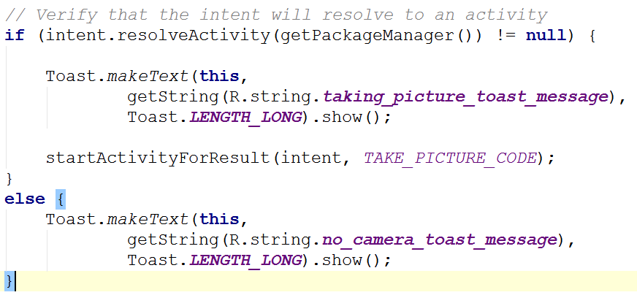
ensure Intent can be resolved

Slide 33
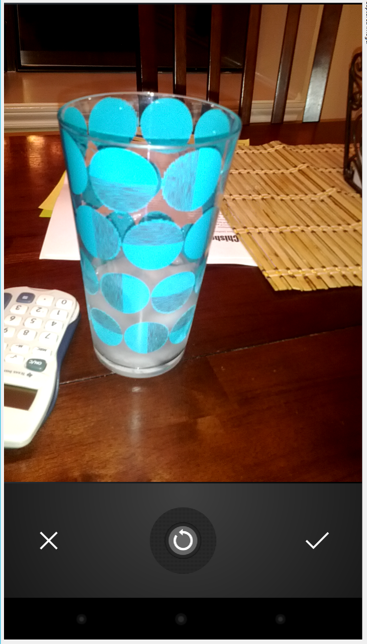
Result
Clicking button starts Camera Activity
IntentExample stops
recall Activity lifecycle, play well with others
when picture taken return to IntentExample activity

Slide 34
onActivtyResult
when camera app finishes, Android system will call this method (callback)
look at result and take appropriate action
verify our requested action was completed

Slide 35
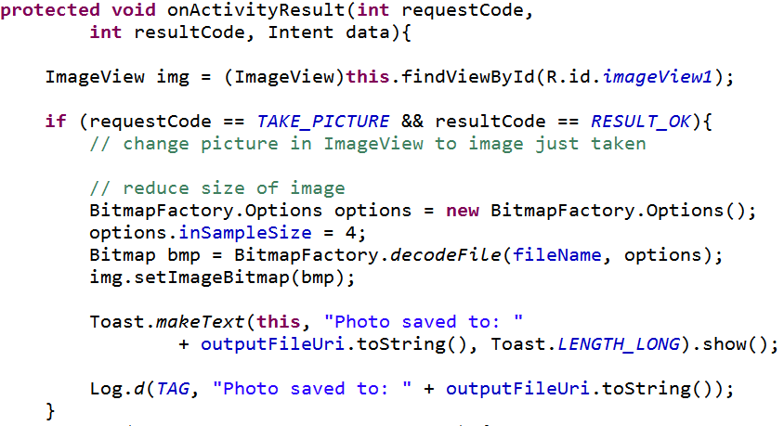
onActivtyResult

Slide 36
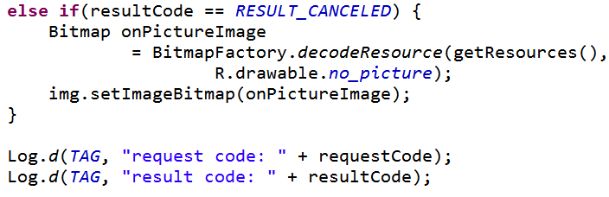

onActivityResult

Slide 37
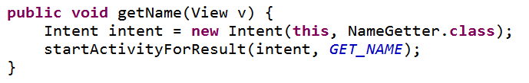
Intent Resolution
How does the Android system determine what component should handle an Intent?
explicit
Intent designates target component by name
typically used for inter application messaging and activity starting
recall, LifeCycleTest

Slide 38
Intent Resolution - Implicit
component name is blank (unknown)
typically used when starting component in another application
Android system uses data from Intent (action, category, data) and tries to find / match best component for job
Intent Filters

Slide 39
Intent Filters
Applications and components that can receive implicit Intents advertise what they can do via Intent Filters
components with no Intent Filters can only receive explicit Intents
typical of many activities
activities, services, and broadcast receivers can have one or more intent filters

Slide 40
Intent Filters
Android system should know what application can do without having to start the component
before runtime
exception is Broadcast Receivers registered dynamically; they create IntentFilter objects at runtime
intent filters generally declared as element of applications AndroidManifest.xml file

Slide 41
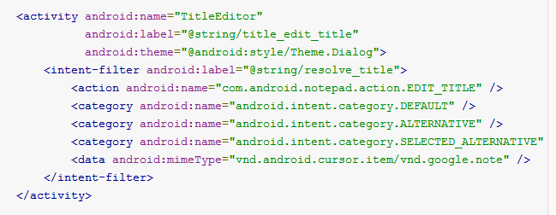
IntentFilter - Example
filter declares action, category, and data

Slide 42
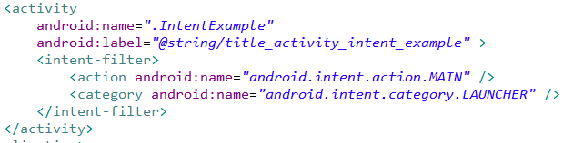
IntentFilter - Example
The Android system populates the application launcher via IntentFilters

Slide 43
permissions

Slide 44
Permissions
Apps must request permission for certain operations
Initially app has zero permission
goal is security and safety
without permissions "app cannot do anything that would adversely impact the user experience or any data on the device."
request permissions in the app manifest
user sees what they are allowing app to do when agree to download / install (5.1 / API 22 and lower)

Slide 45
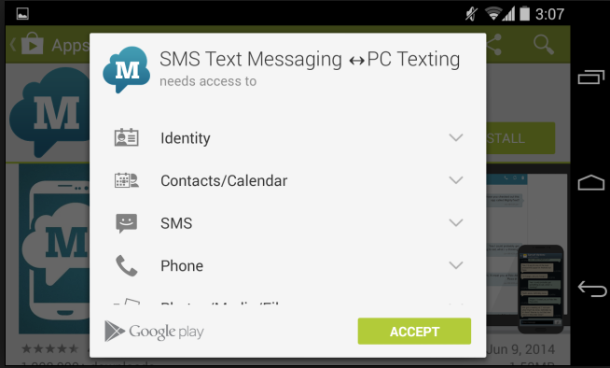
Permissions Types
In Android 6.0 / API level 23 permissions split into 2 types
Normal Permissions
Dangerous Permissions

Slide 46
Normal Permissions
"Normal permissions cover areas where your app needs to access data or resources outside the app's sandbox, but where there's very little risk to the user's privacy or the operation of other apps."
Example: vibrate the devices as a part of UI feedback

Slide 47
Normal Permissions
ACCESS_LOCATION _EXTRA_ COMMANDS
ACCESS_NETWORK _STATE
ACCESS_NOTIFICATION_ POLICY
ACCESS_WIFI_STATE
BLUETOOTH
BLUETOOTH_ADMIN
BROADCAST_STICKY
CHANGE_NETWORK _STATE
CHANGE_WIFI _MULTICAST_STATE
CHANGE_WIFI_STATE
DISABLE_KEYGUARD
EXPAND_STATUS_BAR
GET_PACKAGE_SIZE
INSTALL_SHORTCUT
INTERNET
KILL_BACKGROUND _PROCESSES
MODIFY_AUDIO _SETTINGS
NFC
READ_SYNC_SETTINGS
READ_SYNC_STATS
RECEIVE_BOOT _COMPLETED
REORDER_TASKS
REQUEST_IGNORE_BATTERY_OPTIMIZATIONS
REQUEST_INSTALL_PACKAGES
SET_ALARM
SET_TIME_ZONE
SET_WALLPAPER
SET_WALLPAPER_HINTS
TRANSMIT_IR
UNINSTALL_SHORTCUT
USE_FINGERPRINT
VIBRATE
WAKE_LOCK
WRITE_SYNC_SETTINGS

Slide 48
Dangerous Permissions
"Dangerous permissions cover areas where the app wants data or resources that involve the user's private information, or could potentially affect the user's stored data or the operation of other apps. "
For example, access users contacts on the device

Slide 49
Permission Groups
Dangerous permissions are placed into permission groups
Current Permission groups:
Calendar
Camera
Contacts
Location
Microphone
Phone
Sensors
SMS
Storage

Slide 50
Requesting Dangerous Permissions
Starting with Android 6.0 / API level 23 dangerous permissions granted at runtime instead of install time
Must still list dangerous permissions in the manifest
First time app needs permission
"If an app requests a dangerous permission listed in its manifest, and the app does not currently have any permissions in the permission group, the system shows a dialog box to the user describing the permission group that the app wants access to."

Slide 51
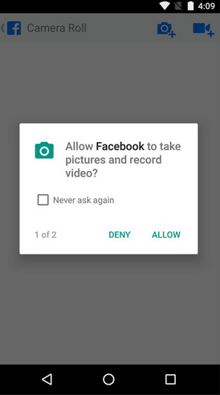
Runtime Permissions
Dialog doesn't describe exact permission, just group
If app needs another dangerous permission, and user has granted permission to another permission in that group, access automatically granted
e.g. granted contacts to read contacts, now need to write contacts

