Slide 1
CS371m - Mobile Computing
Responsiveness

Slide 2
An App Idea
From Nifty Assignments
Draw a picture use randomness
Pick an equation at random
Operators in the equation have the following property: Given an input between -1 and 1 the output is also between -1 and 1
sin and cos scaled to pi / 2, multiply, average, remainder (except for 0)

Slide 3
Random Art
The color at any given point is based on the x and y coordinates of that point scaled to between -1 and 1
Feed the x and y coordinates into the equation
Pick equations at random, keep the good pictures, throws away the boring ones
Given the equation we can reproduce the image

Slide 4
Random Art
X⁺
Y⁺
0, 0
Color of this pixel?
Assume large frame is 400 by 300.
Assume this pixel is at 100, 30
x = 100 / 400 = 0.25 -> scaled to -1 to 1 = -0.5
y = 30 / 300 = 0.1 -> scaled to -1 to 1 = -0.8
Plug these values into random equation:
Assume equation is yxASCSySSxCyCACMMSCSSCC postfix, A = Average, S = Sin, C = Cos, M = Multiply
Assume answer is 0.75. Scale to number of colors. Assume 256 shades of gray.
Color at that pixel is 224th shade of gray (224, 224, 224)

Slide 5
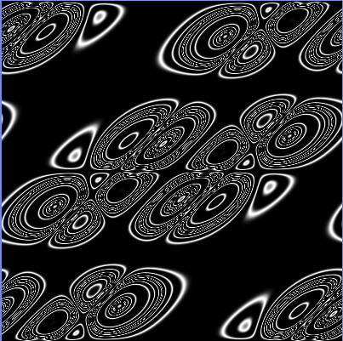
Result yxASCSySSxCyCACMMSCSSCC

Slide 6
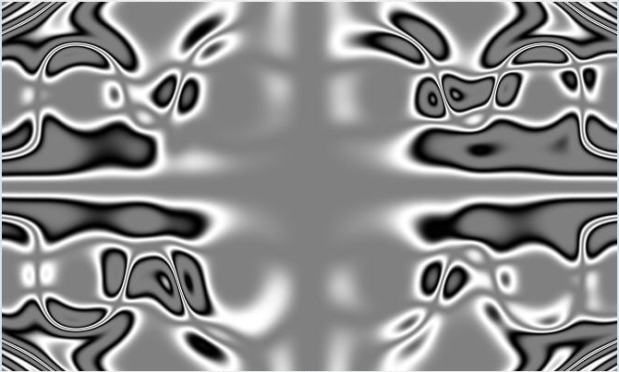
Result xxACSSxCAyCyxASASCAyCCAyyyAAxMSxCxCAxSySMMCMCSMSCS

Slide 7

Result yCCSxxMSSAS

Slide 8


Results

Slide 9


Results

Slide 10


Results

Slide 11
RandomArt Application
Create a subclass of View that does the computation and draws the graphics
More on 2d graphics later in term
but we simply override the onDraw(Canvas) method and draw want we want
colors via Paint objects
Canvas.drawPoint(x, y, Paint) method
add click listener to the View so click results in new expression and a redraw
invalidate() -> leads to onDraw(Canvas)

Slide 12
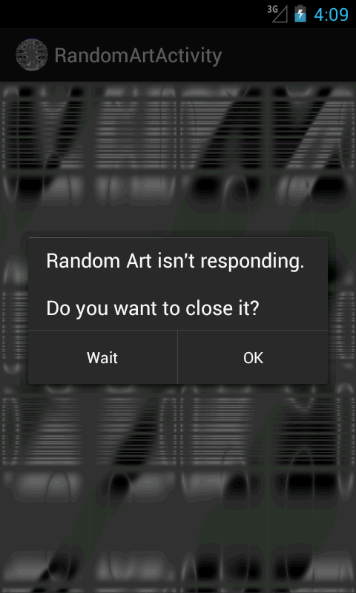
The Problem
Neat idea but computationally expensive
480 by 800 screen on Galaxy Nexus
384,00 pixels
depending on the expressions, tens of millions of computations, plus the rendering

Slide 13
Responsiveness
user's threshold of pain? 1 second? 2?
Android dev documents claim 100 to 200 milliseconds (0.1 to 0.2 seconds)
The Android Systems has its own threshold of pain
if the systems determines an application has become unresponsive it displays the Application Not Responding dialog
ANR occurs if app not responsive to user input

Slide 14
Android System
The Activity Manager and Window Manager system services monitor applications for responsiveness
ANR dialog displayed if:
No response to an input event such as a key press or screen touch in 5 seconds
A BroadcastRecevier doesn't finish executing in 10 seconds

Slide 15
Typical Blocking Operations
complex calculations or rendering
AI picking next move in game
looking at data set of unknown size
parsing a data set
processing multimedia files
accessing network resources
accessing location based services
access a content provider
accessing a local database
accessing a file

Slide 16
The UI Thread
For applications that consist of an Activity (or Activities) it is vital to NOT block the UI thread (main thread of execution)
AND on API level 11 and later certain operations must be moved off the main UI thread
code that accesses resources over a network
for example, HTTPrequests on the main UI thread result in a NetworkOnMainThreadException
discover StrictMode http://developer.android.com/reference/android/os/StrictMode.html

Slide 17
Enabling Responsiveness
move time consuming operations to child threads
Android AsyncTask
Java Thread
Service?
provide progress bar for worker threads
big setups -> use a splash screen or render main view as quickly as possible and filling in information asynchronously
assume the network is SLOW
don't access the Android UI toolkit from outside the UI thread
can result in undefined and unexpected behavior

Slide 18
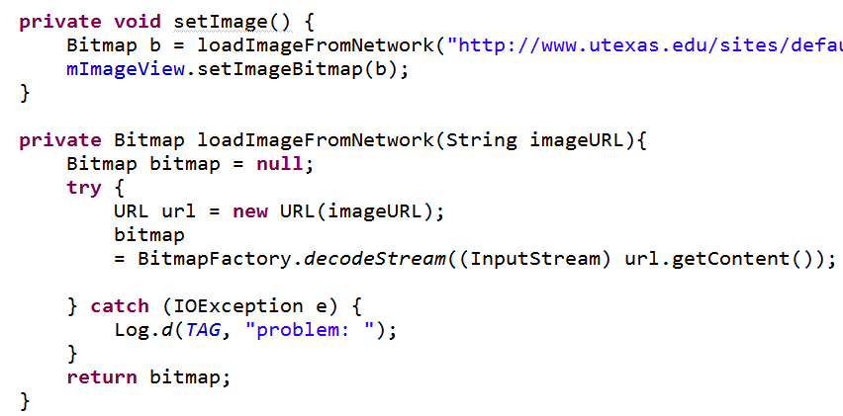
Asking for Trouble
Loading image from network may be slow and can block the main (UI) thread of the application - (Change to TBBT app)

Slide 19
AsyncTask
Android class to handle simple threading for operations that take a few seconds
Removes some of the complexities of Java Thread and Android Handler classes
UI creates an AsyncTask object and calls the execute method
Result published to the UI thread

Slide 20
AsyncTask
Three Generic Parameters
data type of Parameter(s) for task
data type of Progress
data type of Result
four steps in carrying out task
onPreExecute()
doInBackground(Param… params)
onProgressUpdate(Progress values)
onPostExecute(Result result)

Slide 21
Methods
onPreExecute() runs on UI thread before background processing begins
doInBackground(Param… params) runs on a background thread and won't block UI thread
publishProgress(Progress… values) method invoked by doInBackground and results in call to onProgressUpdate() method on UI thread
onPostExecute(Result result) runs on UI thread once doInBackground is done

Slide 22
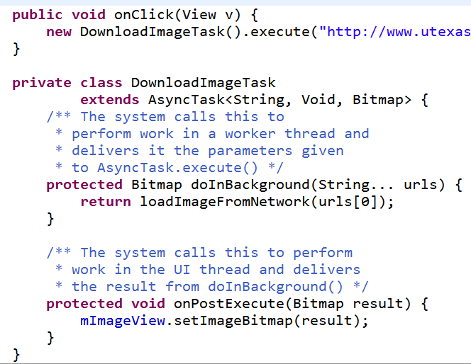
Downloading with AsyncTask

Slide 23
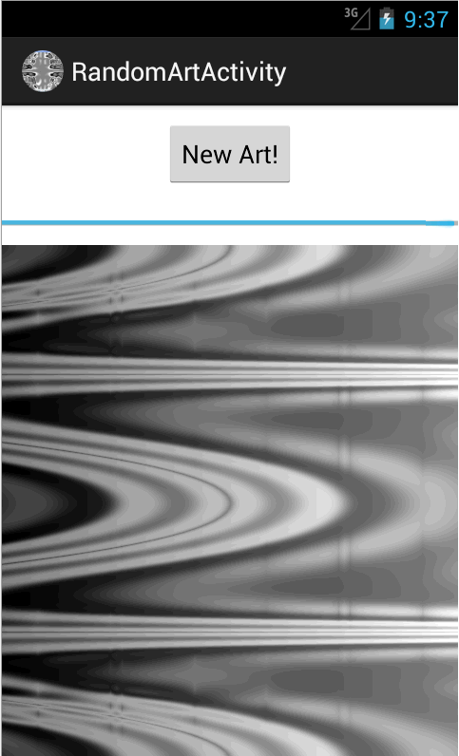
Random Art with AsyncTask
Add progress bar and button for new art
create a Bitmap and draw to that
<Integer, Integer, Bitmap>

Slide 24

Just One More

Slide 25
Loaders
Loader classes introduced in API 11
Help asynchronously load data from content provider or network for Activity or Fragment
monitor data source and deliver new results when content changes
multiple classes to work with

