Slide 1
CS371m - Mobile Computing
Maps

Slide 2

Using Google Maps
Content on using Google Maps inside your app
Alternatives Exist:
Open Street Maps
http://www.openstreetmap.org/
If you simply want to display a "standard Google map" from your app

Slide 3
Displaying Standard Google Map
String uri = String.format( Locale.ENGLISH, "geo:%f,%f", latitude, longitude); Intent intent = new Intent(Intent.ACTION_VIEW, Uri.parse(uri)); context.startActivity(intent);

Slide 4
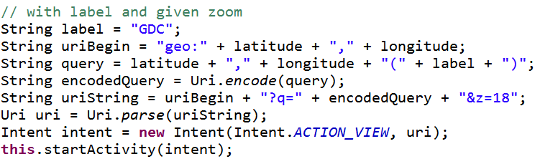
Setting Zoom Level and Label
Specify Zoom Level for standard Map
Zoom Levels in Google Maps, 0 - 21
0 is the whole earth
21 individual buildings

Slide 5
Using Google Maps
Requires an API key from Google
https://developers.google.com/maps/documentation/android/
required to use MapView class or MapFragments
Must:
Register the SHA-1 fingerprint of the certificate used to sign the application.
Adding a reference to the Maps API Key in each MapView (xml or code)

Slide 6
Incorporating Maps in you app

Slide 7
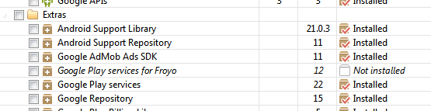
Using Google Maps API v2
Google Maps API v2 part of the Google Play Services sdk
Download via SDK Manager

Slide 8
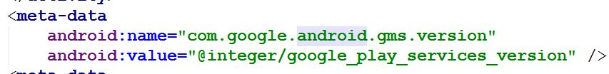
Include Google Play Services in Manifest
To make use of Google Play Services add data to manifest
Google Play Services has a host of non standard android tools
"simple location API"
"activity recognition"

Slide 9
Obtaining an API Key
Most web APIs require a key to use
a few do not such as the Yahoo finance api
Same with Google Maps API
New way of obtaining keys via Android Studio and Google Developers console is mostly painless
Old way of obtaining the key required some knowledge regarding how apps are published and painful

Slide 10
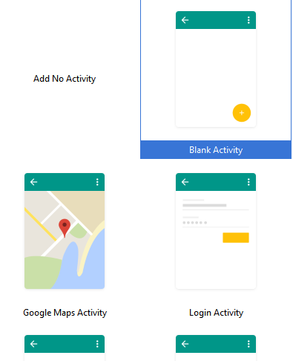
New Way to Get Maps API Key
Create a Google Maps Activity in Android Studio

Slide 11
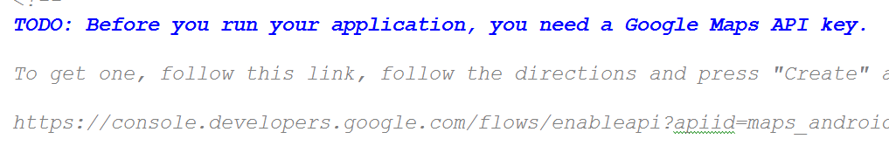
New Way to Get Maps API Key
Look at google_maps_api.xml file in new project

Slide 12
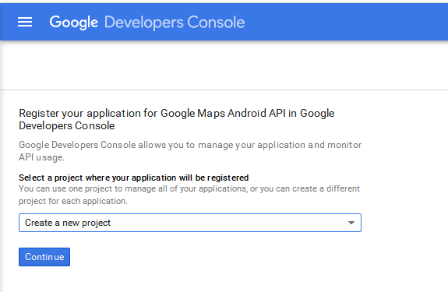
Go to Developer Console

Slide 13
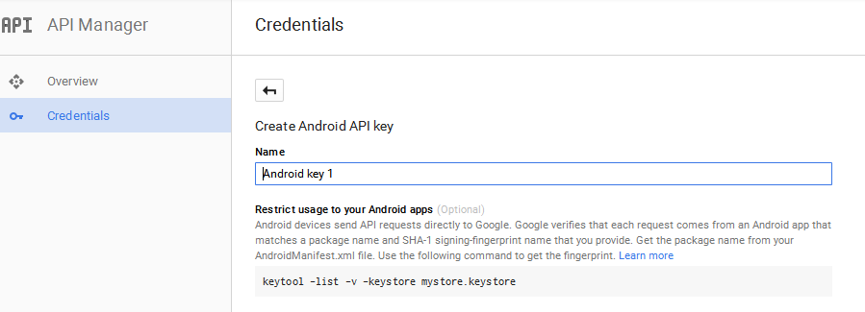
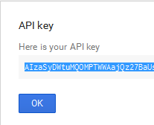
Create Key

Slide 14
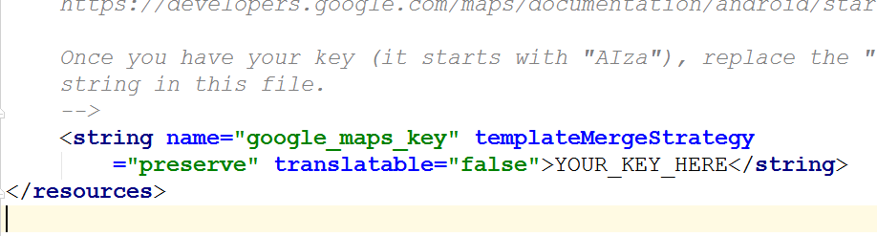
Last Step
Copy API Key into google_maps_api.xml file

Slide 15
old painful way

Slide 16
Signing Apps
deploying apps on the Google Play requires signing the app with a certificate
development and debugging uses an automatic key creation process
invisible to us
In release mode you must create your own private key to sign apps
use of keytool program from Java SDK
http://developer.android.com/guide/publishing/app-signing.html

Slide 17
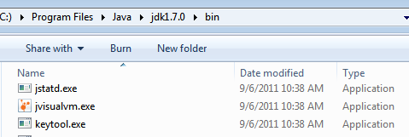
Signing Apps
A Java Keystore is a file (or files) that stores security certificates
Included in the JDK (Java Development Kit) is the keytool program
Used to create manipulate the keystore

Slide 18
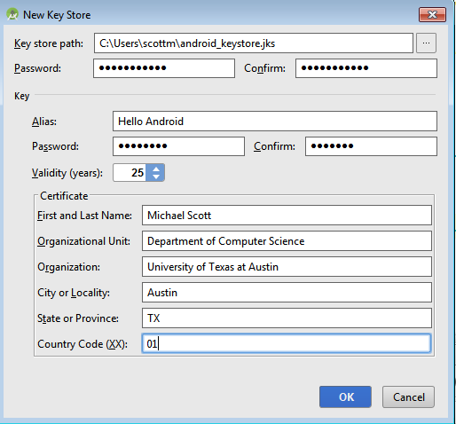
Signing Apps via Android Studio
Android Studio provides a GUI to run keytool for you
Build -> Generate Signed APK

Slide 19
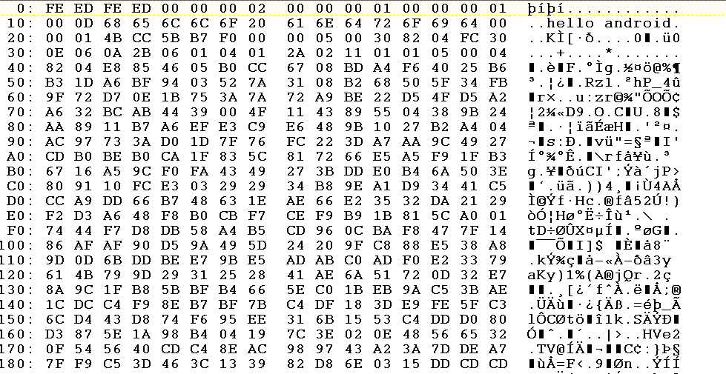
keystore file

Slide 20
Obtaining an API Key
For Google Maps API v2
One key tied to one signing certificate
Same key used for all instances of app
Normally sign apps with different certificates
If so different API keys required if two different apps use maps and signed with different certificates

Slide 21
Obtaining an API Key
To obtain a Google Maps API key we need the SHA-1 fingerprint of the signing certificate
A short form of the certificate based on the SHA-1 hashing algorithm
run keytool from the command line to pull out fingerprint of certificate

Slide 22
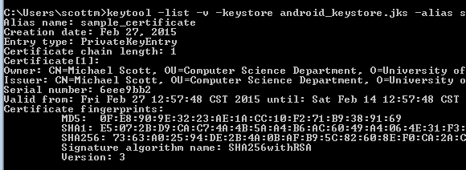
fingerprint via keytool
prompt>keytool -v -keystore <keystore_file_name> -alias <certificate_name> -storepass <keystore_password> -keypass <certificate_password>

Slide 23
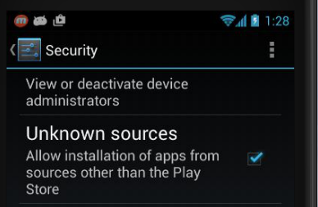
debug certificate
In development you are using a pre generated debug keystore to sign apps
Happens behind the scenes
Security settings on device

Slide 24
debug certificate
possible to obtain API key tied to your debug keystore
works in development
would need to change manifest with certificate used to sign the app

Slide 25
Obtaining the API key
The SHA-1 fingerprint is a 20 digit hexadecimal number
Use Google APIs console to obtain key for Maps
requires Google account
… and must agree to the terms of service.

Slide 26
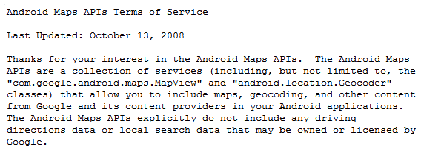
Google Maps Terms of Service
Some Highlights
may include ads in future
Google may limit number of transactions
Cannot use for turn-by-turn directions or autonomous driving
suppose to show license info in the app!

Slide 27

Using Maps API Key in App
Must add key to manifest
KEY POINT: Replace API_KEY in the second line only (android:value) with the API key you obtained in previous steps

Slide 28
displaying a map inside your app

Slide 29
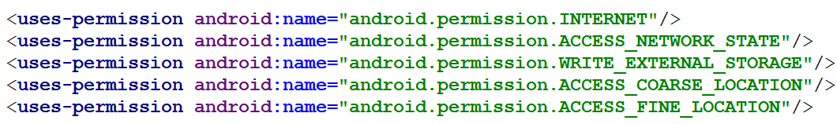
Permissions
Recommended Permissions for manifest when using Google Maps inside your app

Slide 30
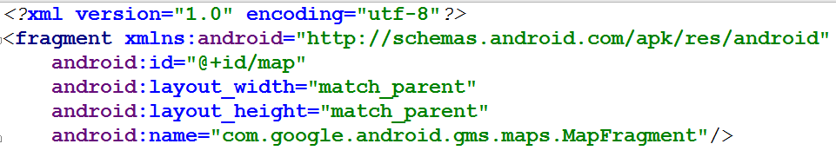
Display Simple Map in App
Hello Map
Like Hello World, but layout file becomes:

Slide 31
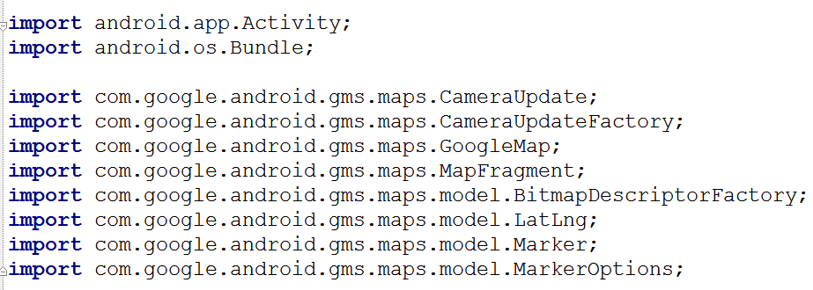
Hello Map Activity
Lots of new classes!!

Slide 32
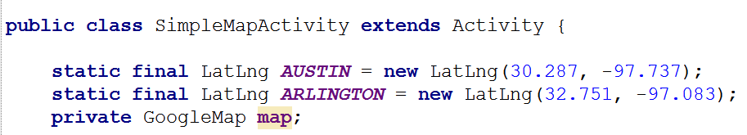
Specifying Locations
Latitude and Longitude

Slide 33
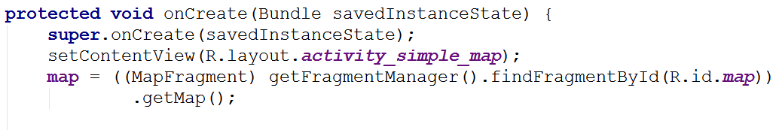
onCreate
More on Fragments later …
mini activities

Slide 34
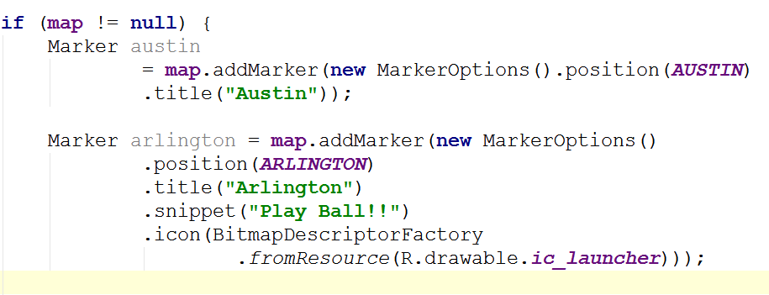
adding Markers in onCreate
first Marker uses default, pin and has a title, "Austin"
second Marker uses a different icon and adds text after the title

Slide 35
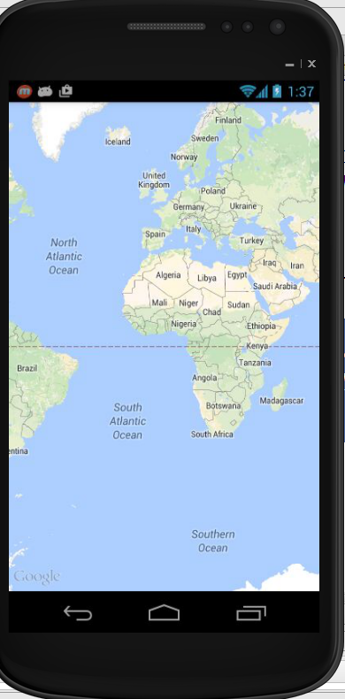
Center and Zoom
Running app as is produces this:
Centered where???
Zoomed out
Zoom levels 0 to 21

Slide 36
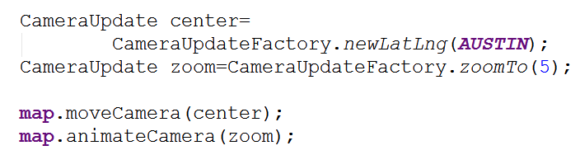
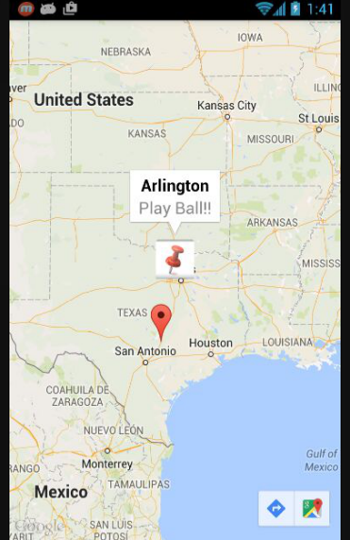
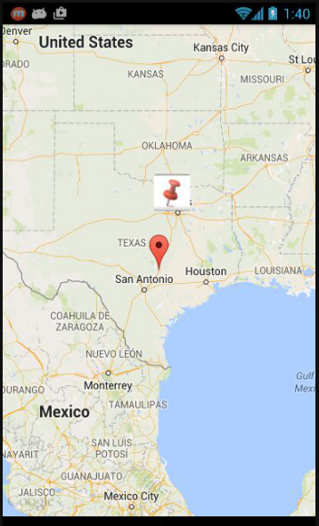

Slide 41
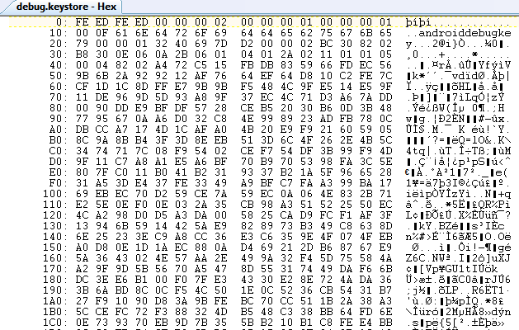
Debug Key
Portion of debug.keystore

Slide 42
Getting MD5 Fingerprint
use keytool program
keytool part of Java SDK
keytool -list -alias androiddebugkey -keystore <path_to_debug_keystore>.keystore -storepass android -keypass android
gives MD5 fingerprint of the debug certificate
keytool of Java 1.7 gives SHA1 by default
use -v after keytool, before -list

Slide 43
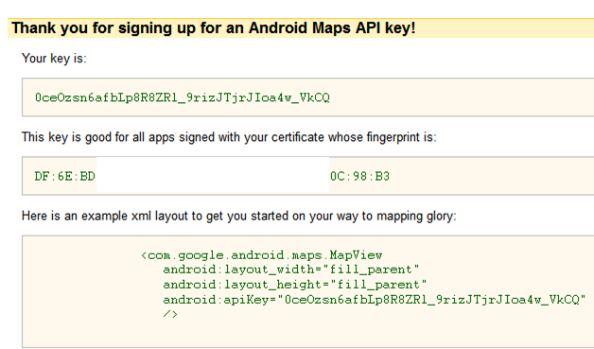
Debug API Key

Slide 44

Hello MapView
Build Target - Google, not Android
MapView not a standard Android class
part of Google Maps Library
add to manifest
must also include INTERNET permission and LOCATION permission

Slide 45
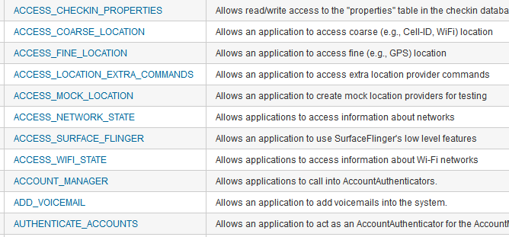
Aside - Permissions
http://developer.android.com/reference/android/Manifest.permission.html

Slide 46
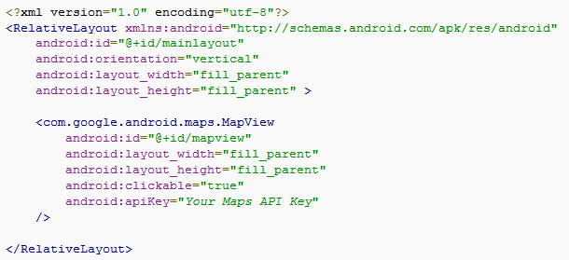
MapView
A type of view for layout file

Slide 47
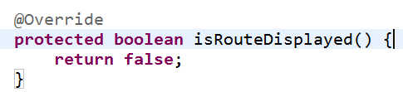
MapActivity
Create class that extends MapActivity instead of Activity
import com.google.android.maps.MapActivity;
must implement isRouteDisplayed method
must return true if any kind of route (to be followed) is displayed, per terms of use

Slide 48
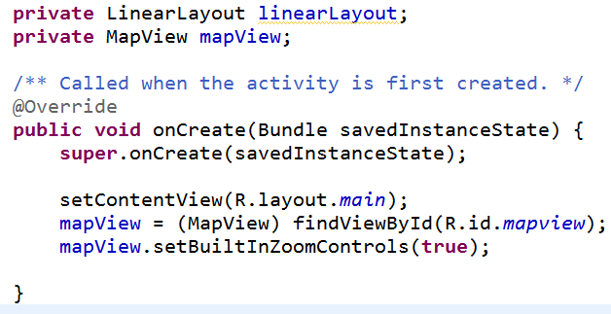
Instance Vars and onCreate
Add instance variables and initialize in onCreate method

Slide 49
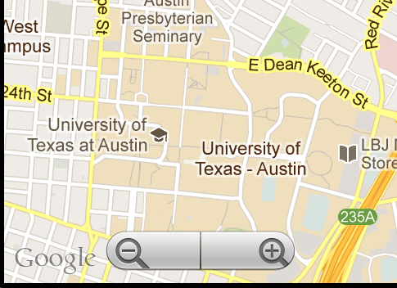
HelloMapView
Run app
Displays map and allows panning and zooming

Slide 50
Customizing Map
Easy to display map and allow interaction
Customize with markers and overlays
Overlays
used to display information on top of map
simple choice: ItemizedOverlay class

Slide 51
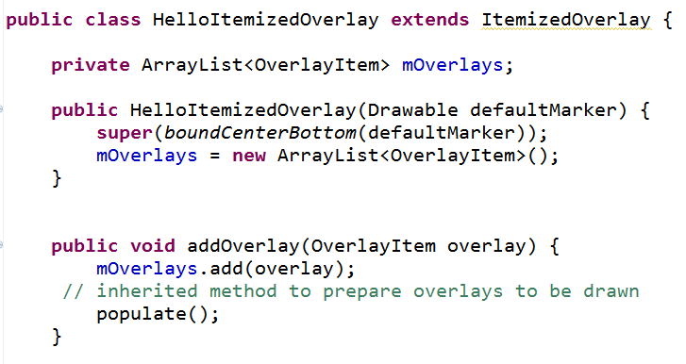
ItemizedOverlay

Slide 52
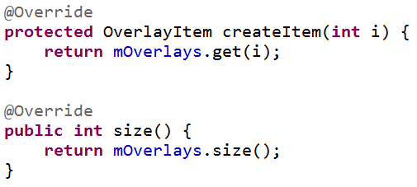
ItemizedOverlay
populate method will call createItem
define createItem and return value from the ArrayList instance var
define size method that returns number of overlay items

Slide 53

Adding Overlays
In MapActivity create OverlayItem
add to HelloItemizedOverlay
add to MapView
Need a drawable for the marker
res/drawable
issues display gif format images on some devices

Slide 54
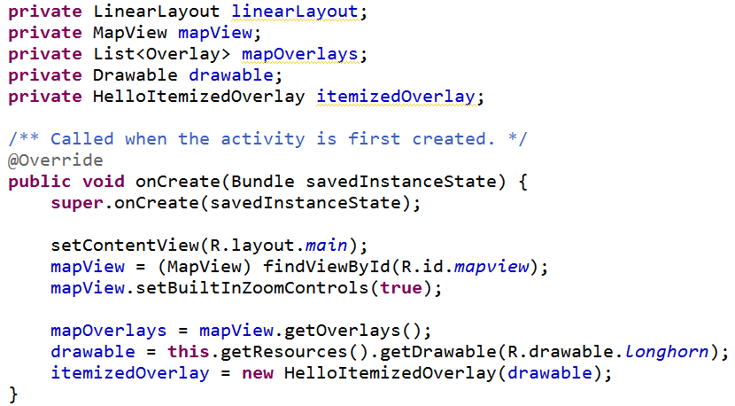
Changes to HelloMapView

Slide 55
Add Overlay Items
Create GeoPoint and use these to create OverlayItems
GeoPoint based on microdegrees
lat and long times 1,000,000
Build OverlayItems out of GeoPoints and include strings for title and snippet text to display when drawable clicked

Slide 56
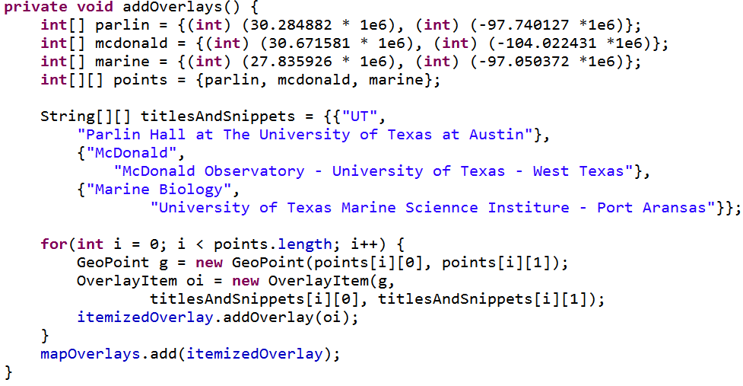
addOverlays method in HelloMapView

Slide 57
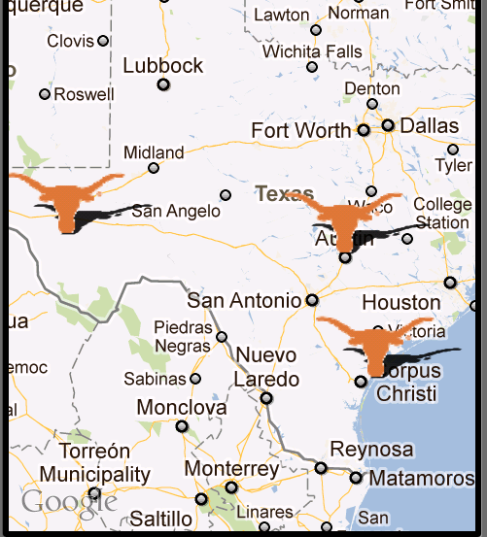
Result
one overlay with multiple items
based on locations we added

Slide 58
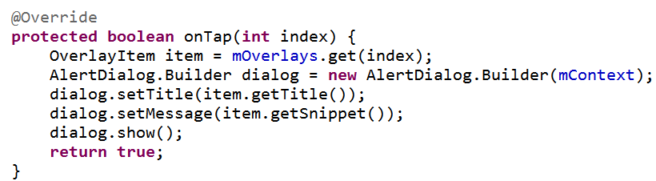
Display Information
To display information (title and snippet) of overlay override the onTap method in the ItemizedOverlay class

Slide 59
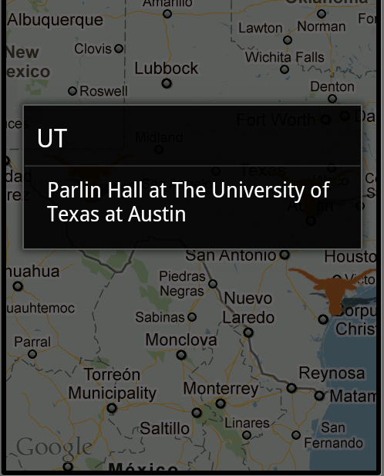
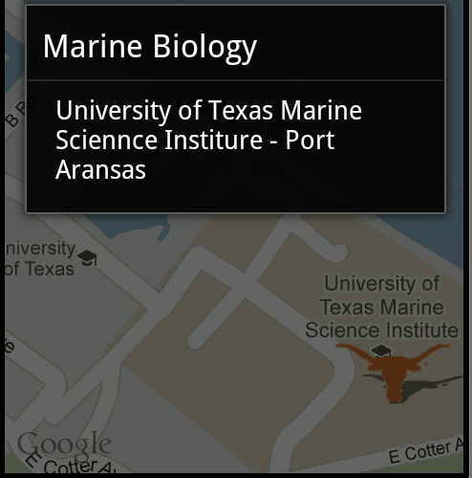
Results of Clicking Longhorn

Slide 60
Reverse Geocoding
Find addresses from longitude/latitude
Geocoder uses a backend that is NOT included in the core android framework
use isPresent method to check for service
location = locationManager.getLastKnownLocation(
LocationManager.GPS_PROVIDER);
double lat = location.getLatitude();
double lng = location.getLongitude();
Geocoder gc = new Geocoder(this, Locale.getDefault());
List<Address> addresses = null;
try {
addresses = gc.getFromLocation(lat, lng, 5); // maxResults
} catch (IOException e) {}

Slide 61
Forward Geocoding
Find longitude/latitude (and more) from address or airport code
Geocoder gc = new Geocoder(this, Locale.US);
List<Address> addresses = null;
try {
addresses = gc.getFromLocationName(
“713 N. Duchese, St. , Missouri”, 5);
} catch (IOException e) {}
double lat = addresses.get(0).getLatitude();
double lng = addresses.get(0). getLongitude (); String zip = addresses.get(0).getPostalCode();

Slide 62
Recent Changes
Google Maps API version 2
somewhat new, Released December 2012 as part of Google Play Services SDK
features:
indoor maps
simplified location services

Slide 63
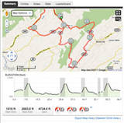
Maps Example
Route Tracker using Locations, MapActivity, MapView, and Google Maps
from Deitel AFP-AADA
Similar to Map My Ride
popular app among cyclists and runners

Slide 64
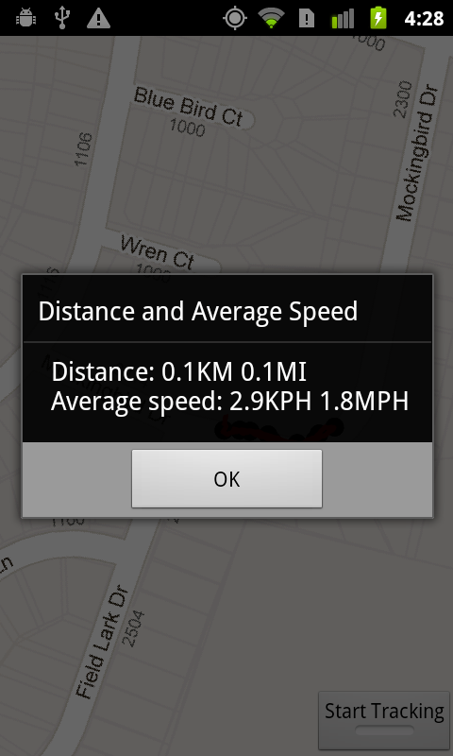
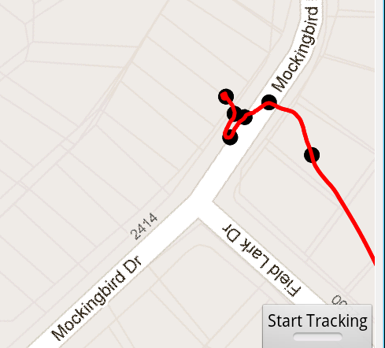
RouteTracker App

Slide 65
RouteTracker App
using FrameLayout to stack components with the most recently added component on top
ToggleButton at bottom to start and stop route tracking
MapView added to FrameLayout
route is an overlay to map with points and lines connecting points

Slide 66
RouteTracker Classes
RouteTracker Starting Activity
deals with LocationProvider
BearingFrameLayout Displays MapView
rotates based on bearing from location
RouteOverlay Overlay with location points
(every 10th)
and lines connecting.
Converts locations to GeoPoints.
Overloads draw

Slide 67
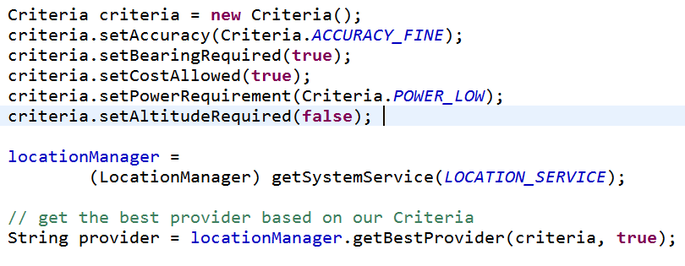
Criteria Class
Set criteria for selecting a LocationProvider

Slide 68
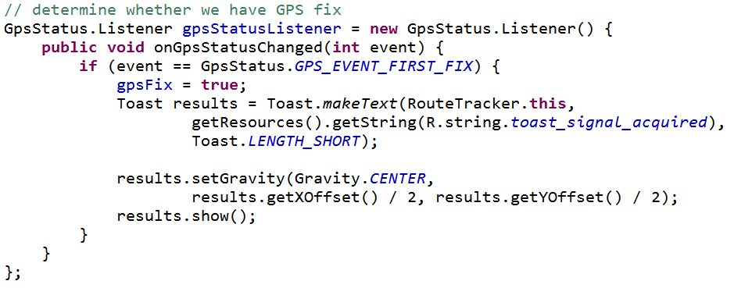
GpsStatus.Listener
Responds to changes in GPS status
Are we receiving GPS fixes?
App does not track unless this is true

Slide 69
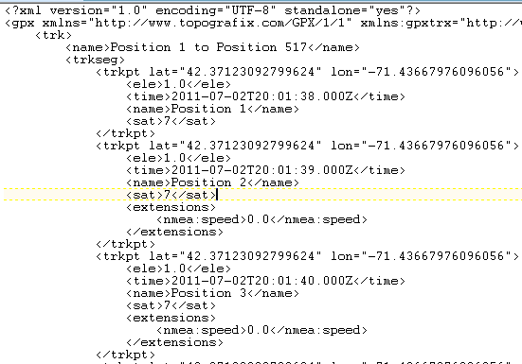
Simulating GPS Data
to simulate changes in location in emulator
GPS data in a file
GPS Exchange Format (GPX)

Slide 70
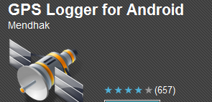
Creating GPX Files
Many apps and programs
One option for Android devices
GPSLogger
gpsbabel to convert between various GPS formats
gpx has different versions

Slide 71
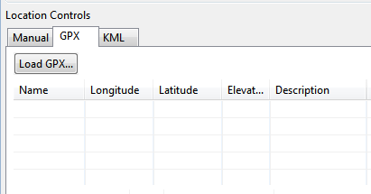
Running GPX files in App
DDMS
Emulator Control Tab
GPX Tab
Load

Slide 72
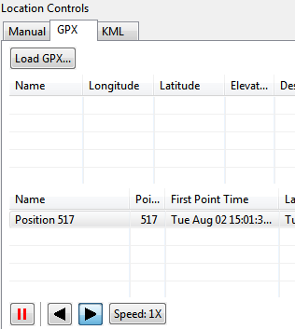
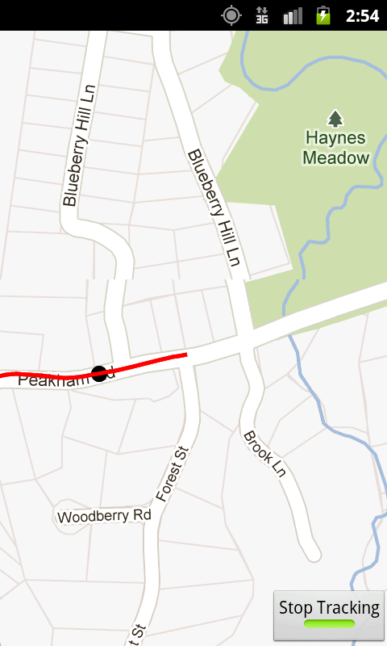
Running GPX

Slide 73
Geocoding
Finding addresses from lat / long and vice versa
Reverse geocoding: find address from lat and long
Forward geocoding: find lat and long from address

