Slide 1
CS378 - Mobile Computing
Web - WebView and Web Services

Slide 2

WebView
A View that display web pages
basis for creating your own web browser
OR just display some online content inside of your Activity
Uses WebKit rendering engine
http://www.webkit.org/

Slide 3
WebView
Built in functionality to:
display page
navigate forward and backwards through a history
zoom in and out
perform searches
and more. some examples:
capture images of page, search page for string, deal with cookies on a per application basis,

Slide 4
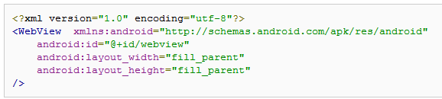
WebView Example
Simple app to view and navigate web pages - demo WebView class
res/layout/main.xml

Slide 5
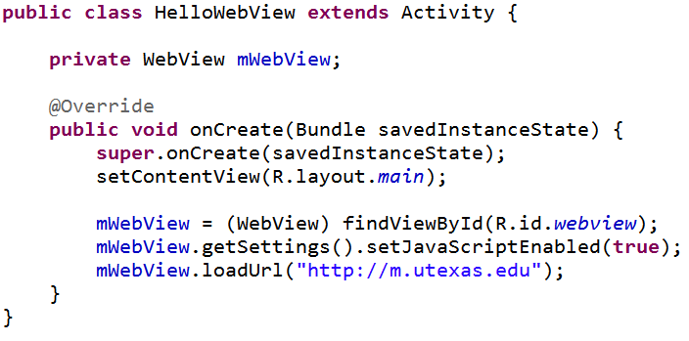
WebView Activity
override onCreate
go to UT mobile site

Slide 6
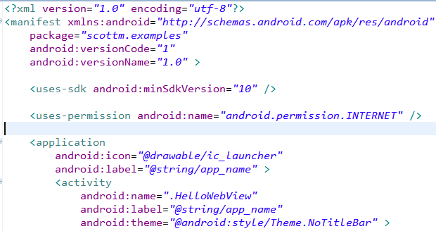
WebView Example
Must add permission for app to use Internet
Also change style so no title bar

Slide 7

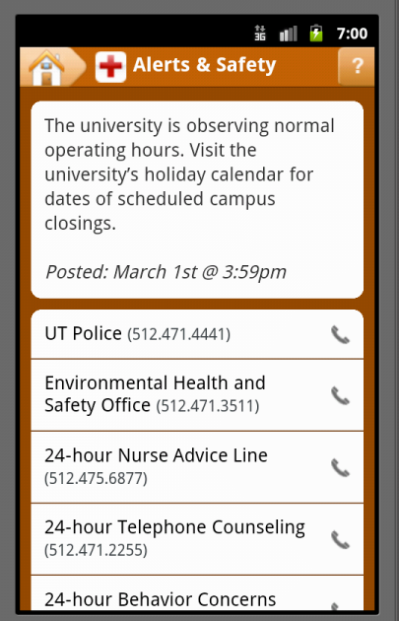
Current Result
Clicking link actually leads to the default Android browser

Slide 8
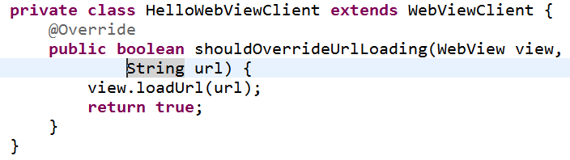
Handling URL Requests
To enable activity to handle its own URL requests create an inner class that extends WebViewClient
set client for mWebView

Slide 9
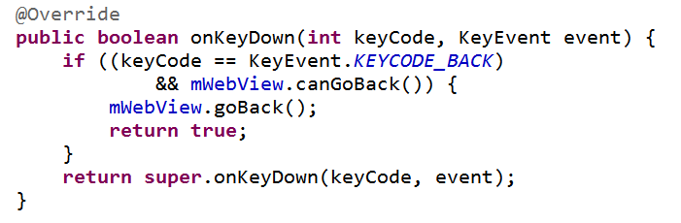
Navigating
Making previous changes disables the back button
Must override onKey down method
Use WebView object to see if possible to go back

Slide 10
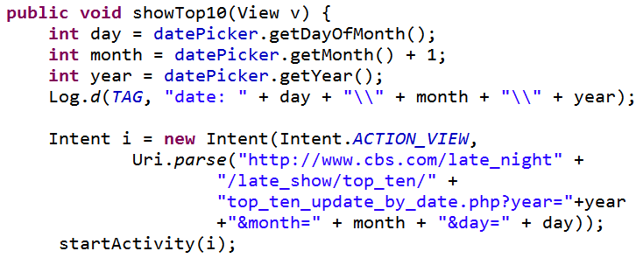
Using Built In Browser
To simply use the built in browser create an Intent and start the Activity
Like the Top Ten List App

Slide 11
More on WebView
Scenarios for using WebView in app instead of built in browser:
provide info the app might need to update such as end user agreement or user guide (instead of doing app update)
display documents hosted online
OR application provides data that ALWAYS requires internet connect to retrieve data
as opposed to performing network request and parsing data to display in Android layout
http://developer.android.com/guide/webapps/webview.html

Slide 12
Web Services
"Web services are a means of exposing an API over a technology-neutral network endpoint.
They are a means to call a remote method or operation that's not tied to a specific platform or vendor and get a result."
Android in Action 3rd edition

Slide 13
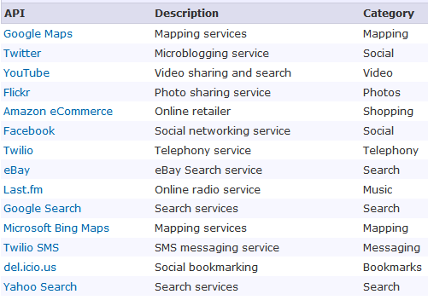
Web Services Sources
http://www.programmableweb.com/apis/directory/1?sort=mashups

Slide 14
WeatherBug Example
From Deitel Android Programmers: An App-Driven Approach
Example for Tablets
Fragments
tabbed navigation in Action Bar
Widget for home screen
Are focus is on the use of Web Services

Slide 15
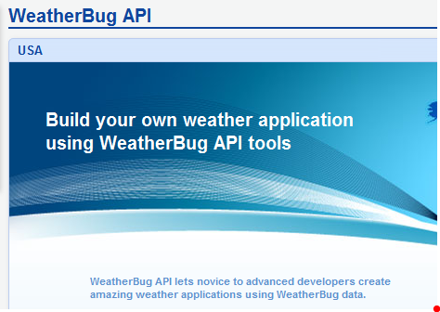
WeatherBug API

Slide 16
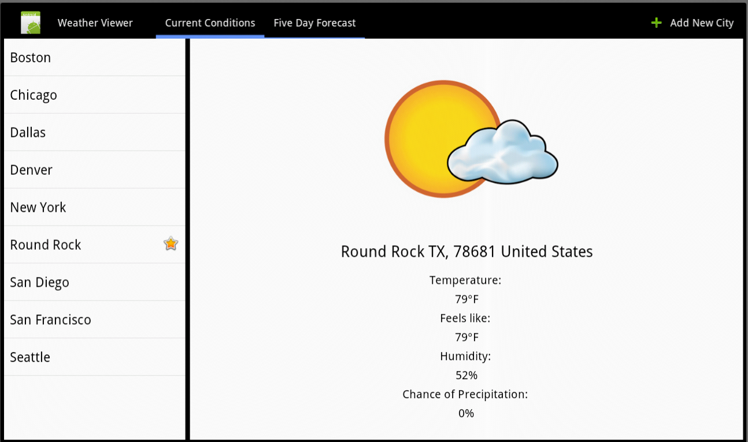
WeatherView App - Current

Slide 17
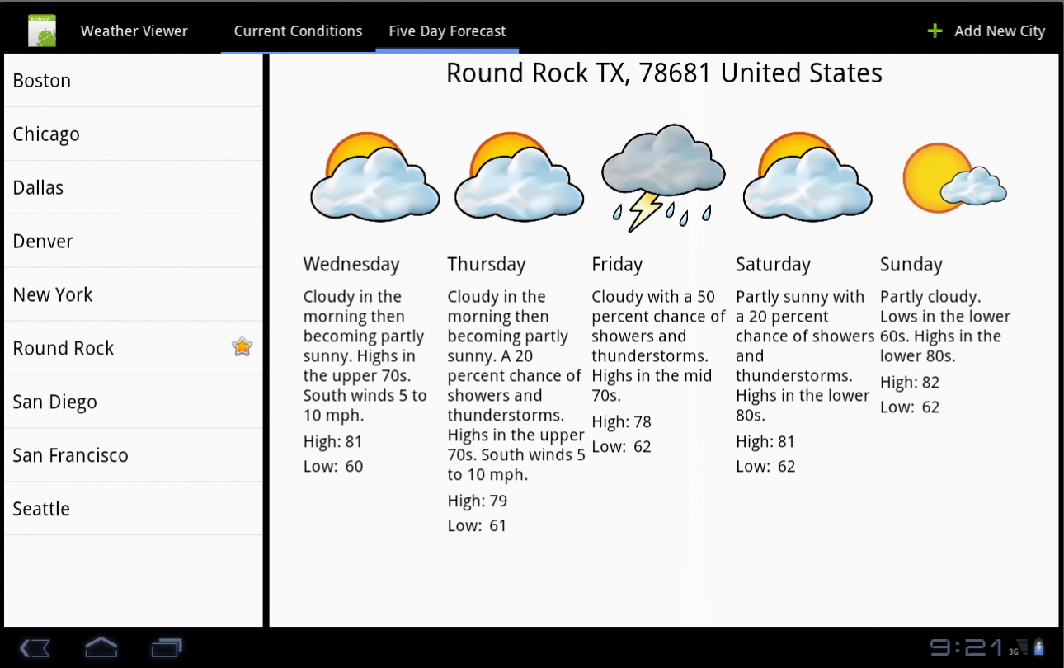
WeatherView App - Five Day

Slide 18
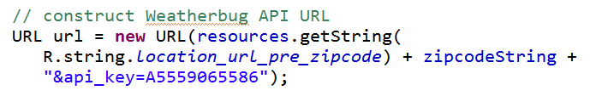
Use of API
many API's require registration and a key value
key used in requests

Slide 19
WeatherBug Web Services
Three classes deal with making requests via the WeatherBug API in WeatherView
ReadLocationTask
based on zip get location information
ReadForecastTask
read current forecast for given zip code
ReadFiveDayForecastTask
get forecast for next five days for given zip

Slide 20
Tasks
All three class extend AsyncTask
constructors
override doInBackground method
override onPostExecute method
define their own listeners
Keep the UI thread responsive by using AsyncTask to perform potentially slow tasks

Slide 21
AsynchTask
"AsyncTask allows you to perform asynchronous work on your user interface. It performs the blocking operations in a worker thread and then publishes the results on the UI thread, without requiring you to handle threads and/or handlers yourself."
Task started by invoking the execute method
http://developer.android.com/reference/android/os/AsyncTask.html

Slide 22
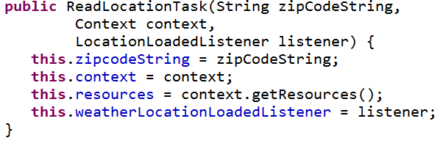
ReadLocationTask
Created with Context, zip code, and Listener
Listener updated in postExecute method

Slide 23
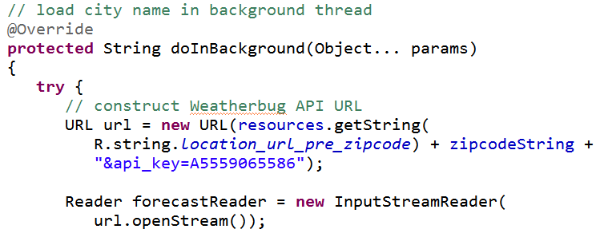
ReadLocationTask - doInBackground
Creates URL using zip and key fro API

Slide 24

JSON
JavaScript Object Notation
a way to represent JavaScript objects as Strings
alternative to XML for passing data between servers and clients
design for data interchange format that humans can also read and write

Slide 25
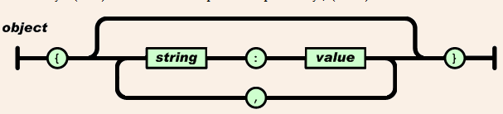
JSON Format
Built on two structures
collection of name value pairs: a.k.a. objects, records, structs, etc.
an ordered list of values: a.k.a. an array
objects

Slide 26
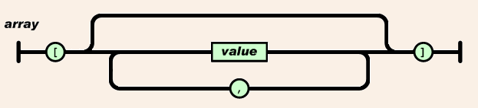
JSON Format
arrays
values
string, number, object, array, true, false, null

Slide 27
JSON Examples
value:
"Round Rock"
array:
["Round Rock", "Dallas", "Houston"]
object
{"height":70,"weight":165}

Slide 28
Results For ReadLocationTask
http://i.wxbug.net/REST/Direct/GetLocation.ashx?zip=78681&api_key=xxxxx
where xxxxx is your API key
Result:
{"location":{"city":"Round Rock","cityCode":null,"country":"United States","dma":"635","isUs":true, "lat":30.5123,"lon":-97.7117, "state":"TX","zipCode":"78681"}}

Slide 29
Parsing JSON
JsonReader class in Android API
Read JSON encoded values as a stream of tokens
In example used by ReadLocationTask to parse the JSON returned by the web request
Pulls out city, state, and country string to display in View

Slide 30
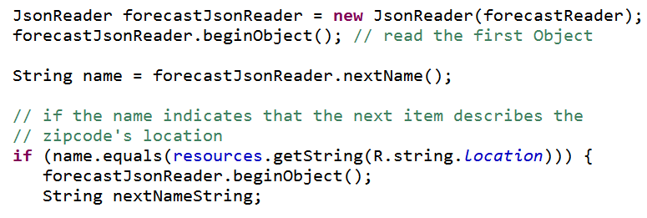
Creating JsonReader
and checking it is a location

Slide 31
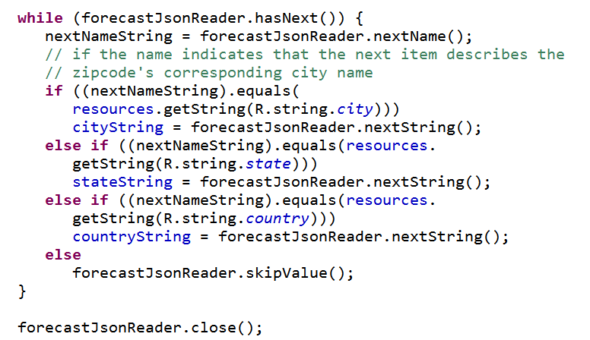
Reading Location Data

Slide 32
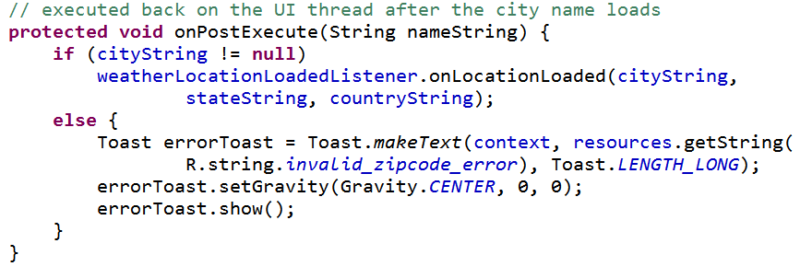
onPostExecute
Send the city, state, and country data to the listener

Slide 33
ReadForecastTask
Similar in nature to ReadLocationTask, but different url for different data
{"forecastHourlyList": [{"chancePrecip":"10","dateTime":1332882000000, "desc":"PartlyCloudy","dewPoint":64,"feelsLike":73, "feelsLikeLabel":"Heat Index","humidity":"74", "icon":"cond002","skyCover":null, "temperature":73,"windDir":null,"windSpeed":10}, {"chancePrecip":"10","dateTime":1332885600000, "desc":"Partly Cloudy","dewPoint":64,"feelsLike":70, "feelsLikeLabel":"Heat Index","humidity":"81", "icon":"cond002","skyCover":null, "temperature":70,"windDir":null,"windSpeed":11},
and on for another 158 hours

Slide 34
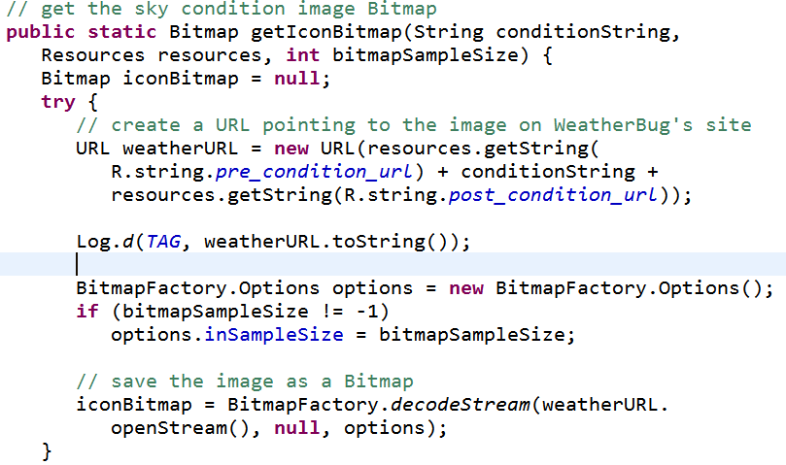
ReadForecastTask
Also downloads image for current condition

Slide 35



Icons Obtained From WeatherBug

Slide 36
ReadFiveDayForecastTask
{"dateTime":1332892800000, "dayDesc":"Partly Cloudy","dayIcon":"cond003", "dayPred":"Cloudy in the morning...becoming partly cloudy. Patchy fog in the morning. Highs 61 to 66. Light winds becoming west 15 mph with gusts to 25 mph in the afternoon.", "dayTitle":"Wednesday","hasDay":true, "hasNight":true,"high":"66","hourly":null,"low":"54","nightDesc":"Drizzle","nightIcon":"cond162", "nightPred":"Partly cloudy in the evening...becoming cloudy. Patchy fog and patchy drizzle overnight. Lows 49 to 55. Areas of winds northwest 15 to 20 mph with gusts to 25 mph in the evening becoming light.", "nightTitle":"WednesdayNight","title":"Wednesday"},

Slide 37
Displaying Data
App does not try and display all data, just chooses "most important"
icon
day of week
day prediction
high temp
low temp

