Slide 1
CS378 - Mobile Computing
Location

Slide 2
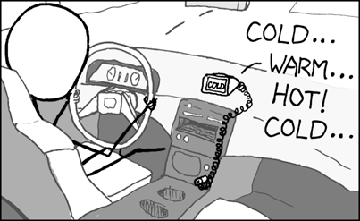
Cheap GPS
http://xkcd.com/407/

Slide 3
Android and Location
location for Android device include:
GPS
cell-ID (cell tower)
Wi-Fi networks
Android can use GPS and the Network Location Provider which combines cell-ID and Wi-Fi data

Slide 4


Location, Location, Location
Dead reckoning
radar fix
visual fix
Loran
Omega
Navsat
GPS
Active Sonar
Inertial Navigation System

Slide 5

Global Positioning System
GPS
US System that provides position, navigation, and timing
Space Segment, Control Segment, User Segment
US Air Force develops, maintains, and operates the space segment and control segment

Slide 6
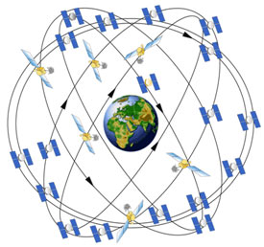
GPS Space Segment
24 core satellites
medium earth orbit, 20k km above the earth
6 orbital planes with 4 satellites each
generally 4 satellites in line of sight at any spot on the earth
recently upgraded to 27 sats

Slide 7
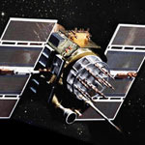
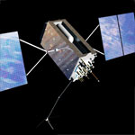
GPS Space Segment
satellites circle the earth twice a day
upgraded over time with different generations of satellites
Current generation of satellites being developed by Lockheed - Martin (FOCS)

Slide 8
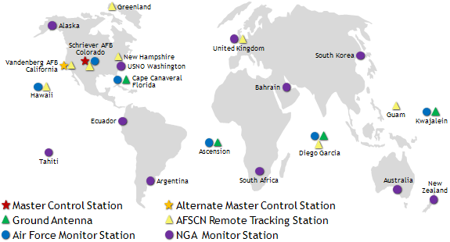
GPS Control Segment
Ground facilities that
monitor transmissions, perform analysis, and send commands and data to satellites

Slide 9
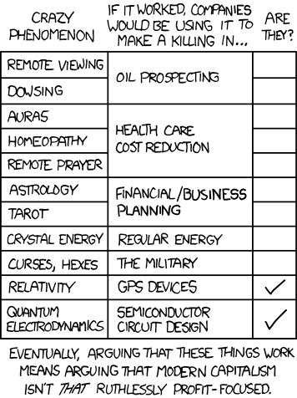
GPS User Segment
Onboard clocks with accuracy of 1 nanosecond (1 billionth of a second)
Satellites transmit one way
receiver calculates position and course by comparing time signals from multiple satellites with the known position of those satellites

Slide 10
GPS User Segment
accuracy easily within 5 - 10 meters
precision requires accuracy of clocks and timing signal on the order of 20 nanoseconds
the Special and General theories of Relativity must be taken into account to achieve the desired accuracy
Special relativity predicts clocks on satellites go slower, on the order of 10 microseconds per day
General relativity predicts the mass of the earth will also have an effect

Slide 11
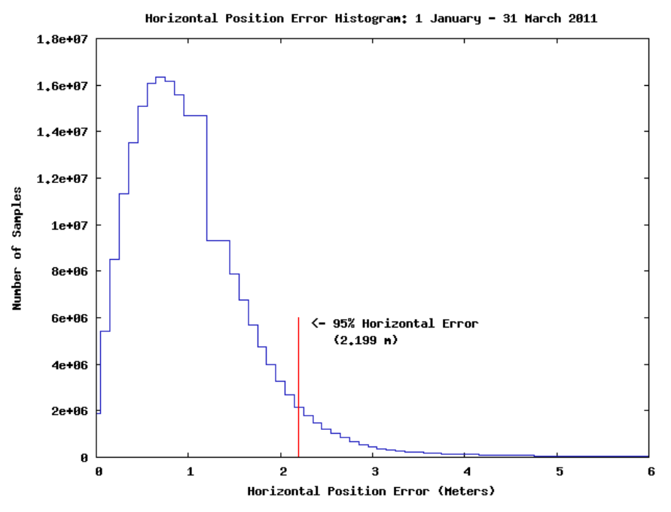
GPS Accuracy

Slide 12
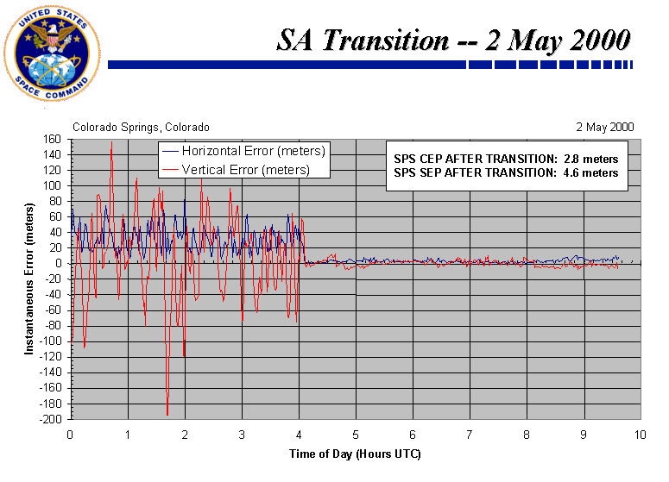
GPS Accuracy
Selective Availability: intentional degradation of signals for civilian use
ended in 2000

Slide 13
GPS Accuracy
civilian GPS: aka SPS
military GPS: aka PPS
military broadcasts on two frequencies, civilian only one
"This means military users can perform ionospheric correction, a technique that reduces radio degradation caused by the Earth's atmosphere. With less degradation, PPS provides better accuracy than the basic SPS. "

Slide 14
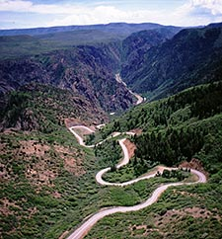

Android and Location
Obtaining User Location
GPS
most accurate but,
only works OUTDOORS
quickly consumes battery power
delay in acquiring satellites or re- acquiring if lost

Slide 15
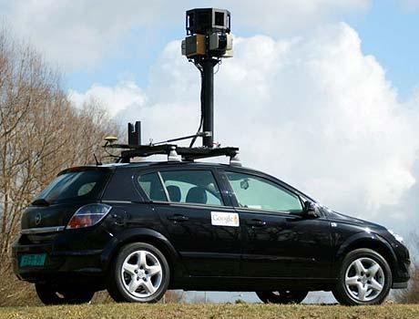
How does Wi-Fi Fix Location?
Use to use StreetView cars
Now, use the devices themselves to map locations to wi-fi spots
Apple and Microsoft do the same thing
default on dev phones was checked

Slide 16
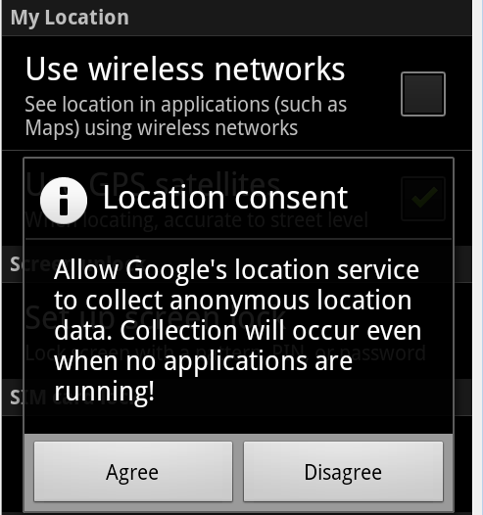
Google Location Services

Slide 17
Finding Location
Add appropriate permission to AndroidManifest.xml
Get instance of LocationManager using getSystemService method using LOCATION_SERVICE
Choose location provider (from all providers or using getBestProvider method)
Implement a LocationListener class
Call requestLocationUpdates method with chosen provider so LocationListener start receiving location information

Slide 18

AndroidManifest.xml
User Permission in manifest
Options: ACCESS_FINE_LOCATION or ACCESS_COARSE_LOCATION
ACCESS_COARSE_LOCATION for use of NETWORK_PROVIDER using cell-ID and Wi-Fi
ACCESS_FINE_LOCATION: GPS or NETWORK_PROVIDER

Slide 19
Uses Features
In addition to request permissions the AndroidManifest.xml file can list features the app uses.
Google Play uses these tags to filter applications for users
examples of features: bluetooth, camera, location, network, microphone, nfc (near field communication), sensors, and more!

Slide 20
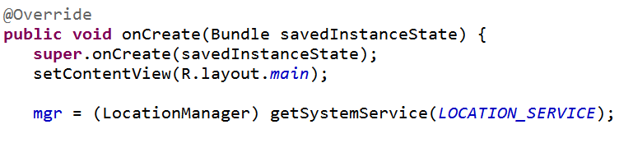
Location Manager
Obtain Location Manager

Slide 21
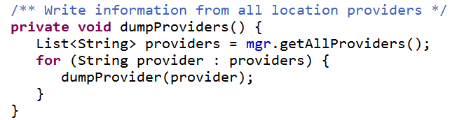
Simple Location Program
Just to demonstrate capabilities
After setting up listener show all providers
mgr is LocationManager

Slide 22
Properties of Location Providers
name
enabled
accuracy
power requirements
monetary cost
requires cell
requires network
requires satellite
supports altitude
supports bearing
supports speed

Slide 23
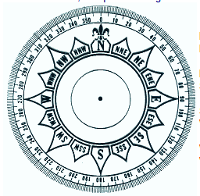
Bearing
direction
360 degrees
degrees east of north
0 = north
90 = east
180 = south
270 = west

Slide 24
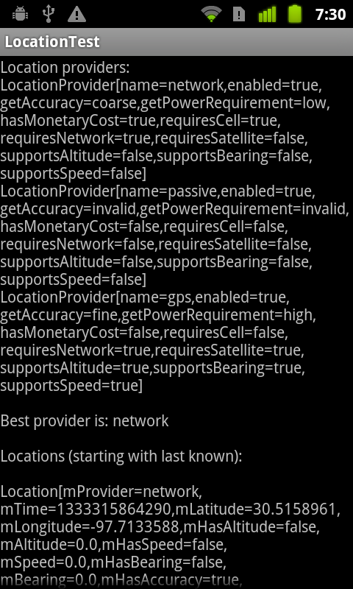
Program Output
network (wifi and cell tower id)
gps
passive
use location updates requested by other applications or services

Slide 25
dev Phones (no cell service)
name | Network | Passive | GPS
enabled | true | true | true
accuracy | coarse | invalid | fine
power req. | low | invalid | high
monetary cost | true?? | false | false
request cell | true | false | false
requires network | true | false | true?
requires satellite | false | false | true
supports altitude | false | false | true
supports bearing | false | false | true
supports speed | false | false | true
requires satellite
supports altitude
supports bearing
supports speed

Slide 26
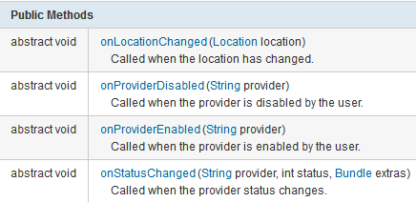
LocationListener
Implement class that implements LocationListener interface

Slide 27
Obtaining Locations
Register the LocationListener to receive location updates
locationManager.requestLocationUpdates(LocationManager.NETWORK_PROVIDER, 15000, 10, locationListener);
provider: name of provider to register with
minTime: the minimum time interval for notifications, in milliseconds. only a hint to conserve power, and actual time between location updates may be greater or lesser than this value.
minDistance: min distance interval for notifications in meters
the listener itself

Slide 28
requestLocationUpdates
More on arguments
0 for minTime AND minDistance indicate obtain updates as frequently as possible
for background services recommended minTime >= 300,000 ms to avoid consuming too much power with the GPS or Wi-Fi receivers
300,000 ms = 5 minutes
clearly less for apps in the foreground

Slide 29
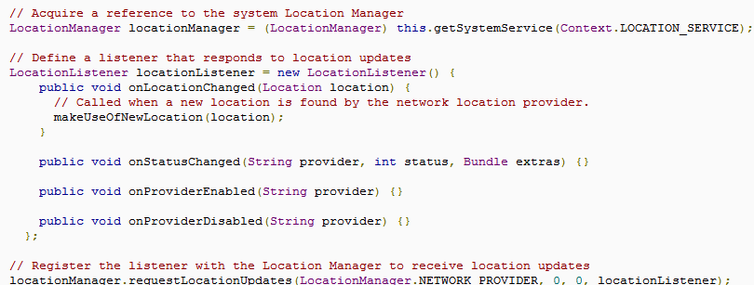
Location Listener

Slide 30
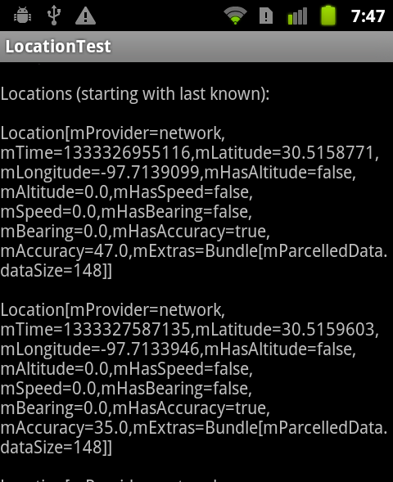
Location Data
onLocationChange method in the LocationListener receives Location objects
toString shown
latitude, longitude, timestamp, possibly altitude, speed, and bearing

Slide 31
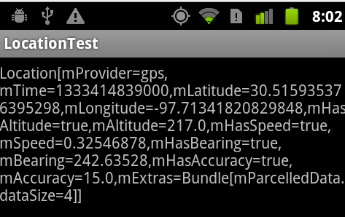
Sample GPS Locations
units for altitude and accuracy: meters
units for speed: meters / sec
units for time: UTC (coordinated universal time) time of this fix, in milliseconds since January 1, 1970.
Java Date class has constructor that accepts UTC

Slide 32
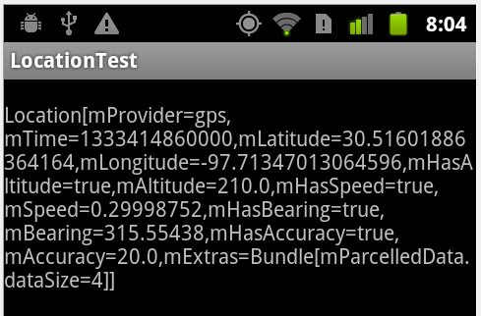
Sample GPS Locations

Slide 33
Location Strategies
Location aware applications
compelling? better information to user?
GPS -> slow, only works outdoors, consumes lots of power, very accurate
Network -> fast, works indoor and outdoor, uses less power, less accurate
Issues: multiple sources (cell id, wifi, gps), user movement, accuracy of locations

Slide 34
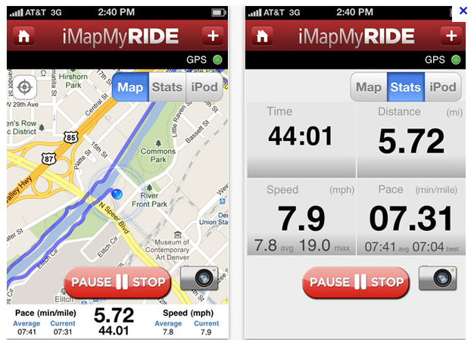
Getting a Fix
Some applications (driving directions, sport tracking) require constant location data
using battery is expected

Slide 35
Periodic Location Updates
Many location aware applications do not need a constant stream of location updates
Obtaining location pattern:
Start application.
Sometime later, start listening for updates from desired location providers.
Maintain a "current best estimate" of location by filtering out new, but less accurate fixes.
Stop listening for location updates.
Take advantage of the last best location estimate.
http://developer.android.com/guide/topics/location/strategies.html

Slide 36
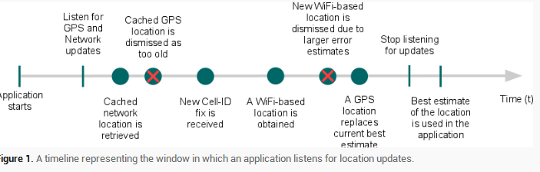
Getting Location
Timeline for getting location based on pattern described:

Slide 37
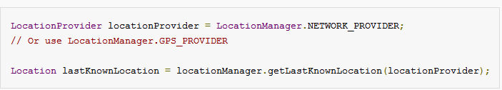
Last Known Location
Recall, application is part of a larger system
other applications may have asked for location and we can use those locations via the LocationManager

Slide 38
Current Best Estimate
The most recent location, may not be the most accurate
Evaluating a location
how long has it been since the current best estimate?
is the accuracy of the new location update better than the best estimate?
what is the source of the location? which do you trust more?

Slide 39
LocationManager - Useful Methods
addProximityAlert(double latitude, double longitude, float radius, long expiration, PendingIntent intent)
Sets a proximity alert for the location given by the position (latitude, longitude) and the given radius.
List<String> getAllProviders()
Returns a list of the names of all known location providers.
Location getLastKnownLocation(String provider)
Returns a Location indicating the data from the last known location fix obtained from the given provider.

