Slide 1
CS378 - Mobile Computing
Maps

Slide 2
Using Google Maps
Like other web services requires an API key from Google
http://code.google.com/android/add-ons/google-apis/mapkey.html
required to use MapView class
Must:
Register the MD5 fingerprint of the certificate used to sign the application.
Adding a reference to the Maps API Key in each MapView (xml or code)

Slide 3
Signing Apps
deploying apps on the market requires signing the app with a certificate
development and debugging uses an automatic key creation process
invisible to us
In release mode you must create your own private key to sign apps
use of keytool program from Java SDK
http://developer.android.com/guide/publishing/app-signing.html

Slide 4
Debugging Maps Applications
Possible to use the debug key to get a certificate for Google Maps
steps:
locate debug keystore
use keytool to get the MD5 fingerprint of the debug certificate to request map certificate
MD5
Message - Digest Algorithm
cryptographic hash function

Slide 5
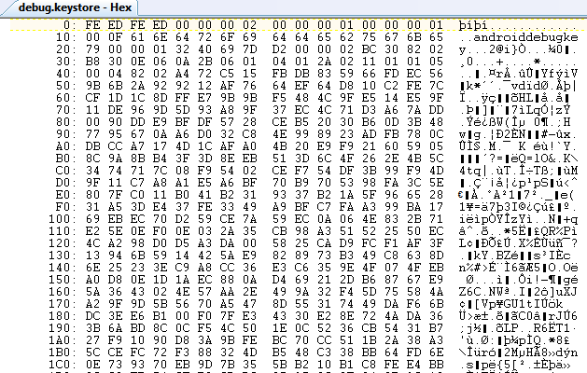
Debug Key
Portion of debug.keystore

Slide 6
Getting MD5 Fingerprint
use keytool program
keytool part of Java SDK
keytool -list -alias androiddebugkey -keystore <path_to_debug_keystore>.keystore -storepass android -keypass android
gives MD5 fingerprint of the debug certificate
keytool of Java 1.7 gives SHA1 by default
use -v after keytool, before -list

Slide 7
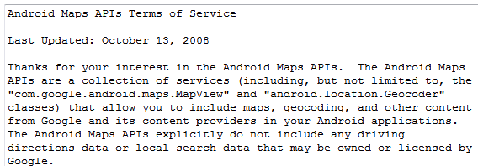
Google Maps Terms of Service
Some Highlights
may include ads in future
Google may limit number of transactions
Cannot use for turn-by-turn directions or autonomous driving

Slide 8
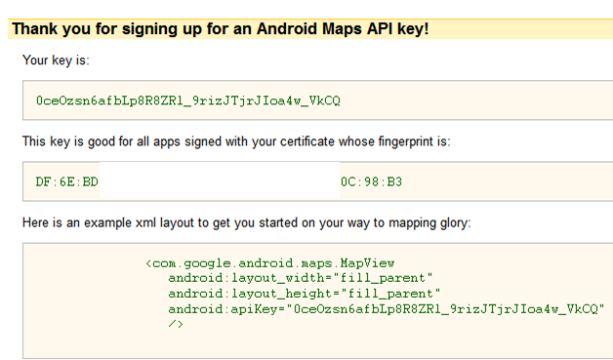
Debug API Key

Slide 9

Hello MapView
Build Target - Google, not Android
MapView not a standard Android class
part of Google Maps Library
add to manifest
must also include INTERNET permission and LOCATION permission

Slide 10
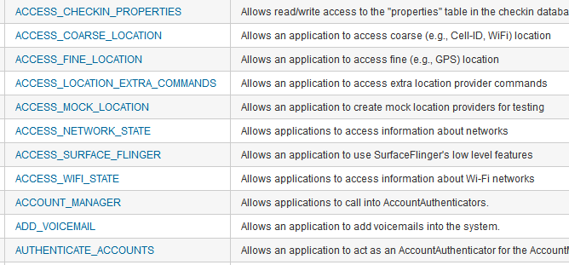
Aside Permissions
http://developer.android.com/reference/android/Manifest.permission.html

Slide 11
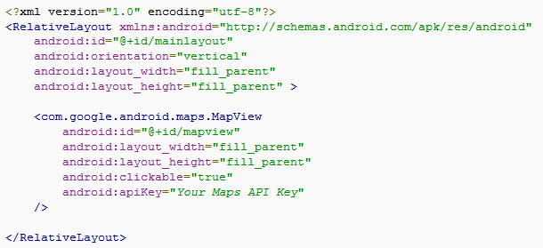
MapView
A type of view for layout file

Slide 12
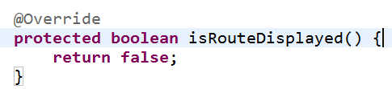
MapActivity
Create class that extends MapActivity instead of Activity
import com.google.android.maps.MapActivity;
must implement isRouteDisplayed method
must return true if any kind of route (to be followed) is displayed, per terms of use

Slide 13
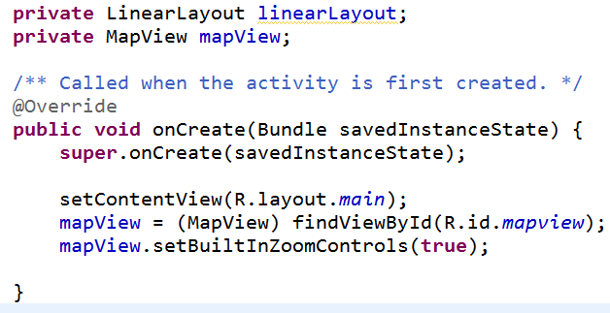
Instance Vars and onCreate
Add instance variables and initialize in onCreate method

Slide 14
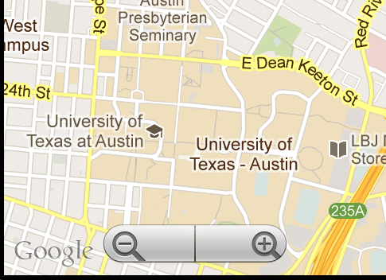
HelloMapView
Run app
Displays map and allows panning and zooming

Slide 15
Customizing Map
Easy to display map and allow interaction
Customize with markers and overlays
Overlays
used to display information on top of map
use ItemizedOverlay class

Slide 16
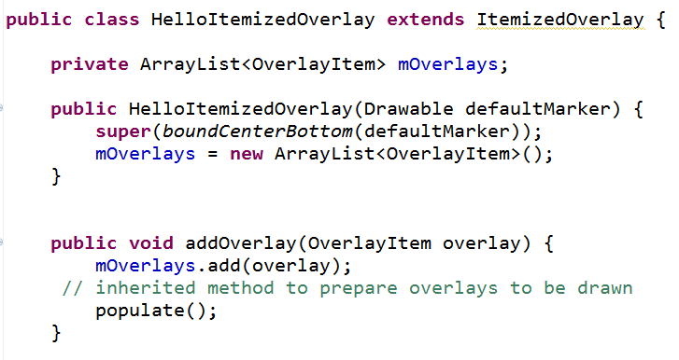
ItemizedOverlay

Slide 17
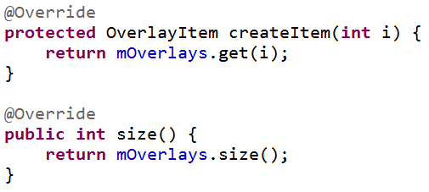
ItemizedOverlay
populate method will call createItem
define createItem and return value from the ArrayList instance var
define size method that returns number of overlay items

Slide 18

Adding Overlays
In MapActivity create OverlayItem
add to HelloItemizedOverlay
add to MapView
Need a drawable for the marker
res/drawable
issues display gif format images on some devices

Slide 19
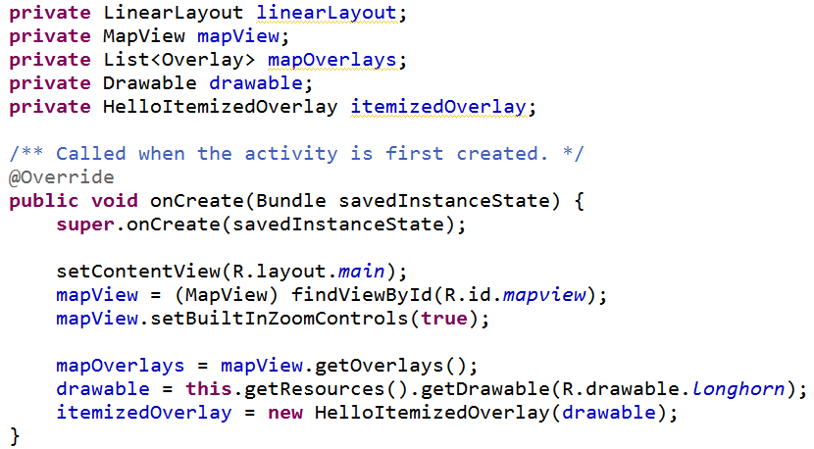
Changes to HelloMapView

Slide 20
Add Overlay Items
Create GeoPoint and use these to create OverlayItems
GeoPoint based on microdegrees
lat and long times 1,000,000
Build OverlayItems out of GeoPoints and include strings for title and snippet text to display when drawable clicked

Slide 21
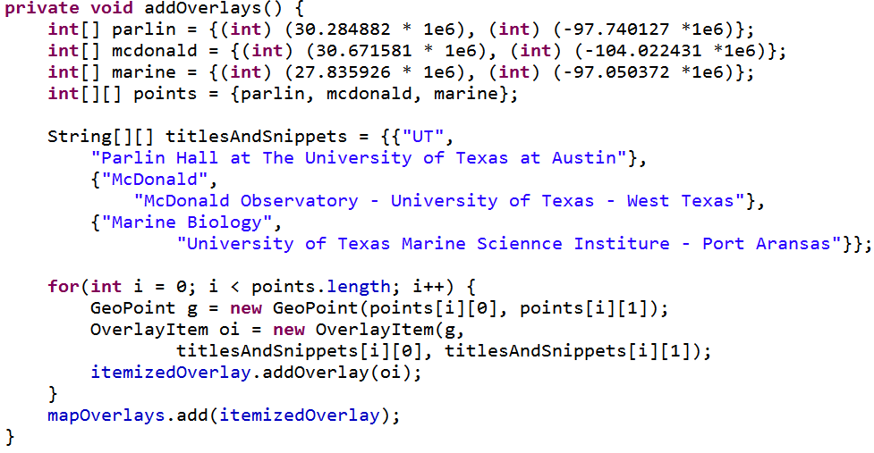
addOverlays method in HelloMapView

Slide 22
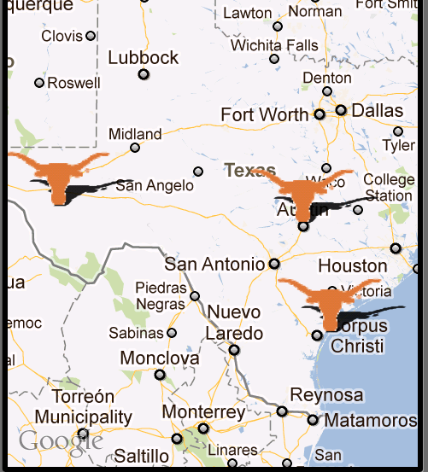
Result
one overlay with multiple items
based on locations we added

Slide 23
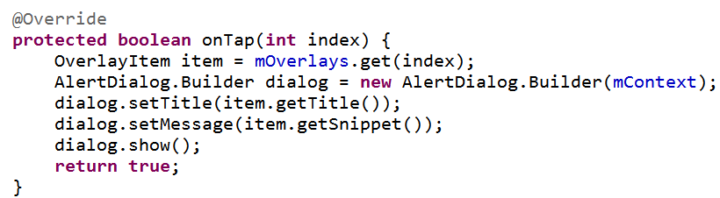
Display Information
To display information (title and snippet) of overlay override the onTap method in the ItemizedOverlay class

Slide 24
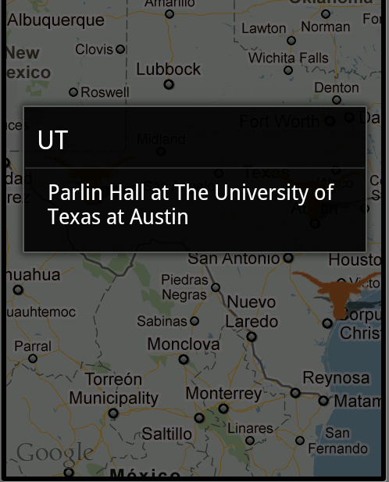
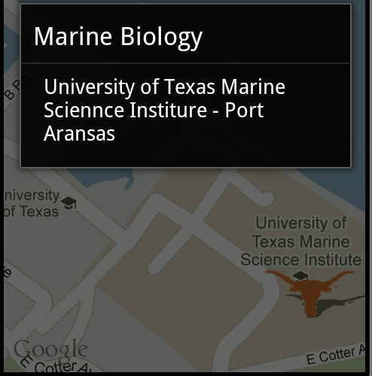
Results of Clicking Longhorn

Slide 25
Reverse Geocoding
Find addresses from longitude/latitude
Geecoder uses a backend that is NOT included in the core android framework
use isPresent method to check for service
location = locationManager.getLastKnownLocation(
LocationManager.GPS_PROVIDER);
double lat = location.getLatitude();
double lng = location.getLongitude();
Geocoder gc = new Geocoder(this, Locale.getDefault());
List<Address> addresses = null;
try {
addresses = gc.getFromLocation(lat, lng, 5); // maxResults
} catch (IOException e) {}

Slide 26
Forward Geocoding
Find longitude/latitude (and more) from address or airport code
Geocoder gc = new Geocoder(this, Locale.US);
List<Address> addresses = null;
try {
addresses = gc.getFromLocationName(
“713 N. Duchese, St. , Missouri”, 5);
} catch (IOException e) {}
double lat = addresses.get(0).getLatitude();
double lng = addresses.get(0). getLongitude (); String zip = addresses.get(0).getPostalCode();

Slide 27
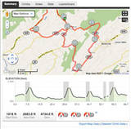
Maps Example
Route Tracker using Locations, MapActivity, MapView, and Google Maps
from Deitel AFP-AADA
Similar to Map My Ride
popular app among cyclists and runners

Slide 28
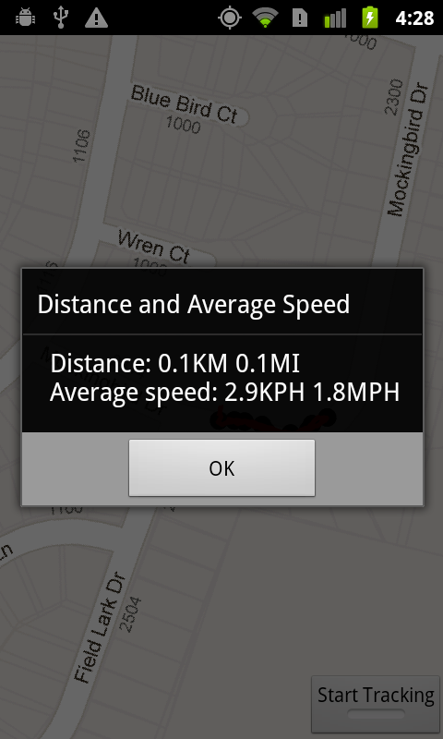
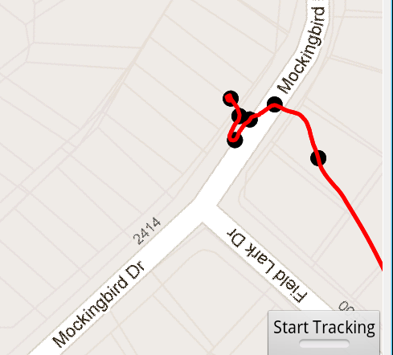
RouteTracker App

Slide 29
RouteTracker App
using FrameLayout to stack components with the most recently added component on top
ToggleButton at bottom to start and stop route tracking
MapView added to FrameLayout
route is an overlay to map with points and lines connecting points

Slide 30
RouteTracker Classes
RouteTracker Starting Activity
deals with LocationProvider
BearingFrameLayout Displays MapView
rotates based on bearing from location
RouteOverlay Overlay with location points
(every 10th)
and lines connecting.
Converts locations to GeoPoints.
Overloads draw

Slide 31
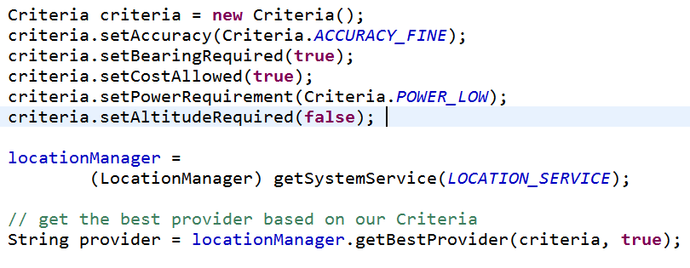
Criteria Class
Set criteria for selecting a LocationProvider

Slide 32
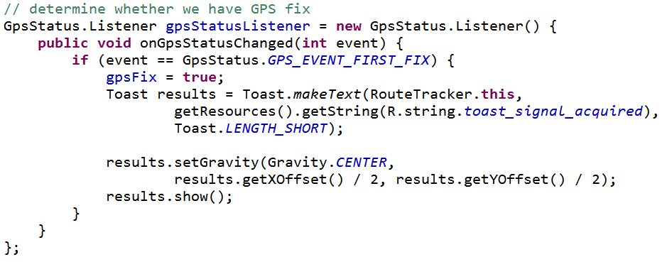
GpsStatus.Listener
Responds to changes in GPS status
Are we receiving GPS fixes?
App does not track unless this is true

Slide 33
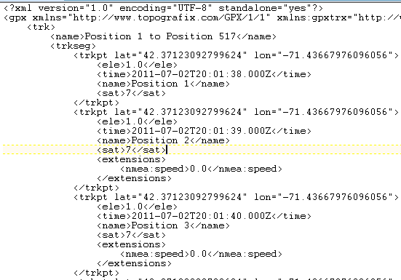
Simulating GPS Data
to simulate changes in location in emulator
GPS data in a file
GPS Exchange Format (GPX)

Slide 34
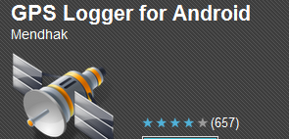
Creating GPX Files
Many apps and programs
One option for Android devices
GPSLogger
gpsbabel to convert between various GPS formats
gpx has different versions

Slide 35
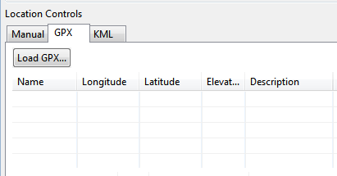
Running GPX files in App
DDMS
Emulator Control Tab
GPX Tab
Load

Slide 36
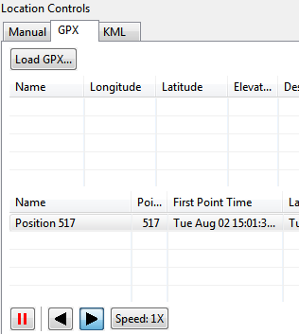
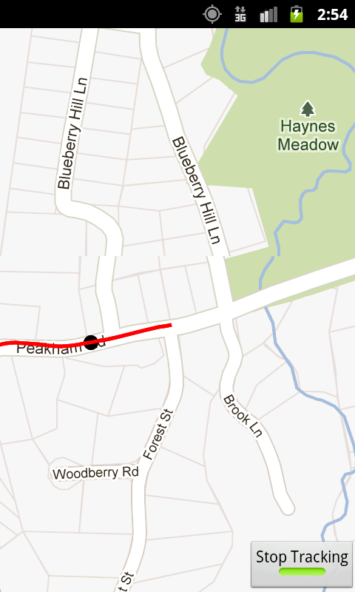
Running GPX

