Slide 1
CS378 - Mobile Computing
Sensing and Sensors

Slide 2
Sensors
"I should have paid more attention in Physics 41"
Most devices have built in sensors to measure and monitor
motion
orientation (aka position)
environmental conditions
sensors deliver raw data to applications

Slide 3
Sensor Framework
Determine which sensors are available on a device.
Determine an individual sensor's capabilities, such as its maximum range, manufacturer, power requirements, and resolution.
Acquire raw sensor data and define the minimum rate at which you acquire sensor data.
Register and unregister sensor event listeners that monitor sensor changes.
http://developer.android.com/guide/topics/sensors/sensors_overview.html

Slide 4
Using Sensors - Basics
Obtain the SensorManager object
create a SensorEventListener for SensorEvents
logic that responds to sensor event
various amounts of data from sensor depending on type of sensor
Register the sensor listener with a Sensor via the SensorManager

Slide 5
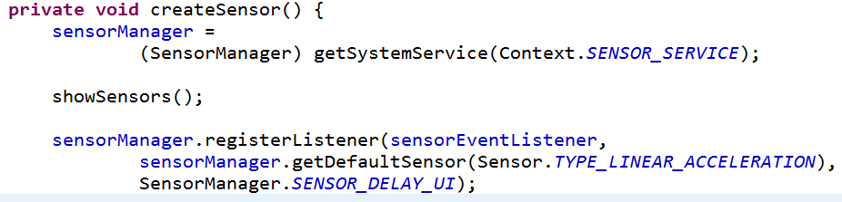
Using Sensors
registerListener(SensorEventListener, Sensor, int rate)
rate is just a hint
SENSOR_DELAY_NORMAL, SENSOR_DELAY_UI, SENSOR_DELAY_GAME, or SENSOR_DELAY_FASTEST, or time in microseconds (millionths of a second)

Slide 6
SensorEventListener
Interface with two methods:
void onAccuracyChanged (Sensor sensor, int accuracy)
void onSensorChanged (SensorEvent event)
Sensor values have changed
this is the key method to override
don't hold onto the event
part of pool and the values may be altered soon

Slide 7
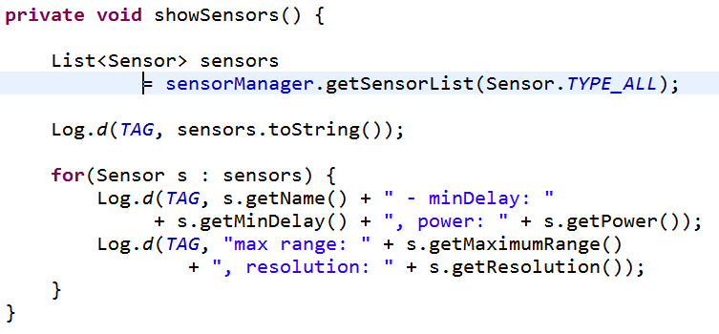
Listing Sensors on a Device to Log

Slide 8
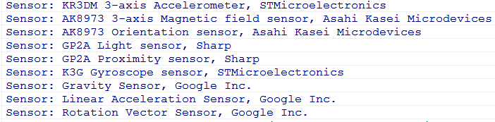
Types of Sensors - Dev Phone - Older
accelerometer, linear acceleration, magnetic field, orientation, light, proximity, gyroscope, gravity

Slide 9
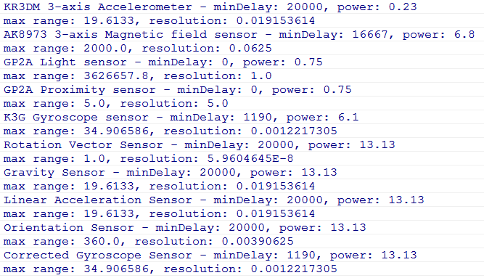
Sensor Capabilities - Dev Phones - Older

Slide 10
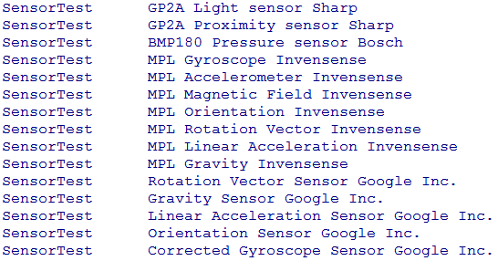
Types of Sensors - Dev Phone - Newer

Slide 11
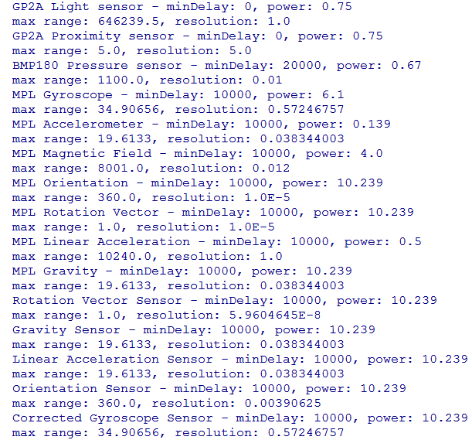
Sensor Capabilities - Dev Phone - Newer

Slide 12
Simple Sensor Example
App that shows linear acceleration
options to display current
… or maximum, disregarding direction
Linear Layout
TextViews for x, y, and z
Buttons to switch between max or current and to reset max

Slide 13
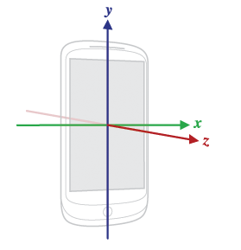
Sensor Coordinate System
For most motion sensors:
+x to the right
+y up
+z out of front face
relative to device

Slide 14
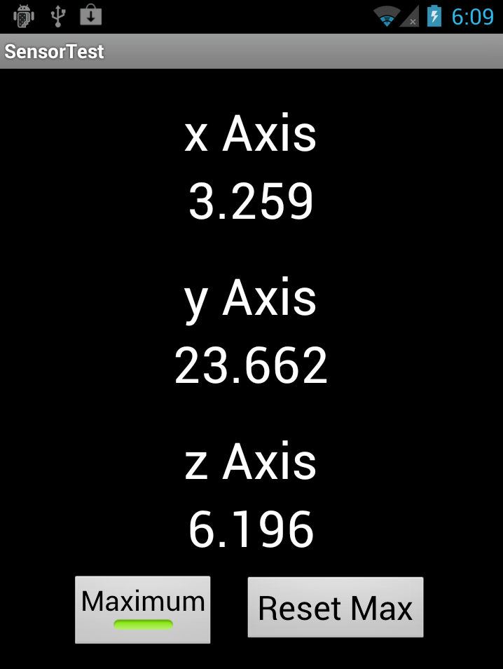
Sensor Coordinate System
App that displays max acceleration along each axis
Hold phone straight up and down and move to ground

Slide 15
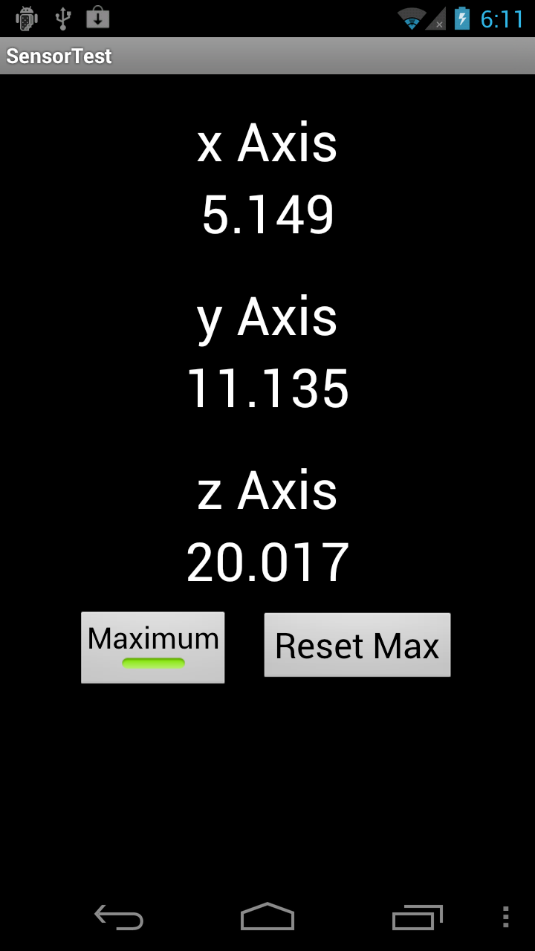
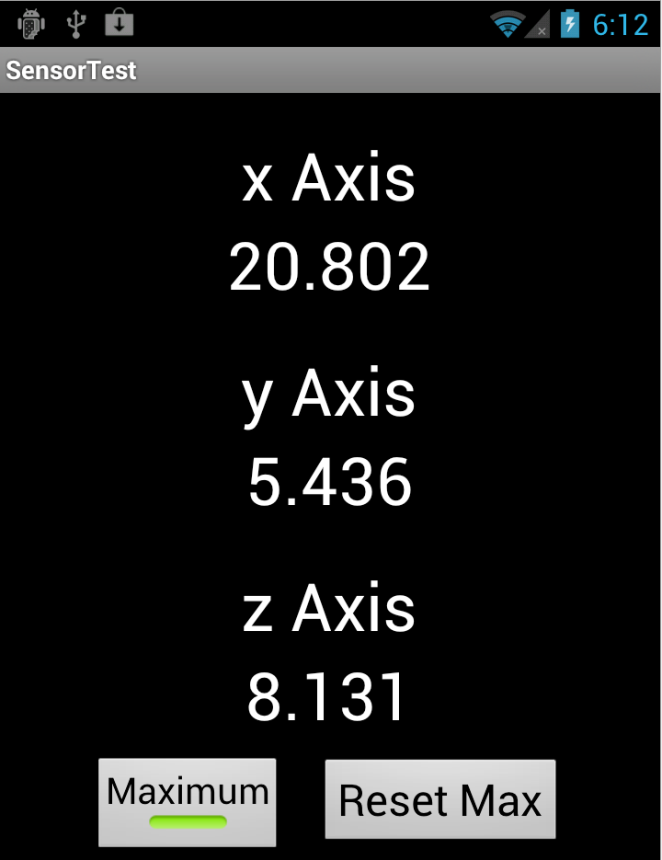
Sensor Coordinate System
Repeat but hold … then sideways phone flat

Slide 16
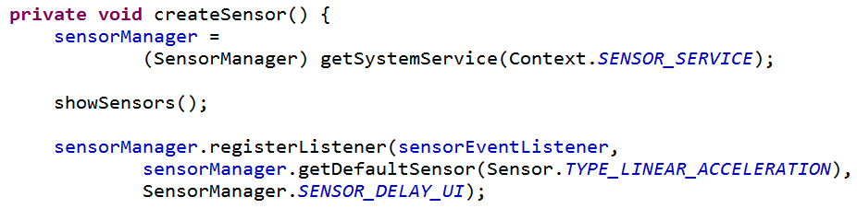
Getting Sensor Data
registerListener
sensorEventListener
Sensor -> obtain via SensorManager
rate of updates, a hint only, or microseconds (not much effect)
returns true if successful

Slide 17
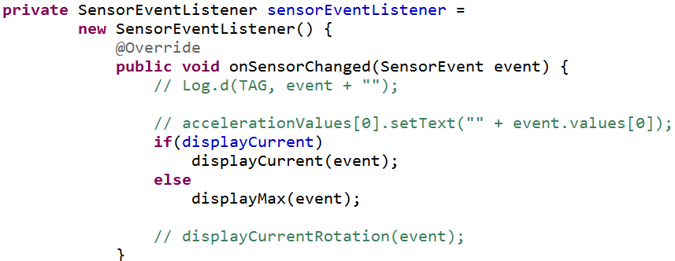
SensorEventListener

Slide 18
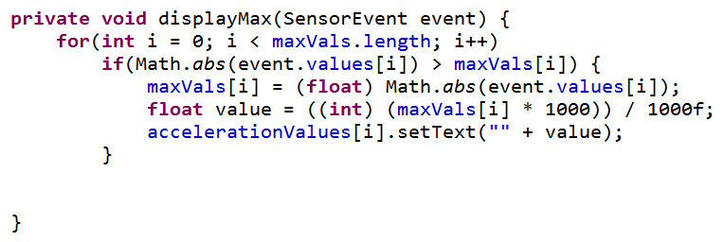
Display Max
Recall, max range of linear acceleration on dev phone is 19.613 + gravity = 29.423
- a baseball pitcher throwing a fastball reaches 350 m/s² or more (various "physics of baseball" articles)

Slide 19
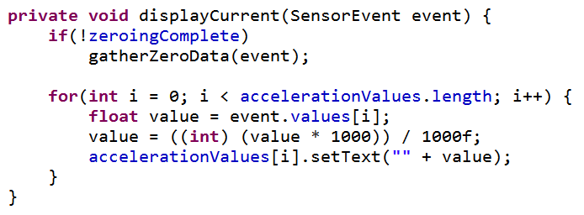
Display Current
Lots of jitter
Attempt to zero out???

Slide 20
Types of Sensors
Not every device has every kind of sensor
Constants from Sensor class
Three main classes of sensors:
motion
environmental
position

Slide 21
Types of Sensors
TYPE_ACCELEROMETER
hardware
acceleration force in m/s²
x, y, z axis
includes gravity

Slide 22
Types of Sensors
TYPE_AMBIENT_TEMPERATURE
hardware
"room" temperature in degrees Celsius
no such sensor on dev phones
TYPE_GRAVITY
software or hardware
just gravity
if phone at rest same as TYPE_ACCELEROMETER

Slide 23
Types of Sensors
TYPE_GYROSCOPE
hardware
measure device's rate of rotation in radians / second around 3 axis
TYPE_LIGHT
hardware
light level in lx,
lux is SI measure illuminance in luminous flux per unit area

Slide 24
Types of Sensors
TYPE_LINEAR_ACCELERATION
software or hardware
measure acceleration force applied to device in three axes excluding the force of gravity
TYPE_MAGNETC_FIELD
hardware
ambient geomagnetic field in all three axes
uT micro Teslas

Slide 25
Types of Sensors
TYPE_ORIENTATION [deprecated]
software
measure of degrees of rotation a device makes around all three axes
TYPE_PRESSURE
hardware
ambient air pressure in hPa or mbar
force per unit area
1 Pascal = 1 Newton per square meter
hecto Pascals (100 Pascals)
milli bar - 1 mbar = 1hecto Pascal

Slide 26
Types of Sensors
TYPE_PROXIMITY
hardware
proximity of an object in cm relative to the view screen of a device
most just binary (see range, resolution)
typically used to determine if handset is being held to person's ear during a call
TYPE_RELATIVE_HUMIDITY
ambient humidity in percent ( 0 to 100)

Slide 27
Types of Sensors
TYPE_ROTATION_VECTOR (ABSOLUTE)
hardware or software
orientation of device, three elements of the device's rotation vector
TYPE_TEMPERATURE
hardware
temperature of the device in degrees Celsius

Slide 28
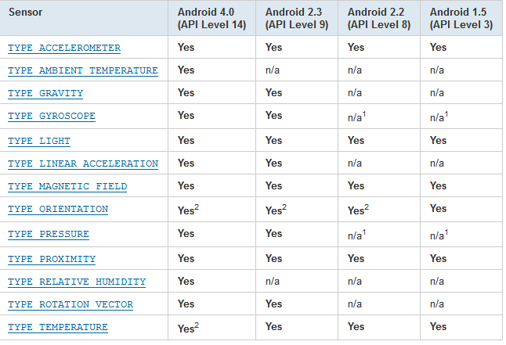
Availability of Sensors

Slide 29
Sensor Capabilities
Various methods in Sensor class to get capabilities of Sensor
minDelay (in microseconds)
power consumption in mA (microAmps)
maxRange
resolution

Slide 30
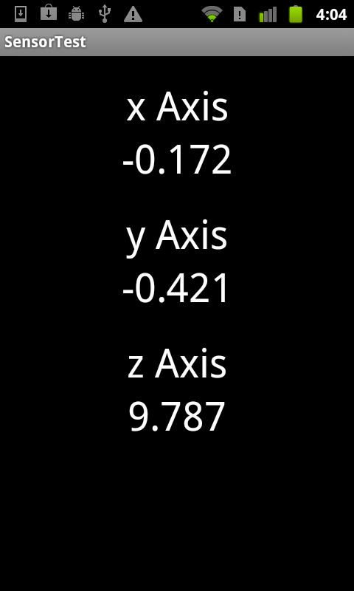

Accelerometer - Includes Gravity
Sensor. TYPE_ACCELEROMETER
Device flat on table
g ~= 9.81 m/s²

Slide 31
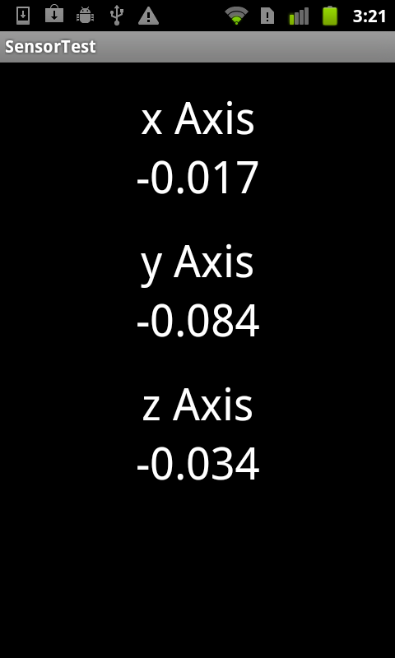
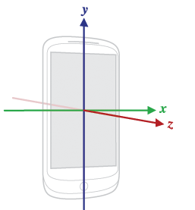
Linear Acceleration
At rest of table
Recall
units are m/s²

Slide 32


Zeroing out
Take average of first multiple (several hundred) events and average
shorter time = more error
Potential error
should be 0 at rest
Results:

Slide 33
Rate of Events
1000 events
SensorManager.SENSOR_DELAY_UI
times in seconds: 21, 21, 21
21 seconds / 1000 events
SensorManager.SENSOR_DELAY_FASTEST
times in seconds: 21, 21, 21
Recall delay of 20,000 micro seconds
2x10⁴ x 1x10³ = 2x10⁷ = 20 seconds

