Slide 1
CS378 - Mobile Computing
Sensing and Sensors Part 2

Slide 2
Using Sensors
Recall basics for using a Sensor:
Obtain the SensorManager object
create a SensorEventListener for SensorEvents
logic that responds to sensor event
Register the sensor listener with a Sensor via the SensorManager

Slide 3
Sensor Best Practices
Unregister sensor listeners
when done with Sensor or activity using sensor paused (onPause method)
sensorManager. unregisterListener(sensorListener)
otherwise data still sent and battery resources continue to be used

Slide 4
Sensor Best Practices
Testing on the emulator
Android SDK doesn't provide any simulated sensors
3rd party sensor emulator
http://code.google.com/p/openintents/wiki/SensorSimulator

Slide 5
SensorSimulator
Download the Sensor Simulator tool
Start Sensor Simulator program
Install SensorSimulator apk on the emulator
Start app, connect simulator to emulator, start app that requires sensor data

Slide 6
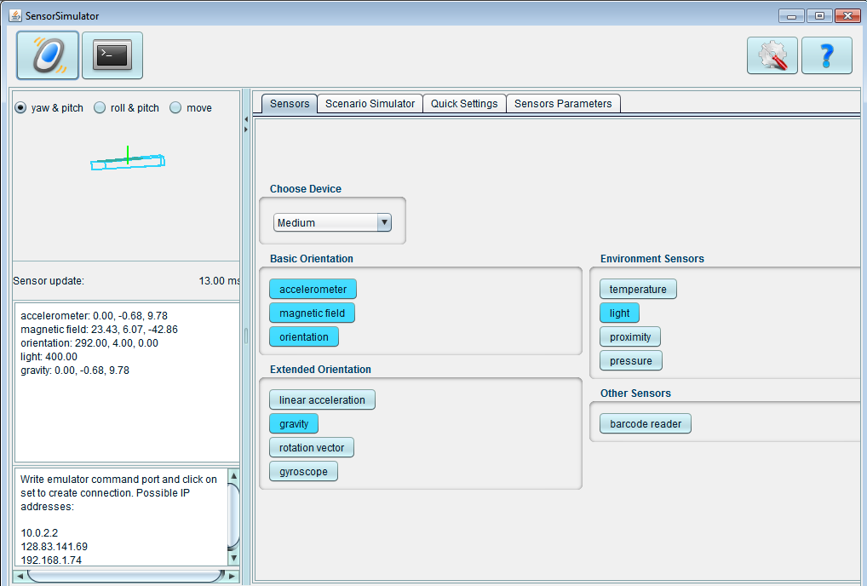
Sensor Simulator

Slide 7
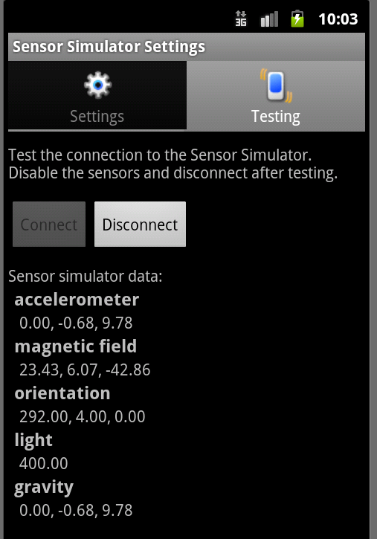
Sensor Simulator
Mouse in Sensor Simulator controls phone, feeds sensor data to emulator
Can also record sensor data from device and play back on emulator

Slide 8
Sensors Best Practices
Don't block the onSensorChanged() method
recall the resolution on sensors
50 updates a second for onSensorChange method not uncommon
when registering listener update is only a hint and may be ignored
if necessary save event and do work in another thread or asynch task

Slide 9
Sensors Best Practices
verify sensor available before using it
use getSensorList method and type
ensure list is not empty before trying to register a listener with a sensor

Slide 10
Sensors Best Practices
Avoid deprecated sensors and methods
TYPE_ORIENTATION and TYPE_TEMPERATURE are deprecated as of Ice Cream Sandwich

Slide 11
Sensor Best Practices
Testing on the emulator
Android SDK doesn't provide any simulated sensors
3rd party sensor emulator
http://code.google.com/p/openintents/wiki/SensorSimulator

Slide 12
SensorSimulator
Download the Sensor Simulator tool
Start Sensor Simulator program
Install SensorSimulator apk on the emulator
Start app, connect simulator to emulator, start app that requires sensor data

Slide 13
Sensor Simulator

Slide 14
Sensor Simulator
Mouse in Sensor Simulator controls phone, feeds sensor data to emulator
Can also record sensor data from device and play back on emulator

Slide 15
Sensor Sample - Moving Ball
Place ball in middle of screen
Ball has position, velocity, and acceleration
acceleration based on linear acceleration sensor
update over time, based on equations of motion, but fudged to suit application

Slide 16

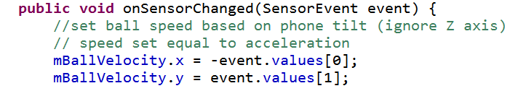
Sensor Sample - Moving Ball
Gross Simplification
velocity set equal to acceleration

Slide 17
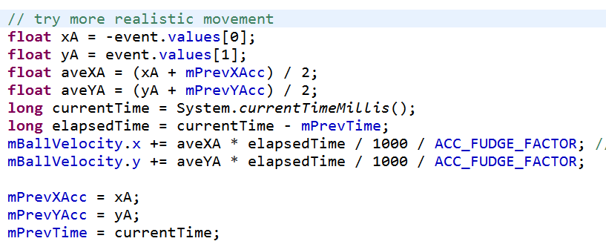
Sensor Sample - Moving Ball
Alternate Implementation
position updated in separate thread which redraws the view

Slide 18
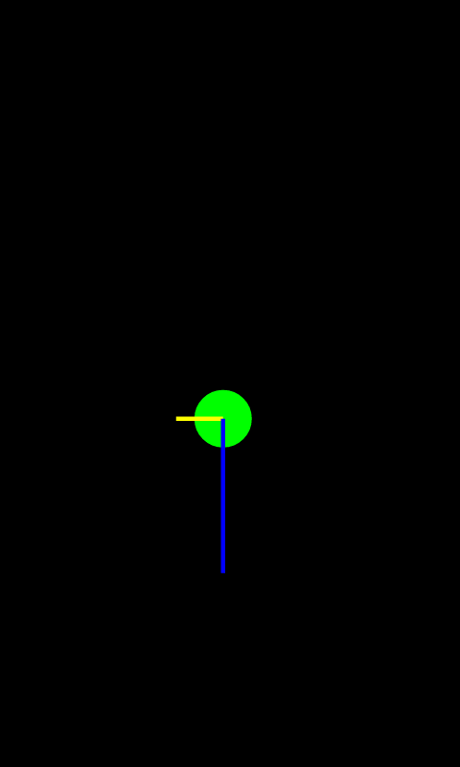
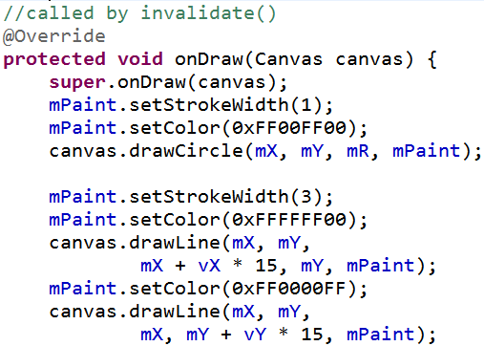
Sensor Sample
Draw lines for x and y velocities

Slide 19
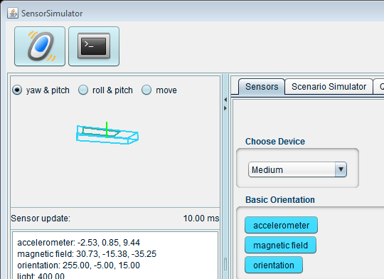
Demo Using SensorSimulator

Slide 20

Sensor Sample - TBBT
Inspired by http://tinyurl.com/7rnbgy5 and http://tinyurl.com/6nhvnnv

Slide 21


TBBT Sound Effect App

Slide 22
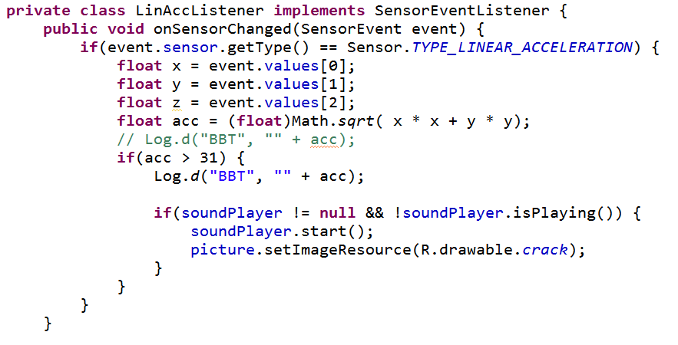
Responding to Events

Slide 23
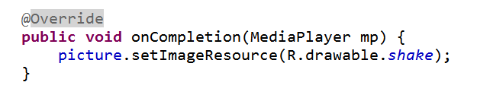
Changing Images
Use of an Image View
Initial Image set in onCreate
new image set in onSensorChange
register listener with MediaPlayer
on completion reset image

