Slide 1
CS378 - Mobile Computing
Content Providers

Slide 2
Content Providers
One of the four primary application components:
activities
content providers
services
broadcast receivers

Slide 3
Android Applications
Recall…
Each application runs as a different user on the OS
private files, user id, separate process with its own instance of the Dalvik VM
Content Providers act as a bridge between applications to share data

Slide 4
Content Providers
Many of the built in applications have content providers to allow other apps to access data
Examples of built in content providers
MediaStore
CallLog
Browser
ContactsContract (contacts)
Settings
UserDictionary
http://developer.android.com/reference/android/provider/package-summary.html

Slide 5
Content Providers
Provide access to a central data repository
ability to read and write to centralized data
data presented by Content Provider in the form of a table
like table from relational database
Each row in data table one "piece" of data in repository

Slide 6
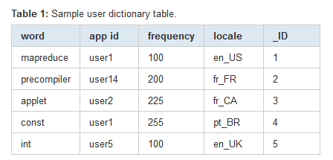
Example Table
Data from user dictionary
primary key optional
_ID column required to bind data from provider to a ListView

Slide 7
Accessing Content Provider
Use a ContentResolver client object in your app
ContentResolver communicates with ContentProvider
matching methods in each class
example: query() method
Create a cursor via content resolver to move through rows of table

Slide 8
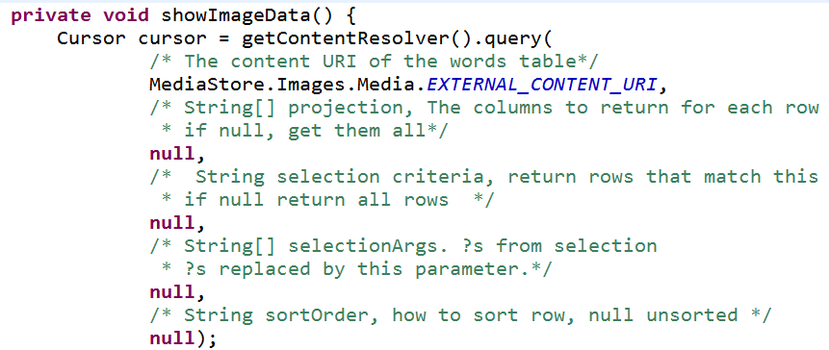
Accessing Content via Provider
Example: Exploring Images on a device
MediaStore.Images.Media class is one of the ContentProviders
get the cursor:

Slide 9
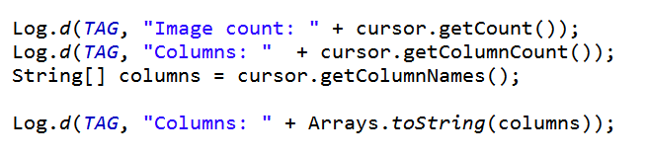
Accessing Content via Provider
After obtaining cursor:
result:

Slide 10
MediaStore.Images.Media
Columns from table:
According to Logcat:
[_id, _data, _size, _display_name, mime_type, title, date_added, date_modified, description, picasa_id, isprivate, latitude, longitude, datetaken, orientation, mini_thumb_magic, bucket_id, bucket_display_name, width, height]

Slide 11
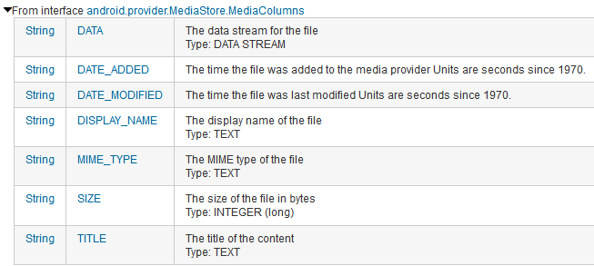
MediaStore.Images.Media
Columns documented in ContentProvider classes and interfaces

Slide 12
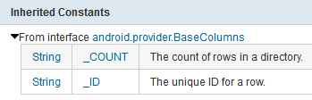
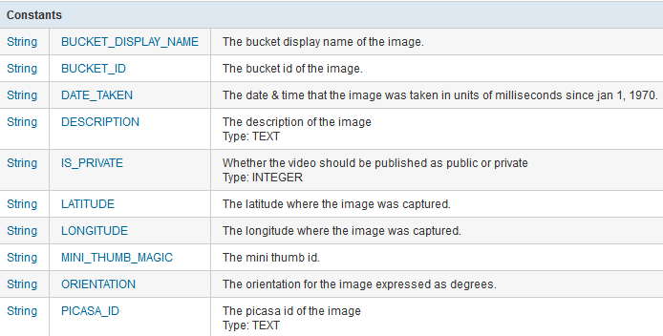
MediaStore.Images.Media Columns

Slide 13
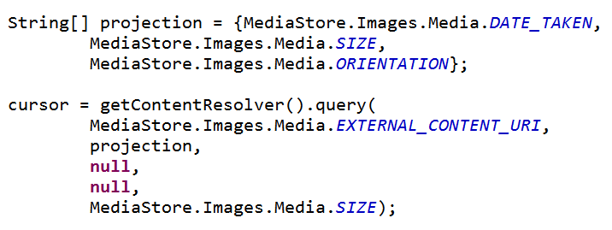
Selection Columns
Limit Columns returned with projection argument to query method that creates Cursor

Slide 14
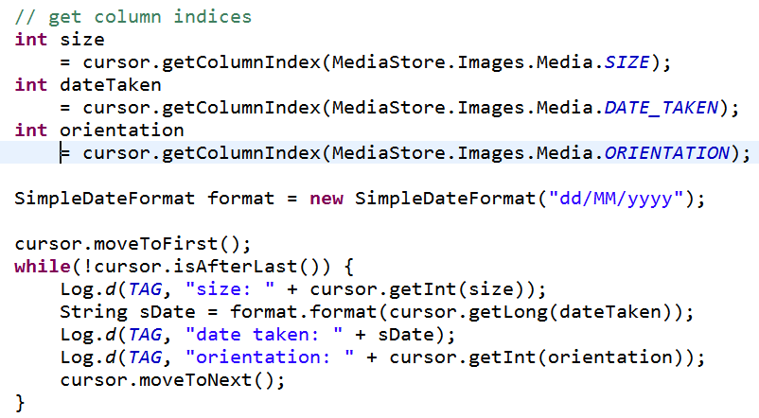
Showing Data in Logcat

Slide 15
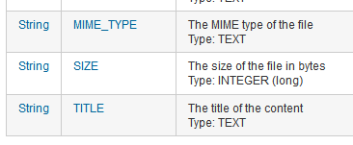
Getting Data from Row
Must determine how what form column data is in, use getX method
refer to constants from ContentProvider class
careful - some INTEGERS longs

Slide 16
Displaying Data in ListView
Like MovieRating Example
Specify columns to get from ContentProvider
Create view that will hold data
Obtain cursor from ContentProvider
Use ListAdapter to convert data from Cursor to Views
Sub class adapter to format text

Slide 17
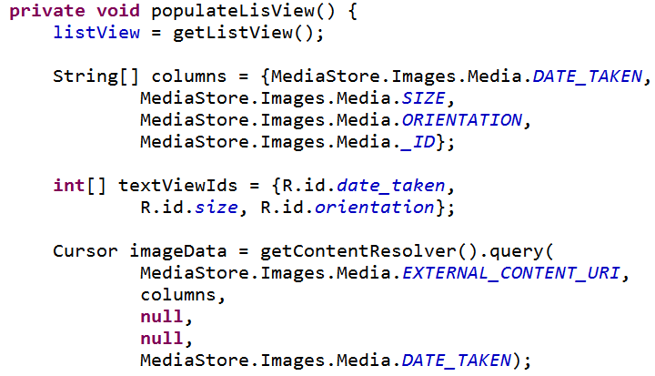
Display Data from ContentProvider

Slide 18
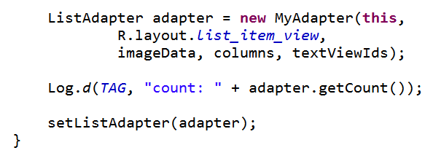
Display Data from ContentProvider
rest of populateListView from ListActivity

Slide 19
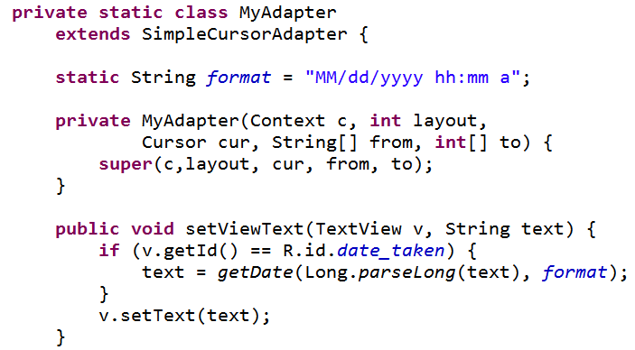
Subclass Adapter

Slide 20
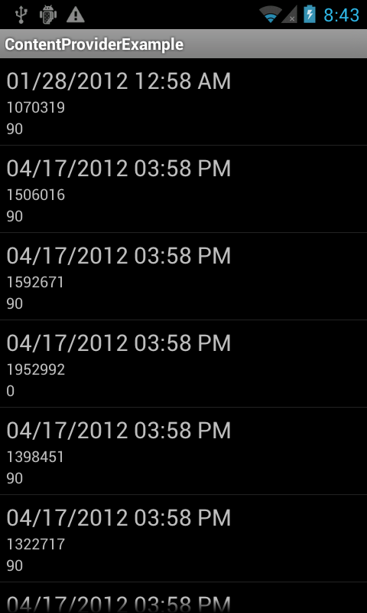
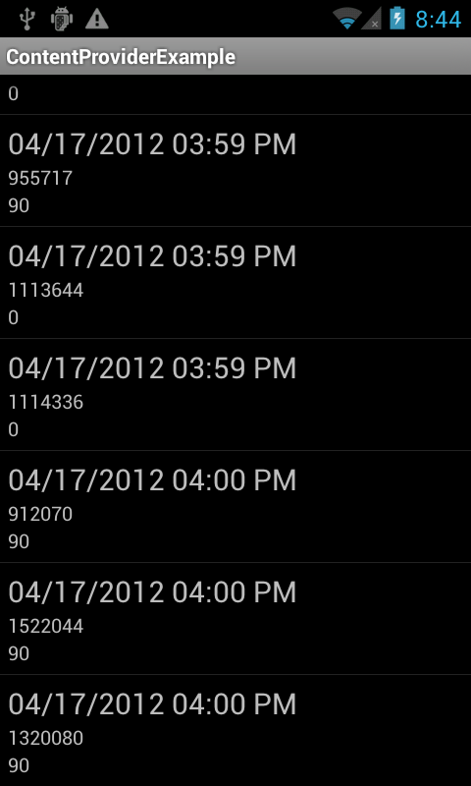
Results

Slide 21
Content Provider Capabilities
Possible to update, insert, and delete data via a ContentProvider
insert, update, and delete methods part of ContentResolver class
important to guard against malicious input from user
sql statements
http://developer.android.com/guide/topics/providers/content-provider-basics.html#Injection

Slide 22
Creating ContentProvider
It is possible to implement a ContentProvider for your app
You may need / want to provide a ContentProvider if:
You want to offer complex data or files to other applications.
You want to allow users to copy complex data from your app into other apps.
You want to provide custom search suggestions using the search framework.
Not normally necessary

Slide 23


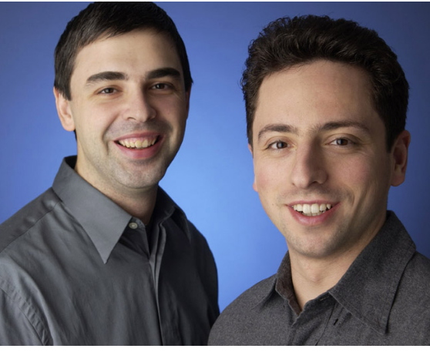

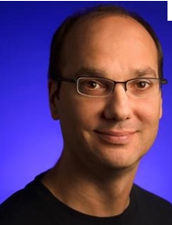
Bonus - Oracle v. Google

Slide 24
Summary and Timeline
Oracle is suing Google for its use of Java in the Android operating system
brief timeline from pc world
August 2005 -- Google buys Android Inc. Soon after, it discusses the possibility of licensing Java from Sun.
October 2005 -- Andy Rubin, the head of Google's Android division, writes in an email that Google can either adopt Microsoft's C# for Android or "do Java anyway and defend our decision, perhaps making enemies along the way." Over the next several months, Google and Sun continue to negotiate for a Java license but fail to reach a deal.
February 2006 -- Sun supposedly offers Google a three-year Java license for US$20 million plus 10 percent of Google's Android-related revenue, capped at $25 million. Google rejects the offer.

Slide 25
TimeLine Continued
November 2007 -- Google announces publicly that it is developing Android, which includes a Java-compatible virtual machine called Dalvik.
October 2008 -- HTC releases the first Android phone, the HTC Dream.
January 2010 -- Oracle acquires Sun and inherits its Java patents and copyrights.
July 2010 -- Oracle meets with Google's lawyers to discuss Oracle's patent infringement allegations.
Aug. 6, 2010 -- Rubin receives an email from a Google engineer stating that the alternatives to Java "all suck" and that "we need to negotiate a license for Java under the terms we need."
Aug. 12, 2010 -- Oracle files a lawsuit against Google, accusing it of infringing seven Java patents and its Java copyrights. Google denies any wrongdoing and calls the lawsuit a "baseless attack" on Google and open-source developers.

Slide 26
Timeline Continued
January 2011 -- Android accounts for one-third of all smartphone sales, Canalys says.
February 2011 -- Google asks the U.S. Patent and Trademark Office to reexamine Oracle's patents, arguing they shouldn't have been issued. By the time the trial starts, only two of the seven patents remain in the suit.
June 2011 -- A court filing reveals that Oracle is seeking between $1.4 billion and $6.1 billion in damages.
July 2011 -- A judge rules that Oracle "overreached" with its damages estimate and tells it to recalculate.

Slide 27
Timeline Continued
September 2011 -- The CEOs of Oracle and Google, Larry Ellison and Larry Page, are ordered to hold settlement talks but can't reach agreement.
November 2011 -- Android accounts for more than 50 percent of smartphone sales, Gartner says.
March 2012 -- The two sides are ordered to hold more settlement talks but still can't reach a deal.
April 2012 -- An eight-week jury trial is scheduled to begin Monday, April 16, at the U.S. District Court in San Francisco.

Slide 28
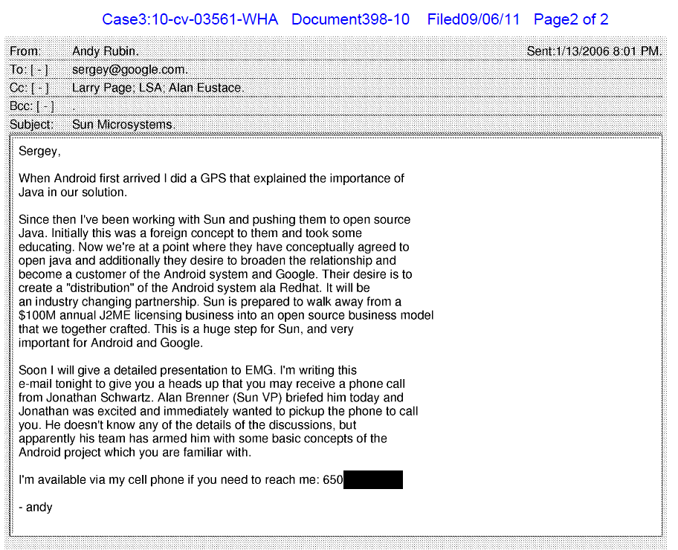
Some of Oracle's Evidence

Slide 29
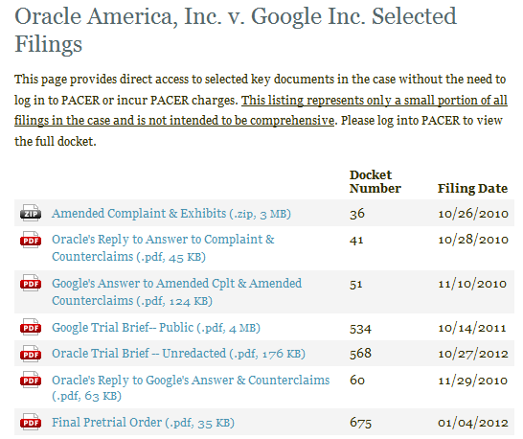
Court Briefs
http://cand.uscourts.gov/wha/oraclevgoogle/docs

Slide 30
Court Briefs
The Introduction and Overview portions are good summaries of the positions
read over the summaries provided

