Slide 1
CS378 - Mobile Computing
Services and Broadcast Receivers

Slide 2
Services
One of the four primary application components:
activities
content providers
services
broadcast receivers

Slide 3
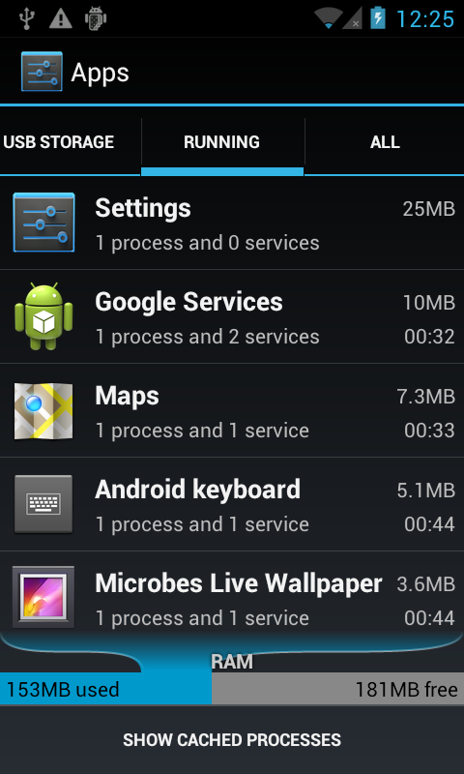
Services
Application component that performs long-running operations in background with no UI
application starts service and service continues to run even if original application ended or user moves to another application

Slide 4
Forms of Services
Stated:
application component, such as an Activity, starts the service with the method call startService()
once started service can run in background indefinitely
generally services do not return a result (see bound service)
service should stop itself when done

Slide 5
Forms of Services
Bound
application component binds itself to existing service via the bindService() method
bound service provides client-server interface that allows application component to interact with service
interact with service, send requests, get result via IPC (inter process communication
service runs as long as one or more applications bound to it
destroyed when no applications bound

Slide 6
Forms of Services
Service can be started and later bound to other applications
private service (manifest) cannot be bound by other applications

Slide 7
Service or Thread
Past examples, kept UI thread responsive with other threads of execution, especially AsyncTask
Should services be used for this?
Service for actions that need to take place even if user not interacting with UI or has closed application
Example, do complex rendering of image to display to user.
Not a job for a service

Slide 8
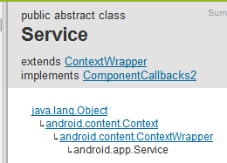
Creating a Service
create subclass of Android Service class or one of its existing subclasses
override callback methods that handle important aspects of service lifecycle
most important of these are:
onStartCommand
startService
onBind
onCreate
onDestroy
stopSelf
stopService

Slide 9
Service Lifecycle
If component starts service with startService method (leads to call to onStartCommand) service runs until it calls stopSelf or another activity calls stopService
if component calls bindService (onStartCommand no called) service runs as long as at least one component bound to it

Slide 10
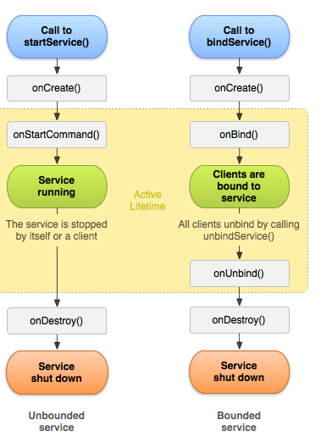
Service Lifecycle

Slide 11
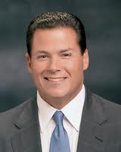
Service Example
From Roger Wallace
wanted an app that would respond to texts (SMS) received when driving and respond with a message ("Driving - Get back to you soon.")
Initial version simply auto responds to all texts
how to change it so it responds only when driving?

Slide 12
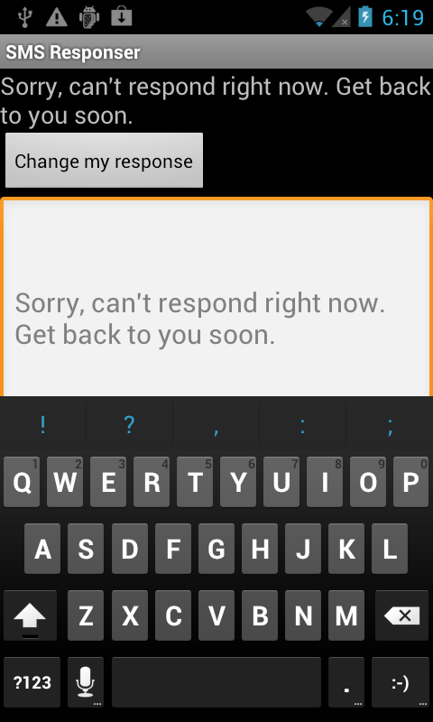
Example Service Application
From The Android Developer's Cookbook
SMSResponder Application
Response stored in shared preferences
App simply allows changes to message

Slide 13

Using SMS
Permission in manifest file to send and / or receive SMS messages

Slide 14
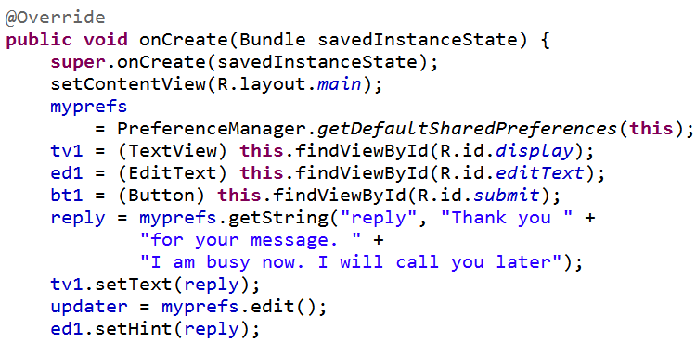
ResponseSMS Basic App
All work done in onCreate method

Slide 15
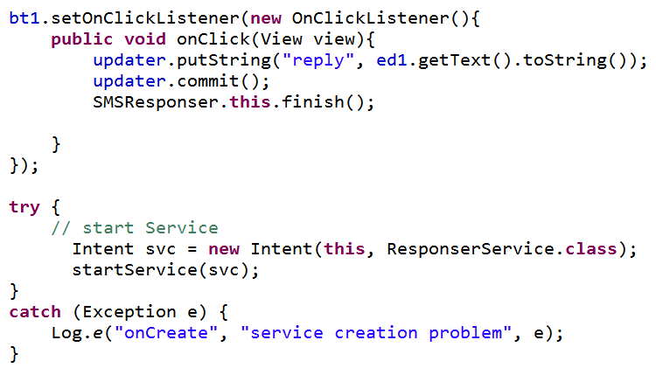
ResponseSMS onCreate

Slide 16
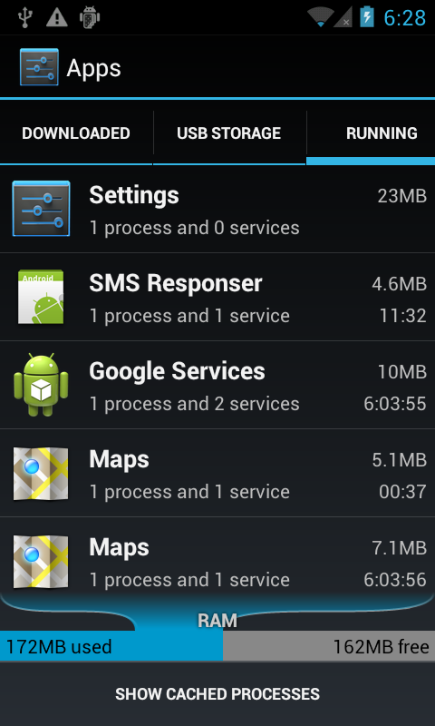
Service Running
app still running, and service has started

Slide 17
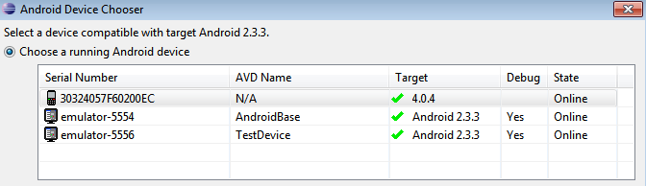
Simulating Texts
Calls and texts can be simulated between emulators
Start two emulators
Use messaging app to send text
Phone number is simply the emulator port number (visible at top of the emulator or in eclipse)

Slide 18
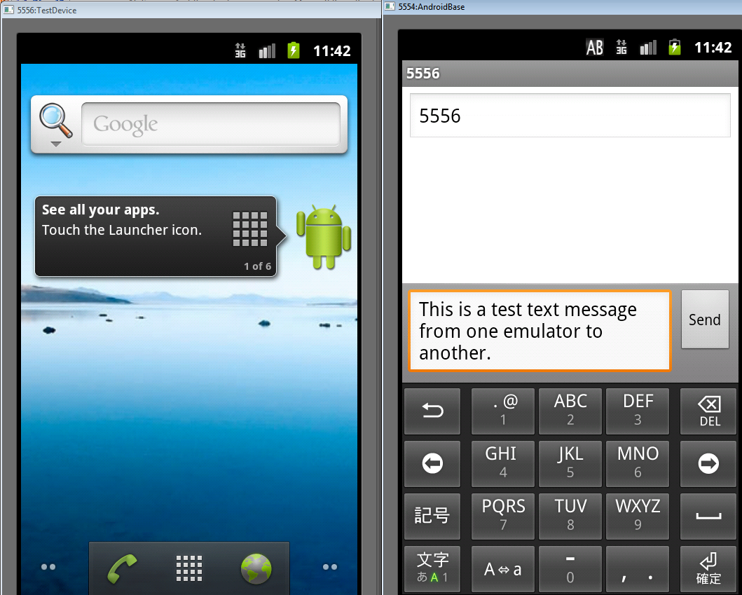
Dual Emulators

Slide 19
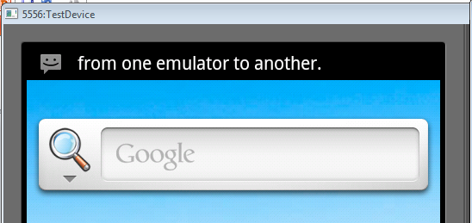
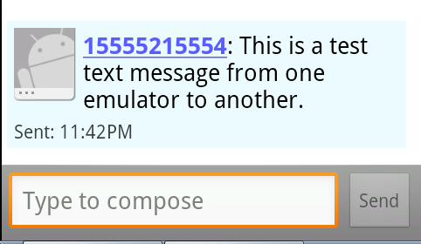
Emulator Texts

Slide 20
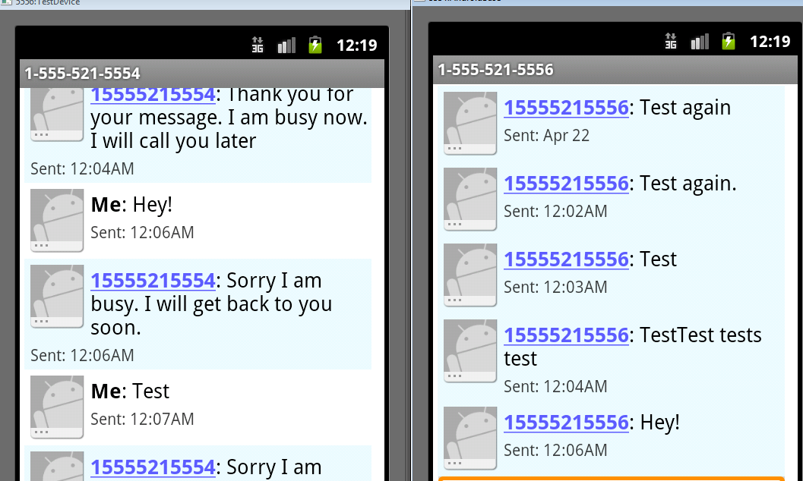
Testing Service

Slide 21
Creating a Service
Extend the Service class
adapter class exists, IntentService that handles a lot of the details
override onStartCommand
return an int describing what system should do for starting service
START_NOT_STICKY, if system kills service don't restart
START_STICKY, if system kills service then recreate, but does not redeliver intent
START_REDELIVER_INTENT, if system kills service then recreate and redeliver last intent

Slide 22
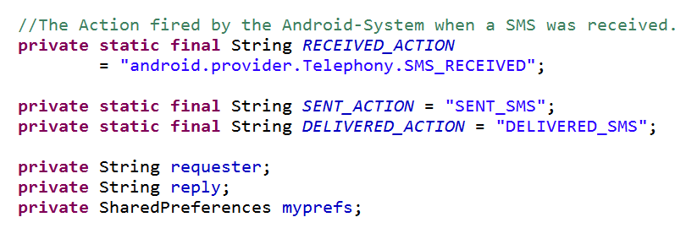
SMS Responder

Slide 23
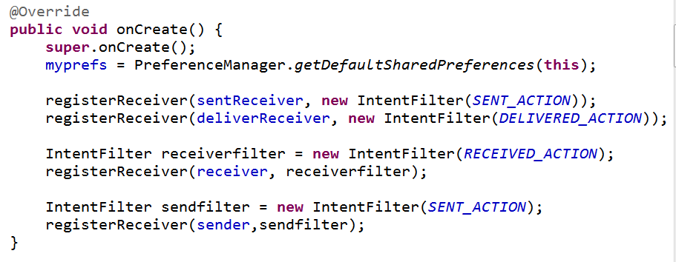
SMS Responder - onCreate

Slide 24
Broadcast Receivers
The fourth main application component
"A broadcast receiver is a component that responds to system-wide broadcast announcements."
Android system sends multiple kinds of broadcasts
screen turned off, battery low, picture captured, SMS received, SMS sent

Slide 25
Broadcast Receivers
Applications can initiate broadcasts to inform other applications of status or readiness
Don't display UI
may create status bar notifications
Usually just a gateway to other components and does very minimal work
initiate service to perform based on some event
Broadcasts are delivered as Intents

Slide 26
Broadcast Receivers
receive intents sent by sendBroadcast() method
LocalBroadcastManager to send Broadcasts within your application only
In SMS responder register receivers
unregister when service destroyed
key point: override the onReceive method for BroadcastReceiver subclass

Slide 27
BroadcastReceivers
What broadcasts are available?
Check the Intent class
http://developer.android.com/reference/android/content/Intent.html
search for "Broadcast Action"
Also look in android-sdk\platforms\<number>\data\ broadcast_actions.txt

Slide 28
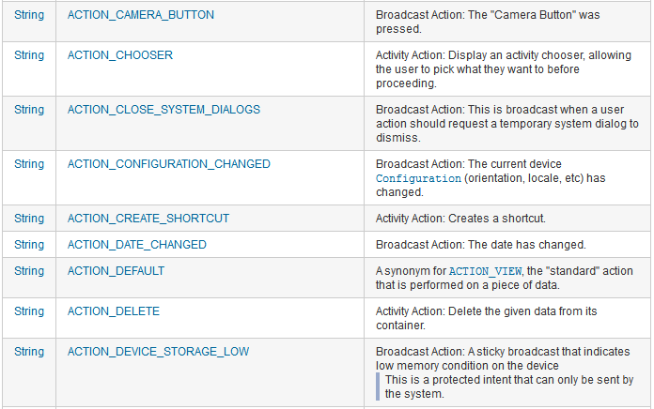
Broadcasts

Slide 29
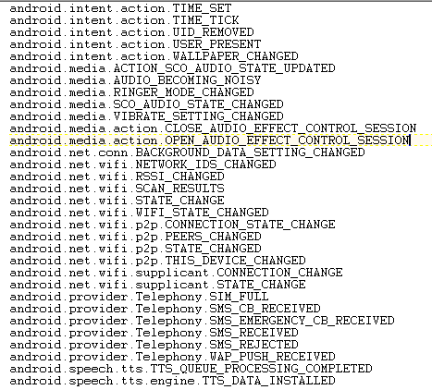
Broadcasts
from broadcast_ actions.txt in sdk files
platforms-> <api level>-> data\

Slide 30
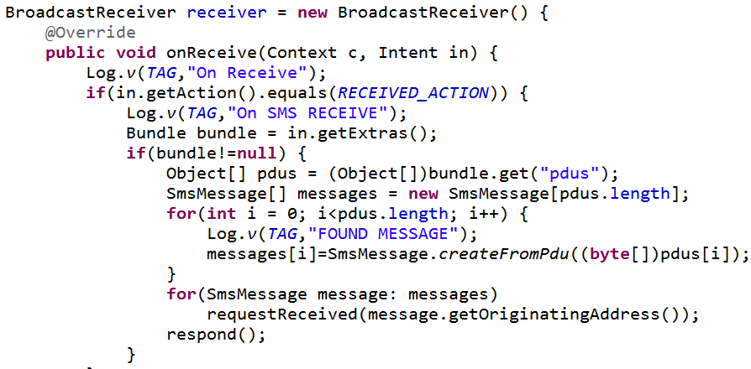
SMS Received - Broadcast Receiver

Slide 31
SMS Data
The SMS data in the Bundle (map) is under the key "pdus"
pdu, protocol data unit (some sources indicate protocol description unit)

Slide 32
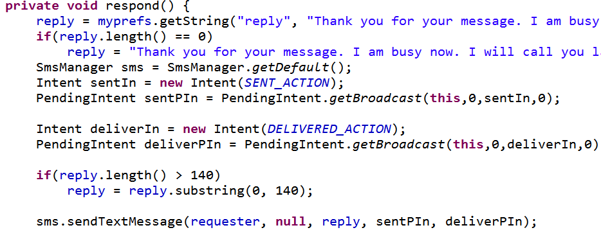
respond method
incoming SMS messages trigger respond method

Slide 33
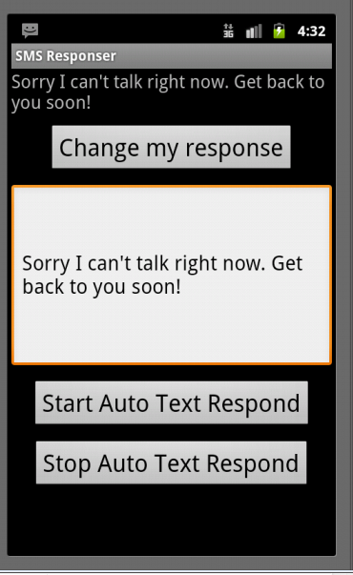
Stopping Service
Once started service runs until device shut down
Starts again when app started again
Add option to start and shut down the service

Slide 34
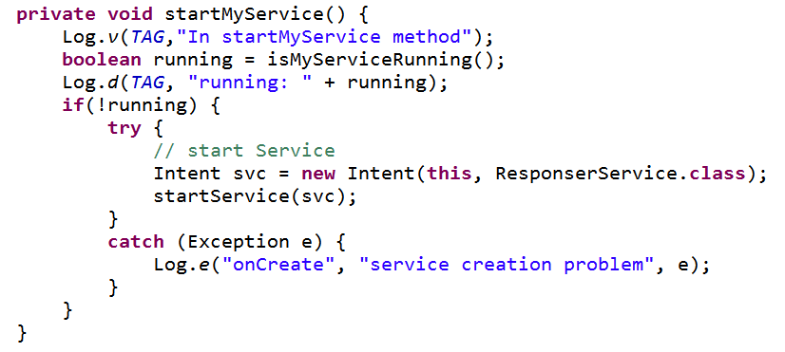
Starting Service

Slide 35
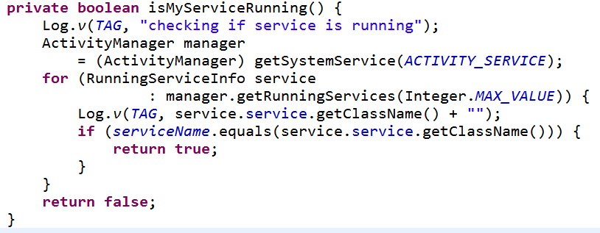
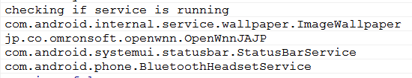
Checking Running Processes

