Slide 1
CS378 - Mobile Computing
What's Next?

Slide 2
Fragments
Added in Android 3.0, a release aimed at tablets
A fragment is a portion of the UI in an Activity
multiple fragments can be combined into multi-paned UI
fragments can be used in multiple activities

Slide 3
Fragments
Part of an activity
directly affected by Activities lifecycle
Fragments can be swapped into and out of activities without stopping the activity
On a handset one with limited screen space, common for app to switch from one activity to another
with a larger screen swap fragments in and out

Slide 4
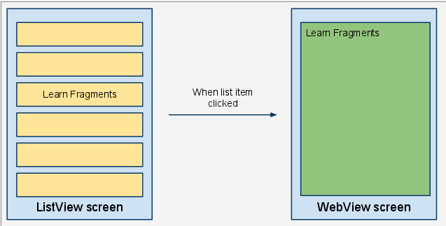
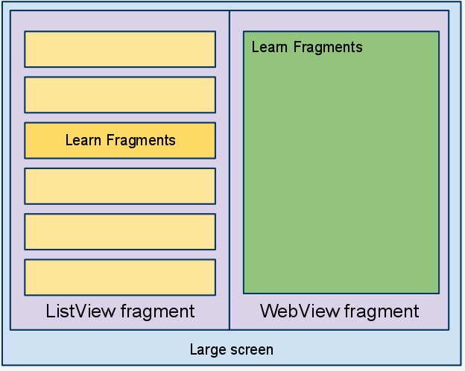
Fragments
old
new

Slide 5
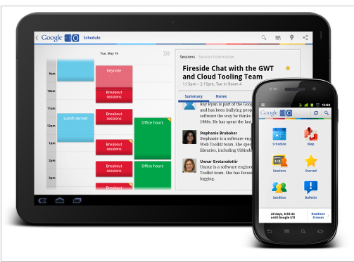
Fragments

Slide 6
Status Bar Notifications

Slide 7
Status Bar Notifications
Status Bar Notifications add an icon to the system's status bar
can add a ticker-text message with icon
and add a message in the notifications window
When user selects the notification Intent created which can start an Activity
can also alert user with sound, vibration, and /or flashing lights on device

Slide 8

Status Bar Notifications
Used when background service needs to alert user to an event that requires response
design: background service should never launch an activity on its own

Slide 9
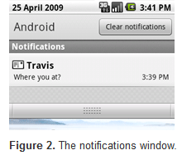
Status Bar Notifications
Advice for Notifications
use for time sensitive events
… that involve other people
don't create notifications for events not directed at user
don't create notification for Activity that is active

Slide 10
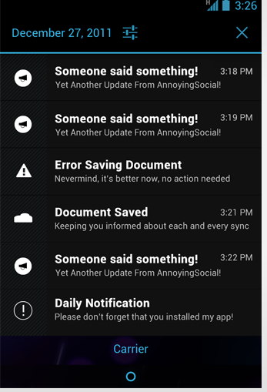
Notifications Window
Bad Notifications
Don't create notifications for low level technical details
Don't create notifications for errors that user can't fix or if app can recover on its own
Don't create notifications for services user can't start and stop
P

Slide 11
copy and paste

Slide 12
Copy and Paste
clipboard based framework
simple and complex data types can be copied and pasted
text strings, complex data structures, text and binary stream data
Simple text stored on clipboard
complex data handled via content providers

Slide 13
Copy and Paste
to copy and paste:
data placed in clip object, clip object placed on system-wide clipboard
clip object can be:
text, a simple String
URI for copying complex data from a content provider
Intents to copy application shortcuts
only one clip on clipboard at a time

Slide 14
Copy and Paste
An app can support some or all of the data types
Examine data on clipboard and decide if user should have option to paste it
may not make sense to allow pasting of URI / content provider data or Intents

Slide 15
Widgets

Slide 16
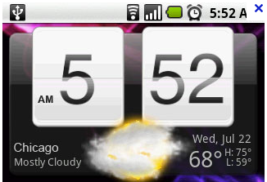
Widgets
Referred to as an App Widget
widgets are miniature application views than can be added to other applications
normally the Home Screen View
other "App Widget Hosts"
Widget sent periodic updates
Widgets essentially a BroadcastRecevier with XML layout

Slide 17
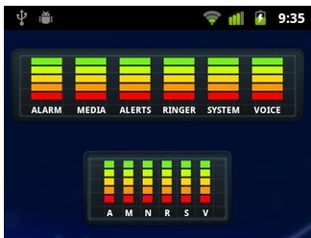
Widgets
To create App Widget:
Create a AppWidgetProviderInfo
object that contains metadata for the App Widget, layout, update frequency
normally defined in XML
Implement AppWidgetProvider class that defines basic methods to update Widget
create layout: not all layouts and UI widgets supported

Slide 18
wi-fi Direct

Slide 19
Wi-Fi Direct
Added in ICS, Android 4.0 API level 14
allows devices with appropriate hardware to connect directly via Wi-Fi with no intermediate access point
discover and connect to other devices
much larger range than Bluetooth
Useful for applications that share data among users
multi player game, photo sharing

Slide 20
Wi-Fi Direct
WifiP2pManager class provides methods to discover, request, and connect to peers
Various Listeners that provide information on success or failure of method calls from WifiP2pManager
Intents notify application of events detected by Wi-Fi direct framework such as newly discovered peer
implement broadcast receiver for intents from Android system about Wifi Direct

Slide 21
gestures

Slide 22
Gestures
Standard gestures handled via the GestureDetector class
touch event
double tap
long press
fling
scroll

Slide 23
Complex Gestures
Non standard gestures required lots of code to rezognize
Android 1.6 introduced new APIs to store, load, draw, and recognize gestures
Gesture Builder app on emulator
emulator must include virtual SD card
allows creating set of gestures for your ppliaction

Slide 24
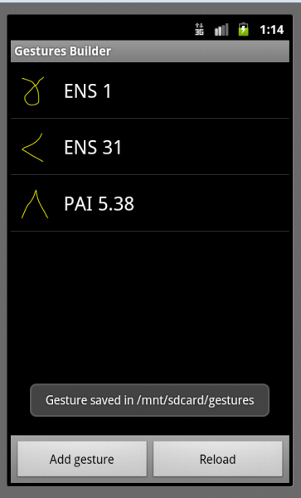
Complex Gestures
Each gesture associated with name
multiple gestures can have same name
variations on same gesture, better chance of recognizing
Move gestures from emulator to application res/raw folder

Slide 25
Complex Gestures
Recognizing gestures via a GestureOverlayView
simple drawing board on top of view that shows and records user gestures
When gesture complete GestureLibrary queried to see if gesture is recognized
Predictions between entered gesture and those in the library

Slide 26
And Still More!
Bluetooth
Near Field Communication
Live Wallpapers
Remote Storage
USB devices (recall radar detector, heart rate monitors)
Audio Capture, Speech Recognition

