Slide 1
CS378 - Mobile Computing
Class Intro

Slide 2
Teaching Staff
Mike Scott
Lecturer (not a professor, no PhD, so "Mike" please)
At UT since 2000
scottm@cs.utexas.edu
lab hours MW 3 - 4:30, F 12 - 4 Microlab / PAI 5.68
TA: Nathan Clement
nathanlclement@gmail.com

Slide 3

The Course
Mobile computing with focus on application development for the Android operating system
Second iteration
Advise against taking if you have ever created an Android App on your own
Large project, self selected project with 2 - 3 students

Slide 4
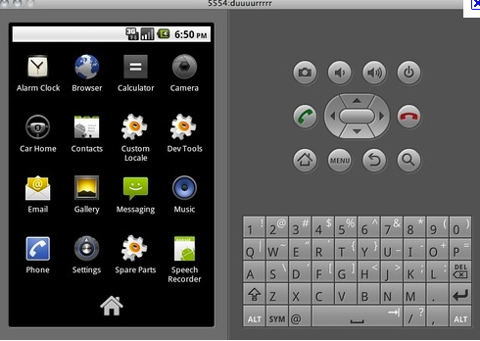
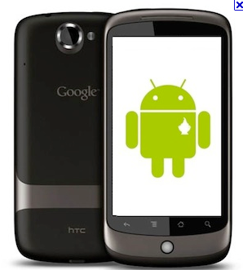
NDR = No Device Required
Android application development in Java using Eclipse plug in
Emulator part of development environment
limitations
dev phones available during lab times and check out
wireless access only

Slide 5
Work Products
Tutorials
step by step guide to creating small applications
Individual assignments
mostly written
Project
design and implement an app and publish it on the Android Market
broken into various milestones
2 - 3 students per project
Point break down on syllabus

Slide 6
Class Materials
Syllabus, Schedule, and Resource Page
www.cs.utexas.edu/~scottm/cs378
Assignments, tutorials, grades on Blackboard
Discussion group on Piazza
Microlab Windows machines have development environment
Tutorial 1 - setting up dev environment on your own machine and using dev env

Slide 7
Course Material
Working in a system. (Not just a stand alone application)
Use library / API
GPS and Sensing
User Interfaces and XML
Graphics and Events
Services and Content Providers
data bases / SQLite

Slide 8
Questions???

