Slide 1
CS378 - Mobile Computing
User Interface Basics

Slide 2
User Interface Elements
View
Control
ViewGroup
Layout
Widget (Compound Control)
Many pre built Views
Button, CheckBox, RadioButton
TextView, EditText, ListView
Can be customized by extending and overriding onDraw()

Slide 3
XML UI Configuration
Layouts can specify UI elements (provided and custom)
res/layout
"Design by Declaration"

Slide 4
Layouts
Layouts are subclasses of ViewGroup
FrameLayout
simplest type of layout object
fill with a single object (such as a picture) that can be switched in and out
child elements pinned to top left corner of screen and cannot be move
adding a new element / child draws over the last one

Slide 5
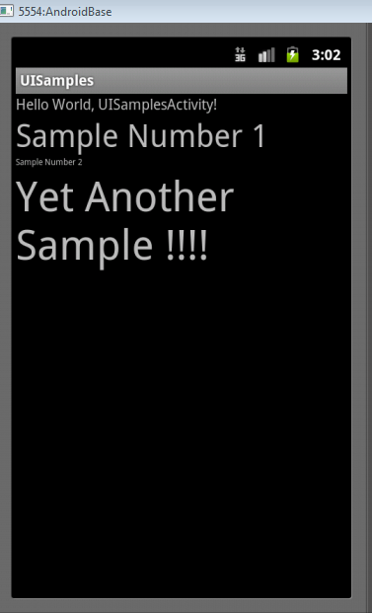
LinearLayout
aligns child elements (such as buttons, edit text boxes, pictures, etc.) in a single direction
orientation attribute defines direction:
android:orientation="vertical"

Slide 6
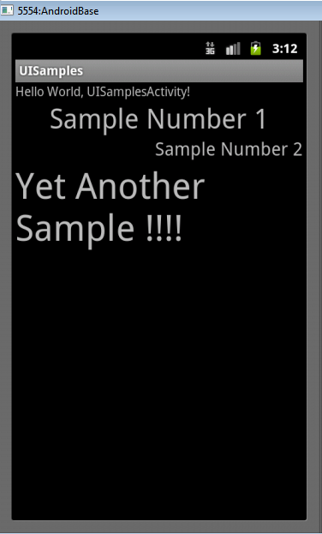
Gravity
Child element's gravity attribute
where to position in the outer container
center
right

Slide 7
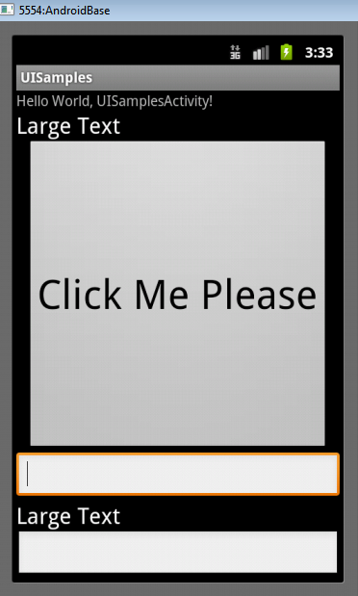
Weight
layout_weight attribute
"importance" of a view
default = 0
if set > 0 takes up more of parent space
BTW, scale emulator Run -> Run Configurations -> target -> command line options "-scale 0.7

Slide 8
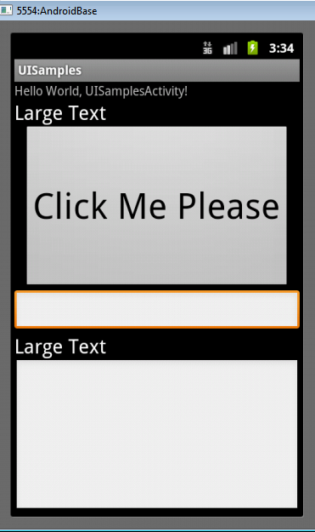
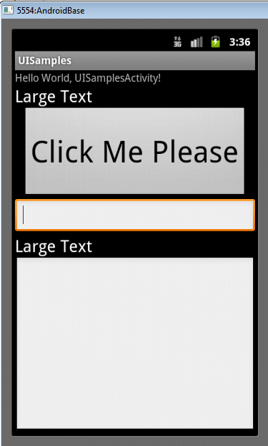
Another Weight Examples
button and bottom edit text weight of 2
button weight 1 and bottom edit text weight of 2

Slide 9
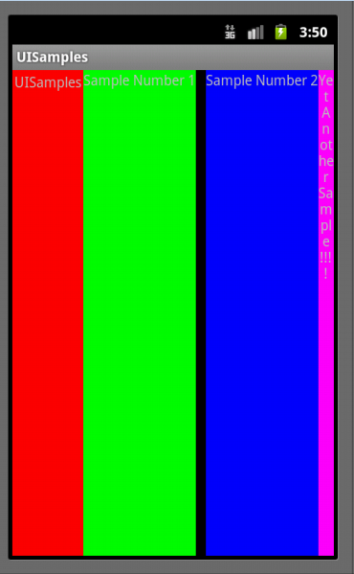
LinearLayout - Horizontal Orientation
padding
background color
margins

Slide 10
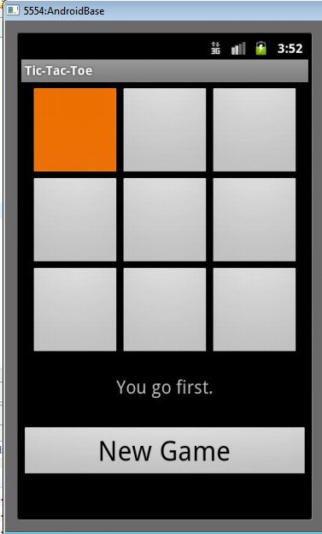
TableLayout
rows and columns
rows normally TableRows
TableRows contain other elements such as buttons, text, etc.

Slide 11
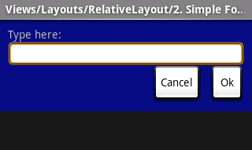
RelativeLayout
children specify position relative to parent or to each other (specified by ID)
First element listed is placed in "center"
other elements placed based on position to other elements

Slide 12
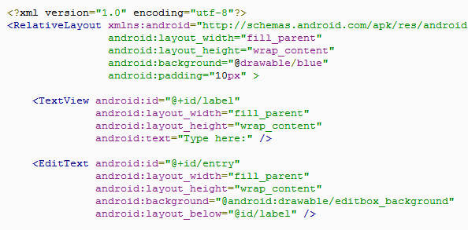
RelativeLayout XML

Slide 13
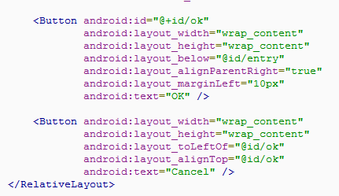
RelativeLayout XML

Slide 14
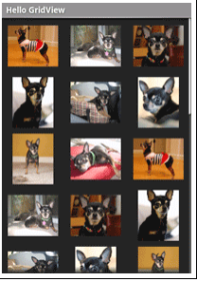
Other Layouts - GridView
Two Dimensional Scrollable Grid
Items inserted into layout via a ListAdapter

Slide 15

Other Layouts - TabLayout
Uses a TabHost and TabWidget
Swap between views in same activity or switch between different activities

Slide 16
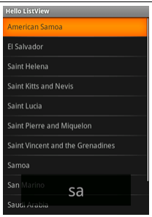
Other Layouts - ListView
Creates a list of scrollable items
Items added via a ListAdapter as in GridView

Slide 17
Other Views - Layouts
Gallery
horizontal scrolling display of images from a list
SurfaceView
provide access to a "drawing" surface. Intended to draw pixels, not display other views / widgets

Slide 18
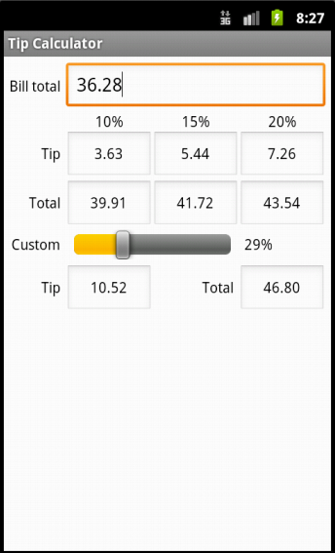
Concrete Example
Tip Calculator
What kind of layout to use?
Widgets:
TextView
EditText
SeekBar

Slide 19
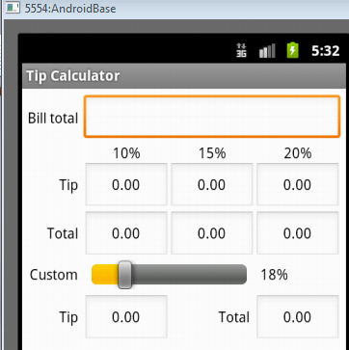
TextViews

Slide 20
EditText
All but top EditText are
uneditable
Alternative?
TextViews?

Slide 21
SeekBar

Slide 22
Layout
TableLayout
row 0
row 1
row 2
row 3
row 4
row 5

Slide 23
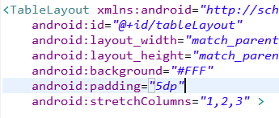
Layout Attributes
android:background
#RGB, #ARGB, #RRGGBB, #AARRGGBB
can place colors in res/values/colors.xml

Slide 24
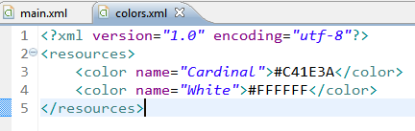

Color Resources
Good Resource / W3C colors
http://tinyurl.com/6py9huk

Slide 25
StretchColumns
columns 0 indexed
columns 1, 2, 3 stretch to fill layout width
column 0 wide as widest element, plus any padding for that element

Slide 26
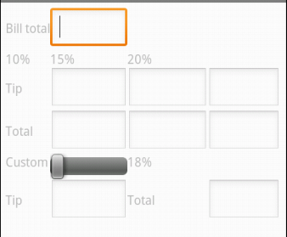
Initial UI
Done via some Drag and Drop, Outline view, and editing XML
Demo outline view
properties

Slide 27

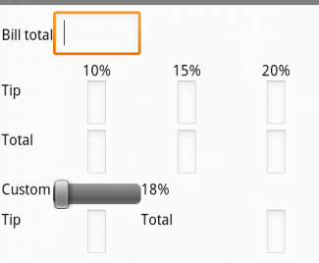
Changes to UI
Outline multiple select properties
all TextViews' textColor set to black #000000
change column for %DD labels
use center gravity for components

Slide 28
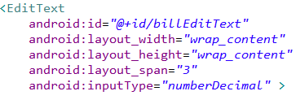
Changes to UI
change bill total and seekbar to span more columns
gravity and padding for text in column 0
align text with seekBar
set seekBar progress to 18
set seekBar focusable to false - keep keyboard on screen

Slide 29
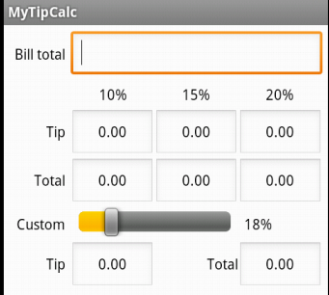
Changes to UI
Prevent Editing in EditText
focusable, long clickable, and cursor visible properties to false
Set text in EditText to 0.00
Change weights to 1 to spread out

Slide 30
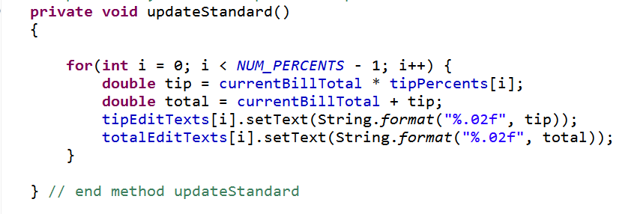
Functionality
onCreate instance variables assigned to components found via ids
update standard percents:

Slide 31
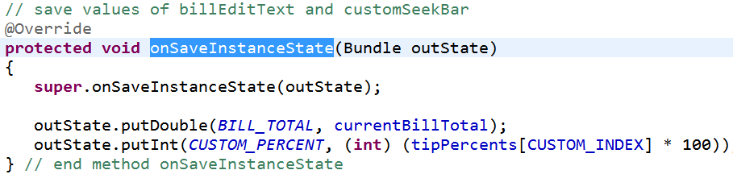
Functionality - Saving State
onSaveInstance
save BillTotal and CustomPercent to the Bundle
check for these in onCreate

Slide 32

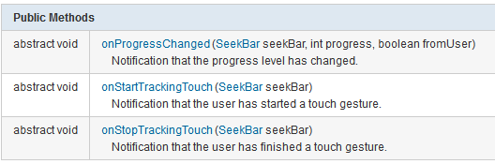
Functionality Responding to SeekBar
customSeekBarListener instance variable
Of type OnSeekBarChangeListener

Slide 33
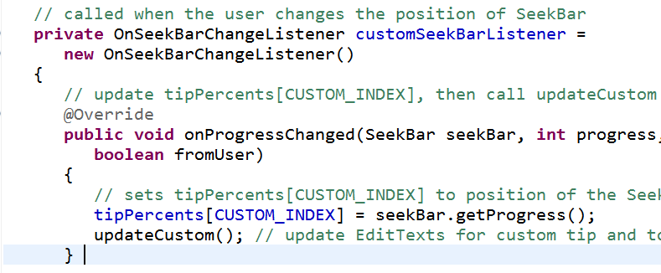
Create an Anonymous Inner Class
Class notified when seek bar changed and program updates custom tip and total amount
must register with the seekBar instance variable in onCreate!

Slide 34

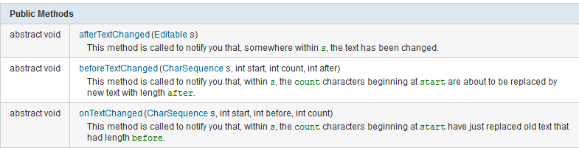
Functionality - Total EditText
Another anonymous inner class
implement onTextChanged to convert s to double and call update methods
register with EditText for total in onCreate()!

