Slide 1
CS378 - Mobile Computing
More UI - Part 2

Slide 2
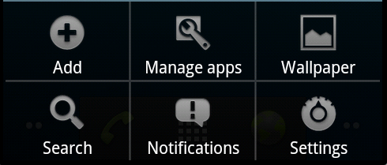
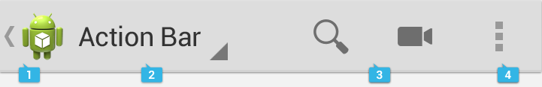
Special Menus
Two special application menus
options menu
context menu
Options menu replaced by action bar (API 11)
menu
action bar

Slide 3
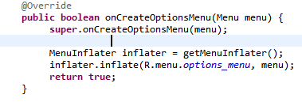
OptionsMenu
User presses Menu Button
Activities onCreateOptionsMenu method is called
In example options_menu.xml in res/menu folder

Slide 4

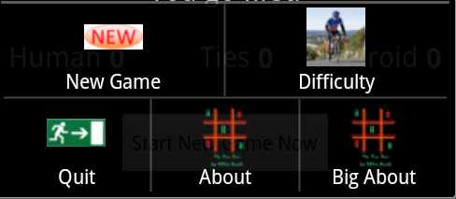
OptionsMenu
Alternate creation of OptionsMenu
add item to menu programmatically
chained method calls

Slide 5
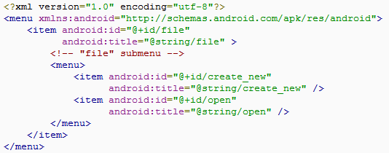
SubMenus
Option on Menu may be creation of a SubMenu
In XML nest menu inside menu or programmatically by adding SubMenus to Menu in onCreateOptionsMenu method

Slide 6
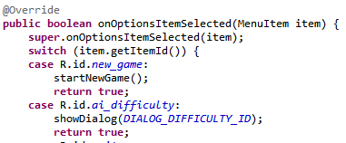
Menu Options Selected
if Menu Option is another Activity it is launched when Menu button pressed
The Big About in previous example
For other items
onOptionsItemSelected(MenuItem item)

Slide 7
Action Bar

Slide 8
ActionBar
Introduced in Android 3.0
Honeycomb, tablet only
4.0, Ice Cream Sandwich, tablet and phones
"The action bar is a window feature that identifies the application and user location, and provides user actions and navigation modes"
http://developer.android.com/guide/topics/ui/actionbar.html

Slide 9

Purpose of ActionBar
identification
navigation
actions
Navigation Tabs
Overflow Menu
Action Item
Icon / Logo

Slide 10
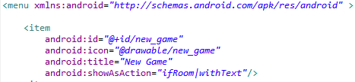
ActionBar
ActionBar items declared in menu.xml

Slide 11
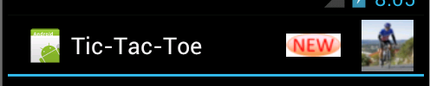
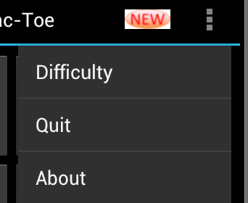

ActionBar
If menu items declared in xml, added to menu in order they appear
Extra items brought up with menu button

Slide 12
Navigation Tabs
Used to switch between fragments
http://developer.android.com/guide/topics/fundamentals/fragments.html

Slide 13
ContextMenu
pre 3.0, aka Floating Menus
subtype of Menu
display when a long press is performed on a View
Activity is a descendant of View
Activity may be broken up into multiple views
implement onCreateContextMenu method
must call registerForContextMenu method and pass View

Slide 14
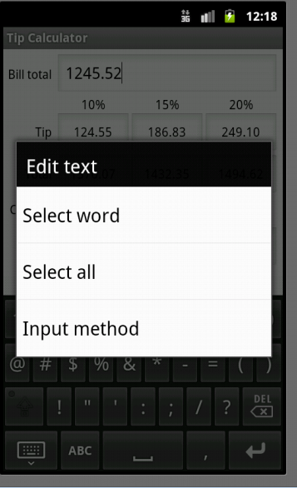
ContextMenu
From Tip Calculator
Long press on total amount EditText
Default behavior for EditText
Nothing added in TipCalculator to create this

Slide 15

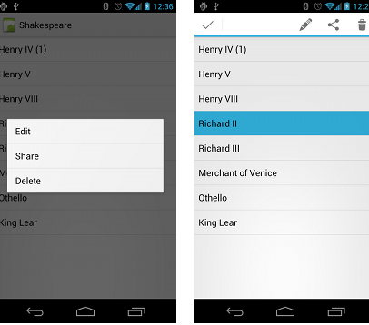
Contextual Action Mode
3.0 and later
http://developer.android.com/guide/topics/ui/menus.html#CAB

Slide 16
styles

Slide 17
Styles
Defined in XML file
res/values/style
similar to a cascading style sheet as used in html
group layout attributes in a style and apply to various View objects (TextView, EditText, Button)

Slide 18
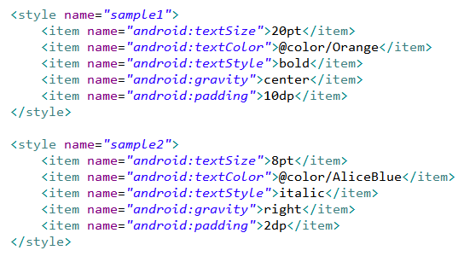
Sample Styles, in styles.xml

Slide 19
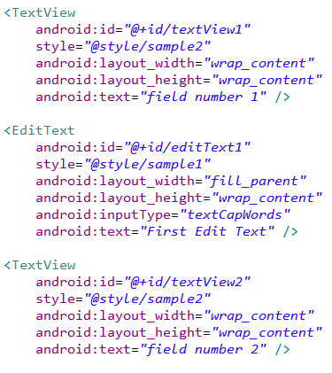
Apply Style - in main xml

Slide 20
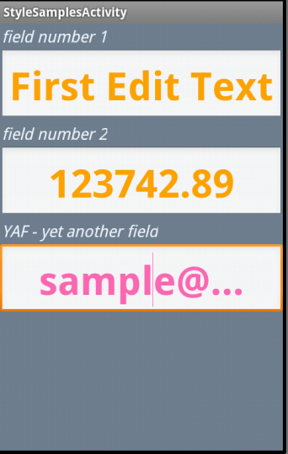
Result of Styles
can override elements of style
bottom edit text overrides color
one style can inherit from another
use UI editor to create view and then extract to style

Slide 21
Gestures

Slide 22
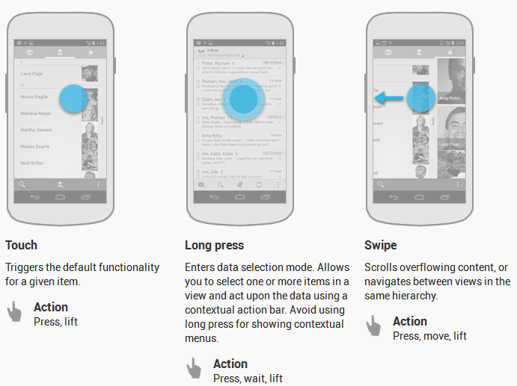
Common Gestures

Slide 23
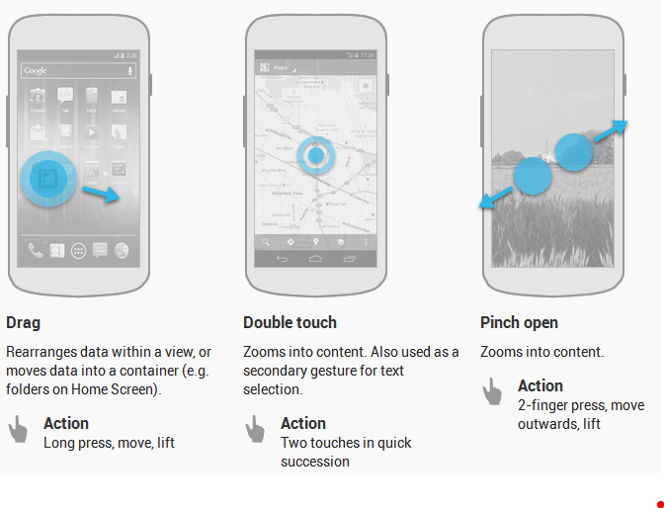
Common Gestures
http://developer.android.com/design/patterns/gestures.html

Slide 24
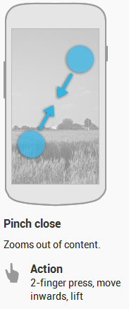
Common Gestures
Fling or flick gesture: similar to swipe or drag
scroll/swipe/drag
user presses then moves finger in s steady motion before lifting finger
fling or flick
user presses then moves finger in an accelerating motion before lifting

Slide 25
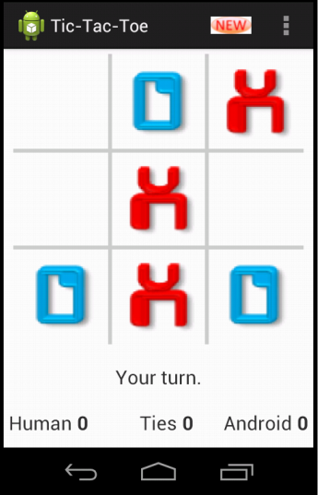
Dealing With Gestures
To handle simple touch events create View.OnTouchListener for view
Example from tutorial, screen press leads to player moving if it is their turn and they touch an open square

Slide 26
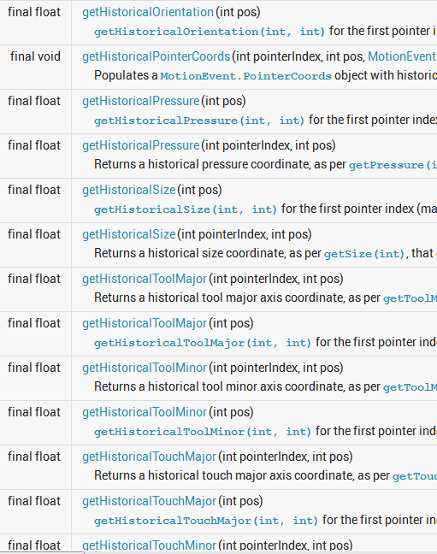
onTouchEvent
passed a MotionEvent object with a large amount of data
in tic tac toe tutorial you only used location of event (x and y)

Slide 27
Handling Common Gestures
Instead of trying to decode gestures from the MotionEvent passed to on touch …
Use the GestureDetector class
Add a GestureDetector object to View
override View.onTouhcEvent method to pass MotionEvent on to the GestureDetector.onTouchEvent method

Slide 28
Handling Common Gestures
create a GestureDetector.OnGestureListener (seveal gestures) or a GestureDetector.SimpleOnGestureListener (more gestures) and register it with the GesturerDetector
callback methods for onDoubleTap, onLongPress, onScroll, onFling, onSingleTapConfirmed, many more

Slide 29
Complex Gestures
Non standard gestures required lots of code to recognize
Android 1.6 introduced new APIs to store, load, draw, and recognize gestures
Gesture Builder app on emulator
emulator must include virtual SD card
allows creating set of gestures for your ppliaction

Slide 30
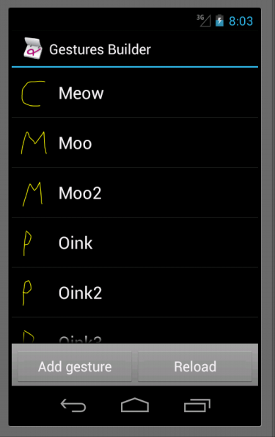
Complex Gestures
Each gesture associated with name
multiple gestures can have same name
variations on same gesture, better chance of recognizing
Move gestures from emulator to application res/raw folder

Slide 31
Complex Gestures
Recognizing gestures via a GestureOverlayView
simple drawing board on top of view that shows and records user gestures
When gesture complete GestureLibrary queried to see if gesture is recognized
Predictions between entered gesture and those in the library

Slide 32
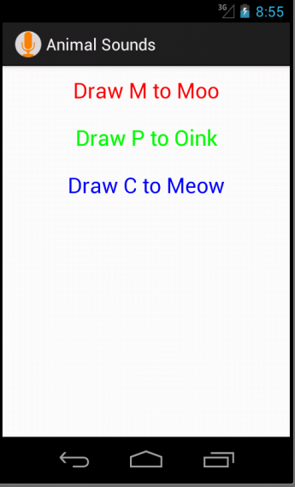
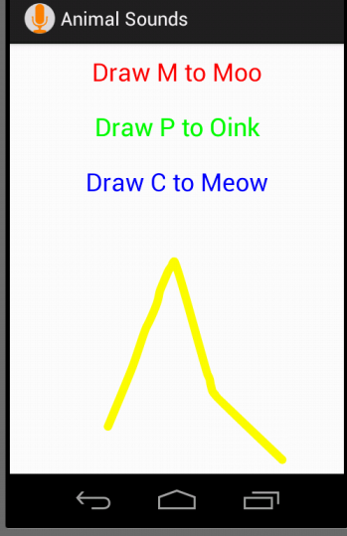
Animal Sounds App

Slide 33
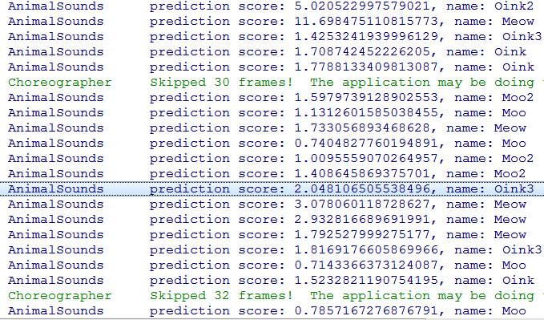
Predictions

Slide 34
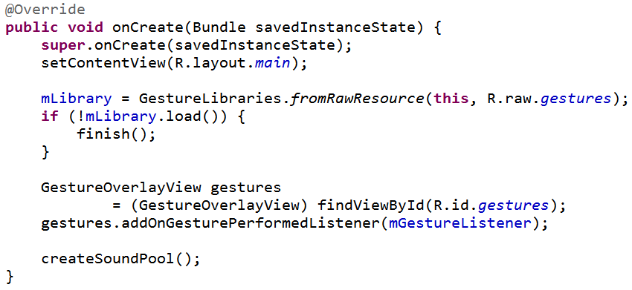
onCreate

Slide 35
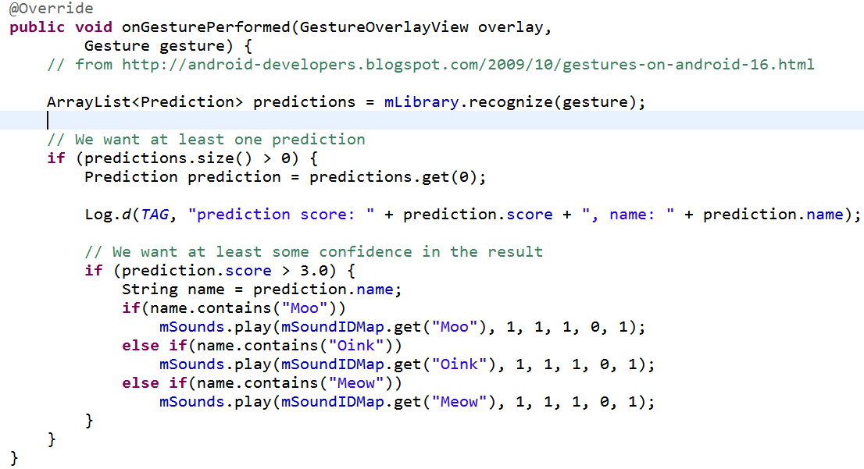
Listener

