Slide 1
CS378 - Mobile Computing
More UI

Slide 2
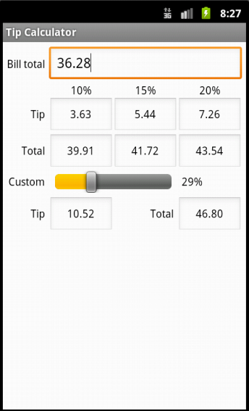
Concrete Example
Tip Calculator
What kind of layout to use?
Widgets:
TextView
EditText
SeekBar

Slide 3
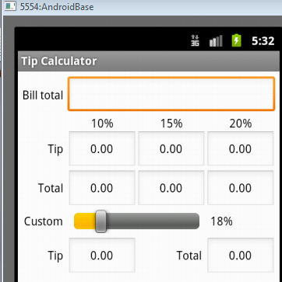
TextViews

Slide 4
EditText
All but top EditText are
uneditable
Alternative?
TextViews?

Slide 5
SeekBar

Slide 6
Layout
TableLayout
row 0
row 1
row 2
row 3
row 4
row 5

Slide 7
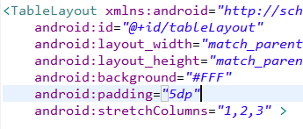
Layout Attributes
android:background
#RGB, #ARGB, #RRGGBB, #AARRGGBB
can place colors in res/values/colors.xml

Slide 8
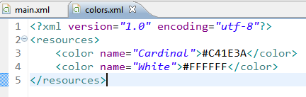

Color Resources
Good Resource / W3C colors
http://tinyurl.com/6py9huk

Slide 9
StretchColumns
columns 0 indexed
columns 1, 2, 3 stretch to fill layout width
column 0 wide as widest element, plus any padding for that element

Slide 10
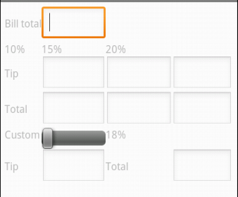
Initial UI
Done via some Drag and Drop, Outline view, and editing XML
Demo outline view
properties

Slide 11

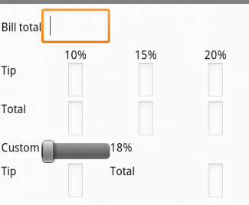
Changes to UI
Outline multiple select properties
all TextViews' textColor set to black #000000
change column for %DD labels
use center gravity for components

Slide 12
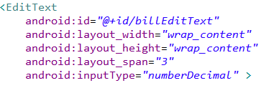
Changes to UI
change bill total and seekbar to span more columns
gravity and padding for text in column 0
align text with seekBar
set seekBar progress to 18
set seekBar focusable to false - keep keyboard on screen

Slide 13
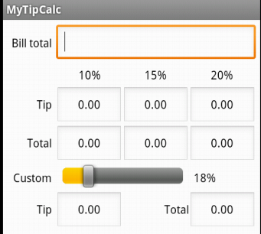
Changes to UI
Prevent Editing in EditText
focusable, long clickable, and cursor visible properties to false
Set text in EditText to 0.00
Change weights to 1 to spread out

Slide 14
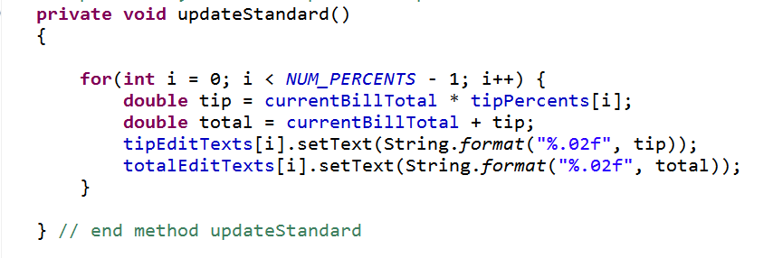
Functionality
onCreate instance variables assigned to components found via ids
update standard percents:

Slide 15
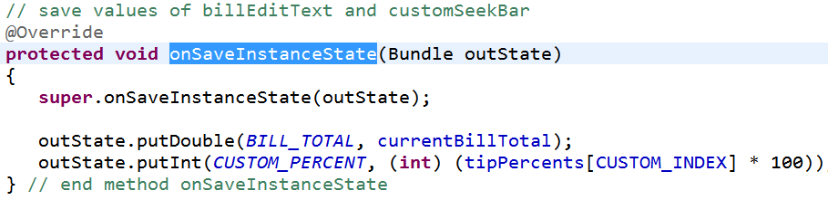
Functionality - Saving State
onSaveInstance
save BillTotal and CustomPercent to the Bundle
check for these in onCreate

Slide 16

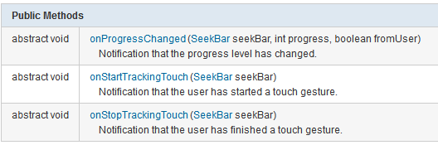
Functionality Responding to SeekBar
customSeekBarListener instance variable
Of type OnSeekBarChangeListener

Slide 17
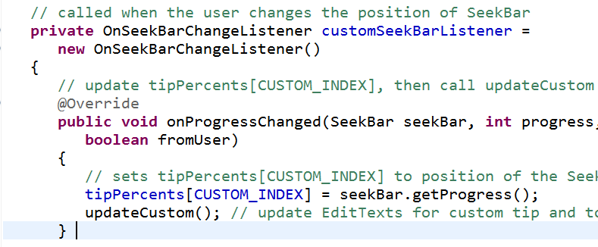
Create an Anonymous Inner Class
Class notified when seek bar changed and program updates custom tip and total amount
must register with the seekBar instance variable in onCreate.

Slide 18

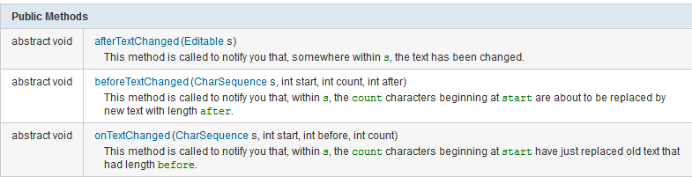
Functionality - Total EditText
Another anonymous inner class
implement onTextChanged to converts to double and call update methods
register with EditText for total in onCreate()!

Slide 19
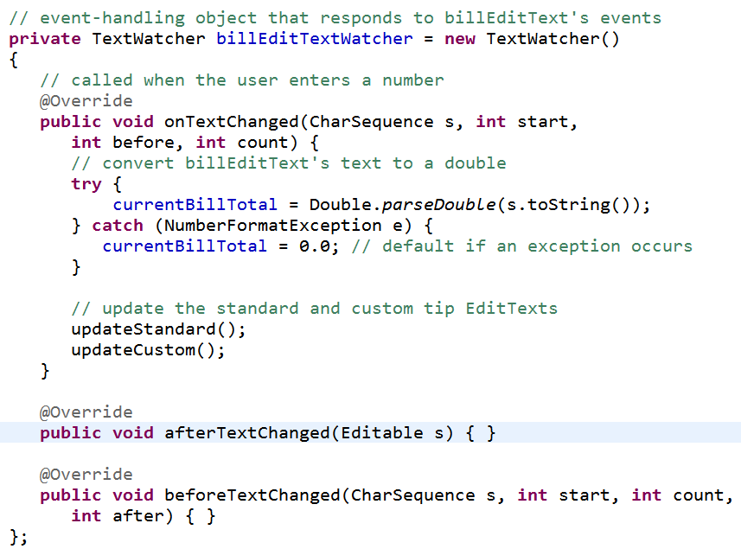

Slide 20
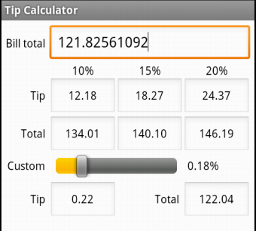
Constraining Input
EditText from tip calculator
input was numberDecimal
Use InputFilter to constrain input
Several built in filters such as AllCaps and LengthFilter

Slide 21
Custom Input Filter
InputFilter has one method:
public CharSequence filter( CharSequence source, int start, int end, Spanned dest, int dstart, int dend) {
replace dstart to dend in dest with new text, start to end of source

Slide 22

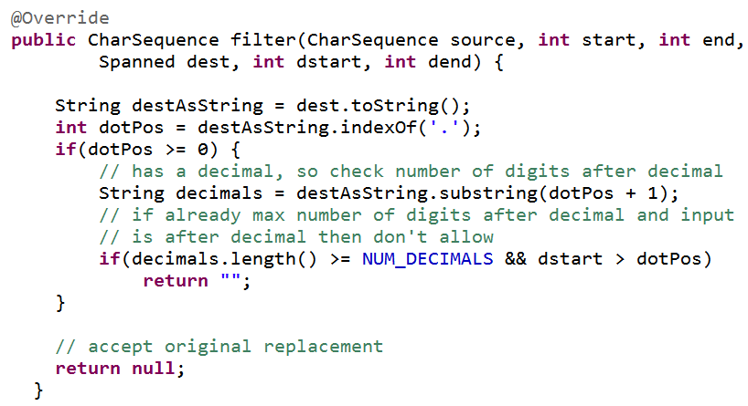

Slide 23
dialogs

Slide 24
Dialogs - Old Way
Dialogs from tutorials were cut and paste
Implementing Dialogs demonstrates evolution of Android SDK
legacy approach has Activity manage its own Dialogs
created, initialized, updated, and destroyed using Activity class call back methods

Slide 25
Dialogs - New Way
Android evolving from smartphone OS to smart device OS
API level 11 (Android 3.0, the tablet release) introduced Fragments
A fragment represents a behavior or a portion of a UI in an Activity
like a sub activity
multiple fragments combined in multi-pane UI
reuse fragments in multiple activities

Slide 26
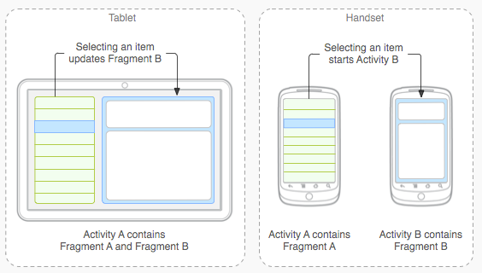
Fragments

Slide 27
Dialogs as Fragments
Dialogs are special type of Fragment
managed by the FragmentManager class
still part of an activity, but lifecycle not managed by the Activity
life cycle issues of Dialogs as Fragments will be more difficult to deal with
must save state and restore instance

Slide 28
Types of Dialogs
Used to organize information and react to user events without creating a whole new activity
Old Dialogs:
Dialog, AlertDialog, DatePickerDialog, TimePickerDialog, ProgressDialog
New Dialogs:
DialogFragment

Slide 29
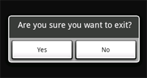

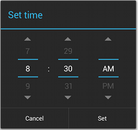
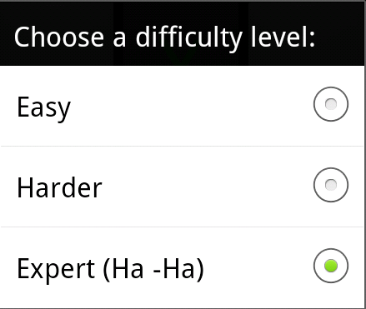
Sample Dialogs

Slide 30
Legacy Approach
Dialog defined in Activity it is used
Activity maintains a pool of Dialogs
showDialog() method displays Dialog
dismissDialog() method used to stop showing a Dialog
in tutorial, when we have difficulty
removeDialog removes from pool

Slide 31

Legacy Approach - Steps
Define unique indentifier for the Dialog in Activity (constants)
implement onCreateDialog method, returns Dialog of appropriate type

Slide 32
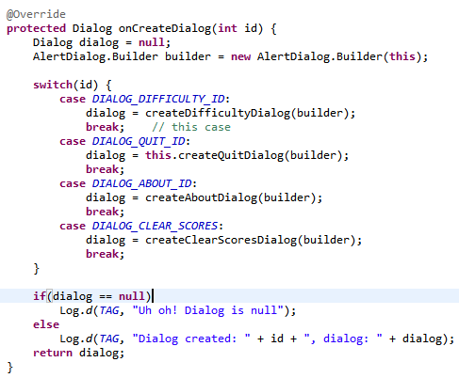
onCreateDialog

Slide 33
Dialog Steps - Legacy Approach
implement onPrepareDialog() if necessary
if necessary to update dialog each time it is displayed
for example, a time picker, update with the current time
launch dialog with showDialog()
in tutorials done when a menu or action bar menu item selected
could launch Dialogs for other reasons

Slide 34
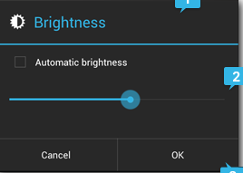
Alert Dialogs
Most common type
Title, Content Area, Action buttons (up to 3)
Content area could be message, list, seekbar, etc.
set positive, set negative, set neutral

Slide 35
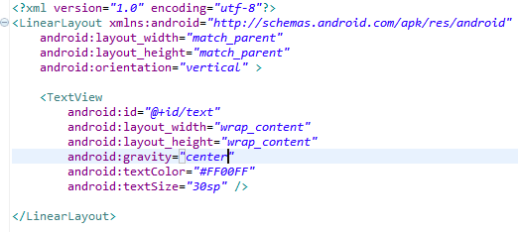
Custom Dialogs
AlertDialog very flexible, but you can create CustomDialogs
Create a layout

Slide 36
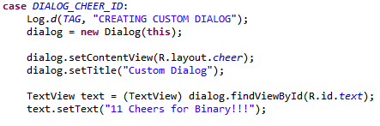
Custom Dialogs
from onCreateDialog

Slide 37
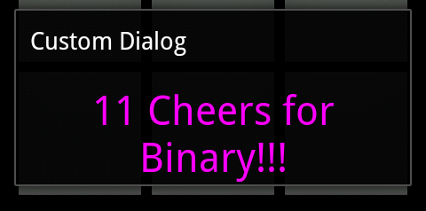
Custom Dialog
Simple dialogs are dismissed with the back button
dialog title

Slide 38
Dialogs - Fragment Method
Decouple Dialogs from the Activity
good SE approach?
TicTacToe UI is almost 500 lines long!
Implement a class that is a subclass of DialogFragment
DifficultyFragment
Send info to newInstance method (current difficulty, listener for updates)
onCreateDialog now in DifficultyFragment

Slide 39
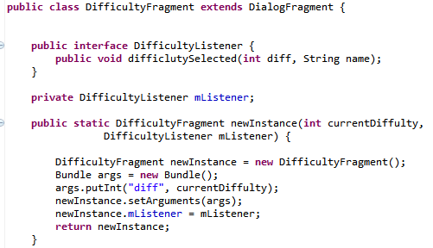
DifficultyFragment

Slide 40
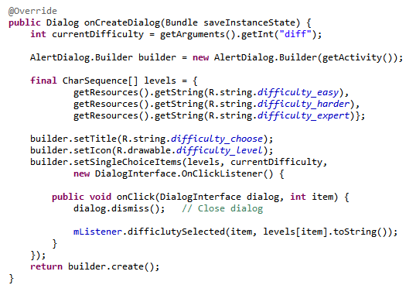
DifficultyFragment - onCreateDialog

Slide 41
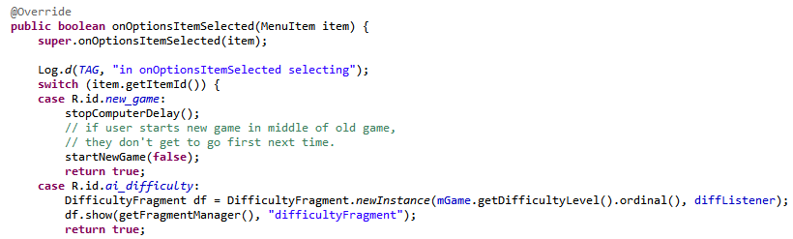
Using DifficultyFragment
In AndroidTicTacToe create a listener to pass to the newInstance method
create and show Dialog as part of onOptionsItemSelected()

Slide 42
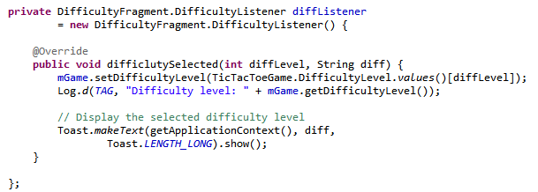
DifficultyListener

Slide 43
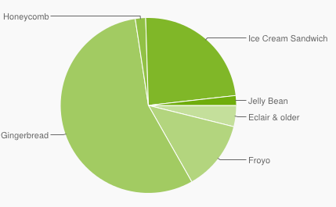
Using Fragments
Fragments added in API level 11, Android 3.0, the tablet release
Developers behind Android think fragments are so important that can be used in pre API 11 builds using the Android Support Library
Froyo and Gingerbread pre API 11

Slide 44
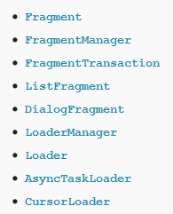
Android Support Library (ASL)
add library to project and application
android.support.v4.app.DialogFragment
for example
instead of android.app.DialogFragment
ASL does not support action bar in earlier versions of API

Slide 45
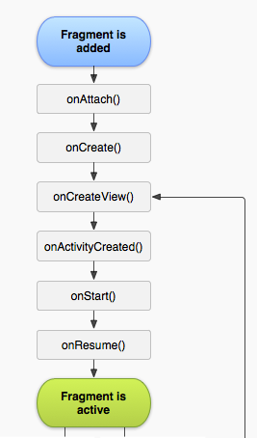
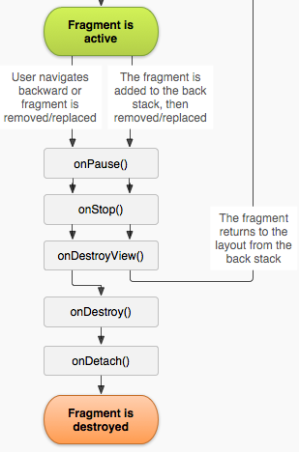
Fragment Lifecycle
Demo Tic Tac Toe with old style Dialog and Fragment Dialog
Alter orientation - result?
http://developer.android.com/guide/components/fragments.html

