Slide 1
CS378 - Mobile Computing
2D Graphics

Slide 2
Android Graphics
Does not use the Java awt or swing packages
Whole set of custom classes
Canvas: class that holds code for various "draw" methods
Paint: Controls the drawing. A whole host of properties. Similar to Java Graphics object
Bitmap: the things drawn on
Drawable: the thing to draw. (rectangles, images, lines, etc.)

Slide 3
Common Methods for Drawing
Two approaches
draw graphics or animations into a View object that is part of layout
define graphics that go into View
the simple way
Draw graphics directly to a Canvas
the complex way

Slide 4
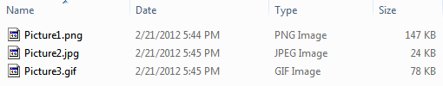
Simple Graphics
Use Drawables in Views
Create a folder res/drawable
Add images
png (preferred)
jpg (acceptable)
gif (discouraged)
Images can be added as background for Views

Slide 5
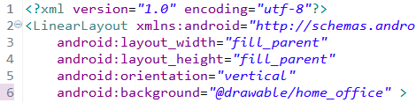
Simple Graphics
Change background to an image
previously used background colors

Slide 6

Top Ten With Image Background

Slide 7

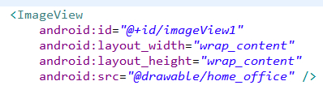
Add ImageView to Layout
In the main.xml for top ten

Slide 8

ImageView Attributes
scaleType: how image should be moved or resized in the ImageView
tint: affects color of image
more to position image in ImageView

Slide 9
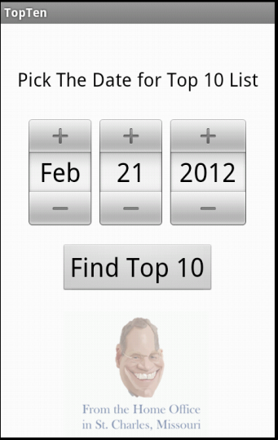
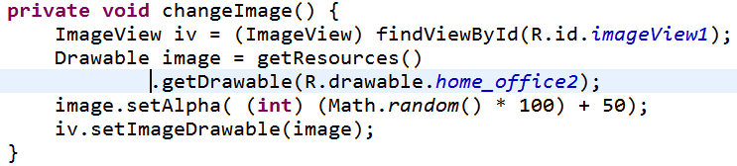
Changing ImageView Programmatically
Randomly set the alpha (transparency of the image)
Or pick an image randomly
Or set image based on month (Season)

Slide 10
Using a Canvas
Simple way -> Create a custom View and override the onDraw method
The Canvas is sent as a parameter
Create a class that extends View
override the 2 parameter constructor
override the onDraw method
perform custom drawing in the onDraw method
add the View to the proper layout

Slide 11
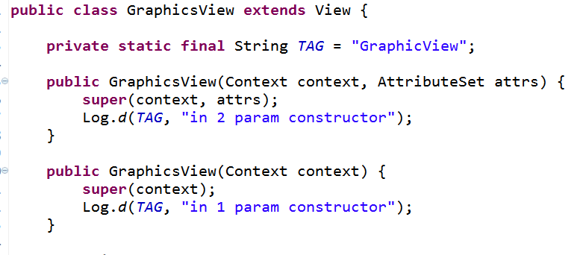
Simple Example - Graphics View

Slide 12
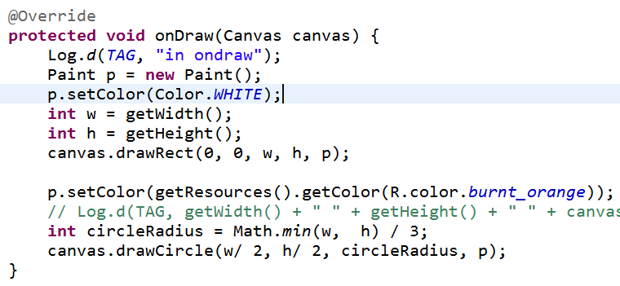
GraphicsView - onDraw

Slide 13
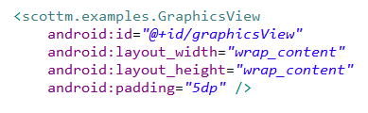
Add CustomView to XML
in main.xml
add custom View as last element in LinearLayout

Slide 14
Canvas Class
methods to draw
lines
arcs
paths
images
circles
ovals
points
text
and a few I missed

Slide 15
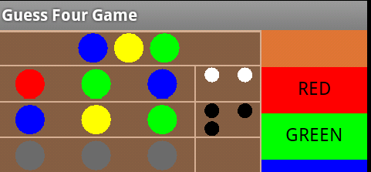
Paint
typically create Paint with anti aliasing
Paint p = new Paint(Paint.ANTI_ALIAS_FLAG);

Slide 16

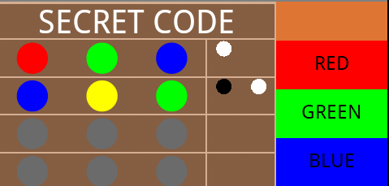

Anti Aliasing

Slide 17
Paint Object
many, many attributes and properties including:
current color to draw with
whether to fill or outline shapes
size of stroke when drawing
text attributes including size, style (e.g. underline, bold), alignment,
gradients

Slide 18
Gradients
3 kinds of gradients
LinearGradeint
RadialGradeint
SweepGradient
at least 2 color, but possibly more
flows from one color to another

Slide 19
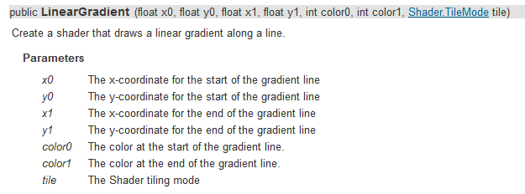
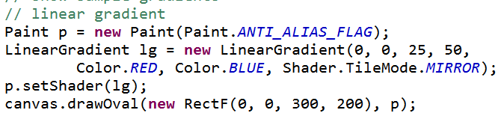
Linear Gradient

Slide 20
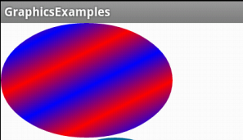
LinearGradient

Slide 21
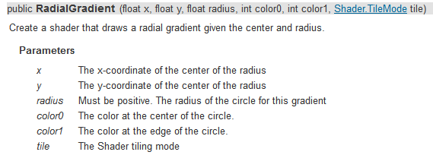
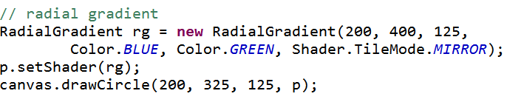
RadialGradient

Slide 22
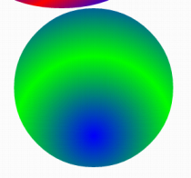
RadialGradient

Slide 23
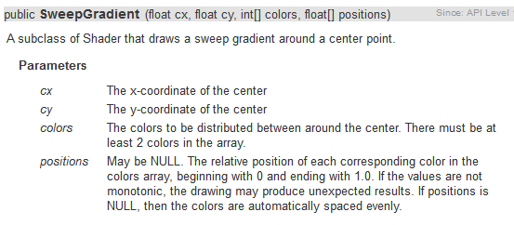
SweepGradient

Slide 24
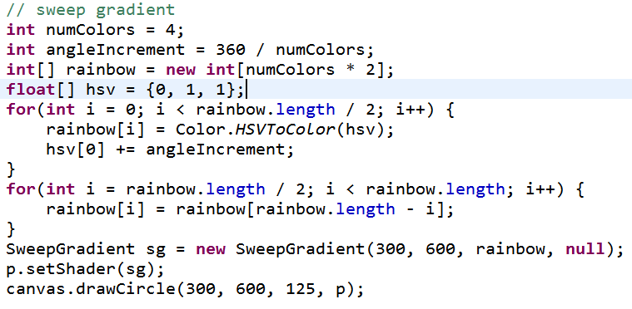
SweepGradient

Slide 25
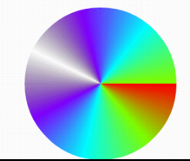
SweepGradient

Slide 26
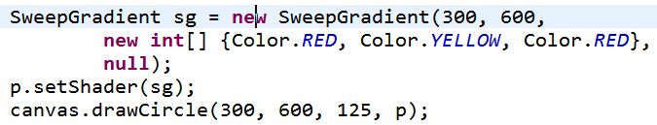
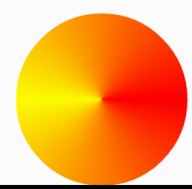
SweepGradient

Slide 27
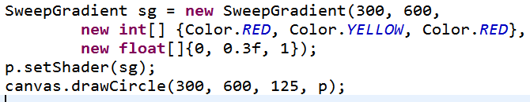
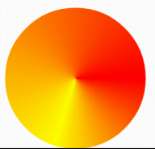
SweepGradient

Slide 28
GuessFour

Slide 29
Simple Animations
Tweened Animations
provide a way to perform simple animations on Views, Bitmaps, TextViews, Drawables
provide start point, end point, size, rotation, transparency, other properties
Can set up tweened animation in XML or programmatically

Slide 30
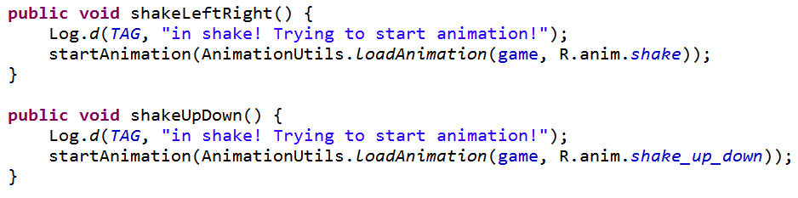
GuessFour Example
On error board shakes back and forth
On win board shakes up and down
From BoardView in GuessFour

Slide 31
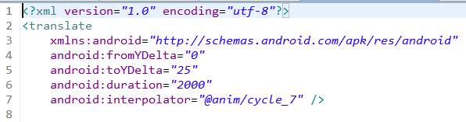
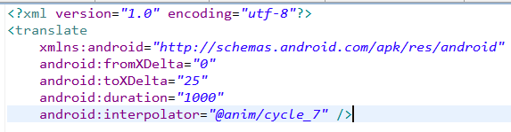
res/anim
shake up down
shake left right

Slide 32
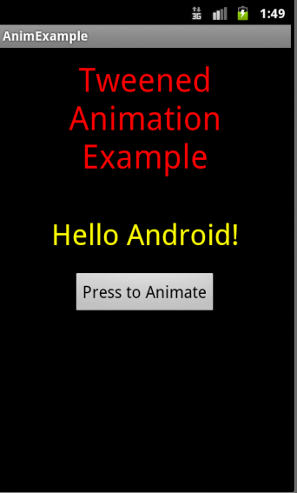
More Tweened Examples
hyperspace example from android dev site
rotate and change alpha
animation types:
alpha
scale
translate
rotate
http://developer.android.com/guide/topics/resources/animation-resource.html

Slide 33
More Complex Graphics
Don't want apps to become unresponsive
If complex graphics or animation use SurfaceView class
Main view not waiting on onDraw to finish
secondary thread with reference to SurfaceView
SrufaceView draws and when done display result

Slide 34
Using a SurfaceView
extend SurfaceView
implement SurfaceHolder.Callback
methods to notify main View when SurfaceView is created, changed or destroyed

Slide 35
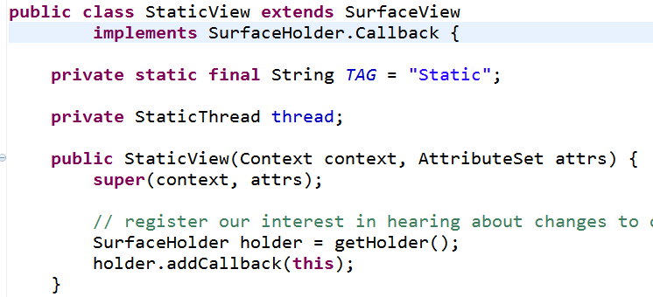
Simple Example
Static Screen
continuously draw several hundred small rectangles (points, with stroke = 10)
slowly fill screen and then keep changing

Slide 36
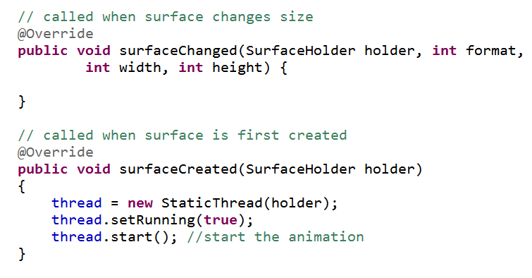
Implement SurfaceHolder.Callback methods

Slide 37
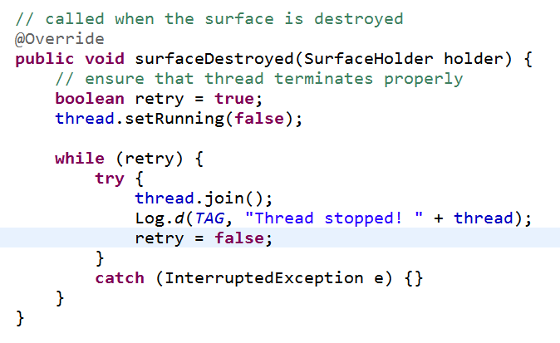
Prevent Runaway Threads!

Slide 38
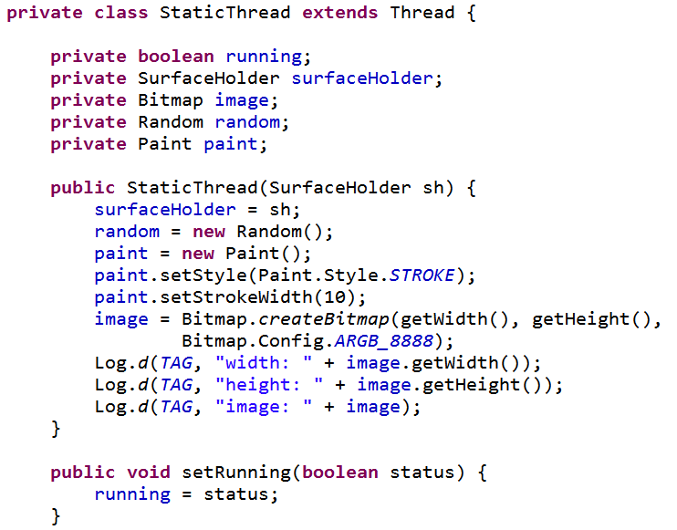
Inner Class for Thread

Slide 39
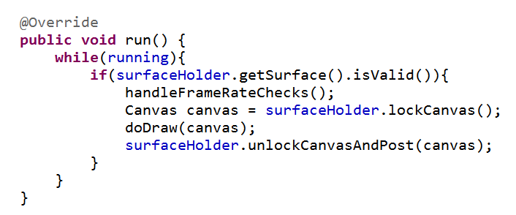
Run Method in StaticThread
Standard Approach for Drawing on SurfaceView

Slide 40
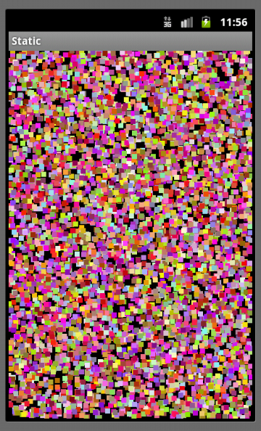
Demo run()
Pronounced flicker and jitter
Double buffer under the hood
We are drawing on two different Bitmaps
Canvas does drawing onto Bitmap

Slide 41
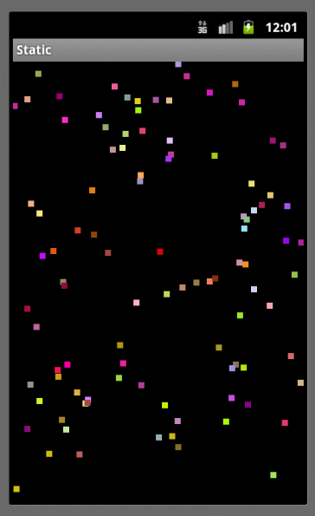
Remove Flicker / Jitter
If we draw background each "frame" then we don't redraw previous rectangles
How about "saving" all the data?
points, colors

Slide 42
Alternative
Recall two approaches:
draw on UI thread by overriding onDraw
create custom View (tutorial 4)
okay if not a lot of drawing
must keep UI thread responsive
complex drawing or animations using SurfaceView
Third approach, possible variation on the above two approaches
maintain a separate Bitmap

Slide 43
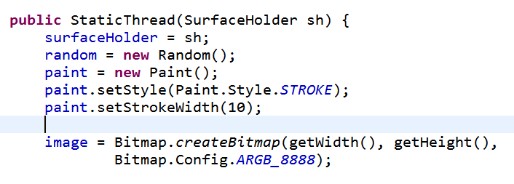
Separate Bitmap
StaticThread has a Bitmap instance var
Initialize in constructor

Slide 44
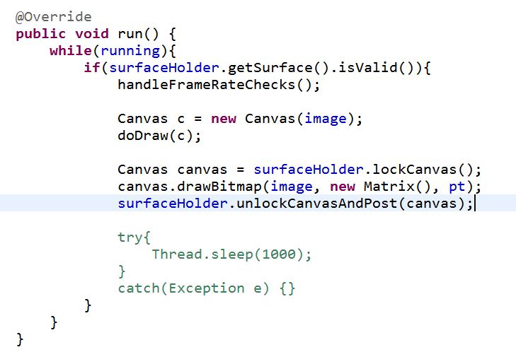
Updates to Bitmap
Create a
Canvas to draw on
the Bitmap
we are
saving
When done drawing to Bitmap use SurfaceView Canvas to draw

Slide 45
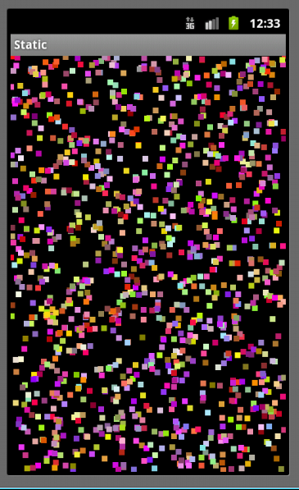
Demo Alt Version of run()
Flicker and jitter?
Also possible to save Bitmap to file for later use

Slide 46
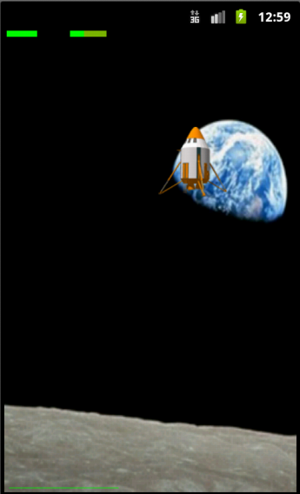
Animations
Frame based vs. Time based
Frame based:
update every frame
simple, but difference in frame rates
Time based
update every frame but based on time elapsed since last frame
more work, more accurate
sdk example lunar lander

Slide 47
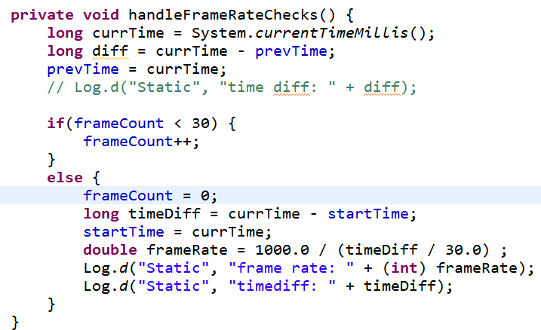
Checking Frame Rate
From StaticView
Emulator 6-7 fps, dev phone 40 -45 fps

Slide 48
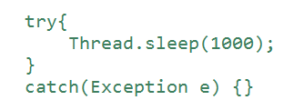
Controlling Frame Rate
Sleep after completing work in loop of run
More complex than shown, use previous time and current time

