Slide 1
CS378 - Mobile Computing
Intents

Slide 2
Intents
Allow us to use applications and components that are part of Android System
and allow other applications to use the components of the applications we create
Examples of Google applications: http://developer.android.com/guide/appendix/g-app-intents.html

Slide 3
Four Primary Application Components
Activity
single screen with a user interface, app may have several activities, subclass of Activity
Service
Application component that performs long-running operations in background with no UI
Content Providers
a bridge between applications to share data
Broadcast Receivers
component that responds to system wide announcements

Slide 4
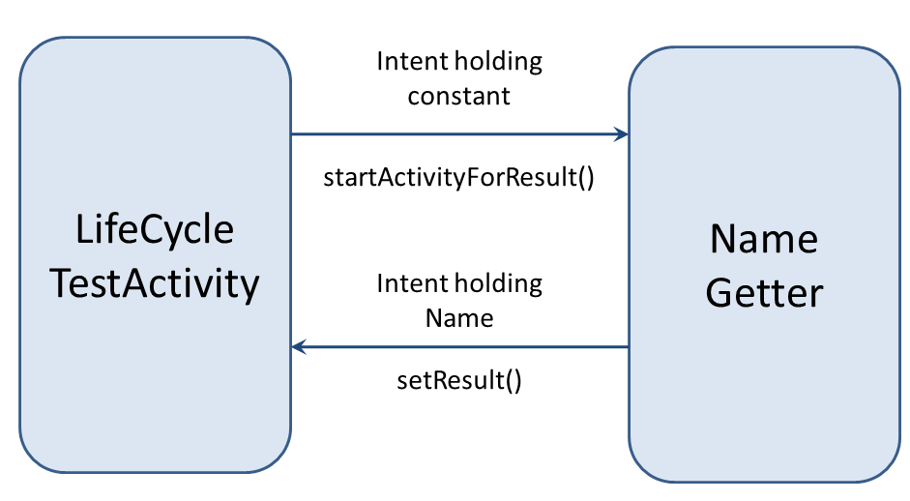
Activation of Components
3 of the 4 core application components (activities, services, and broadcast receivers) are started via intents
intents are a messaging system to activate components in the same application
and to start one application from another

Slide 5
AndroidManifest.xml
Recall the manifest is part of the application project.
The manifest contains important data about the application that is required by the Android system before the system will run any of the application's code
common error: have Activity in application that is not included in manifest
runtime error when application tries to start Activity not declared in manifest

Slide 6
AndroidManifest.xml Purpose
contains Java package name of application - unique id for application
describes components of application: activities, services, broadcast receivers, content providers and intent messages each component can handle
declares permissions requested by application
minimum required API level
libraries application to link to

Slide 7
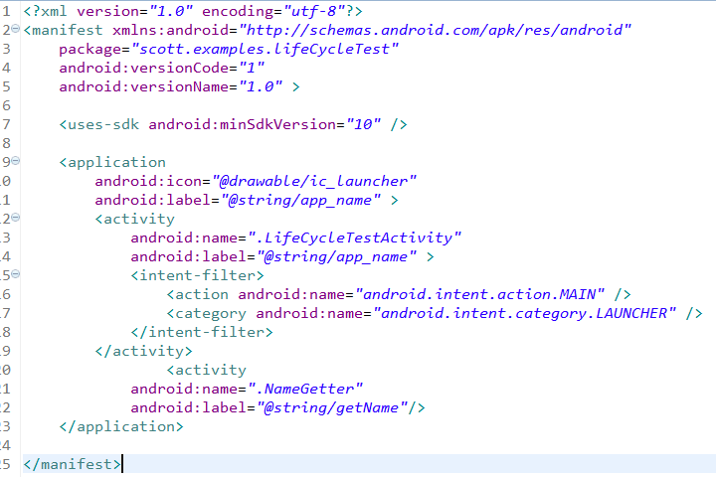
AndroidManifest.xml - Launcher Intent
Declare this as Activity
to start when application
started

Slide 8
Intent Class and Objects
android.content.Intent
passive data structure
description of action to performed or if created by a broadcast, a description of something that has happened and is being announced to broadcast receivers
Intent objects carry information, but do not perform any actions themselves

Slide 9
Intents and App Components
Context.startActivity() Activity.startActivityForResult() Activity.setResult()
Intent to Launch Activity or change purpose of existing Activity
Context.startService() Context.bindService()
Intent to Initiate Service or give new instructions to existing Service
Intents intended for Broadcast Receivers
Context.sendBroadcast() Context.sendOrderedBroadcast() Context.sendStickyBroadcast()
The Android System finds the right application component to respond to intents, instantiating them if necessary.

Slide 10
Intent Object Information
component name (of desired component)
action (to execute)
data (to work on)
category (of action)
type (of intent data)
extras (a Bundle with more data)
flags (to help control how Intent is handled)

Slide 11
Intent Object Info- Component
data for the component that receives the intent
action to take
data to act on
data for the Android system
category of component to handle intent (activity, service, broadcast receiver)
instructions on how to launch component if necessary

Slide 12
Intent Info - Component
Component name that should deal with Intent
fully qualified class name of component and
the package name set in the manifest file of the application where the component resides
optional! if not provided Android system uses resolves suitable target
name is set by setComponent(), setClass(), or setClassName()

Slide 13
Intent Info - Action Name
Action desired (or for broadcast intents, the action / event that took place)
Many actions defined in Intent class
Other actions defined through the API
example, MediaStore class declares ACTION_IMAGE_CAPTURE and ACTION_VIDEO_CAPTURE
You can define your own Intent Action names so other applications can activate the components in your application

Slide 14
Intent Action Name
Action acts like a method name
determines what rest of data in Intent object is and how it is structured, especially the data and extras
setAction() and getAction() methods from Intent class

Slide 15
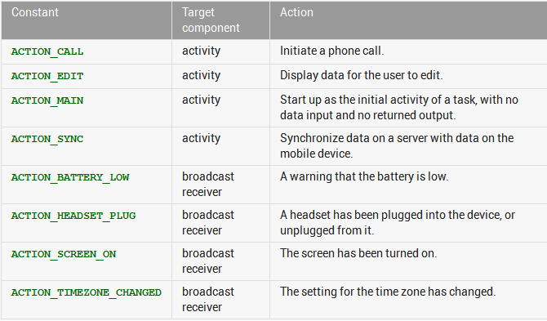
Intent Action

Slide 16
Intent Info - Data
URI (uniform resource identifier) of data to work with / on
for content on device a content provider and identifying information, for example an audio file or image or contact
MIME (Multipurpose Internet Mail Extension, now internet media type) initially for email types, but extended to describe type information in general about data / content
image/png or audio/mpeg

Slide 17
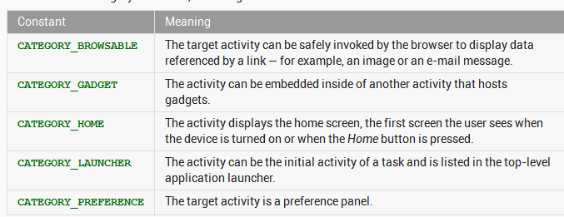
Intent Info - Category
String with more information on what kind of component should handle Intent

Slide 18
Intent - Extras
A Bundle (like a map / dictionary, key-value pairs) of additional information to be given to the component handling the Intent
Some Action will have specified extras
ACTION_TIMEZONE_CHANGED will have an extra with key of "time-zone" (documentation is your friend)
Intent method has put methods or put a whole Bundle

Slide 19
Example
Use an Intent so app asks camera to take picture and displays the resulting picture
important details:
permission to write and read (JellyBean) to and from SD card
getting file names correct
reduce size of original image

Slide 20
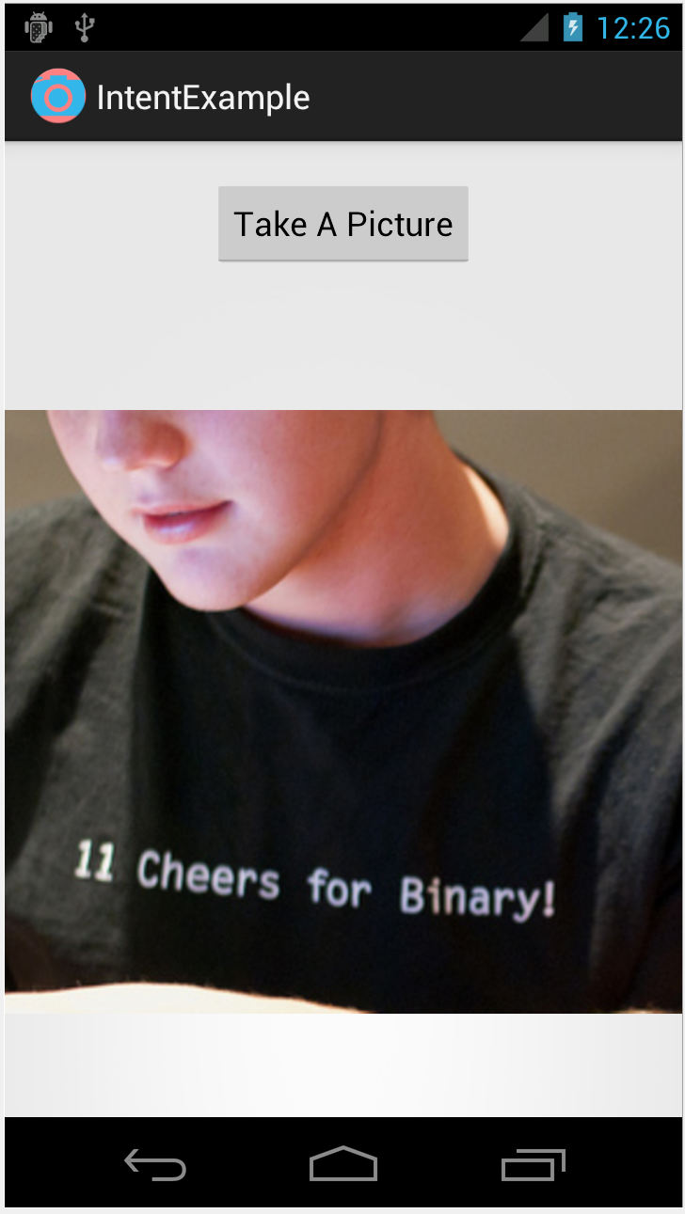
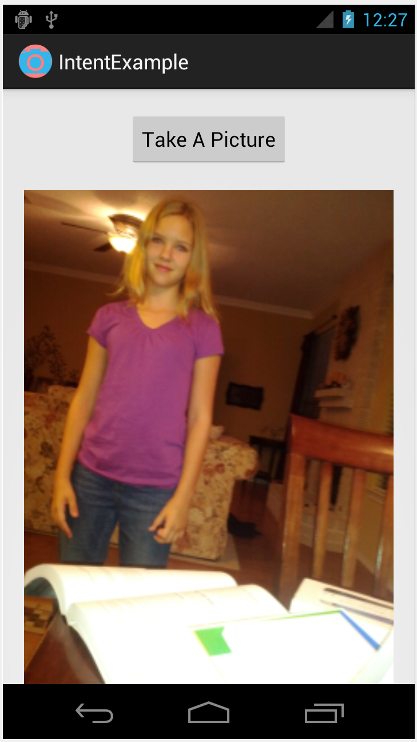
IntentExample

Slide 21
Layout
LinearLayout with
button
ImageView
ImageView initially displays default Image
button click results in call to takePhoto
android:onClick attribute set

Slide 22
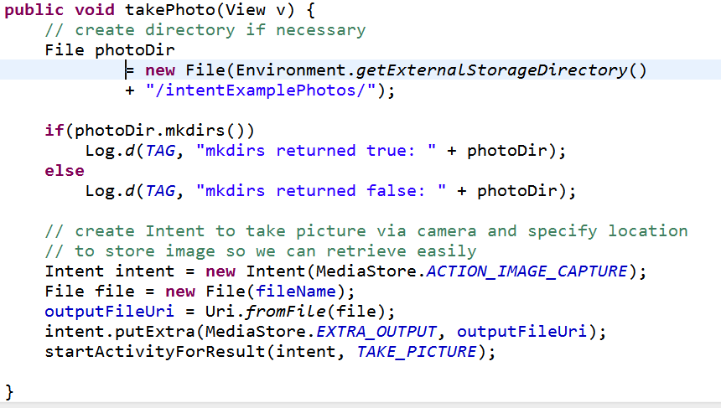
takePhoto in IntentExample Activity

Slide 23
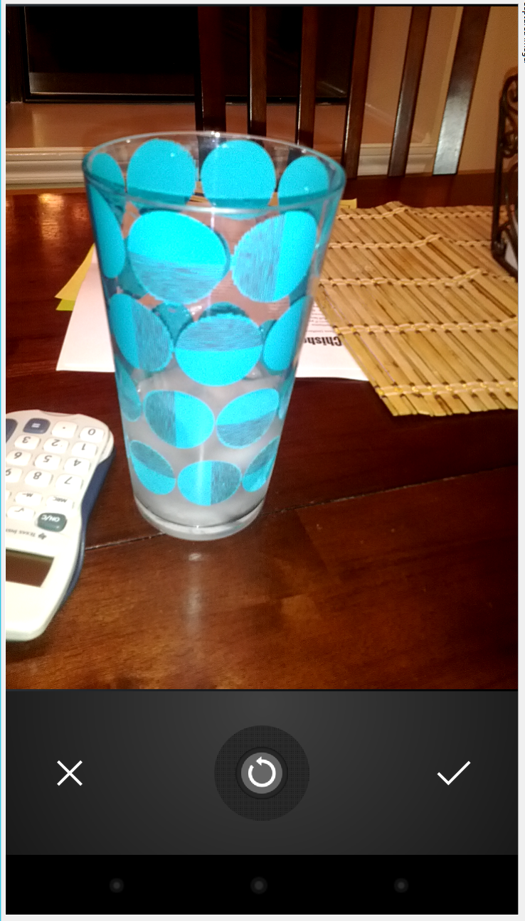
Result
Clicking button starts Camera Activity
IntentExample will be stopped
recall Activity lifecycle, play well with others
when picture taken return to IntentExample activity

Slide 24
onActivtyResult
when camera app checks Android system will call this method (callback)
look at result and take appropriate action
verify our requested action was completed

Slide 25
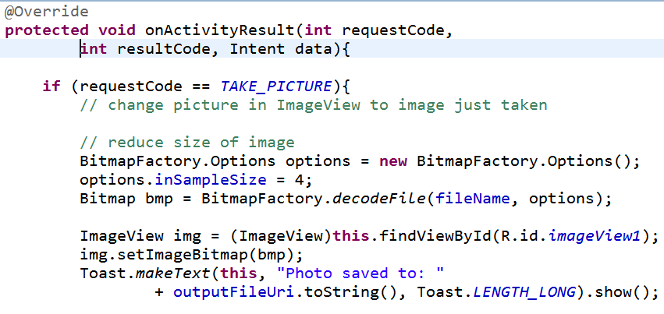
onActivtyResult

Slide 26
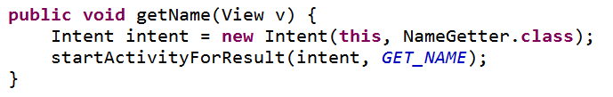
Intent Resolution
How does the Android system determine what component should handle an Intent?
explicit
Intent designates target component by name
typically used for inter application messaging and activity starting
recall, LifeCycleTest

Slide 27
Intent Resolution - Implicit
component name is blank (unknown)
typically used when starting component in another application
Android system uses data from Intent (action, category, data) and tries to find / match best component for job
Uses Intent Filters

Slide 28
Intent Filters
Applications and components that can receive implicit Intents advertise what they can do via Intent Filters
components with no Intent Filters can only receive explicit Intents
typical of many activities
activities, services, and broadcast receivers can have one or more intent filters

Slide 29
Intent Filters
Android system should know what application can do without having to start the component
before runtime
exception is Broadcast Receivers registered dynamically; they create IntentFilter objects at runtime
intent filters generally declared as element of applications AndroidManifest.xml file

Slide 30
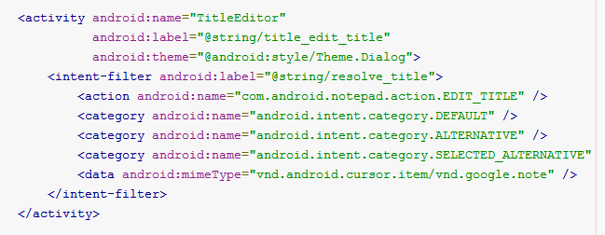
IntentFilter - Example
filter declares action, category, and data

Slide 31
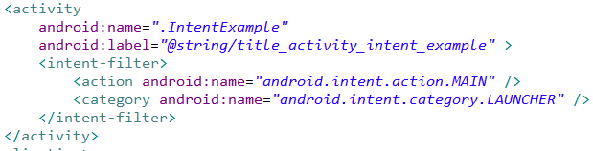
IntentFilter - Example
The Android system populates the application launcher via IntentFilters

