Slide 1
CS378 - Mobile Computing
Audio

Slide 2
Android Audio
Use the MediaPlayer class
Common Audio Formats supported:
MP3, MIDI (.mid and others), Vorbis (.ogg), WAVE (.wav) and others
Sources of audio
local resources (part of app)
internal URIs (Content Provider for other audio available)
External URLs (streaming)

Slide 3
MediaPlayer
Playback control of MediaPlayer managed as a state machine
Idle
Initialized
Preparing
Prepared
Started
Paused
Playback Complete
Stopped
End
Invalid state transitions result in errors

Slide 4
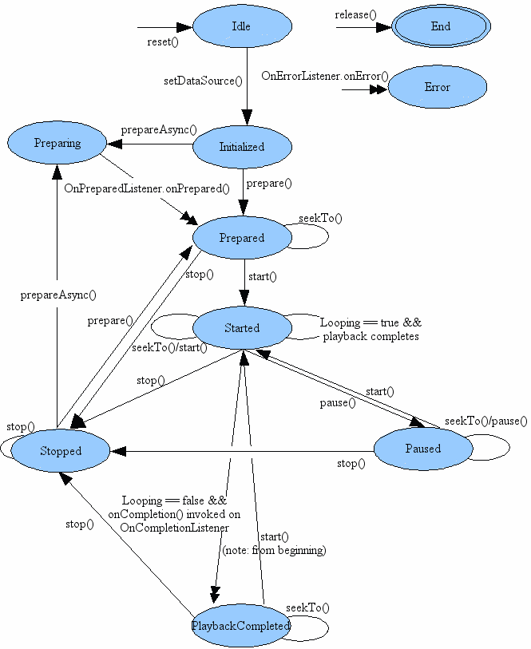
MediaPlayer State Diagram
Single arrows are synchronous transitions
Double arrows are asynchronous transitions

Slide 5
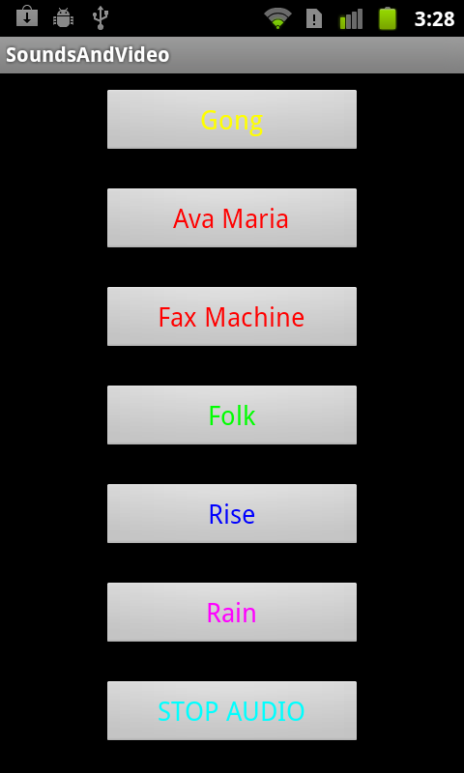
Simple Sound Demo App
audio files local to app placed in res/raw
CAUTION
large sound files difficult to install on emulator:
http://tinyurl.com/3pwljfj
better success with dev phones / actual devices

Slide 6
Playing Local Audio
To play audio local to the app
use the MediaPlayer.create convenience method
when complete MediaPlayer in the prepared state
start MediaPlayer
approach:
build listeners for each button to call the playSound method with appropriate song id when clicked

Slide 7
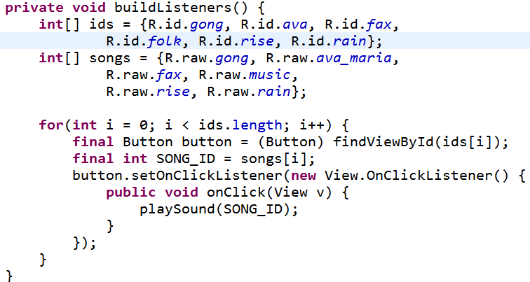
Simple Approach
button ids
ids for sound files

Slide 8
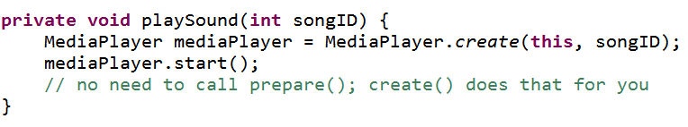
playSound method
okay for short sounds
downsides:
plays to completion
multiple sounds play at same time (desirable in some cases)
audio continues to play when app paused

Slide 9
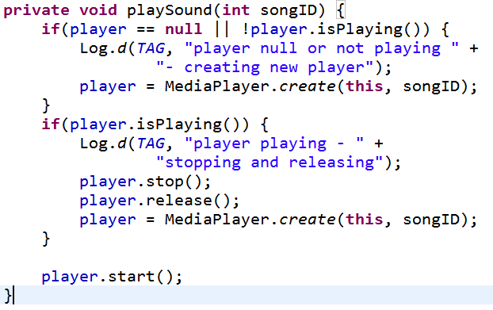
Changing Behavior
Add instance variable for MediaPlayer
If playing stop and release before creating new Player

Slide 10
Cleaning Up
Current version does not end well
Audio continues to play if back button pressed and even if home button pressed!
Activity Life Cycle
on pause we should stop MediaPlayer and release

Slide 11
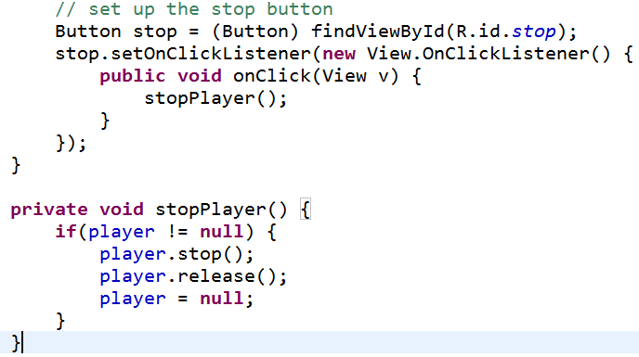
stopPlayer method
Connect app stop button to stopPlayer
could use XML onClick and add View parameter or set up listener ourselves
in buildListeners method

Slide 12
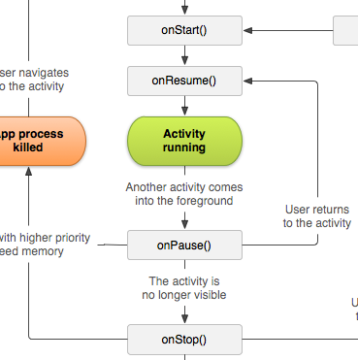
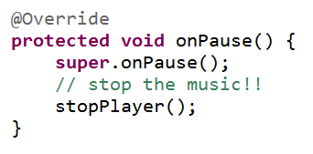
onPause
onPause() should call the stopPlayer method
what happens if activity resumed?

Slide 13
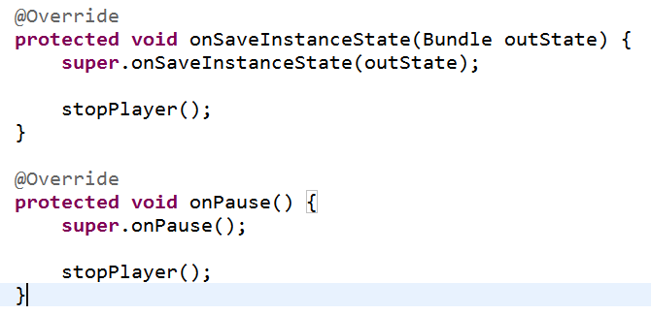
Saving State
Resume music where we left off if paused or activity destroyed due to orientation change

Slide 14
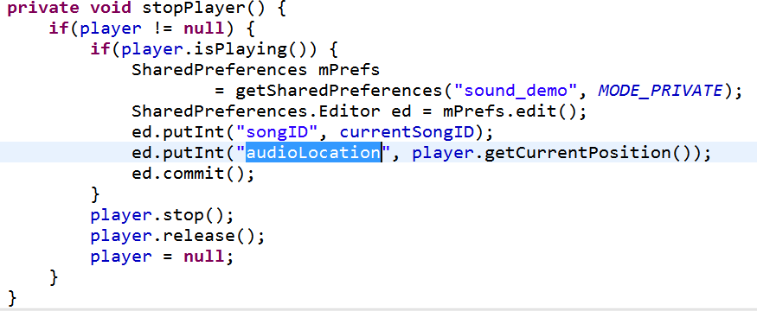
Saving MediaPlayer State
Not a lot of data so used the SharedPreferences

Slide 15
Restarting Audio
In onCreate check if audio was interrupted recreate player with same id and move to correct position
Can write data to shared preferences or bundle (onSaveInstanceState) and pull out in onCreate
Possible fix for orientation changes
in app manifest file under activity field
android:configChanges="orientation"
But now we are responsible for orientation changes
http://developer.android.com/guide/topics/resources/runtime-changes.html#HandlingTheChange

Slide 16
Playing Audio from Phone
If audio is on device / system, but not local to app use a URI
Obtain URIs of Music via a Content resolver
Example of simply listing URIs to the logcat

Slide 17
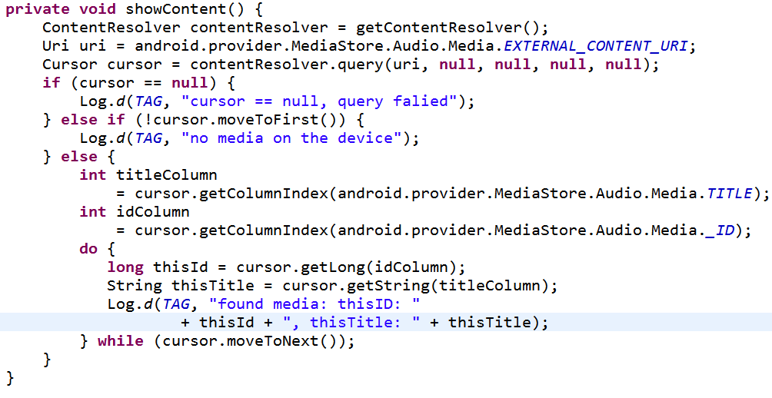
Retrieving Music URIs

Slide 18
MediaPlayer and System Audio
After URI retrieved can play audio with MediaPlayer
this approach requires calling prepare yourself
no convenience method

Slide 19
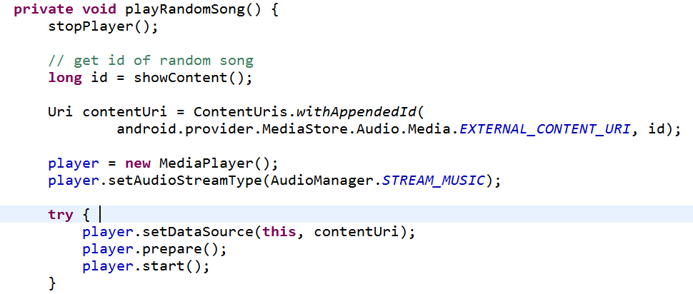
Playing Audio Via Local URI
id obtained via approach from showContent method

Slide 20
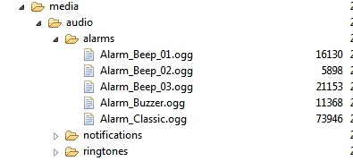
Other Audio
Other audio for ringtones, notifications, and alarms can be accessed via a RingtoneManager
Obtain URIs and play with media player
from DDMS:

Slide 21
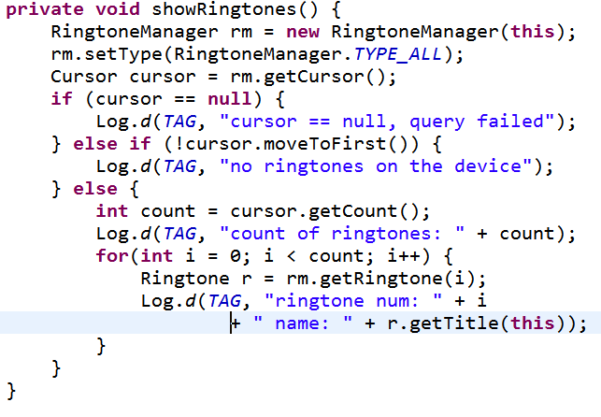
Listing Other Audio

Slide 22
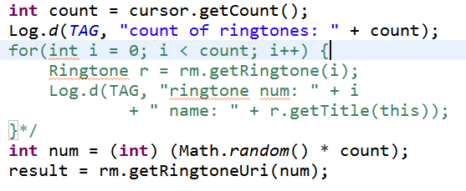
Playing Other Audio
Once the URI is obtained, playing other audio is same as playing song

Slide 23
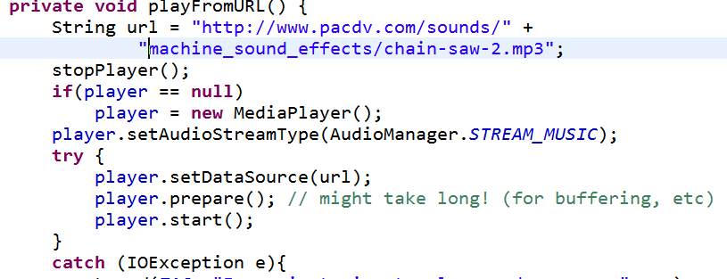
Playing Audio from Remote URL
Straightforward given the URL

Slide 24
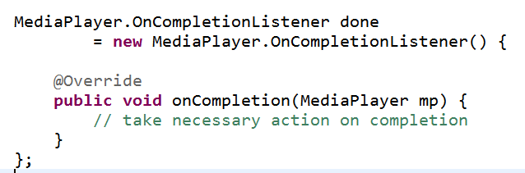
Completion of Audio
If action required when audio done playing implement the MediaPlayer.onCompletionListener interface
could make activity the listener

Slide 25
Looping
to loop sound (play over and over) simply set the isLooping method of the MediaPlayer to true

Slide 26
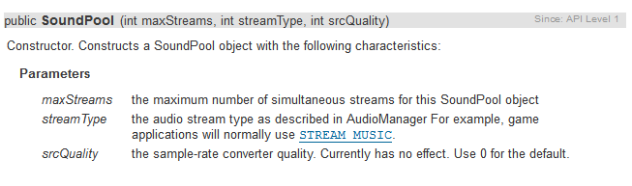
SoundPool
Another Android class

Slide 27
Using SoundPool
Great for applications with a number of short sound samples
maxStreams parameter sets maximum number of sounds that can be played at once via this SoundPool
If max is exceeded stream with lowest priority stopped
and then by age (oldest) with lowest priority

Slide 28
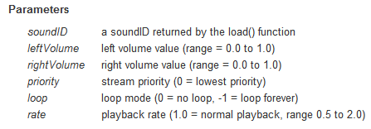
SoundPool play

Slide 29
Using SoundPool
Looping of sounds:
0 no looping
-1 loop forever
>0, play that many times
frequency (speed) can be changed
range from 0.5 to 2.0
0.5 twice as long to play
2.0 half as long to play

