Slide 1
CS378 - Mobile Computing
Persistence

Slide 2
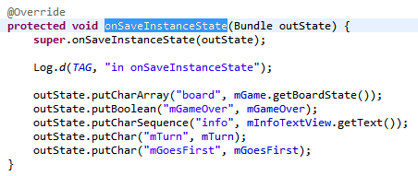
Saving State
We have already seen saving app state into a Bundle on orientation changes or when an app is killed to reclaim resources but may be recreated later

Slide 3
Storing Data
Multiple options for storing data associated with apps
Shared Preferences
Internal Storage
device memory
External Storage
SQLite Database
Network Connection

Slide 4
Sharing Data
Private data can be shared by creating a Content Provider
Android has many built in Content Providers for things such as
audio (random song from last time)
images
video
contact information

Slide 5
Shared Preferences
Private primitive data stored in key-value pairs
SharedPreferences Class
Store and retrieve key-value pairs of data
keys are Strings
values are Strings, Sets of Strings, boolean, float, int, or long
Not strictly for preferences

Slide 6

Using SharedPreferences
Obtain a SharedPreferences object for application using these methods:
getSharedPreferences(String name, int mode)
if you want multiple files
getPreferences(int mode)

Slide 7
SharedPreferences Modes
File creation modes
Constants from the Context class
Activity is a descendant of Context
MODE_PRIVATE
accessed only by calling application
MODE_WORLD_READABLE
other applications have read access
MODE_WORLD_WRITEABLE
other applications have write access
MODE_MULTI_PROCESS
file on desk checked for modification even if shared preferences instance loaded. (Multiple threads using the same file)

Slide 8
Writing to SharedPreferences
After obtaining SharedPreferences object:
call edit() method on object to get a SharedPreferences.Editor object
place data by calling put methods on the SharedPreferences.Editor object
also possible to clear all data or remove a particular key

Slide 9
Writing to SharedPreferences
When done writing data via the editor call either apply() or commit()
apply() is the simpler method
used when only one process expected to write to the preferences object
commit() returns a boolean if write was successful
for when multiple process may be writing to preferences

Slide 10
Reading From Shared Preferences
After obtaining SharedPreferences object use various get methods to retrieve data
Provide key (string) and default value if key is not present
get Boolean, Float, Int, Long, String, StringSet
getAll() returns Map<String, ?> with all of the key/value pairs in the preferences

Slide 11
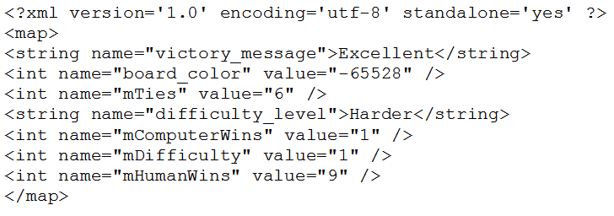
Shared Preferences File
Stored as XML

Slide 12
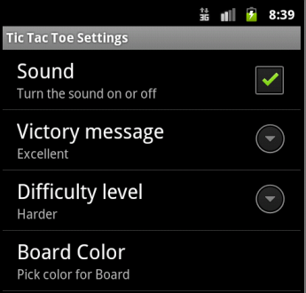
Preference Activity
An Activity framework to allow user to select and set preferences for your app
tutorial 6 has an example
difficulty, sound, color, victory message
Main Activity can start a preference activity to allow user to set preferences

Slide 13
Internal Storage
Private data stored on device memory
More like traditional file i/o
by default files are private to your application
other apps cannot access
files removed when app is uninstalled

Slide 14
Internal Storage
To create and write a private file to the device internal storage:
call openFileOutput(String name, int mode)
method from Context
file created if does not already exist
returns FileOutputStream object (regular Java class)
Modes same as SharedPreferences minus MODE_MULTI_PROCESS and addition of MODE_APPEND

Slide 15
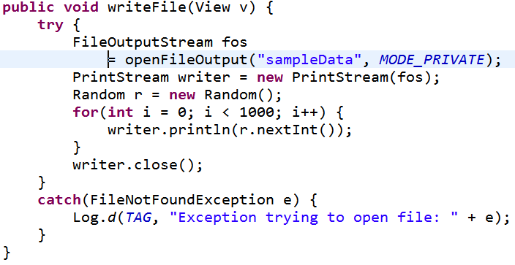
Writing to Files
FileOutputStream writes raw bytes
arrays of bytes or single bytes
Much easier to wrap the FileOutputStream in PrintStream object

Slide 16
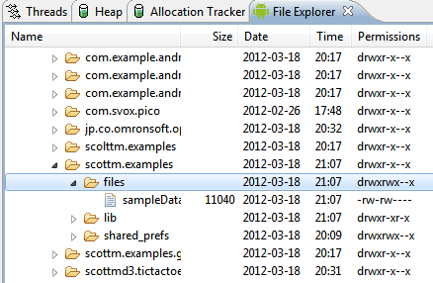
Reading from Files
files saved to device
data directory for app
call openFileInput(String name) method to obtain a FileInputStream
FileInputStream reads bytes
for convenience may connect to Scanner object or wrap in a DataInputStream object

Slide 17
Static Files
If you need / have a file with a lot of data at compile time:
save file in project res/raw / directory
can open file using the openRawResource(int id) method and pass the R.raw.id of file
returns an InputStream to read from file
cannot write to the file

Slide 18
Cache Files
If need to cache data for application instead of storing persistently:
call getCacheDir() method to obtain a File object that is a directory where you can create and save temporary cache files
files may be deleted by Android later if space needed but you should clean them up on your own
recommended to keep under 1 MB

Slide 19
External Files - Other Useful Methods
All of these are inherited from Context
File getFileDir()
get absolute path to filesystem directory when app files are saved
File getDir(String name, int mode)
get and create if necessary a directory for files
boolean deteleFile(String name)
get rid of files, especially cache files
String[] fileList()
get an array of Strings with files associated with Context (application)

Slide 20
External Storage
Public data stored on shared external storage
may be SD (Secure Digital) card on non removable
files saved to external storage are world-readable
files may be modified by user when they enable USB mass storage for device

Slide 21
Checking Media Availability
Call Environment.getExternalStorageState() method to determine if media available
may be mounted to computer, missing, read-only or in some other state that prevents accessing

Slide 22
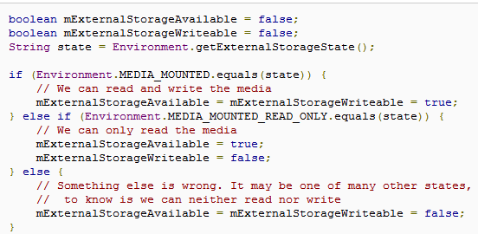
Checking Media State
other states such as media being shared, missing, and others

Slide 23
Accessing Files on External Storage
call getExternalFilesDir(String type) to obtain a directory (File object) to get directory to save files
type is String constant from Environment class
DIRECTORY_ALARMS, DIRECTORY_DCIM (Digital Camera IMages), DIRECTORY_DOWNLOADS, DIRECTORY_MOVIES, DIRECTORY_MUSIC, DIRECTORY_NOTIFICATIONS, DIRECTORY_PICTURES, DIRECTORY_PODCASTS, DIRECTORY_RINGTONES

Slide 24
External File Directory
If not a media file then send null as parameter to getExternalFilesDir() method
The DIRECTORY_<TYPE> constants allow Android's Media Scanner to categorize files in the system
External files associated with application are deleted when application uninstalled

Slide 25
External Data Shared Files
If you want to save files to be shared with other apps:
save the files (audio, images, video, etc.) to one of the public directories on the external storage device
Environment.getExternalStoragePublicDirectory( Strint type) method returns a File object which is directory
same types as getExternalFilesDir method

Slide 26
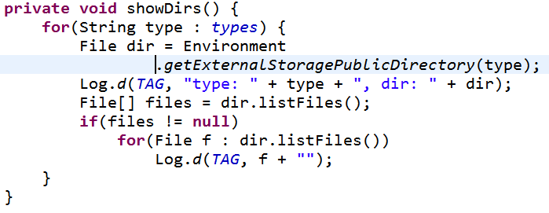
Examining Shared Directories
Not the same as the system media directories

Slide 27
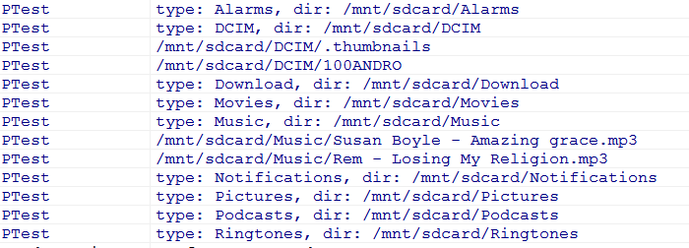
Result

Slide 28
SQLite Database
Structured data stored in a private database
More on this next lecture

Slide 29
Network Connection
Store data on web with your own network server
Use wireless or carrier network to store and retrieve data on web based server
classes from java.net and android.net

