Slide 1
CS378 - Mobile Computing
Persistence - SQLite

Slide 2

Databases
RDBMS
relational data base management system
Relational databases introduced by E. F. Codd
Turing Award Winner
Relational Database
data stored in tables
relationships among data stored in tables
data can be accessed and view in different ways

Slide 3
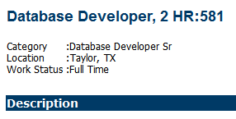

SQL and SQLite
Structured Query Language
programming language to manage data in a RDBMS
SQLite implements most, but not all of SQL
SQLite becomes part of application

Slide 4
SQLite and Android
Databases created with or for application accessible by name to all classes in application, but none outside application
Creating database:
create subclass of SQLiteOpenHelper and override onCreate() method
execute SQLite command to create tables in database

Slide 5
Creating Database
Example: Movie Rating App
Stores user ratings
Not a complex example
Database only has one table
Adapted from Deitel Address Book Application
http://www.deitel.com/Books/Android/ AndroidforProgrammers/tabid/3606/Default.aspx

Slide 6
Classes
MovieRaterActivity Starting Activity
Displays List of RatedMovies
click on Movie Title
menu - Add Rating
ViewRating Show Rating and Information
AddEditRating Add or Edit Rating
menu - Edit Rating
menu - Delete Rating
DatabaseConnector Interact With Database
Row remove from database

Slide 7
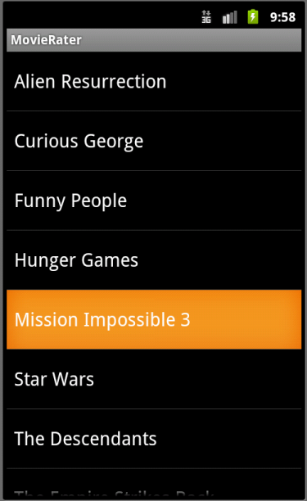
MovieRaterActivity
ScrollView
Queries data base for all names / titles
Clicking on Title brings up that rating in ViewRating

Slide 8
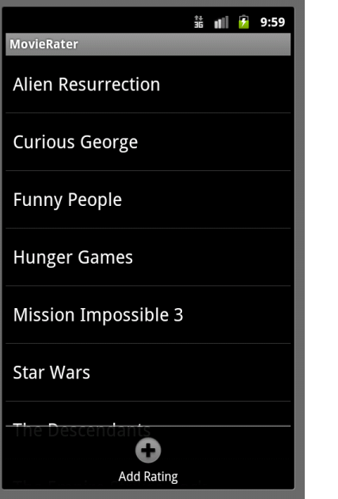
Menu for MovieRaterActivity
Only one menu option
button to Add Rating
Brings up AddEditRating Activity

Slide 9
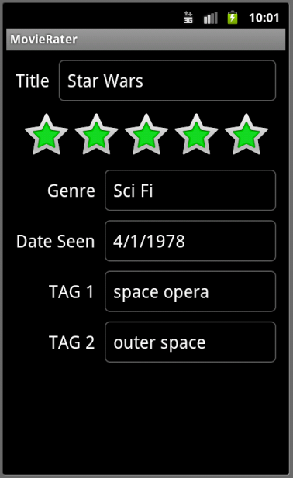
ViewRating
Pulls all data from database for row based on name / title
Use of a RatingBar
ViewRating has its own Menu

Slide 10
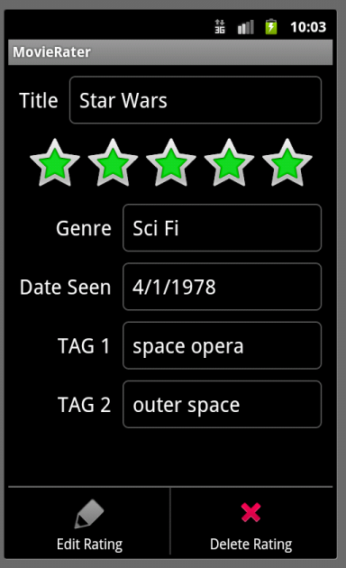
ViewRating Menu
Edit Rating starts AddEditRating activity and populates fields with these values (place in Extras)
Delete Rating brings up confirmation Dialog

Slide 11
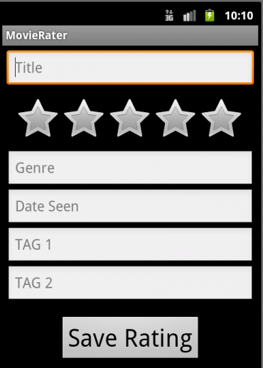
AddEditRating
Add Rating
fields are blank
Consider adding a button for date picker instead of typing data
Must enter title / name
other fields can be blank

Slide 12
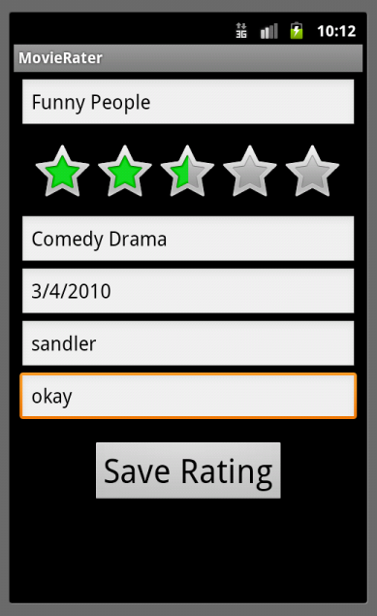
AddEditRating
When title clicked in main Activity, MovieRaterActivity
Make changes and click save

Slide 13
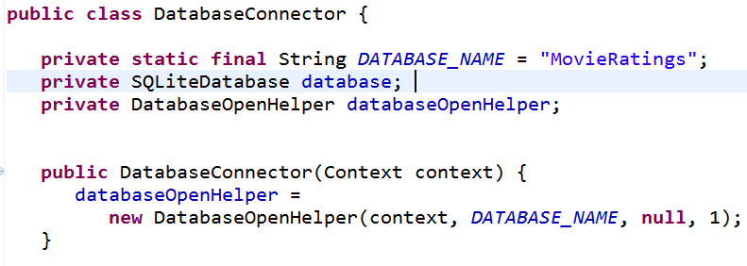
DatabaseConnector Class
Start of class

Slide 14
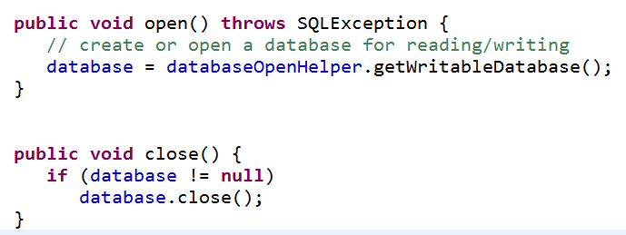
DatabaseConnector Class

Slide 15
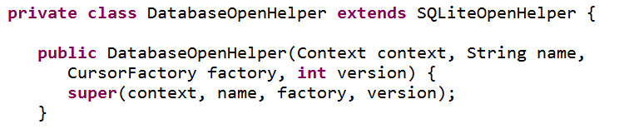
Creating Database
Via an inner class that extends SQLiteOpenHelper

Slide 16
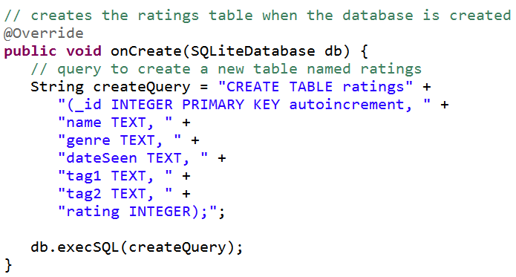
Creating Database
Money method

Slide 17
Creating Database
String is a SQLite command
ratings is name of table
table has seven columns
_id, name, genre, dateSeen, tag1, tag2, rating
storage classes for columns:
TEXT, INTEGER, REAL
also NULL and BLOB
_id is used as primary key for rows

Slide 18
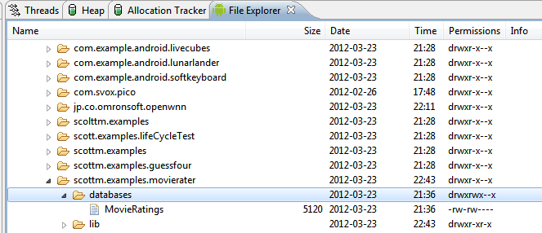
Database on Device
can pull database and view
sqlitebrowser is a good tool

Slide 19
Inserting Data
ContentValues are key/value pairs that are used when inserting/updating databases
Each ContentValue object corresponds to one row in a table
_id being added and incremeneted automatically

Slide 20
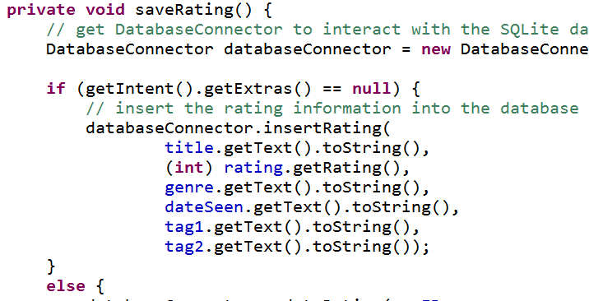
Inserting Data
In AddEditRating
When save button clicked

Slide 21
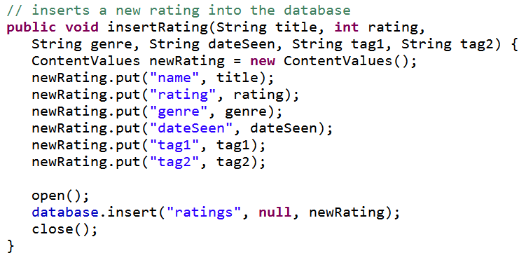
Inserting Data
In DatabaseConnector
nullCoumnHack, for inserting empty row

Slide 22
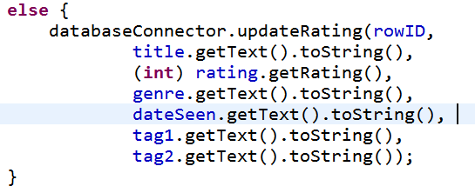
Updating Data
In AddEditRating
When save button clicked
notice id added

Slide 23
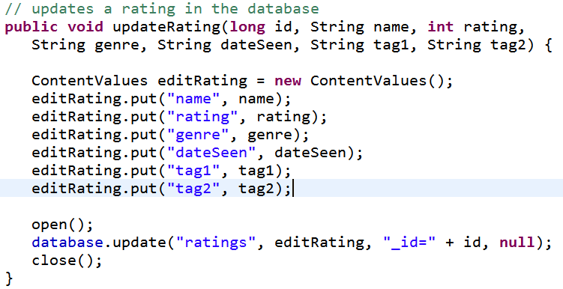
Updating Data
In DatabaseConnector

Slide 24
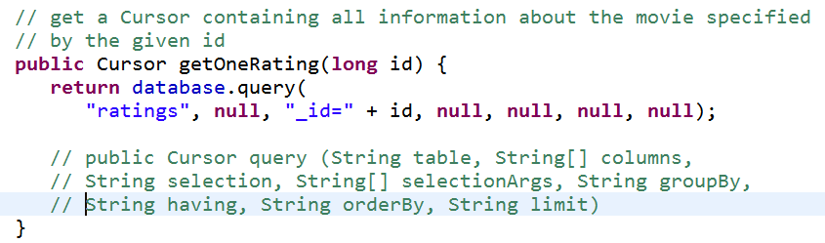
Query Data
Getting a single row by _id
in order to populate ViewRating

Slide 25
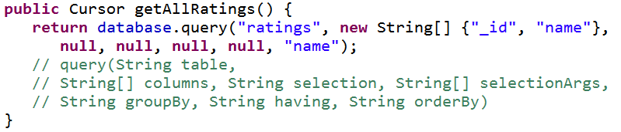
Query Data
Get all rows
To populate the ListView in the MovieRaterActivity
only getting _id and name columns

Slide 26
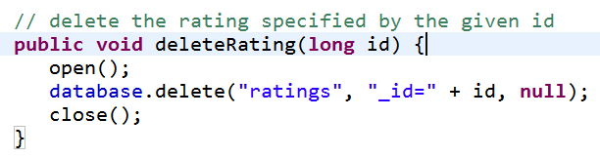
Deleting Data
Menu Option in ViewRating

Slide 27
Database Cursor
Cursor objects allow random read - write access to the result of a database query
Ours only used to read the data
Use a CursorAdapter to map columns from cursor to TextView or ImageViews defined in XML files

Slide 28
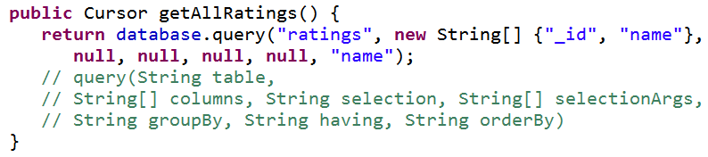
Database Connection
Recall:

Slide 29
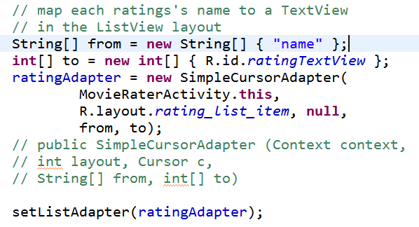
MovieRaterActivity
Rating Adapter is a CursorAdapter
from onCreate method

Slide 30
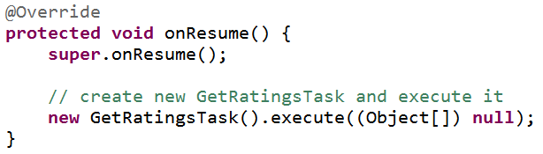
Updating Cursor
Cursor initially null
separate task to create cursor and update adapter

Slide 31
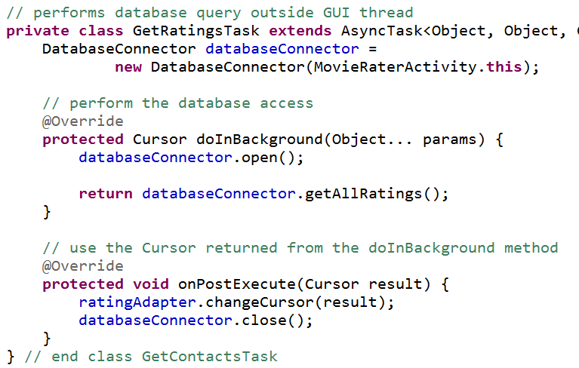
Asynch Task

Slide 32
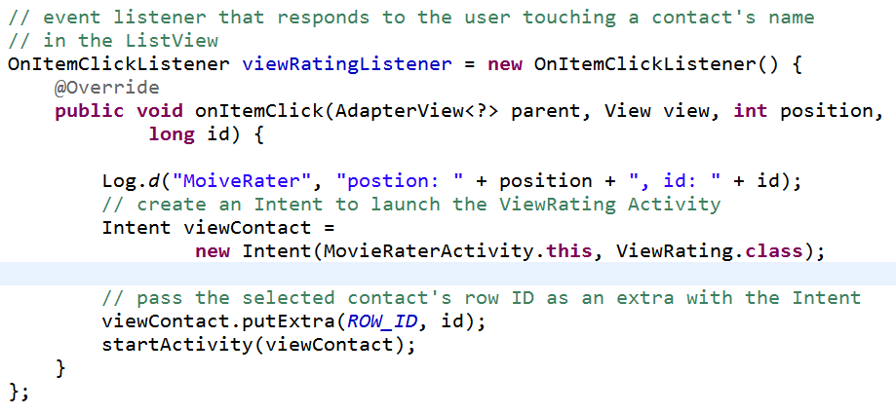
Clicking on Item in List
_id not displayed but still part of entry in list -> use _id to get back to database row

Slide 33
Other Cursor Options
moveToPrevious
getCount
getColumnIndexOrThrow
getColumnName
getColumnNames
moveToPosition
getPosition

Slide 34
Possible Upgrades
Add functionality to
show all movies that share a particular genre
movies from a date range
shared tags
Just more complex data base queries

