Slide 1
CS378 - Mobile Computing
App Project Overview

Slide 2
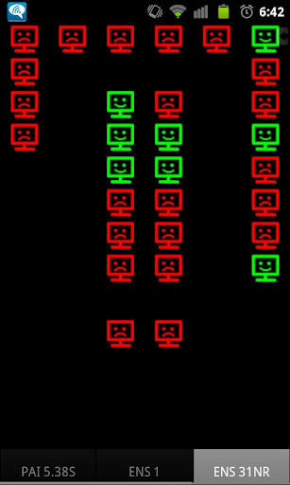
App Project
Teams of 2 or 3 students
Develop an Android application of your choosing subject to instructor approval
Application must run on class dev phones, API Level 15

Slide 3
App Milestones
App Proposals
written 10/1
posters 10/1, 10/3, or 10/5 depending on assigned poster session
Teams and app choice, 10/8
Paper prototypes, 10/15
Alpha Release, 11/9
Alpha Evals, 11/19 (Individual)
How to, 11/26 (Individual)
Beta Release, 11/30
Web ad, 12/5
Beta Evals, 12/7 (Individual)

Slide 4
App Proposals
individual assignment
every student proposes two applications
one service oriented, one profit oriented
written due in class on 10/1
posters due day of assigned session
10/1, 10/3, 10/5
compelling reason for a given day, email me ASAP
Posters - polished, not hand drawn

Slide 5
Team and App Choice
By 10/8 via email to Mike
App requires instructor approval
teams of 2 or 3 people
solo students will be grouped together at random or assigned to a team

Slide 6
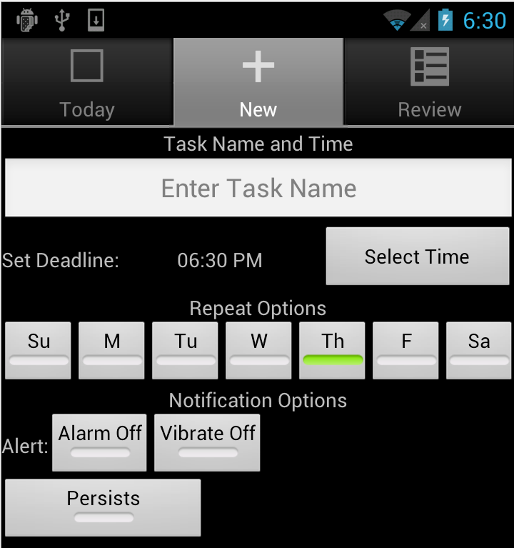
Alpha Release
11/9
Focus on Basic UI and Functionality
turn in APK and readme file

Slide 7
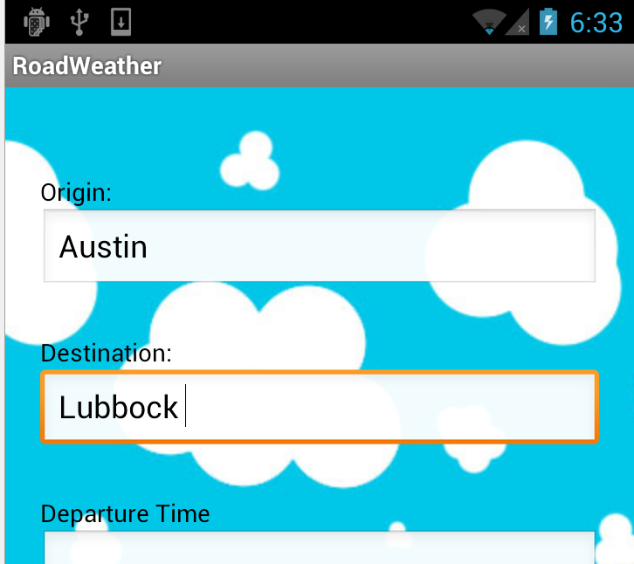
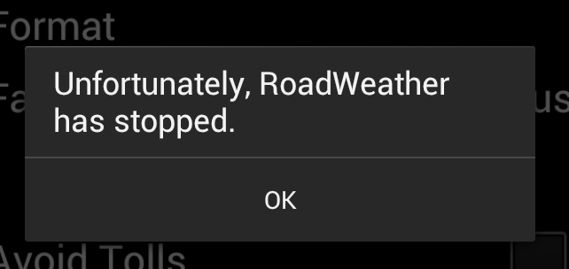
Evals
For alpha and Beta releases each student reviews 3 other apps
feedback provided to team
good, bad, ugly, suggestions, ERRORS

Slide 8
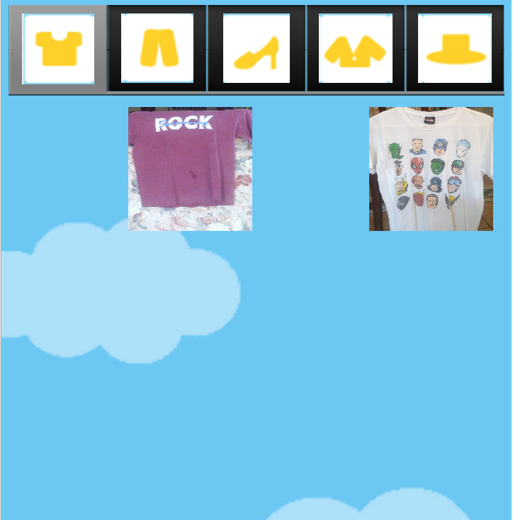
Beta Release
11/30
Fully Functional
Polished
UI polished
icon
graphics if necessary
menu options / action bar
sound / feedback
persistence
responsiveness

Slide 9
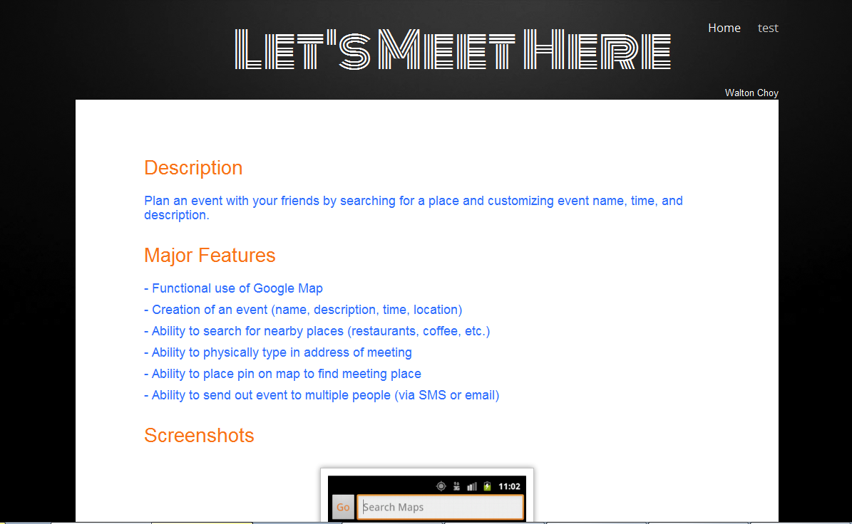
Web Ad 12/5

Slide 10
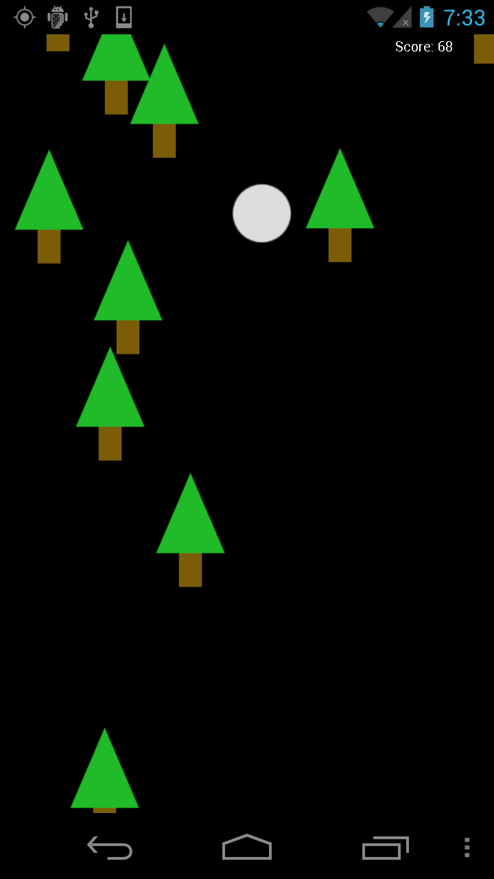
Recommendations
Based on my own experience (and bias)
Pick something you are interested in
… but that is reasonable!
Better to have simple idea / app that can be improved and extended
.. than a non functioning pile of garbage

Slide 11
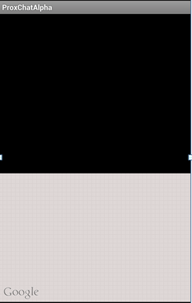
Recommendations
Games are okay
Apps designed for kids are okay
Okay to use APIs / libraries
but no silver bullet
integration is hard and time consuming
Don't try to learn new technologies
if you want your own web server, but don't know how to set one up, now is NOT the time to learn

Slide 12
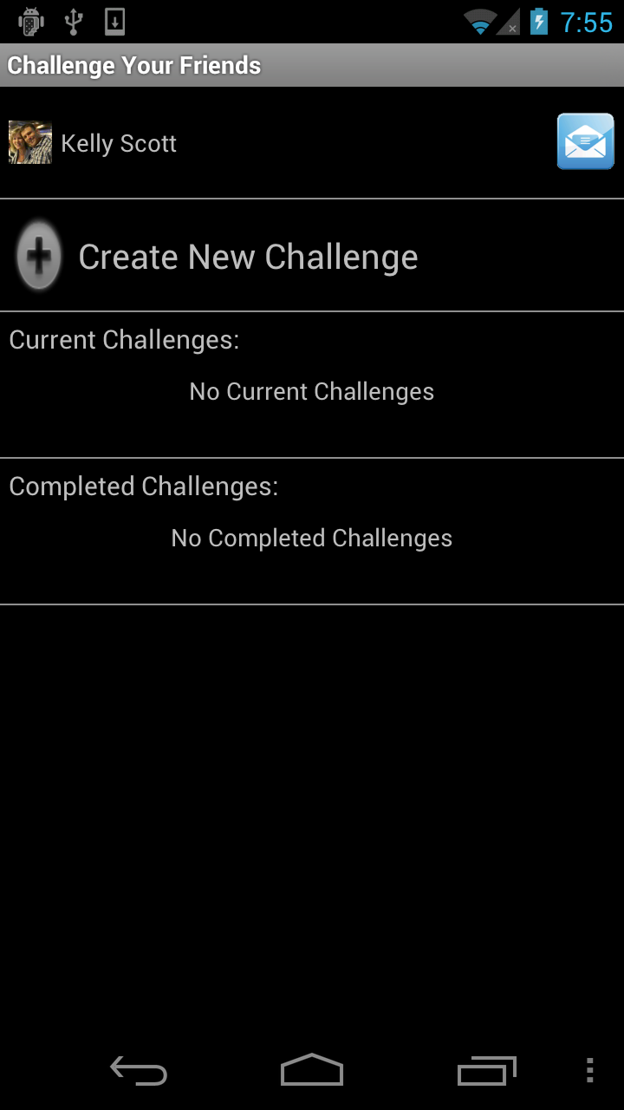
Recommendations
Avoid plain graphics
Avoid social media
probably my bias, but kind of boring and high barriers to entry
sharing stuff to social media okay, but should not be focus of app
Avoid apps with lots of initial data entry

Slide 13
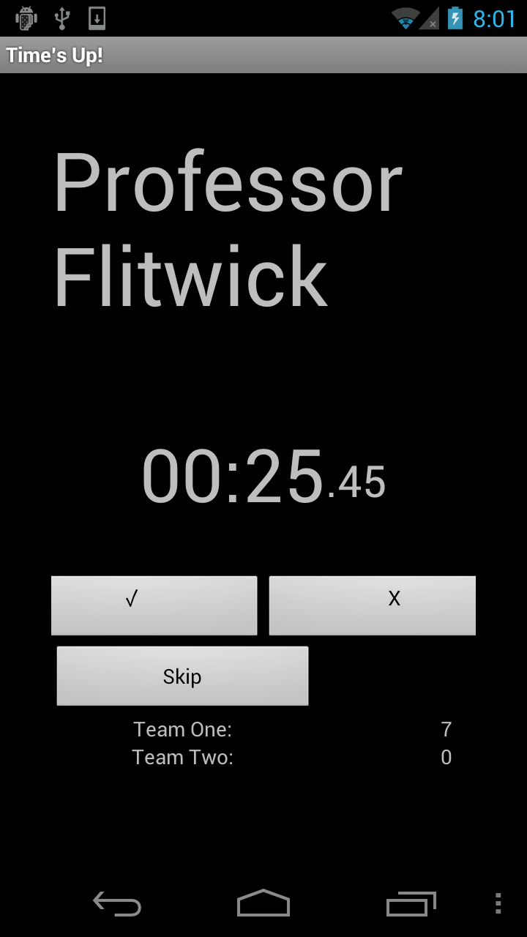
Recommendations
Use features of the mobile device such as:
Location / Maps
Sensors
Gestures / Touch Screen
Contacts
Camera
Network
Available applications / services

Slide 14

Android Design Guidelines
Create Vision!
Enchant Me!
Simplify My Life!
Make ME Amazing!
http://developer.android.com/design/index.html

Slide 15
Create Vision
Delight me in surprising ways
Real objects are more fun than buttons and menus
Let me make it mine
Get to know me

Slide 16
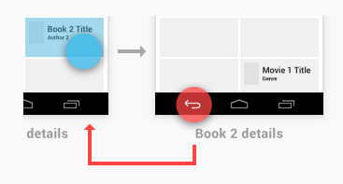
Simplify My Life
Keep it brief
Pictures are faster than words
Decide for me but let me have the final say
Only show what I need when I need it
I should always know where I am
Never lose my stuff
If it looks the same, it should act the same
Only interrupt me if it's important

Slide 17
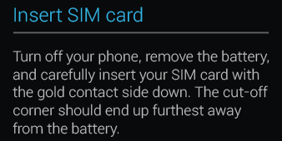

Make Me Amazing
Give me tricks that work everywhere
It's not my fault
Sprinkle encouragement
Do the heavy lifting for me
Make important things fast

Slide 18
Apple App Guidelines
The Display Is Paramount, Regardless of Its Size
Device Orientation Can Change
Apps Respond to Gestures, Not Clicks
People Interact with One App at a Time
Preferences Are Available in Settings
Onscreen User Help Is Minimal
Most iOS Apps Have a Single Window
http://tinyurl.com/3yj7b5y

Slide 19
Apple Human Interface Principles
Aesthetic Integrity
Consistency
Direct Manipulation
Feedback
Metaphors
User Control

Slide 20
User Experience Guidelines
Focus on the Primary Task
Elevate the Content that People Care About
Think Top Down
Give People a Logical Path to Follow
Make Usage Easy and Obvious
Use User-Centric Terminology
Minimize the Effort Required for User Input
Downplay File-Handling Operations
Enable Collaboration and Connectedness
De-emphasize Settings

Slide 21

User Experience Guidelines
Make Search Quick and Rewarding
Entice and Inform with a Well-Written Description
Be Succinct
Use UI Elements Consistently
Consider Adding Physicality and Realism
Delight People with Stunning Graphics

