Slide 1
Apache Maven 2 Overview
Getting started with Apache Maven 2

Slide 2
The Goal
Understand Maven principles
Build project with Maven
Compare to Apache Ant

Slide 3
GETTING STARTED
What is Maven?

Slide 4
Glossary
Artifact
Maven repository
Dependency

Slide 5
What is Maven?
Open Source: Apache License 2.0
Uniform build system
Knowledge accumulator
Project management tool
Declarative logic instead of imperative
Notes:
О лицензии.
Создавался как унифицированая билд-система.
В основу программы лег опыт разработчиков Apache.
Не только тупой сборщик и выполняльщик команд для сборки проекта, но также довольно удобный тул для конфигурирования, управления проекта
Ключевое отличие от популярного Apache Ant то, что Мавен проповедует декларативную логику вместо императивной.

Slide 6
Maven help us
Build
Dependencies
Quality project info
Release

Slide 7
CORE MAVEN 2
Change your mind

Slide 8



Maven project
pom.xml
Project
Object
Model
Dependency
Manager
Project lifecycle
Repositories
plug-in
plug-in
plug-in
source
code
generated
code
resources
binary
files

Slide 9

Project Object Model (pom.xml)
Identification
Hierarchy
Structure
Dependencies
Build settings
project home
Spring
2.5.6
groupId
artifactId
version
type
parent
sources
Junit
4.5
my-app
classes
my-app
another-app
Servlet
API
2.5
etc.

Slide 10
Super POM
Package: jar
Default project structure
Default artifacts Repository
Release profile

Slide 11
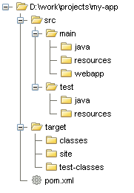
Default folders structure

Slide 12
Maven does your work
Store your stuff only
Maven knows what you need
Dependencies are stored in shared repository

Slide 13
Dependency scope
Result Scope | Compile classpath | Result package | Test classpath | Lookup repository
compile | + | + | + | +
provided | + | - | + | +
runtime | - | + | + | +
test | - | - | + | +
system | + | - | + | -

Slide 14
Transitive dependencies
my-app
dependency.1
dependency.2
dependency.3
dependency.1.1
dependency.1.2

Slide 15
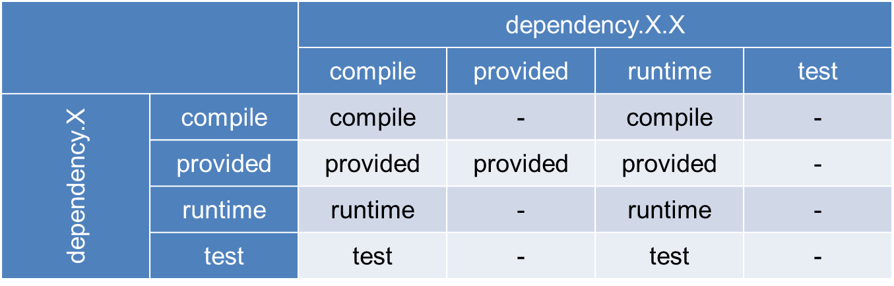
Transitive dependency scope
dependency of our dependency
our dependency
result scope of 3rd party dependency

Slide 16




Maven Repository
Local repository
External repositories
user local
internal
external
Central (default)
User workstation
Local network
Internet

Slide 17
Build lifecycle
validate
compile
test
package
verify
install
deploy
check pom.xml
compile the source
run unit tests
create jar/war/...
verify the package
publish package to local repo
publish package to remote repo

Slide 18
MAVEN IN ACTION
Simple Maven project example

Slide 19
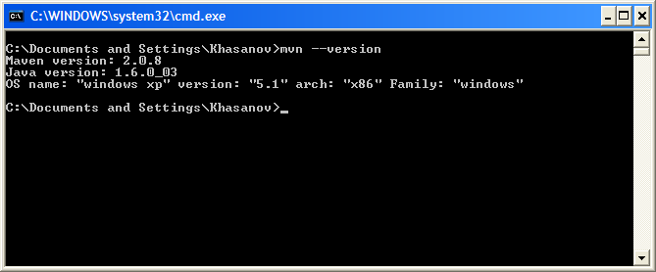
Installation
Requirements:
  JRE/JDK 1.4 or higher
Download
Unzip
Setup environment variables:
  M2_HOME
  M2
  PATH
Enjoy ☺

Slide 20
Configuration
Global
  <M2_HOME>/conf/settings.xml
User local
  <USER_HOME>/.m2/settings.xml

Slide 21
settings.xml
Path to local repository
Proxy
Repository mirrors
Servers authentication
Profiles
Other Maven 2 configurations

Slide 22
Configuration - Proxy
<settings>
<proxies>
<proxy>
<active>true</active>
<protocol>http</protocol>
<host>cache</host>
<port>3128</port>
</proxy>
</proxies>
</settings>

Slide 23
mvn
mvn [goal(s)] [phase(s)] [options]
mvn compile:compile
mvn install
mvn install –X –DsomeProperty=10
mvn <plugin>:<goal>
mvn <phase name>

Slide 24
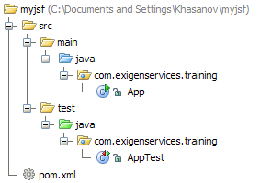
Start-up new project
mvn archetype:create
-DarchetypeGroupId=org.apache.maven.archetypes
-DgroupId=com.exigenservices.training
-DartifactId=myjsf
Result:
Default folder structure
pom.xml
First java class
First unit-test class

Slide 25
pom.xml: Minimal POM
<project>
<modelVersion>4.0.0</modelVersion>
<groupId>com.exigenservices.app</groupId>
<artifactId>my-app</artifactId>
<version>SNAPSHOT</version>
</project>

Slide 26
pom.xml: Dependencies
<project>
<dependencies>
<dependency>
<groupId>junit</groupId>
<artifactId>junit</artifactId>
<version>4.6</version>
<scope>test</scope>
</dependency>
</dependencies>
</project>

Slide 27
Add repository
<project>
<repositories>
<repository>
<id>Jboss.repository</id>
<url>
http://repository.jboss.org/maven2
</url>
</repository>
</repositories>
</project>

Slide 28
pom.xml: Plug-ins configuration
<project>
<build>
<plugins>
<plugin>
<artifactId>maven-compiler-plugin</artifactId>
<configuration>
<source>1.5</source>
<target>1.5</target>
</configuration>
</plugin>
</plugins>
</build>
</project>

Slide 29
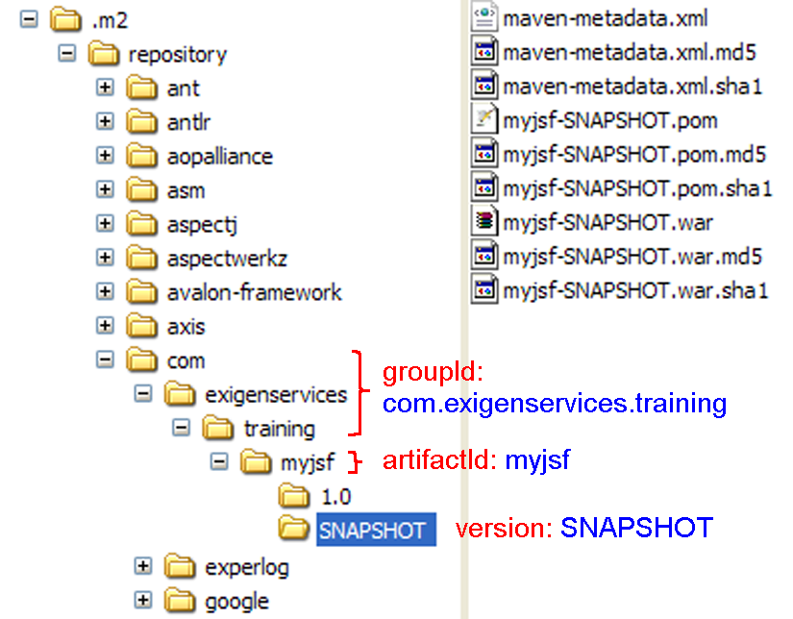
Build project
mvn install
  validate
  compile
  test
  package
  install
Notes:
TODO: replace screen-shot to generalize examples groupId, artifactId

Slide 30


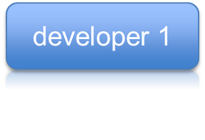



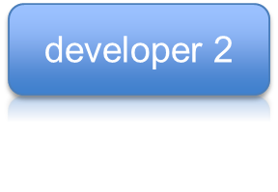


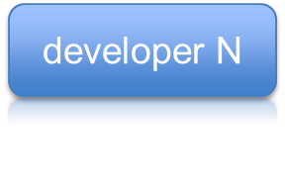
Install and Deploy
deploy
install
…
Local network
Internet

Slide 31
When deploy is needed?
Release
Update snapshot
  available for other projects

Slide 32
IDE INTEGRATION
Develop with pleasure!

Slide 33
IDE list
InteliJ IDEA from 7.0
Eclipse
NetBeans 6.5

Slide 34
NetBeans
Embedded
Basic features
Weak Dependency Management

Slide 35
Eclipse
Plug-in “m2eclipse”
All necessary features
Dependency synchronization
POM visual editor
Lifecycle build runners

Slide 36
InteliJ IDEA
Embedded from 7.0
All Necessary Features
Dependency synchronization
XML editor for POM
Lifecycle build runners

Slide 37
CONCLUSION
Let’s summarize

Slide 38
Advantages (vs. Ant)
Know Maven – can build project
Dependency management
Less CM activities
Force to standardization
Readable pom.xml
High reusability

Slide 39
Disadvantages (vs. Ant)
Understanding
Artifacts search
Plug-ins documentation
“Exotic things” - maven-ant-plugin
Difficult to move from Ant

Slide 40
Maven repositories
Central
  http://repo1.maven.org/maven2/
Central repository Explorer
  http://mvnrepository.com
Collection of plugins for Maven 2
  http://mojo.codehaus.org
JBoss
  http://repository.jboss.com/maven2/
Sun
  http://download.java.net/maven/2/
Atlassian
  http://repository.atlassian.com/maven2/

Slide 41
References
Maven site
  http://maven.apache.org
Quick guide
  http://maven.apache.org/guides/MavenQuickReferenceCard.pdf
Maven FAQ
  http://docs.codehaus.org/display/MAVENUSER/FAQs-1
Maven: The Definitive Guide
  http://www.sonatype.com/node/158?file=books/maven-definitive-guide.pdf
Maven overview in Russian
  http://www.ibm.com/developerworks/ru/edu/j-mavenv2/index.html
m2eclipse plug-in
  http://m2eclipse.codehaus.org

Slide 42
QUESTIONS
Now it’s your turn…

