Slide 1
SPRING Framework
Marcin Sztec

Slide 2
Tools
IDE
Spring Tool Suite™ http://spring.io/tools
IntelliJ IDEA http://www.jetbrains.com/idea/download/
NetBeans https://netbeans.org/downloads/
Maven
http://maven.apache.org/
Tomcat
http://tomcat.apache.org/ version depending on Java version
Java
Version 1.7/1.8
Versioning
GIT

Slide 3

Spring basics
Topics
What is Spring framework?
Why Spring framework?
Live Codding ☺

Slide 4
Spring basics
What is Spring Framework?
Spring Framework is a Java platform that provides comprehensive infrastructure support for developing Java applications. Spring handles the infrastructure so you can focus on your application.
Light-weight yet comprehensive framework for building Java applications
Web applications
Enterprise applications
Standalone applications
Batch application
Integration application

Slide 5
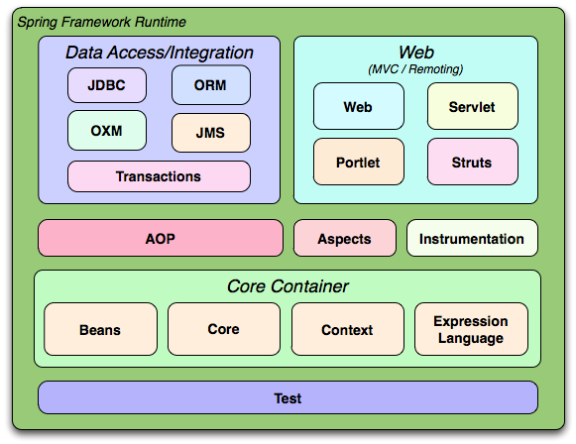
Spring Framework Modules

Slide 6
Spring Framework Modules
Core and Beans modules provide the fundamental parts of the framework
Inversion of Control
Dependency Injection
BeanFactory
Context greatly extends the previous two modules
Provides a framework-level access to the contained objects
Context support
Internationalization, event-propagation and Java EE features
Application Context
Expression Language provides a language for querying and manipulating the object graph at runtime

Slide 7
DEMO
DEMO

Slide 8
Dependency Injection
Dependency Injection – the fundamental feature of Spring
Java itself provides great application development functionality
That is why it is being used so much in the enterprise world
However, it lacks the means to organize the basic building blocks into a coherent structure
Hence the need of implementing various design patterns, such as Factory, Builder etc.
A good developer should know what the pattern does and where to apply it, but why do we have to implement them ourselves?
This is where Spring Framework Inversion of Control (IoC) component comes into play

Slide 9
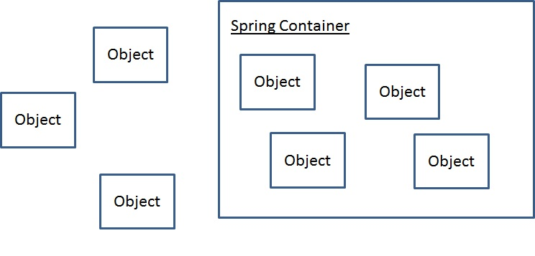
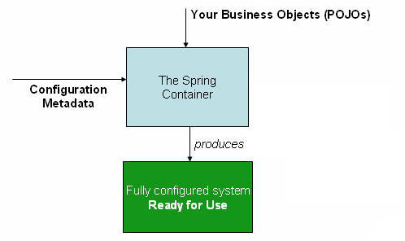
Spring Application Context
The interface org.springframework.context.ApplicationContext represents the Spring IoC container and is responsible for instantiating, configuring, and assembling the aforementioned beans.

Slide 10
Spring Application Context
XML-based configuration: Configuration metadata is traditionally supplied in a simple and intuitive XML format
Annotation-based configuration: Spring 2.5 introduced support for annotation-based configuration metadata.
Java-based configuration: Starting with Spring 3.0, many features provided by the Spring JavaConfig project became part of the core Spring Framework. Thus you can define beans external to your application classes by using Java rather than XML files. To use these new features, see the @Configuration, @Bean, @Import and @DependsOn annotations.

Slide 11
ApplicationContext implementations
The most commonly used ApplicationContext implementations are:
FileSystemXmlApplicationContext: This container loads the definitions of the beans from an XML file. Here you need to provide the full path of the XML bean configuration file to the constructor.
ClassPathXmlApplicationContext This container loads the definitions of the beans from an XML file. Here you do not need to provide the full path of the XML file but you need to set CLASSPATH properly because this container will look bean configuration XML file in CLASSPATH.
WebXmlApplicationContext: This container loads the XML file with definitions of all beans from within a web application.

Slide 12
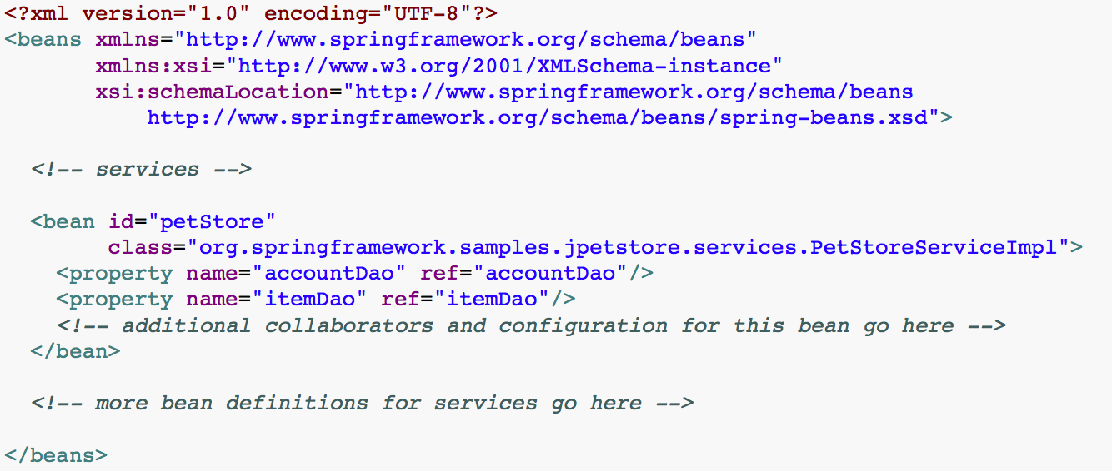
ApplicationContext implementations
Instantiate XML context
ApplicationContext context = new ClassPathXmlApplicationContext("spring-config.xml");
PetStoreServiceImpl helloService = context.getBean(“petStore”, PetStoreServiceImpl.class);
List userList = service.getUsernameList();

Slide 13
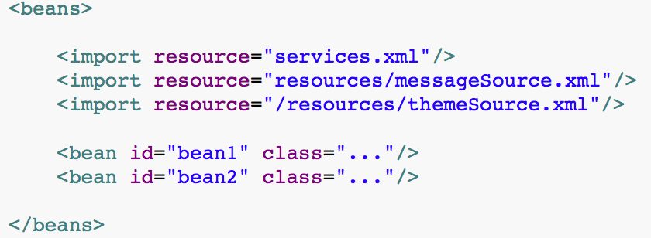
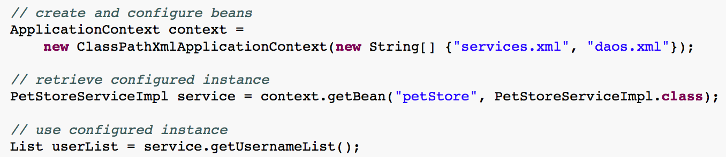
ApplicationContext implementations
We can use the application context constructor to load bean definitions from all these XML fragments. This constructor takes multiple Resource locations, as was shown in the previous section. Alternatively, use one or more occurrences of the <import/> element to load bean definitions from another file or files. For example:

Slide 14
Spring Bean Lifecycle
Id
Unique identifier of a bean
Unique per application context
Name
Can be used as kind of aliases
Does not have to be unique
You can specify multiple names separated by comma, semicolon or space
Container-generated unique name
Generated only if no id nor name is supplied
Cannot be wired using ref elements
<bean id="exampleBean” name=“bean” class="examples.ExampleBean"/>
<bean name="anotherExample" class="examples.ExampleBeanTwo"/>
<bean class=“examples.ExampleBeanThree”/>

Slide 15
Instantiating beans
With constructor
<bean id="foo" class="x.y.Foo">
<constructor-arg ref="bar"/>
<constructor-arg ref="baz"/>
</bean>
<bean id="bar" class="x.y.Bar"/>
<bean id="baz" class="x.y.Baz"/>

Slide 16
Instantiating beans
With constructor
With static factory method
<bean id="clientService"
class="examples.ClientService"
factory-method="createInstance"/>
…..
public class ClientService {
private static ClientService clientService = new ClientService();
private ClientService() {}
public static ClientService createInstance() {
return clientService;
}
}

Slide 17
Instantiating beans
With constructor
With static factory method
With instance factory method
<!-- the factory bean, which contains a method called createInstance() -->
<bean id="serviceLocator" class="examples.DefaultServiceLocator">
<!-- inject any dependencies required by this locator bean -->
</bean>
<!-- the bean to be created via the factory bean -->
<bean id="clientService"
factory-bean="serviceLocator"
factory-method="createClientServiceInstance"/>

Slide 18
Bean Scopes
The Spring Framework supports following five scopes, three of which are available only if you use a web-aware ApplicationContext.
Scope | Description
singleton | This scopes the bean definition to a single instance per Spring IoC container (default).
prototype | This scopes a single bean definition to have any number of object instances.
request | This scopes a bean definition to an HTTP request. Only valid in the context of a web-aware Spring ApplicationContext.
session | This scopes a bean definition to an HTTP session. Only valid in the context of a web-aware Spring ApplicationContext.
global-session | This scopes a bean definition to a global HTTP session. Only valid in the context of a web-aware Spring ApplicationContext.

Slide 19
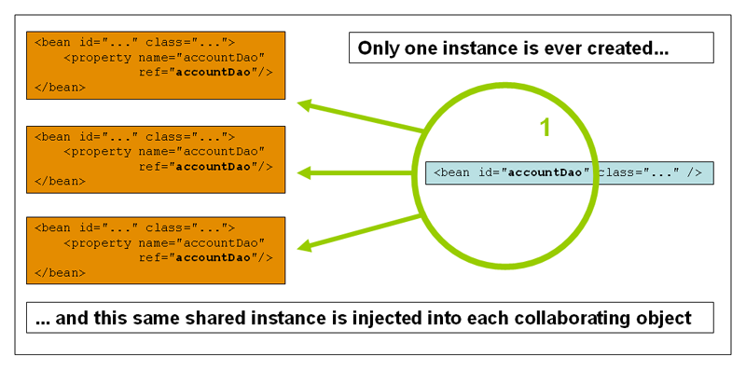
Initialization, use, and destruction phases
Singleton Scope
- Same bean instance injected to all the requesting beans
- Default behavior in Spring

Slide 20
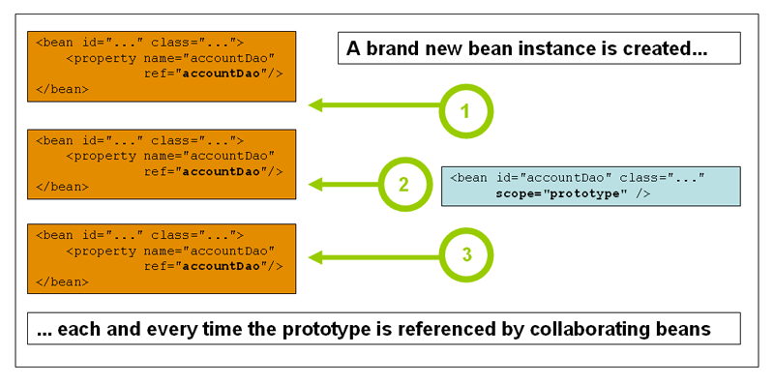
Initialization, use, and destruction phases
Prototype
- Each time the bean is requested, a new instance will be constructed
- Should be used for stateful beans

Slide 21
Initialization, use, and destruction phases
Example
<?xml version="1.0" encoding="UTF-8"?>
<beans xmlns="http://www.springframework.org/schema/beans"
xmlns:xsi="http://www.w3.org/2001/XMLSchema-instance"
xsi:schemaLocation="http://www.springframework.org/schema/beans
http://www.springframework.org/schema/beans/spring-beans-3.0.xsd">
<bean id="helloWorld" class="com.tutorialspoint.HelloWorld"
scope="singleton">
</bean>
</beans>

Slide 22
Annotation-Based Dependency Injection
Once <context:annotation-config/> is configured, you can start annotating your code to indicate that Spring should automatically wire values into properties, methods, and constructors. Let us see few important annotations to understand how they work:
S.N. | Annotation & Description
1 | @Required The @Required annotation applies to bean property setter methods.
2 | @Autowired The @Autowired annotation can apply to bean property setter methods, non-setter methods, constructor and properties.
3 | @Qualifier The @Qualifier annotation along with @Autowired can be used to remove the confusion by specifiying which exact bean will be wired.
4 | JSR-250 Annotations Spring supports JSR-250 based annotations which include @Resource, @PostConstruct and @PreDestroy annotations.

Slide 23
Spring Application Context
@Autowired
1) Can be applied to:
Setter methods
Arbitrary methods
Constructors and fields
public class MovieRecommender {
@Autowired
private MovieCatalog movieCatalog;
private CustomerPreferenceDao customerPreferenceDao;
@Autowired
public MovieRecommender(CustomerPreferenceDao customerPreferenceDao) {
this.customerPreferenceDao = customerPreferenceDao;
}
// ...
}

Slide 24
Spring Application Context
@Autowired
1) Can be applied to:
Setter methods
Arbitrary methods
Constructors and fields
2) Can be used to wire all beans of a particular type
public class MovieRecommender {
@Autowired
private MovieCatalog[] movieCatalogs;
@Autowired
private Set<MovieCatalog> movieCatalogSet;
// ...
}}

Slide 25
Spring Application Context
@Autowired
1) Can be applied to:
Setter methods
Arbitrary methods
Constructors and fields
2) Can be used to wire all beans of a particular type
3) Required by default, but this behavior can be changed
public class SimpleMovieLister {
private MovieFinder movieFinder;
@Autowired(required=false)
public void setMovieFinder(MovieFinder movieFinder) {
this.movieFinder = movieFinder;
}
// ...
}

Slide 26
Annotation-Based Dependency Injection
Autowiring and component scanning
Normally you declare all the beans or components in XML bean configuration file, so that Spring container can detect and register your beans or components. Actually, Spring is able to auto scan, detect and instantiate your beans from pre-defined project package, no more tedious beans declaration in in XML file.
<beans xmlns="http://www.springframework.org/schema/beans"
xmlns:xsi="http://www.w3.org/2001/XMLSchema-instance"
xmlns:context="http://www.springframework.org/schema/context"
xsi:schemaLocation="http://www.springframework.org/schema/beans
http://www.springframework.org/schema/beans/spring-beans-3.0.xsd
http://www.springframework.org/schema/context
http://www.springframework.org/schema/context/spring-context-3.0.xsd">
<context:component-scan base-package=”com.ptc.controller" />
</beans>

Slide 27
Annotation-Based Dependency Injection
Auto Components Scan Annotation Types
@Component – Indicates a auto scan component.
@Repository – Indicates DAO component in the persistence layer.
@Service – Indicates a Service component in the business layer.
@Controller – Indicates a controller component in the presentation layer.
You will noticed that all @Repository,@Service or @Controller are annotated with @Component. So, can we use just @Component for all the components for auto scanning? Yes, you can, and Spring will auto scan all your components with @Component annotated.

Slide 28
Categories of design patterns
Design patterns are grouped into several categories:
Creational patterns (Singleton, Builder, Factory Method)
Structural patterns (Bridge, Decorator, Facade, Front Controller)
Behavioral patterns (Interpreter, Memento, Visitor, Chain of responsibility)
Concurrency patterns (Monitor, Scheduler, MDP)
Architectular patterns (MVC, Peer-to-peer)

Slide 29
Model-View-Controller design pattern
Model-View-Controller is an architectural design pattern for implementing user interfaces
Divides application into three interconnected parts in order to separate internal representations of information from ways that information is exchanged with user
Originally developped for desktop computing, however has been widely adopted as an architecture for World Wide Web applications in all major programming languages

Slide 30
Model-View-Controller design pattern
In addition to dividing the application into three kinds of components, MVC design pattern also defines interactions between them:
Model: notifes its associated views and controllers when there has been a change in its state
View: recieves all neccessary information from the controller for generation an output representation to the user. It can also pass user input into controllers
Controller: sends commands to the model to update the model’s state. It can also send commands to associated view to change representation of the model

Slide 31
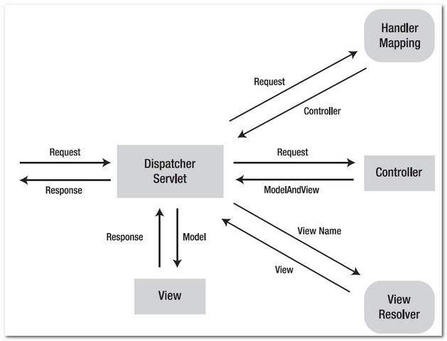
Spring Web MVC – request life cycle

Slide 32
Spring Web MVC – request life cycle
Dispatcher servlet: front controller of the framework which is responsible for delegating control to the various interfaces during the execution phases of a HTTP request.
HandlerMapping: selecting objects that handle incoming requests (handlers) based on any attribute or condition internal or external to those requests

Slide 33
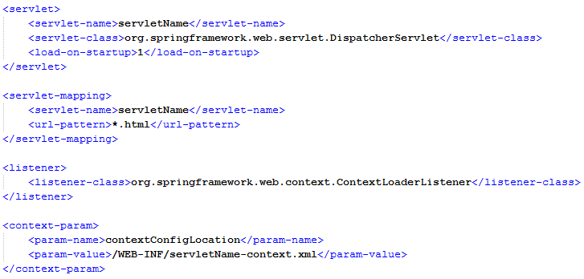
Spring Web MVC – Dispatcher servlet
The front controller
Definition and configuraton of the dispatcher servlet is stored in WEB-INF/web.xml
Name of the servlet is important, as by default Spring will lookup for the context in SERVLET_NAME-context.xml file

Slide 34
Spring Web MVC – HandlerMapping
By default, Spring automatically registers a RequestMappingHandlerMapping bean as a HandlerMapping interface implementation
It replaced the DefaultAnnotationHandlerMapping in Spring 3.2.x
Matches request to controllers using the annotations
Fine solution in most situations
Spring comes with other implementations, for example: SimpleUrlHandlerMapping or BeanNameUrlHandlerMapping, however developer must specify handling mapping manually in context
User can develop own handling interceptors by implementing HandlerInterceptor if they want to apply specific functionality to certain request

Slide 35
Spring Web MVC – request life cycle
Controller: comes between Model and View to manage incoming requests and redirect to proper response. It acts as a gate that directs the incoming information. It switches between going into model or view.

Slide 36
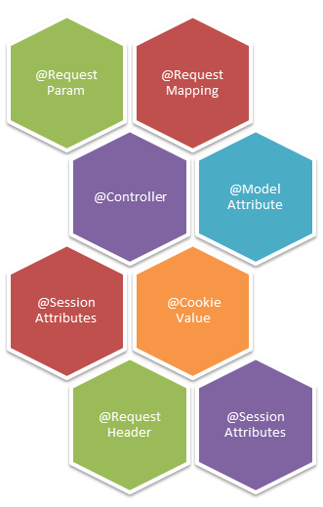
Spring Controllers
Since Spring 3.0, a new way of declaring Controller beans has been provided – using a @Controller annotation
Using annotation-based controllers allows the developers to create their controllers as POJOs which do not depend on Spring-specific interfaces and/or abstract classes
Spring provides number of annotations to fully support Controllers development

Slide 37
Spring Controllers - @RequestMapping annotation
@RequestMapping annotation is used to map a particular HTTP request method (GET/POST) to specific class (or method) in controller which will handle the respective request
The annotation can be applied both at class and method level
In class level we can map the URL of the request
In method level we can map the url as well as HTTP request method
Use of wildcard characters (*) for path pattern matching

Slide 38
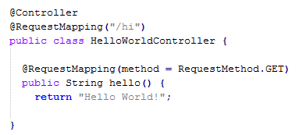
Spring Controllers - @RequestMapping annotation

Slide 39
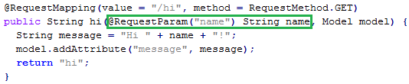
Spring Controllers - @RequestParam annotation
@RequestParam annotation is used to bind request parameter to a variable in method scope
In above example value from parameter „name” is bound to name variable:
Example request: http://localhost:8080/hi?name=John
String name value: John

Slide 40
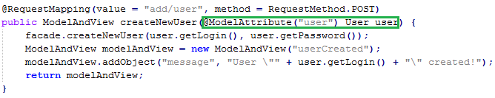
Spring Controllers - @ModelAttribute annotation
@ModelAttribute can be used to map method parameter to an attribute in a model
Usually used when processing forms
In above example we are passing User object and controller calls facade method to create new user in model
Finally it returns „userCreated” view with appropriate message by ModelAndView object

Slide 41
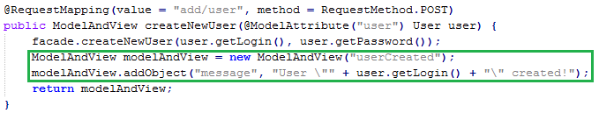
Spring Controllers – ModelAndView object
ModelAndView object is one of the possible return type objects for controller methods
It combines model variables and name of the view to be returned
In above example we are creating ModelAndView object so it redirects to userCreated view (in constructor) and adding new object named „message” with String value to be passed to the view
We can add any kind of object to ModelAndView
Asside from ModelAndView, thera are few other supported return types for controller methods

Slide 42
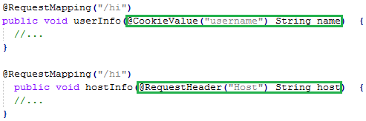
Spring Controllers – Other annotations
@SessionAttribute annotation is used when we declare session attributes in controller methods
@CookieValue annotation is used to bind a method parameter to a HTTP cookie
@RequestHeader annotation is used to bind a HTML header value to a method parameter

Slide 43
Spring Controllers - @Controller annotation
With annotation-driven MVC, any class annotated with @Controller becomes a Spring controller and it just tells the IoC container that this bean is a designated controller class
The dispatcher servlet will scan all the classes from base-package (and any nested packages) and instantiate beans annotated with @Controller annotation
Each @Controller will then be scanned for provided @RequestMapping, which will allow the HandlerMapping to associate controllers methods with an actual HTTP address
In order to enable autoscanning and detecion of MVC beans you must add following declaration in Spring context:

Slide 44
Spring Web MVC – request life cycle
ViewResolver: selecting a View based on a logical name for the view (use is not strictly required)
View: responsible for returning a response to the client. Some requests may go straight to view without going to the model part; others may go through all three.

Slide 45

Spring Web MVC – ViewResolver and View
By default, Spring automatically registers a InternalResourceViewResolver bean as a ViewResolver interface implementation (extenstion of UrlBasedViewResolver)
Usually, Spring developers redeclares the bean with application-specific properties, for example:
There are several other ViewResolver implementations, for example:
AbstractCachingViewResolver (provdies caching mechanism)
XmlViewResolver (configuration of views written in XML)
ResourceBundleViewResolver (configuration stored in properties file)
UrlBasedViewResolver (simplest view resolver, matching views by names)
There may be more than one view resolver within single servlet (priority mechanism)

Slide 46
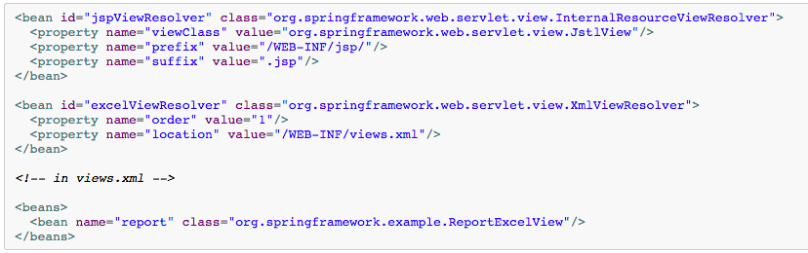
Spring Web MVC – ViewResolver and View
There may be more than one view resolver registered within a single servlet
We just need to customize the order

Slide 47
Spring Web MVC – request life cycle
The front controller
Definition and configuraton of the dispatcher servlet is stored in WEB-INF/web.xml
Name of the servlet is important, as by default Spring will lookup for the context in SERVLET_NAME-context.xml file

Slide 48
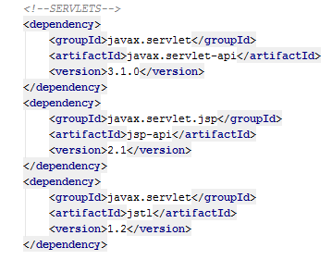
Spring Web MVC – Maven dependencies
If you are planning to use jsp pages as a view component you will probably want to have JSTL tag collection available:
Note that newer versions of this artifacts may be available in repositories

Slide 49
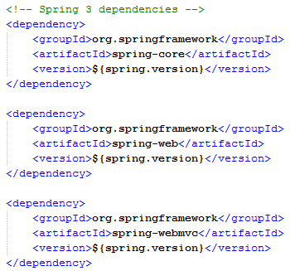
Spring Web MVC – Maven dependencies
In order to use Spring Web MVC in your application you have to add following dependecies into your Maven pom.xml file:

Slide 50
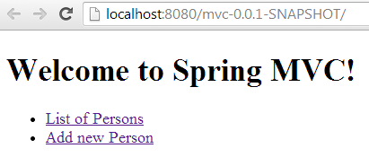
Live demo – Create welcome page
Create new Spring MVC application with single page
On the page we should have menu which contains two actions:
List of Persons
Add new Person
All labels should be taken from properties file (not hardcoded)
Welcome message should be passed from designated Controller

Slide 51
Initial project
git clone https://github.com/msztec/uni.git
cd uni
mvn clean install

Slide 52
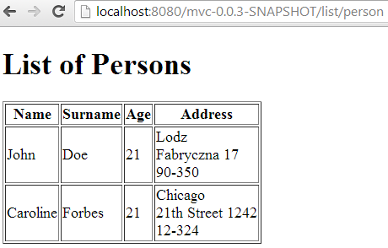
Live demo – Display list of Persons
Create new view where list of Persons will be displayed
The page should be navigated from welcome page via „List of Persons” link
New controller class should be implemented for this purpuse
In the controller there must be TrainingFacade injected

Slide 53
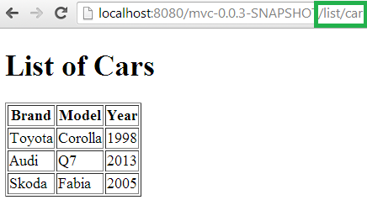
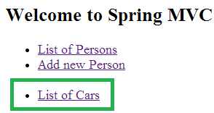
Exercise 2.1 – Display list of Cars
Create new view where list of Cars will be displayed (with new link on welcome page and label value from property)
The page should be navigated from welcome page via „List of Cars” link
New controller class should be implemented for this purpuse
In the controller there must be TrainingFacade injected

Slide 54
Handling Forms
Spring comes with taglib repository for handling forms:
It’s similar to simple HTML <form> tag, however provides much more
Automatic binding of model bean properties to form inputs
Controller methods can fill in default values for model objects (method GET)
Form logic in corresponding Controller (method POST)
Binding errors displayed in form itself

Slide 55
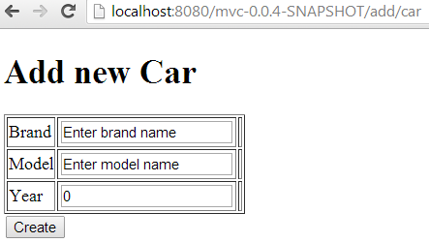
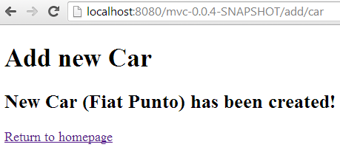
Live demo – Create new Car
Create new view with form for creating new Car object
Existing CarController should be used for handling the form logic
Default values must be filled in
Binding errors should be displayed in the form
In case of success, new view should be displayed with proper information

Slide 56
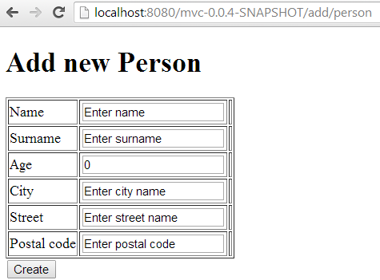
Exercise 2.2 – Create new Person
Create new view with form for creating new Person object
Existing PersonController should be used for handling the form logic
Default values must be filled in
Binding errors should be displayed in the form
In case of success, new view should be displayed with proper information

Slide 57
Data validation
Spring provides number of OOTB validators (represented by annotations), for example:
@NotNull
@Digits
@Max/@Min
@Pattern
Annotations comes from javax.validation group
Custom validators can be developped by creating new annotation and corresponding validator class inherited from ConstraintValidator
Validation errors are displayed in <f:errors /> tag
Validation is enabled by @Valid annotation in binding method (for example in Controller)

Slide 58
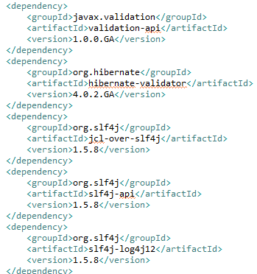
Data validation – Maven dependencies
For custom validators you must add following dependencies to your pom.xml:

Slide 59
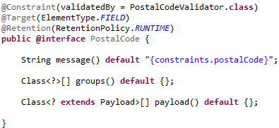
Data validation – custom annotation

Slide 60
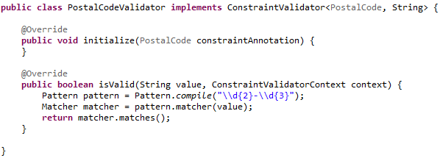
Data validation – custom validator

Slide 61
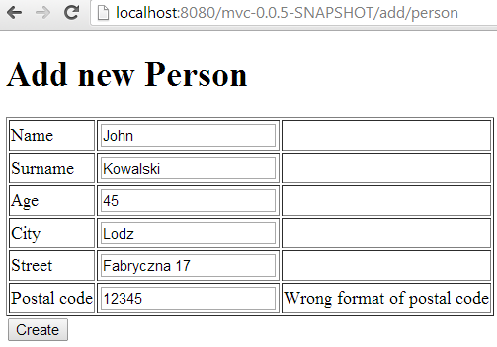
Live demo – Create validator for postal code
Add custom validator to postal code field of Address class

Slide 62
www.tt.com.pl

