Slide 1
C# async await

Slide 2
The need for Async
Need responsive user interfaces
App features are ofen dependent on:
network access
database functionality or I/O
complex processing on mobile CPUs
stuff that takes some time
You want to run these on a different thread to keep the UI
responsive... they should be ASYNCHRONOUS!
Fast!
Long running tasks!
Threads!

Slide 3
What is “async”?
Tasks running outside of the main program flow
Code runs on another thread, so the UI doesn’t block/freeze
Completion runs on the calling thread, so if you started on the
UI that’s where you’ll be after the async task is complete
async and await syntax in C# 5 takes Task support to the next
level!
Frameworks need to support it on long running tasks
Task Parallel Library (TPL)
has been around a while

Slide 4
Old-style
Threads are too low level
Threads are not the answer
Thread creation is expensive
Each managed thread takes 1MB of stack space
Context switching is expensive
Writing asynchronous methods is difficult
Using callbacks for continuations (Callbacks are the new “GOTO”)
Error handling, Cancellation, Progress Reporting is complicated
Doesn’t feel natural
Notes:
http://blogs.msdn.com/b/somasegar/archive/2010/10/28/making-asynchronous-programming-easy.aspx
With Async, our goal now is to make asynchronous programming far more approachable so asynchronous code is as easy to write and maintain as synchronous code. Making your code asynchronous should require only simple changes and should be possible to implement in a non-disruptive manner in your code. At the same time, it should be evident when code is “going async” so that the inherently-concurrent nature of the method can be understood at a glance.

Slide 5

Task
Task
A Task is promise of a result that will delivered at some time in future
Awaiters
Tasks are the backing types for async methods in .Net 4.5
Compositional
Tasks can be composed using continuations
Farewell
Threads
Two types
Task
Task<T>
Hollywood Principle
“Don’t call us, we’ll call you”
Awaiters
Tasks are the backing types for async methods in .Net 4.5
Cancellable
Tasks can be designed to be cancelled easily
Notes:
http://en.wikipedia.org/wiki/Hollywood_principle

Slide 6
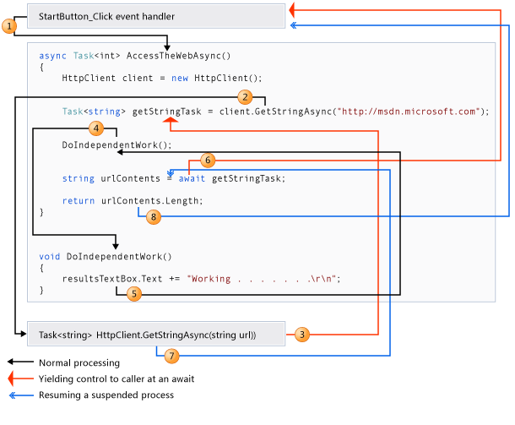
Using async
Notes:
http://msdn.microso!.com/en-us/library/vstudio/hh191443.aspx

Slide 7
Using async
async keyword informs the compiler that this method needs to be
“munged”
await keyword indicates a suspension point where a callback
needs to be generated, along with error handling
Continuations are generated after each suspension point
Error handling (support for enclosing try-catch) is taken care of
All you need to remember is async and await
and use Tasks

Slide 8
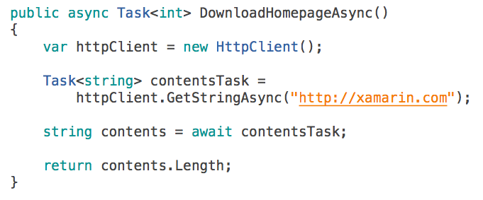


How to use: async?
async modifier on methods, lambdas and anonymous methods
use Async suffix, eg LoadAsync, SendAsync
return Task or Task<T> preferably
Task for methods that don’t return a value
Task<T> to return a value
void for event handlers only!
void for event handlers

Slide 9
How to use: async?
await keyword on awaitable objects (Tasks)
only within an async context
marks a suspension point - control is returned to caller
can’t be used in catch or finally blocks
Task, Task<T> or a custom type
get a reference
to the Task first
... or just await

Slide 10
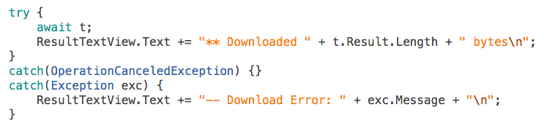
How to use: error handling?
async Task or Task<T>
Returned TaskState == Faulted
Exception re-thrown when task is awaited
async void methods (event handlers)
Exception is thrown on the current synchronization context and the app will crash...

Slide 11
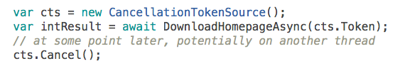
How to use: cancellation?
Cancellation is optional
provide another Async method, usually an overload, that
takes a CancellationToken parameter
caller uses the token
async tasks complete with Faulted state (time for this to happen isn’t guaranteed)
Cancellation.None means it won’t be cancelled by the caller

Slide 12
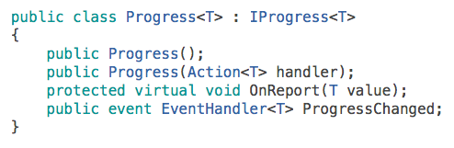
How to use: progress reporting?
Progress reporting is optional
provide another Async overload with an IProgress<T> parameter
basic Progress<T> implementation can be used
exposes EventHandler<T> ProgressChanged
send events to
track progress

Slide 13
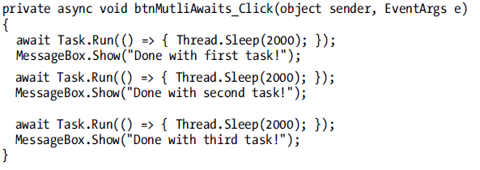
Async Methods with Multiple Awaits
A single async method can have multiple await contexts.

Slide 14
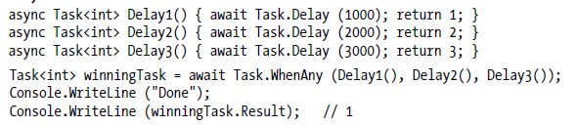
Task Combinators
Task.WhenAny returns a task that completes when any one of a set of tasks complete.The following completes in one second:
Task.WhenAll returns a task that completes when all of the tasks that you pass to it complete. The following completes after three seconds

Slide 15
Async Doesn’t Solve Everything
You need to be careful with lots of things that behave differently when you use async, including:
• Exceptions and try..catch...finally blocks
• Return values of methods
• Threads and context
• Performance

Slide 16
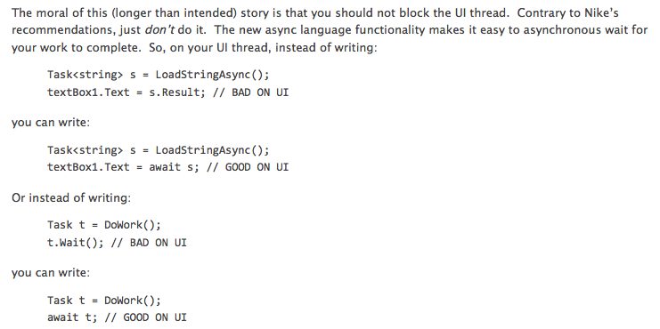
WARNING: Await, and UI, and deadlocks
Notes:
http://blogs.msdn.com/b/pfxteam/archive/2011/01/13/10115163.aspx

Slide 17
Async in .Net 4.5 BCL
System.Xml.XmlReader
public virtual Task<bool> ReadAsync()
System.Net.Mail
public Task SendMailAsync( MailMessage message )
Methods doing IO
System.Net.Http.HttpClient
public Task<string> GetStringAsync( string requestUri )
System.IO.Stream
public Task CopyToAsync( Stream destination )
System.Net.WebSockets
public abstract Task<WebSocketReceiveResult> ReceiveAsync( ArraySegment<byte> buffer, CancellationToken cancellationToken )
System.IO.TextReader
public virtual Task<int> ReadAsync( char[] buffer, int index, int count )

Slide 18
Async in WPF/WinForms apps
Caller
Void Async Method
Task Async Method
Awaitable
UI
thread
IOCP
thread
async void
LoadPhotosAsync(string tag)
{
…
var photosTask = GetPhotosAsync(tag, page);
var photos = await photosTask;
DisplayPhotos(photos);
}
async Task<FlickrPhoto[]>
GetPhotosAsync(string tag, int page)
{
WebClient client = new WebClient();
var webTask = client.DownloadStringTaskAsync(…);
var apiResponse = await webTask;
var photos = ParseResponse(apiResponse);
return photos;
}
webTask

Slide 19
Async in Server Apps
Thread Pool Exhaustion
IIS
Worker
Process
DB
ASP.Net
IIS I/O Thread
WS
MaxConcurrentRequestsPerCPU
File
Worker Threads
Waiting for I/O ops
To complete
HTTP.SYS
Kernel
Queue
HTTP
Requests
Notes:
http://msdn.microsoft.com/en-us/library/ee728598.aspx
On the Web server, the .NET Framework maintains a pool of threads that are used to service ASP.NET requests. When a request arrives, a thread from the pool is dispatched to process that request. If the request is processed synchronously, the thread that processes the request is blocked while the request is being processed, and that thread cannot service another request. If all available threads might be blocked. This condition is known as thread starvation. When this condition is reached, the Web server queues requests. If the request queue becomes full, the Web server rejects requests with an HTTP 503 status (Server Too Busy).
However, during an asynchronous call, the server is not blocked from responding to other requests while it waits for the first request to complete. Therefore, asynchronous requests prevent request queuing when there are many requests that invoke long-running operations.
When an asynchronous action is invoked, the following steps occur:
1. The Web server gets a thread from the thread pool (the worker thread) and schedules it to handle an incoming request. This worker thread initiates an asynchronous operation.
2. The worker thread is returned to the thread pool to service another Web request.
3. When the asynchronous operation is complete, it notifies ASP.NET.
4. The Web server gets a worker thread from the thread pool (which might be a different thread from the thread that started the asynchronous operation) to process the remainder of the request, including rendering the response.
http://blogs.msdn.com/b/tmarq/archive/2007/07/21/asp-net-thread-usage-on-iis-7-0-and-6-0.aspx
in IIS 7.5 and 7.0 integrated mode, ASP.NET restricts the number of concurrently executing requests. Obviously if the reqeusts are synchronous, then the number of concurrently executing requests is the same as the number of threads concurrently executing requests, but if the requests are asynchronous then these two numbers can be quite different as you could have far more requests than threads.

Slide 20
ASP.Net Core Services
Asynchronous HTTP modules
public class MyHttpModule : IHttpModule
{
private async Task
ScrapeHtmlPage(object caller, EventArgs e)
{
await ...
}
public void Init(HttpApplication
context)
{
EventHandlerTaskAsyncHelper helper =
new EventHandlerTaskAsyncHelper(ScrapeHtmlPage);
context.AddOnPostAuthorizeRequestAsync(
helper.BeginEventHandler, helper.EndEventHandler);
}
}
Asynchronous HTTP handlers
public class MyAsyncHandler : HttpTaskAsyncHandler
{
public override async Task ProcessRequestAsync(HttpContext context)
{
await …
}
}
Notes:
http://www.asp.net/vnext/overview/whitepapers/whats-new

Slide 21
ASP.Net MVC 4
Controller
Derive from AsyncController ??
Timeout
[AsyncTimeout(2000)]
[HandleError(ExceptionType = typeof(TaskCanceledException), View = "TimedOut")]
Actions
async methods returning Task or Task<ActionResult>
Notes:
http://msdn.microsoft.com/en-us/library/hh420390(v=vs.110).aspx

Slide 22
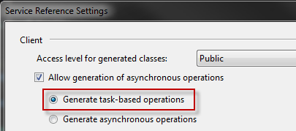
WCF
Service: Async operations
[ServiceContract]
public interface IDemoService
{
[OperationContract]
Task<string> GetStockQuoteAsync(string ticker);
}
public class DemoService : IDemoService
{
public async Task<string> GetStockQuoteAsync (string ticker)
{
await ...
}
}
Client: Async proxies
Use svcutil or Add Service Reference
var proxy = new StockQuoteService.StockQuoteSoapClient();
var quote = await proxy.GetQuoteAsync("MSFT");

Slide 23
VS 2012 Unit Tests
Async Test Methods – return Task
[TestMethod]
public async Task UnitTestMethod()
{
await Task.Delay(1000);
Assert.AreEqual(1,1);
}
Test Frameworks
MS Test – Supports async, Built in test provider
xUnit – Supports async in v1.9, downloadable test provider
NUnit – Doesn’t support async, downloadable test provider
Execution Time
1 sec

Slide 24
ADO.Net
Tabular Data Stream Protocol
Worker
Thread
reader.NextResult()
i/o
Result Set
“DONE”
Token
Result Set
“DONE”
Token
reader.Next()
i/o
“ROW”
Token
Row
“ROW”
Token
Row
“ROW”
Token
Reader.IsDBNull()
i/o
Column
Header
Column
Data
Column
Header
Column
Data
Column
Header
pa
ck
et
s
Large Column e.g. varbinary(8000)
Notes:
http://blogs.msdn.com/b/adonet/archive/2012/04/20/using-sqldatareader-s-new-async-methods-in-net-4-5-beta.aspx
http://blogs.msdn.com/b/adonet/archive/2012/07/15/using-sqldatareader-s-new-async-methods-in-net-4-5-beta-part-2-examples.aspx

Slide 25
ADO.Net
Recommendations
Use CommandBehavior.SequentialAccess
Unless reading large columns
Use
NextResultAsync() and ReadAsync()
Use
Synchronous column access
IsDBNull, GetFieldValue<T>
Unless reading large columns
IsDBNullAsync, GetFieldValueAsync<T>
Use
Streaming for massive columns
GetStream()
GetTextReader()
GetXmlReader()
Notes:
In roadmap for Entity Framework 6
http://msdn.microsoft.com/en-us/library/hh556234(v=vs.110).aspx

Slide 26
Resources
http://msdn.microsoft.com/en-US/async
C# (implementation details) - https://msmvps.com/blogs/jon_skeet/archive/tags/Eduasync/default.aspx
Async in C# 5.0 https://the-eye.eu/public/Books/IT%20Various/async_in_c_5.0.pdf

