Slide 1
Def Con Reverse Engineering Arm / Ghidra
Internet of Things is expected to grow to 30 billion devices in two years
Introduction
Reason for Project (ARM64 Hardware, Ubuntu Core Server, Ghidra)
Introduce the Banking Project Program
Reverse Engineering with Ghidra
Code Injection and Function Hooking
Demonstrate Exploit
Questions
More Info in Def Con Forum - https://forum.defcon.org/node/228721

Slide 2

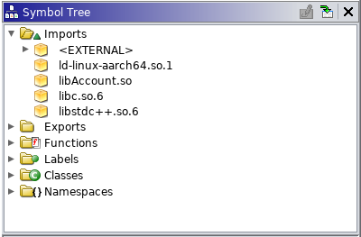
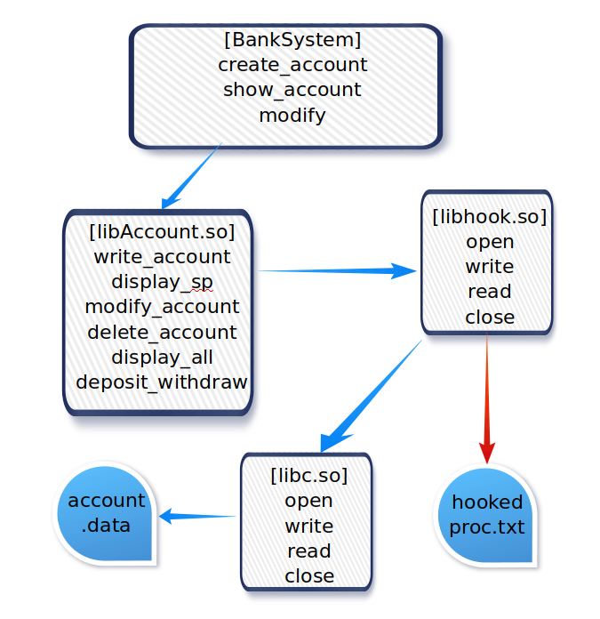
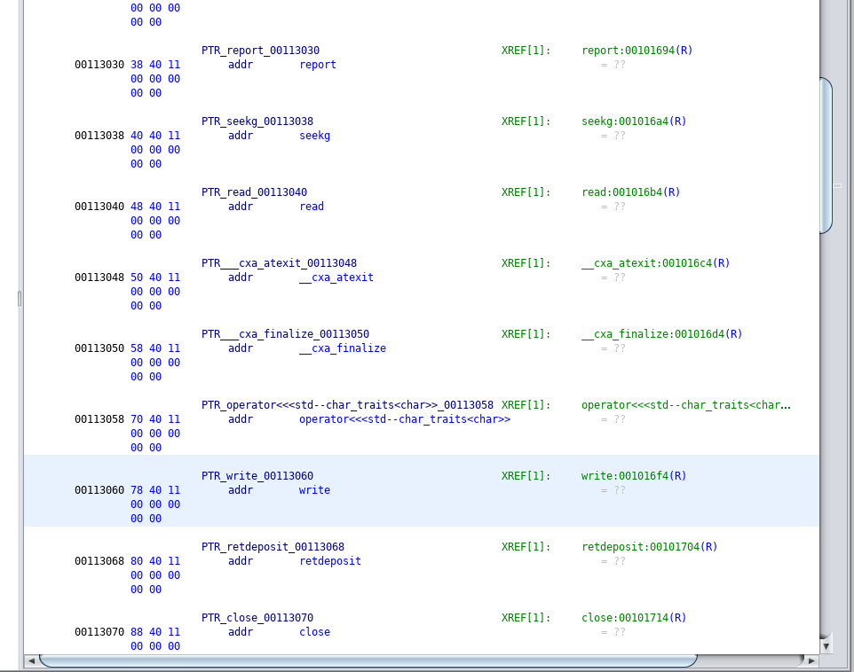
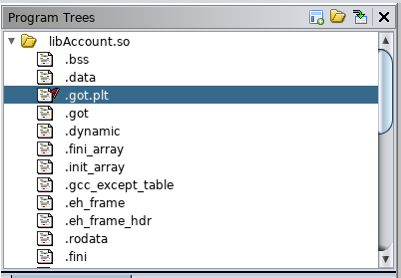
Reverse Engineering Embedded ARM with Ghidra

