Slide 1
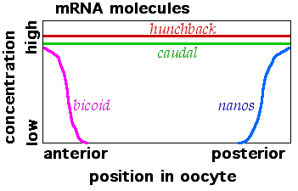
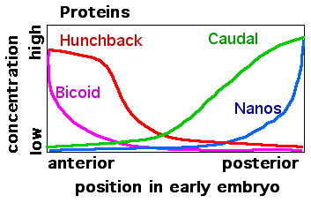
ESTABLISHMENT OF MORPHOGEN GRADIENTS DURING
DROSOPHILA melanogaster EMBRYOGENESIS
Jemma Kehoe, Max Conway, Jonathon Very
INTRODUCTION
During metazoan embryonic development morphogen gradients are one method used to provide naive tissues with positional information. Morphogen gradients determine pattern production by inducing target genes and the corresponding downstream developmental programs at specific concentrations.
Drosophila embryogenesis has been used as model system to understand the establishment and effects of morphogen gradients. During Drosophila embryogenesis the formation of morphogen gradients define both the anterior-posterior and dorso-ventral axis, providing the basis of hierarchical gene expression networks which are vital for the segmentation of the embryo.
Maternal mRNAs are deposited into the Drosophila oocyte before fertilisation and localised as seen in Fig1. Following translation and diffusion of the protein products high anterior to low posterior gradients of bicoid and hunchback are formed, with opposing gradients of nanos and caudal (Fig 1). During this early stage of development, up to cycle 14, the embryo is a syncytium. These morphogens define broad domains of zygotic gene expression which set up segmentation in the embryo.
Despite the extensive research on the establishment of the Bicoid and Nanos gradients and their downstream effects on Hunchback and Caudal translation, the system has not been modelled stochastically.
AIM?
Fig 1
ESTABLISHMENT of the BICOID GRADIENT
The gradient of Bicoid in the early Drosophila Embryo is generally believed to be established by the diffusion of the bicoid protein following translation of maternal mRNA which is deposited at the anterior pole of the embryo. There is however much controversy about the exact mechanisms involved.
Existing models proposed in Grimm et al., 2011 and more recent experimental data were used to build multiple models of the establishment of the Bicoid gradient up to cycle 14. Comparing data from our models to data from the FlyEx database (reference) to determine the optimum model and parameters.
ADDITION OF NANOS
Nanos acts as a translational repressor of bicoid mRNA. Addition of nanos into model 6 further tuned our simulated data and improved the match to FlyEx data.
Bicoid + nanos
MODELS TESTED (Fig 2)
Different bicoid diffusion coefficient. Experimental data is inconclusive on the diffusion coefficient (D). Values of D between the minimum, 0.3μm²/s, and maximum, 7.4μm²/s, reported rates were modelled. (1-3)
Increasing translation rate during development to match experimental data(reference). (4)
Bicoid mRNA gradient REFERNCE demonstrated a gradient of bicoid mRNA forms around cycle 3. Directed diffusion of the bicoid mRNA was initiated at fertilisation (5) and at the end of cycle 3 (6).
Bicoid concs
CONTROL of CAUDAL and HUNCHBACK TRANSLATION
Caudal and hunchback mRNA were uniformly distributed across the embryo. The following interactions were added to produce caudal and hunchback gradients:
Bicoid inhibits caudal translation
2) Nanos inhibits hunchback translation
3) Bicoid activates zygotic hunchback transcription
The hunchback promoter has 6 Bicoid binding sites and 2 self regulatory hunchback binding sites. Rates for each binding event and transcriptional rates for each TF complex were defined (REFERENCE).
Something about gradient of hunchback with and without bicoid acting as a TF
All 4 proteins
Simulation shot
OPTIMUM MODEL
Heat map
Surface plot
CONCLUSION & DISCUSSION
Stochasitc stuff worked! Not really sure what our conclusion is…
REFERENCES

