Slide 1
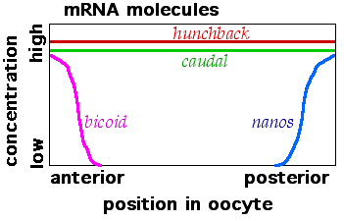
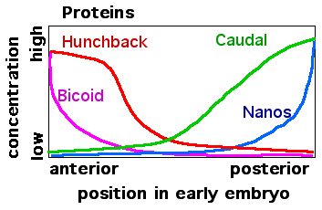
ESTABLISHMENT OF MORPHOGEN GRADIENTS DURING
DROSOPHILA melanogaster EMBRYOGENESIS
Jemma Kehoe, Max Conway, Jonathon Very
INTRODUCTION
During metazoan embryonic development morphogen gradients are one method used to provide naive tissues with positional information. Morphogen gradients determine pattern production by inducing different target genes at different concentrations.
During Drosophila embryogenesis the formation of morphogen gradients define both the anterior-posterior and dorso-ventral axis, providing the basis of hierarchical gene expression networks which underly the segmentation of the embryo. Maternal mRNAs are deposited into the Drosophila oocyte before fertilisation and localised as seen in Fig1. Following translation and diffusion of the protein products, anterior to posterior gradients of morphogens are formed (Fig 1). These morphogens define broad domains of zygotic gene expression which in turn induce expression of genes that set up segmentation in the embryo.
Despite the extensive research on the establishment of the Bicoid and Nanos gradients and their downstream effects on Hunchback and Caudal translation, the system has not been modelled stochastically.
Fig 1
ESTABLISHMENT of the BICOID GRADIENT
The gradient of bicoid in the early Drosophila Embryo is established by the diffusion of the bicoid protein following translation of maternally-deposited bicoid mRNA at the anterior pole of the embryo. There is controversy about the exact mechanisms involved.
Existing models¹ and more recent experimental data were used to build multiple models of the establishment of the Bicoid gradient up to cycle 14. Data from our models was compared to data from the FlyEx database² to determine the optimum model and parameters.
ADDITION OF NANOS
Nanos acts as a translational repressor of bicoid mRNA. Addition of nanos into model 6 improved the match to FlyEx data.
Bicoid + nanos
PARAMETERS TESTED
1) Varying Bicoid diffusion coefficient.
Experimental data is inconclusive on the diffusion coefficient of Bicoid (D). Varying values of D were tested. (a-c)
2) Increasing translation rate of bicoid.
Translation of bicoid increases during development due to polyadenylation of the mRNA³. (d)
3) bicoid mRNA gradient. A gradient of bicoid mRNA has been demonstrated to form around 20 mins after fertilisation (cycle 3)⁴. Directed diffusion of the bicoid mRNA was initiated at fertilisation (e) and at the end of cycle 3 (f).
Bicoid concs
CONTROL of CAUDAL and HUNCHBACK TRANSLATION
Caudal and hunchback mRNA were uniformly distributed across the embryo. The following interactions were added to produce caudal and hunchback gradients:
Bicoid inhibits caudal translation
2) Nanos inhibits hunchback translation
3) Bicoid activates zygotic hunchback transcription
Something about gradient of hunchback with and without bicoid acting as a TF
All 4 proteins
Figure 2 – Gradient of bicoid proteins formed from simulation of different models
(a) D = 0.3μm²/s, (b) D = 4 μm²/s , (c) D = 7.4μm²/s
(d) Increasing translation rate through simulation, D = 4μm²/s
(e-f) As in (d) with directed diffusion of bicoid mRNA initated at fertilisation (e) and at cycle 3 (f).
Simulation shot
Surface plot
CONCLUSION & DISCUSSION
Stochasitc stuff worked! Not really sure what our conclusion is…
OPTIMUM MODEL
REFERENCES
1 Grimm et al., 2011
2 FlyEx
3 Translation rates Coordinate initiation of Drosophila development by regulated polyadenylation of maternal messenger RNAs.

