Slide 1
Senior Project
Max Corder

Slide 2
Overview
Website that will sell PC parts
Will also have recent reviews from all major websites for those products
Customers will be able to read reviews from other customers and then use that information in order to determine whether they should proceed with the purchase or not

Slide 3
Content Thus Far
Everything is obviously a work in progress

Slide 4
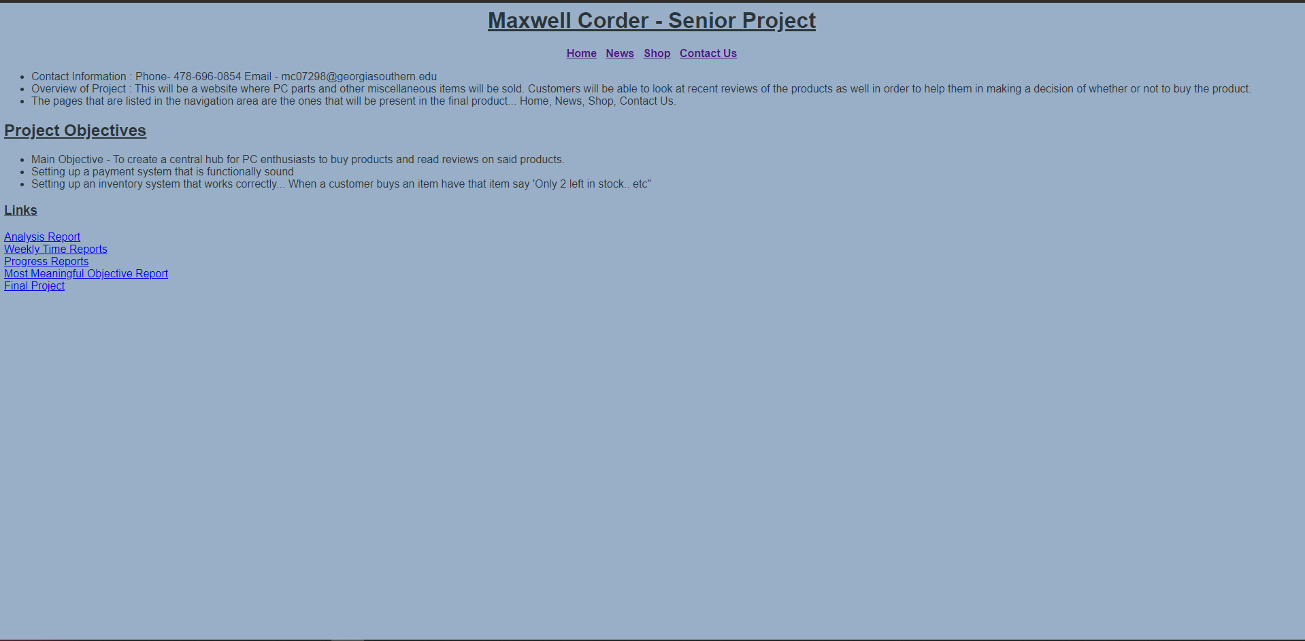
Home Page

Slide 5
Home Page cont.
This page is really for myself at the moment
This is where I will write down my ideas and things, I want to achieve
I will transform this page into a traditional home page for a store later down the road
Will include shortcuts to ‘hot selling’ items, most recent reviews, etc.

Slide 6
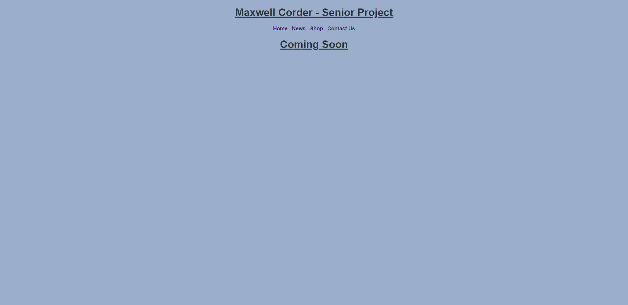
News

Slide 7
News cont.
This will be the main hub for all new products that have just be released
There will be recent articles posted for these products as well as reviews from bigger corporations or ‘YouTubers’
Ex: GTX 3080 benchmark results.

Slide 8
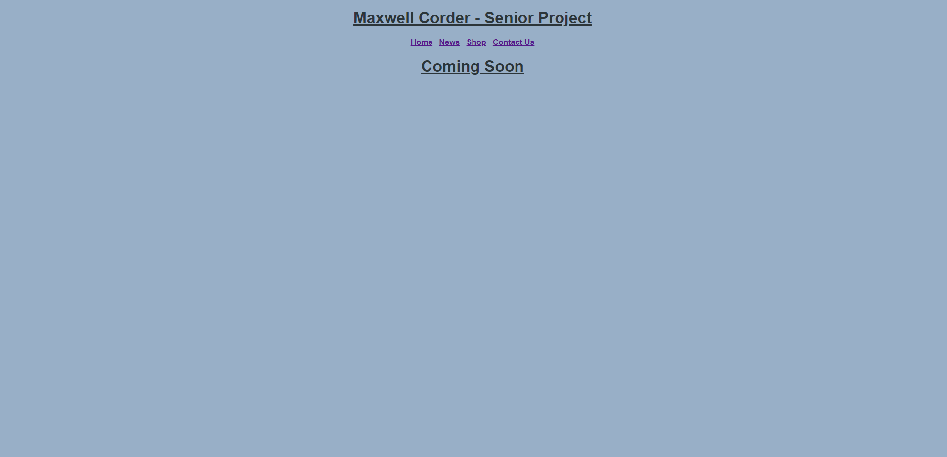
Shop

Slide 9
Shop cont.
This will be the main shopping webpage
All products will be listed here as default with a criteria tab on the left to narrow down results
I am going to be selling primarily PC components (GPU, CPU, PSU, etc.)
I will also put a few peripherals as well like mice, keyboards, and microphones (which I should buy for myself)

Slide 10
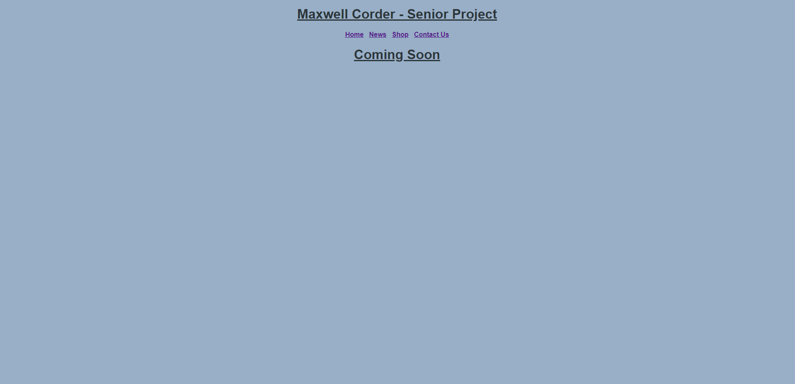
Contact Us

Slide 11
Contact Us cont.
This webpage will contain contact information where customers can voice their issues over the phone or via email

Slide 12
Design
I don’t plan on doing anything over the top, but my finished website will be a step above what current design I have
Currently barebones
Still brainstorming over design/implementation of those designs

Slide 13
Shop
The big thing I will have to figure out will be the checkout and inventory system I will have
Any recommendations/feedback will be welcome.
Sorry no voiceover, I have no microphone.

