Slide 2
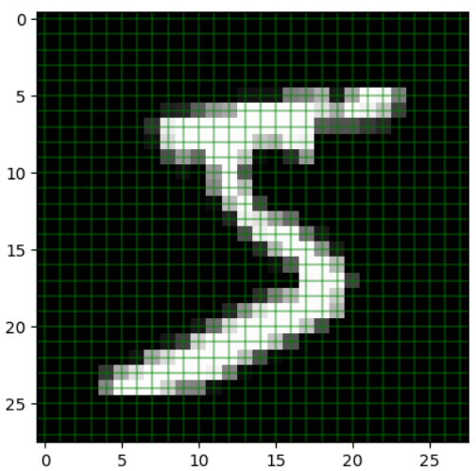

Slide 4
https://poloclub.github.io/cnn-explainer/

