Slide 3
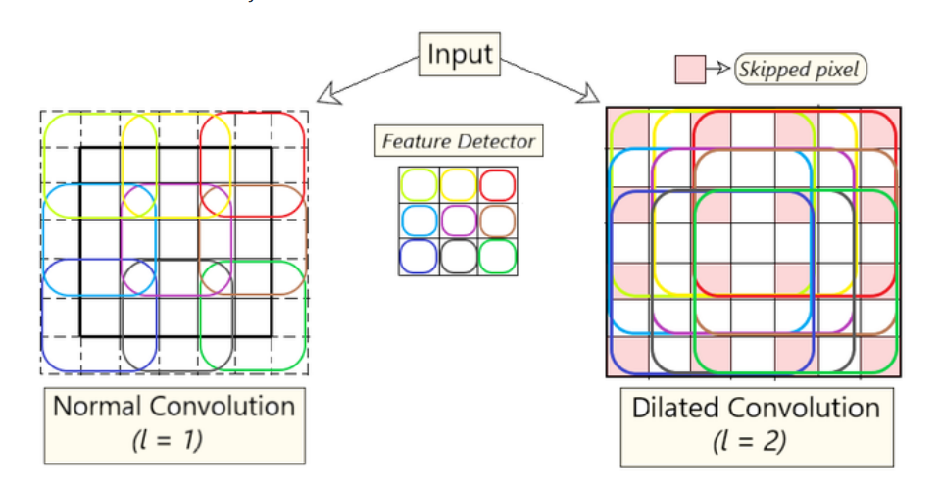
https://www.geeksforgeeks.org/dilated-convolution/

Slide 4
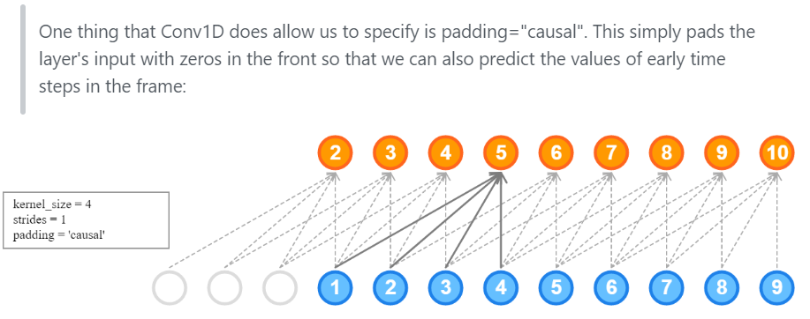
"causal" padding
https://stackoverflow.com/questions/52578950/causal-padding-in-keras

Slide 5
