Slide 2
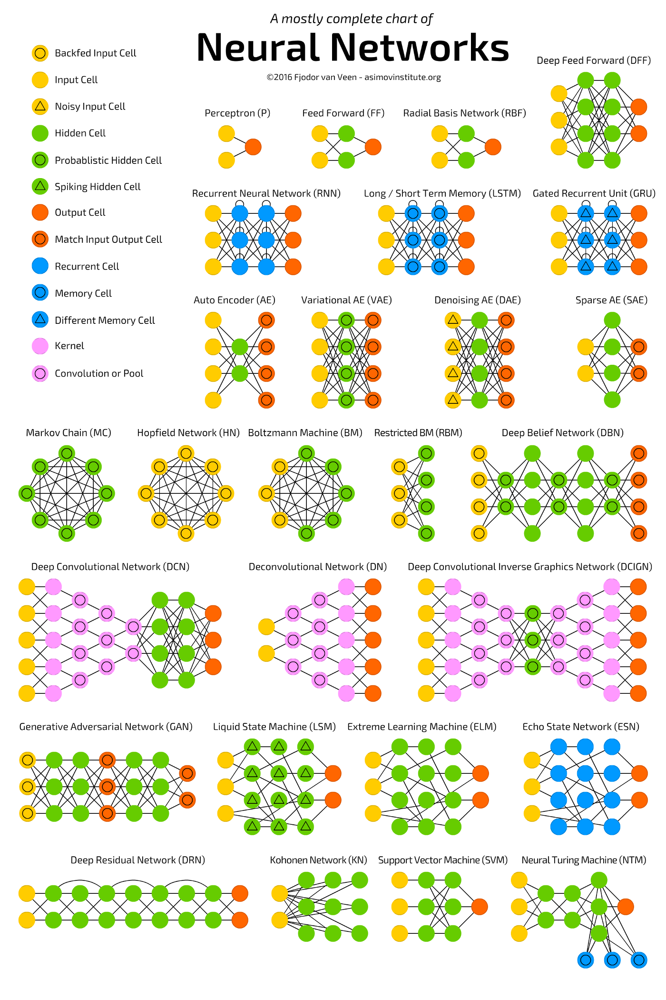
Layers
https://towardsdatascience.com/the-mostly-complete-chart-of-neural-networks-explained-3fb6f2367464

