Slide 2
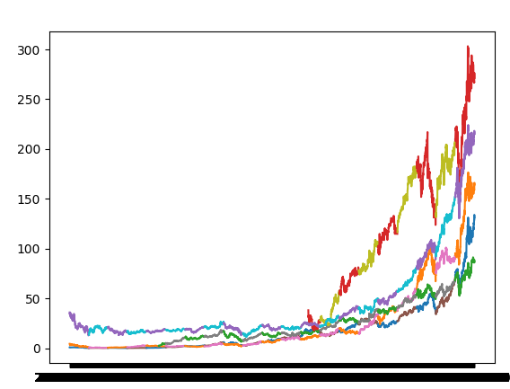
01 visualization

Slide 3
Data
10k data, t-distribution with 2 degree of freedom

Slide 4
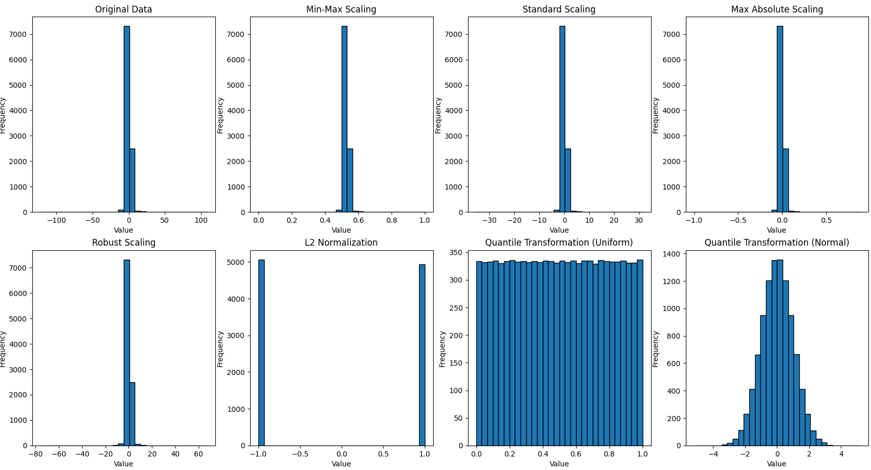

Slide 5
