Slide 1
Get started with GENE

Slide 2
Overview
Step1: Request access to GENE code
Step2: Request allocations of a server
Step3(3 options): Login to the server via terminal
Step4: Download the code to server
Step 5: configure the environment
Step 6: Compile
Step7: Test

Slide 3
Requirment to get started
Basic knowledge of linux command line: https://www.hostinger.com/tutorials/linux-commands
A way to login to remote server:
For windows:
Nomachine https://www.nomachine.com/
Bitvise SSH Client https://www.putty.org/ +Xming https://sourceforge.net/projects/xming/
For iOS:
Nomachine https://www.nomachine.com/

Slide 4
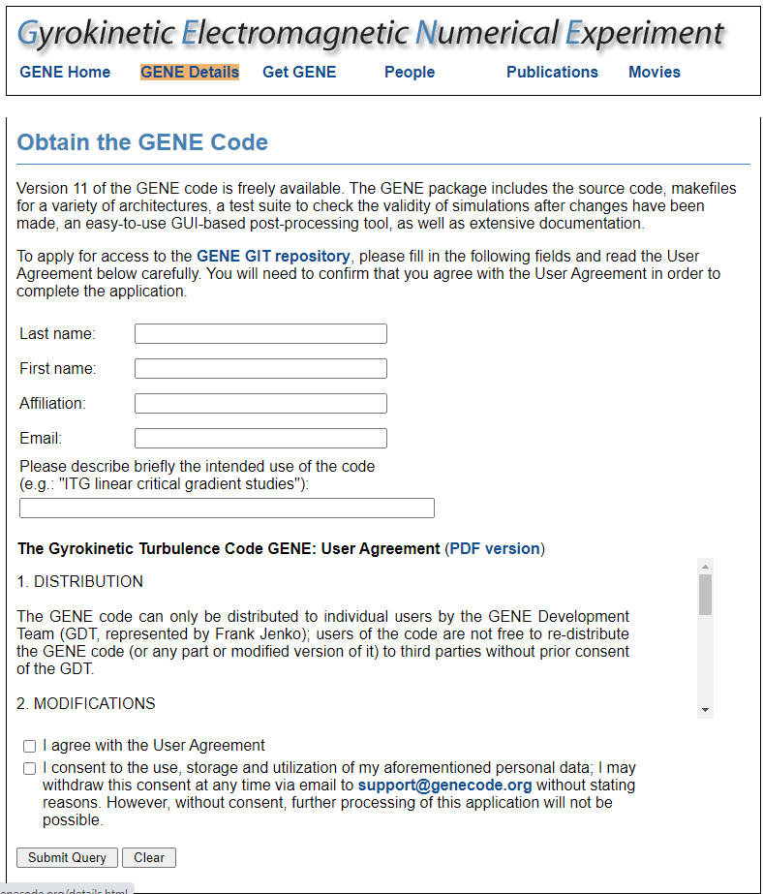
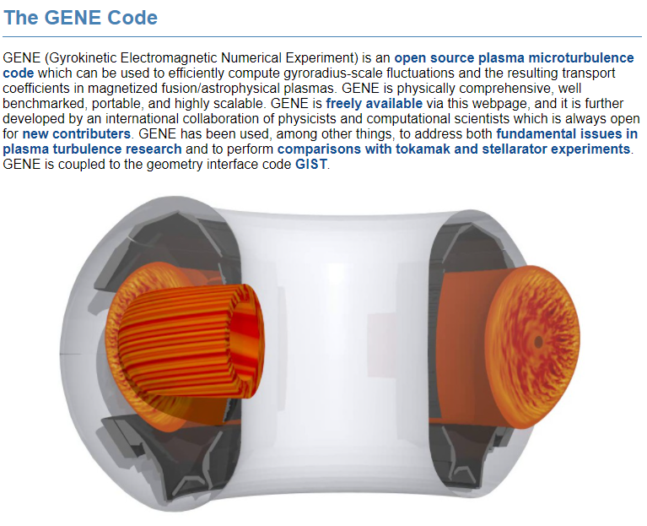
Step1: Request access to GENE code
Go to website http://genecode.org/
Click “Get GENE” and fill the form

Slide 5
Step2: Request allocations of a server
Info
NERSC: https://docs.nersc.gov/getting-started/
TACC: https://www.tacc.utexas.edu/
Get an account
NERSC: https://docs.nersc.gov/accounts/#obtaining-an-account
TACC: https://www.tacc.utexas.edu/

Slide 6
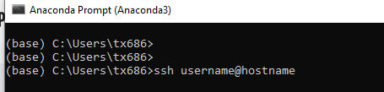
Step3(option 1): Login to the server via terminal
TACC Stampede2: ssh username@stampede2.tacc.utexas.edu
NERSC Cori: ssh username@cori.nersc.gov
General: ssh username@hostname
For enable the graphic do: ssh -X username@hostname
More info: https://phoenixnap.com/kb/ssh-to-connect-to-remote-server-linux-or-windows

Slide 7
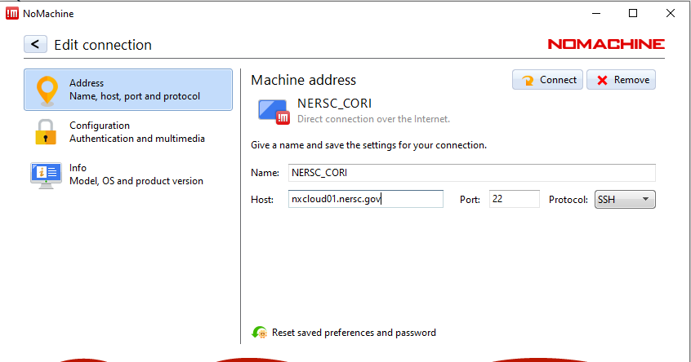
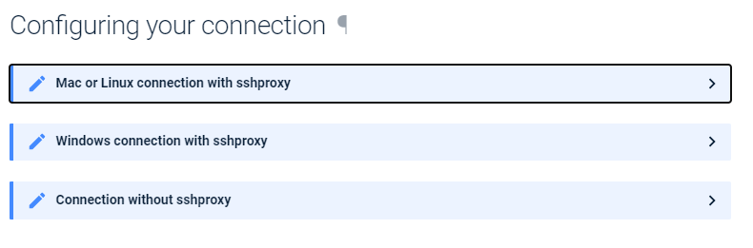
Step3(option 2): Login to the server via nomachine
Step by step guide for NERSC: https://docs.nersc.gov/connect/nx/

Slide 8
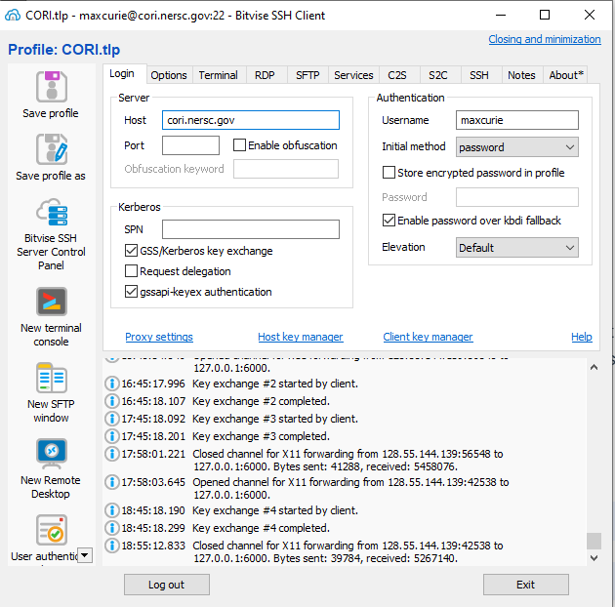
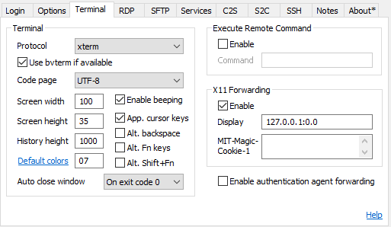

Step3(option 3): Login to the server via SSH client

Slide 9
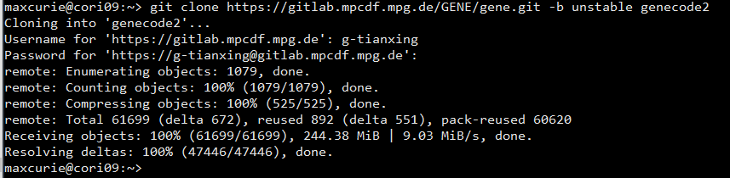
Step4: Download the code to server
Type
git clone https://gitta.rzg.mpg.de/~GENE/guest/git.py/gene.git -b unstable genecode2

Slide 10
Step 5: configure the enviroment
Edit .bashrc.ext
Adding the following line on the right
Save and exit
Source by typing
source ~/.bashrc.ext
module swap craype-haswell craype-mic-knl
module load gnuplot/5.2.5
module load nsg craype PrgEnv-intel
module load PrgEnv-intel
module load atp cray-mpich cray-fftw
module load cray-hdf5-parallel altd darshan
module load cray­-petsc­-complex
module load cray­-fftw
module load cray­-hdf5­-parallel
module load craype
module load python

Slide 11

Step 6: Compile
Getting into the director of genecode2
cd genecode2
Compile and wait to finish
gmake

Slide 12
Step7: Test
Create a new prob
./newprob
Enter the directory
cd prob01/
Submit the simulation job to debug queues
sbatch submit_knl.cmd
Check the status of the job
squeue -u username

Slide 13
Good reference
GENE manual
Merz paper: http://genecode.org/PAPERS_1/merz.pdf
Note from the author: https://www.overleaf.com/read/wtbjzpvkmktw
Video series from the author : https://youtube.com/playlist?list=PLgNi5MiqkBWZqdiHhKQqXiMqsWCFjJXr8

