Slide 1
Get started with GENE
Physics Helper
https://www.youtube.com/playlist?list=PLgNi5MiqkBWZqdiHhKQqXiMqsWCFjJXr8

Slide 2
Pre required skills and recomanded software
Linux command: https://hackr.io/blog/basic-linux-commands
For Windows:
Nomachine (https://www.nomachine.com/)
Bitvise SSH Client (https://www.bitvise.com/ssh-client-download)
Xming (for the graph display: https://sourceforge.net/projects/xming/)
Sublime (code editor: https://www.sublimetext.com/)
For iOS: Nomachine

Slide 3

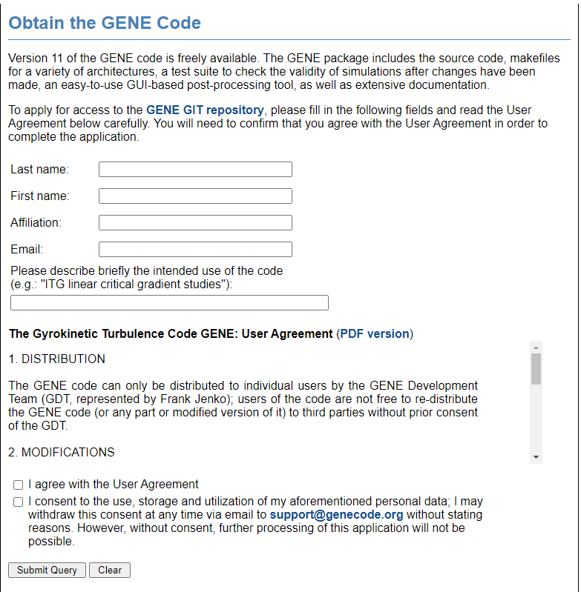
Step1: Request for the access to GENE
Go to: http://genecode.org/
Click get GENE and file the info

Slide 4
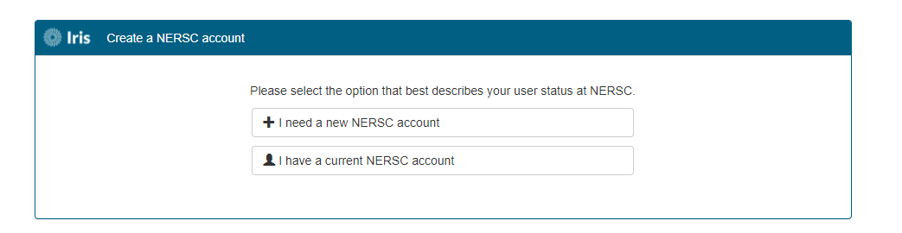
Step2: Request allocation in Supercomputer
Check detail in NERSC accounts in https://docs.nersc.gov/getting-started/

Slide 5
Step3: Get GENE from git
Login the termial
Type the following command line:
git clone https://username@gitta.rzg.mpg.de/~GENE/guest/git.py/gene.git -b unstable genecode

Slide 6
Step4: Setup the enviroment
Put the following the into .bashrc.ext in the home directory
module load gnuplot/5.2.5
module load nsg craype PrgEnv-intel
module load PrgEnv-intel
module load atp cray-mpich cray-fftw
module load cray-hdf5-parallel altd darshan
module load cray­-petsc­-complex
module load cray­-fftw
module load cray­-hdf5­-parallel
module load craype
module load python

Slide 7
Step5: Compile!
Get into the director:
cd genecode
Compile:
gmake

Slide 8
Step6: submit a test run
Create a new simulation folder:
./newprob
Change the parameter in submit.cmd
cd prob01 (get into the simulation folder)
Submit the job
sbatch submit.cmd
Check job status
squeue -u maxcurie

Slide 9
Useful resouces
GENE manual
GENE and its pre post-processing(Max edition):
https://www.overleaf.com/read/wtbjzpvkmktw
YouTube:
https://www.youtube.com/playlist?list=PLgNi5MiqkBWZqdiHhKQqXiMqsWCFjJXr8
Theory thesis about GENE: http://genecode.org/PAPERS_1/merz.pdf

