Slide 1
Structure of output

Slide 2
Naming system
Data_*species_suffix
Example
mom_e.dat
Data= mom , species=electron, Suffix=‘.dat’
energy.dat
Data= mom, Suffix=‘.dat’
energy_0001
Data= mom, Suffix=‘_0001’

Slide 3
Output files
Nrg
Field
Mom
*Omega
Tracer_efit
energy

Slide 4
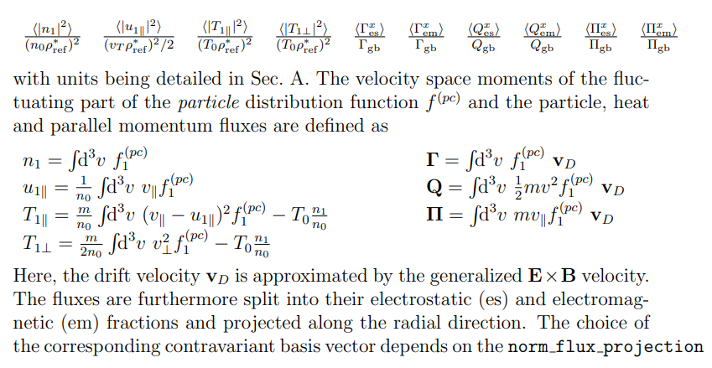
Nrg

Slide 5
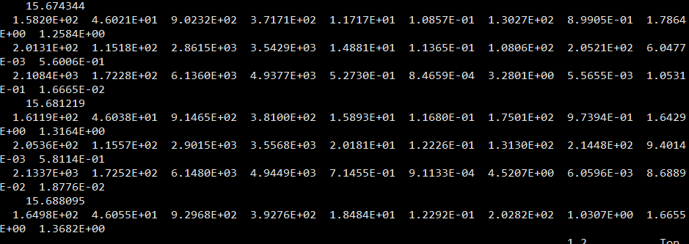
Nrg data
Data from species 1 2 3
Time

Slide 6
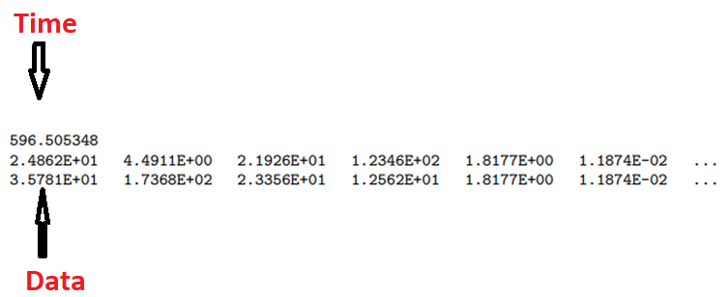
Data structure(field, mom)
Nonlinear: Phi[i_kx, i_ky, i_z]
Linear: Phi[i_x, 0, i_z]

Slide 7
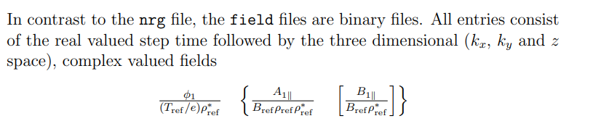
field

Slide 8

mom

Slide 9
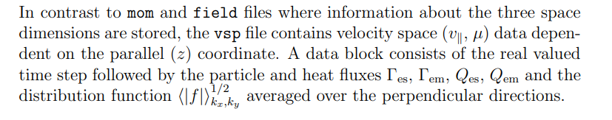
vsp

Slide 10
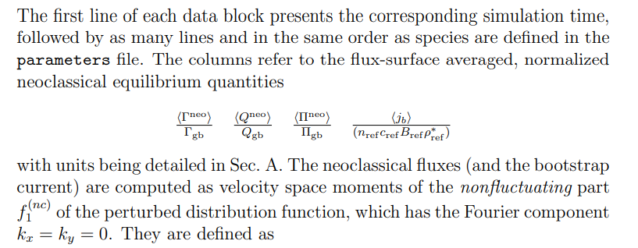
Neoclass*(only in neoclassical)

Slide 11

Omega*(Only in linear)

Slide 12

Eigenvalues*(only in Eigenvalues solver)

Slide 13
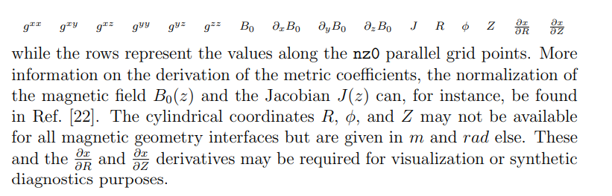
<magn_geometry>.dat

Slide 14
Common quantities(refer to appendix)
Tref: default electron temperature in unit of eV
Any frequency(omega, gamma, coll, nuei…) in the unit of cs/a
Length(x)
Wavenumber(rho_s)
Where cs is the speed of sound, rho_s is larmor radius
Example:
Frequency in cs/a
freq_SI = omega_GENE* C_s/(2*pi*Lref)

Slide 15
Good reference
Chapter 4 in GENE manual
Appendix in GENE manual

