Slide 1
Global Theory of Microtearing Modes in the Tokamak Pedestal
J. L. Larakers , M. Curie , D. R. Hatch, R. D. Hazeltine, and S. M. Mahajan
Institute for Fusion Studies, University of Texas, Austin, Texas 78712, USA
published 4 June 2021
https://link.aps.org/doi/10.1103/PhysRevLett.126.225001

Slide 2
Citation
@article{PhysRevLett.126.225001,
title = {Global Theory of Microtearing Modes in the Tokamak Pedestal},
author = {Larakers, J. L. and Curie, M. and Hatch, D. R. and Hazeltine, R. D. and Mahajan, S. M.},
journal = {Phys. Rev. Lett.},
volume = {126},
issue = {22},
pages = {225001},
numpages = {6},
year = {2021},
month = {Jun},
publisher = {American Physical Society},
doi = {10.1103/PhysRevLett.126.225001},
url = {https://link.aps.org/doi/10.1103/PhysRevLett.126.225001}
}

Slide 3
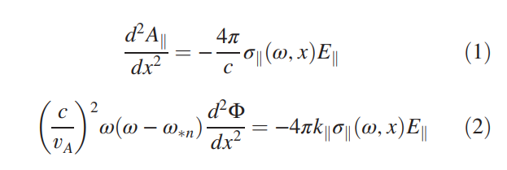
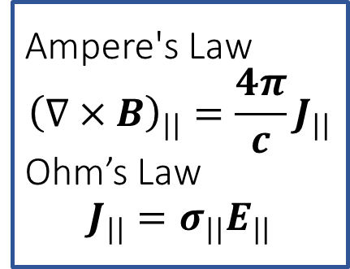
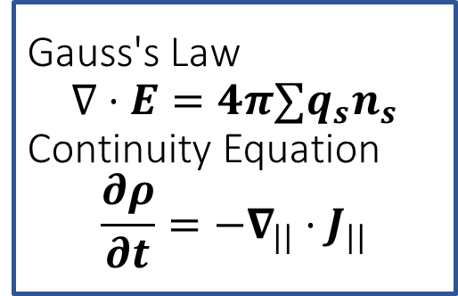
Ampere's Law $${\left(∇×B\right)}_{||}=\frac{4π}{c}J_{||}$$ Ohm’s Law $$J_{||}=σ_{||}E_{||}$$
Gauss's Law $$∇⋅E=4π{∑q_{s}n}_{s}$$ Continuity Equation $$\frac{∂ρ}{∂t}=−∇_{||}⋅J_{||}$$
[9] Kinetic theory of tearing instability: The Physics of Fluids: Vol 18, No 12 (scitation.org)

Slide 4
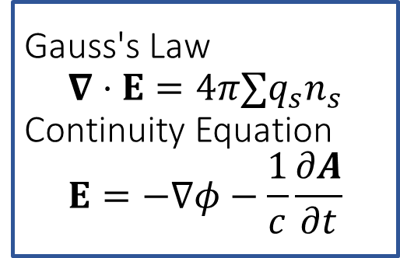
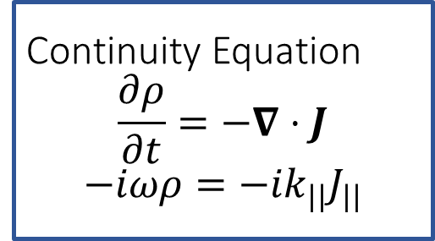
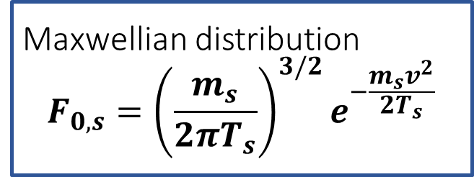
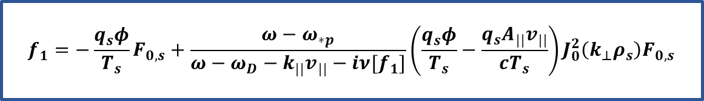


Gauss's Law $$∇⋅E=4π{∑q_{s}n}_{s}$$ Continuity Equation $$E=−∇φ−\frac{1}{c}\frac{∂A}{∂t}$$
$$n_{e}=∫f_{1}\left(v\right)dv$$
$$=∫f_{1}\left(v\right)dv$$
Continuity Equation $$\frac{∂ρ}{∂t}=−∇⋅J$$
$$−iωρ=−{ik}_{||}J_{||}$$
$$J_{||}=∫v_{||}f_{1}\left(v\right)dv$$
$$f_{1}={−\frac{q_{s}φ}{T_{s}}F}_{0,s}+\frac{ω−ω_{∗p}}{ω−ω_{D}−k_{||}v_{||}−iν[f_{1}]}\left(\frac{q_{s}φ}{T_{s}}−\frac{q_{s}A_{||}v_{||}}{cT_{s}}\right)J_{0}^{2}\left(k_{⊥}ρ_{s}\right)F_{0,s}$$
Maxwellian distribution $$F_{0,s}={\left(\frac{m_{s}}{2πT_{s}}\right)}^{3/2}e^{−\frac{m_{s}v^{2}}{2T_{s}}}$$

Slide 5
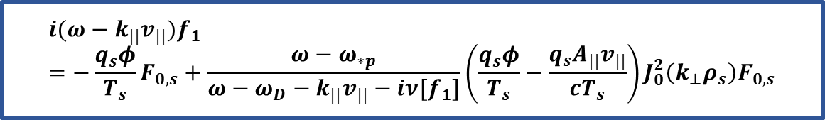
electron drift kinetic equation
$$i(ω−k_{||}v_{||})f_{1}={−\frac{q_{s}φ}{T_{s}}F}_{0,s}+\frac{ω−ω_{∗p}}{ω−ω_{D}−k_{||}v_{||}−iν[f_{1}]}\left(\frac{q_{s}φ}{T_{s}}−\frac{q_{s}A_{||}v_{||}}{cT_{s}}\right)J_{0}^{2}\left(k_{⊥}ρ_{s}\right)F_{0,s}$$

Slide 6
[26] A comprehensive conductivity model for drift and micro-tearing modes: Physics of Plasmas: Vol 27, No 6 (scitation.org)

Slide 7

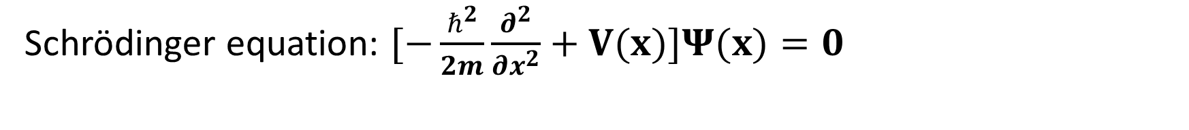
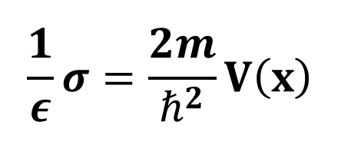
$$\frac{1}{ε}σ=\frac{2m}{ℏ^{2}}V\left(x\right)$$
Final Equation
Schrödinger equation: $[−\frac{ℏ^{2}}{2m}\frac{∂^{2}}{∂x^{2}}+V(x)]Ψ(x)=0$

Slide 8
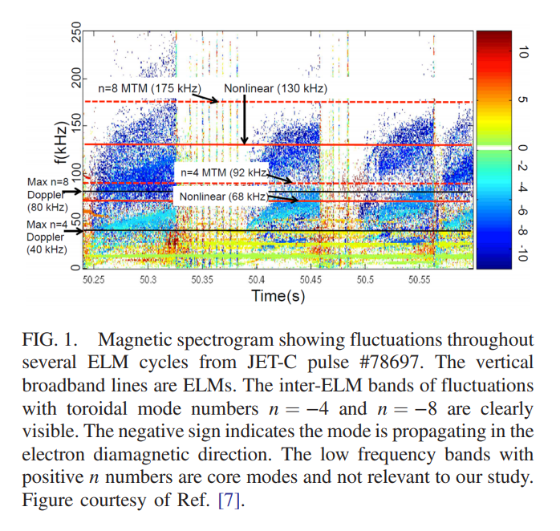

Slide 9
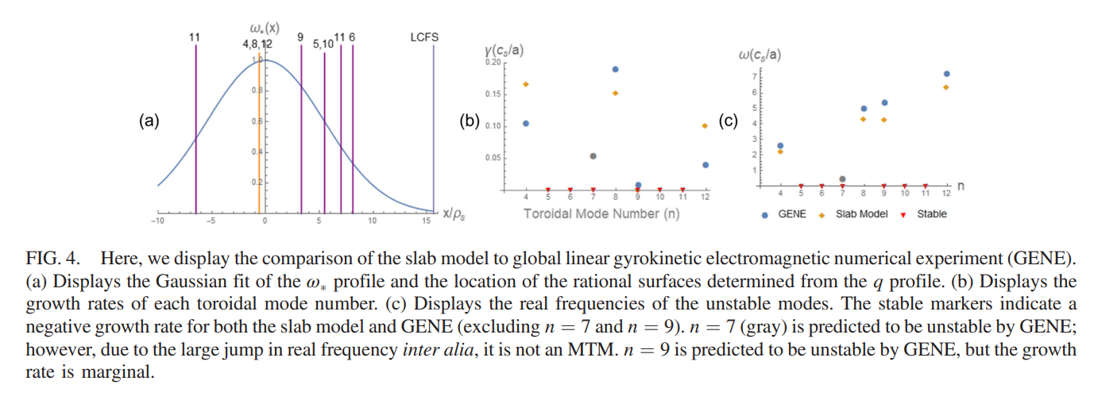

Slide 10
Additional material
GitHub: https://github.com/maxcurie1996/mode_finder

