Slide 1
Get started with GENE

Slide 2
Requirment to get started
Basic knowledge of linux command line: https://www.hostinger.com/tutorials/linux-commands
A way to login to remote server:
For windows:
Nomachine https://www.nomachine.com/
Bitvise SSH Client https://www.putty.org/ +Xming https://sourceforge.net/projects/xming/
For iOS:
Nomachine https://www.nomachine.com/

Slide 3
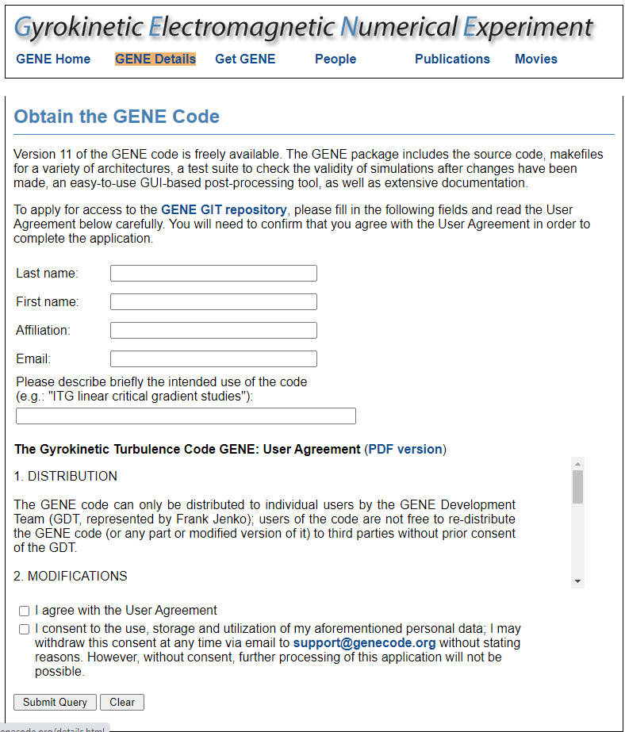
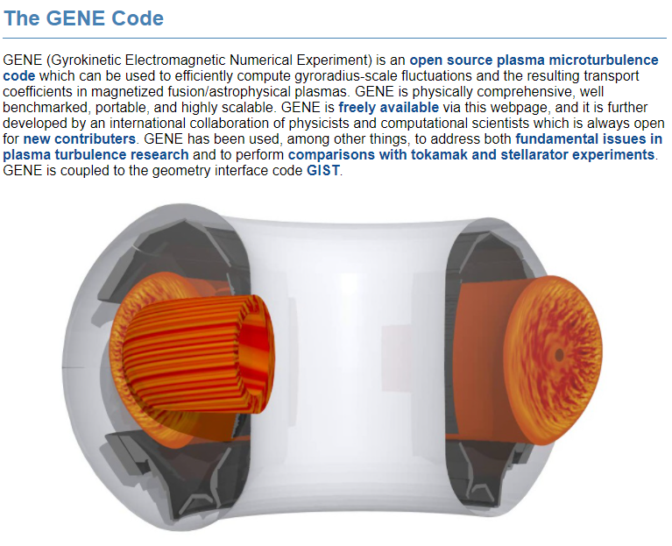
Step1: Request access to GENE code
Go to website http://genecode.org/
Click “Get GENE” and fill the form

Slide 4
Step2: Request allocations of a server
Info
NERSC: https://docs.nersc.gov/getting-started/
TACC: https://www.tacc.utexas.edu/
Get an account
NERSC: https://docs.nersc.gov/accounts/#obtaining-an-account
TACC: https://www.tacc.utexas.edu/

Slide 5
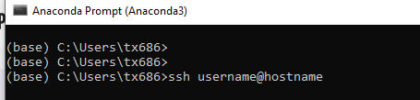
Step3(option 1): Login to the server via terminal
TACC Stampede2: ssh username@stampede2.tacc.utexas.edu
NERSC Cori: ssh username@cori.nersc.gov
General: ssh username@hostname
For enable the graphic do: ssh -X username@hostname
More info: https://phoenixnap.com/kb/ssh-to-connect-to-remote-server-linux-or-windows

Slide 6
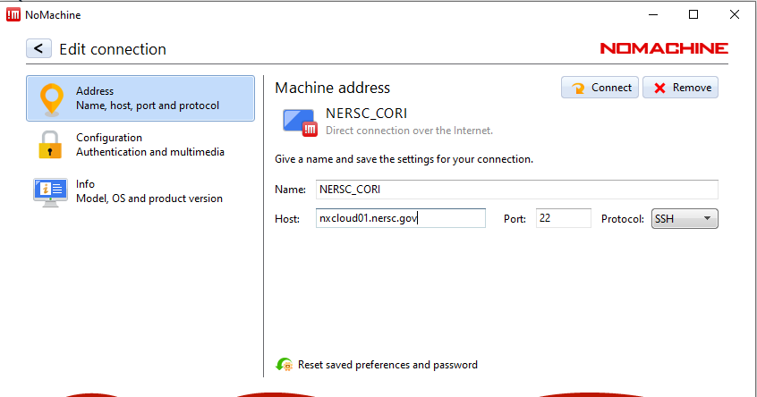
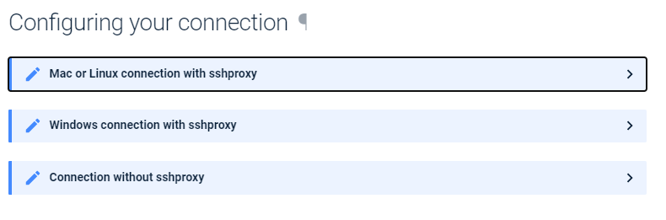
Step3(option 2): Login to the server via nomachine
Step by step guide for NERSC: https://docs.nersc.gov/connect/nx/

Slide 7
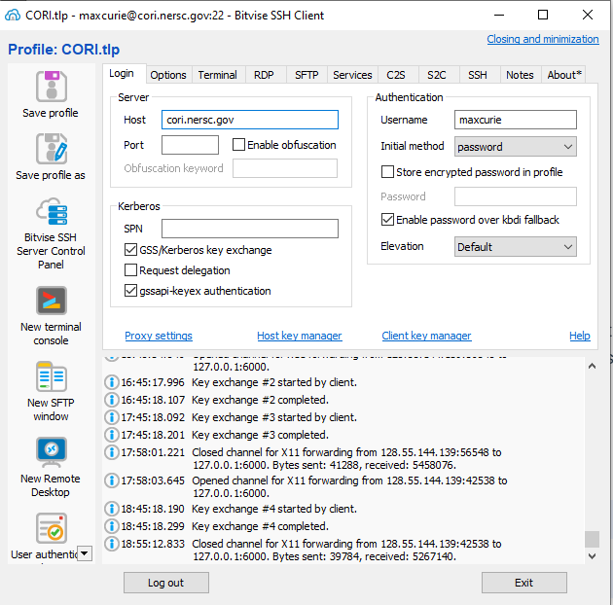
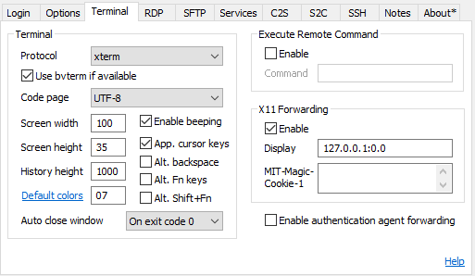

Step3(option 3): Login to the server via SSH client

Slide 8
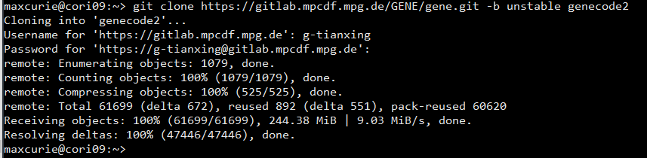
Step4: Download the code to server
Type
git clone https://gitta.rzg.mpg.de/~GENE/guest/git.py/gene.git -b unstable genecode2

Slide 9
Step 5: configure the enviroment

