Slide 1
Pitfalls of FFT and spectral density
https://youtu.be/jZVekQ2ZDXQ

Slide 2
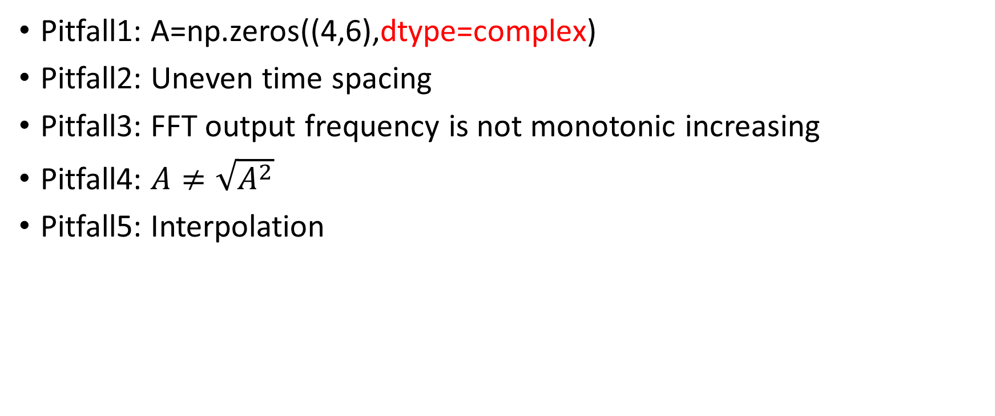
Pitfalls
Pitfall1: A=np.zeros((4,6),dtype=complex)
Pitfall2: Uneven time spacing
Pitfall3: FFT output frequency is not monotonic increasing
Pitfall4: $A≠\sqrt{A^{2}}$
Pitfall5: Interpolation

Slide 3

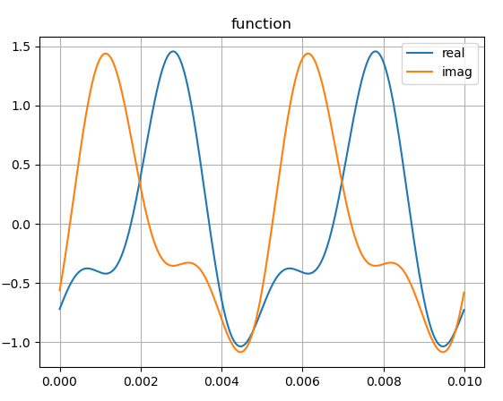
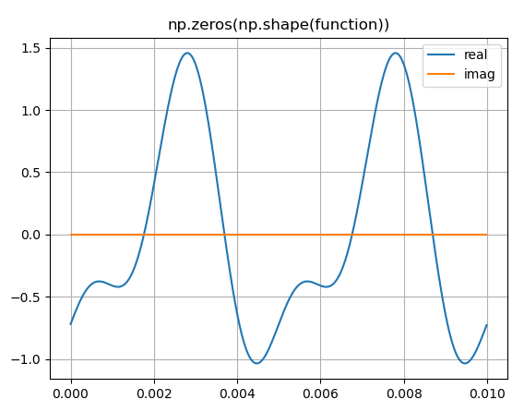
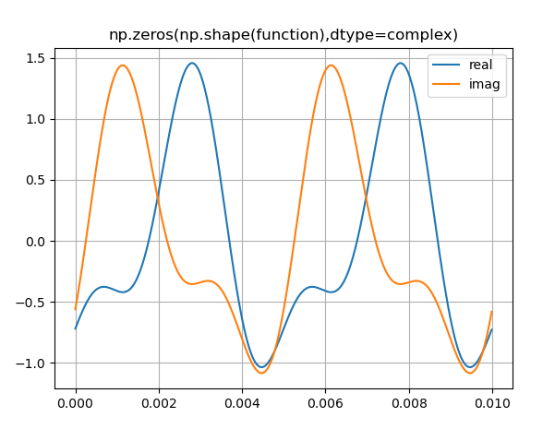
Pitfall1: A=np.zeros((4,6),dtype=complex)

Slide 4
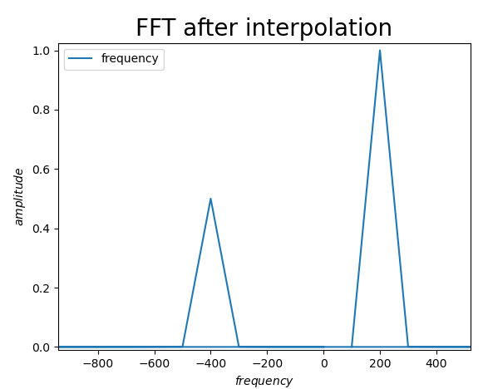
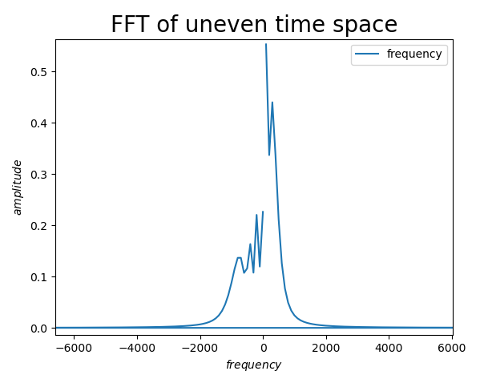
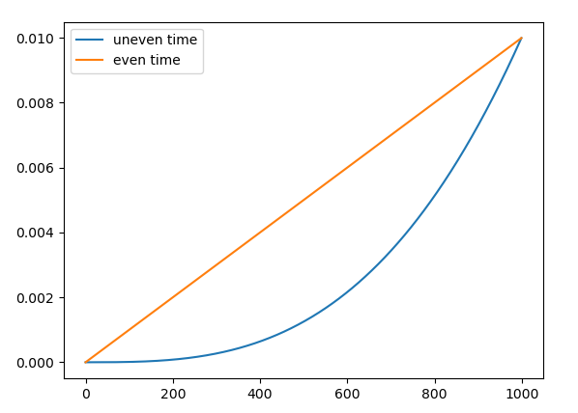
Pitfall2: Uneven time spacing
Before FFT, one must check if the time is evenly distributed. Sort to monotonic increasing if needed. Then interpolate. And perform FFT

Slide 5
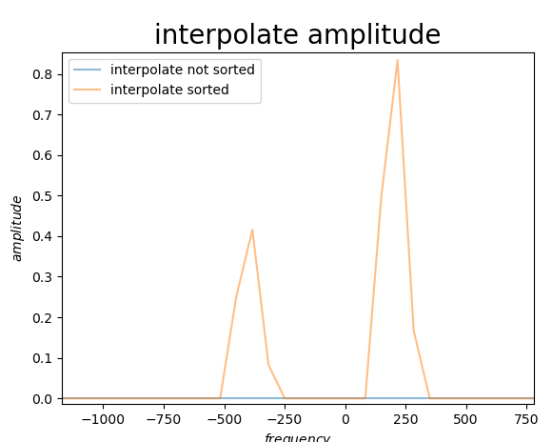
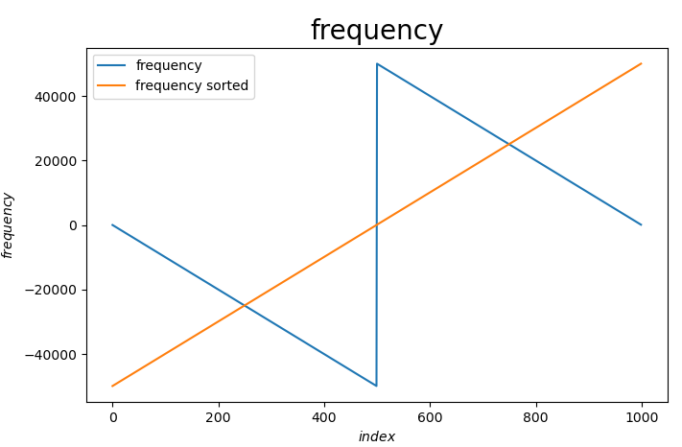
Pitfall3. FFT output frequency is not monotonic increasing
Bad for interpolations

Slide 6
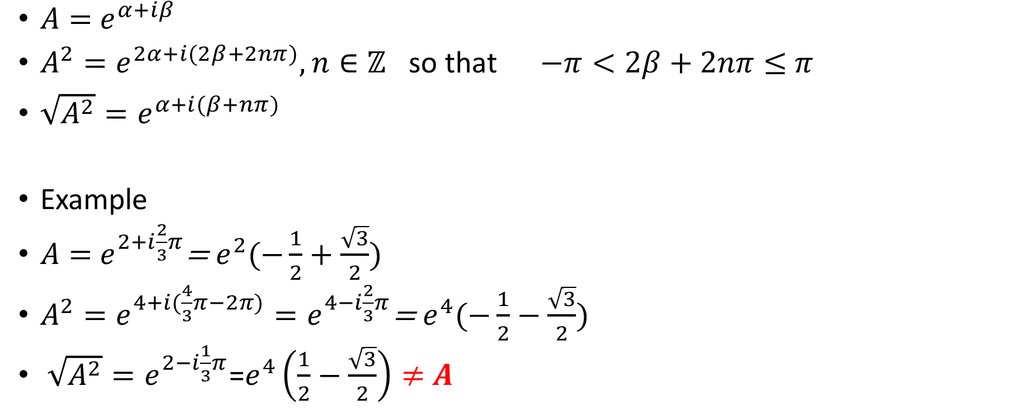

Pitfall4. $A≠\sqrt{A^{2}}$
$A=$ $e^{α+iβ}$
$A^{2}=e^{2α+i(2β+2nπ)},n∈ℤ$ so that $−π<2β+2nπ≤$ $π$
$\sqrt{A^{2}}=e^{α+i(β+nπ)}$
Example
$A=$ $e^{2+i\frac{2}{3}π}$= $e^{2}(−\frac{1}{2}+\frac{\sqrt{3}}{2})$
$A^{2}=e^{4+i(\frac{4}{3}π−2π)}=e^{4−i\frac{2}{3}π}$= $e^{4}(−\frac{1}{2}−\frac{\sqrt{3}}{2})$
$\sqrt{A^{2}}=e^{2−i\frac{1}{3}π}$=$e^{4}\left(\frac{1}{2}−\frac{\sqrt{3}}{2}\right)≠$ $A$

Slide 7

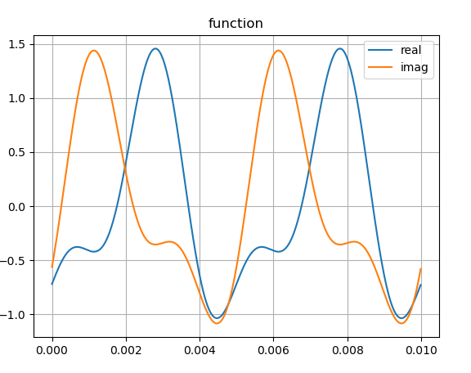
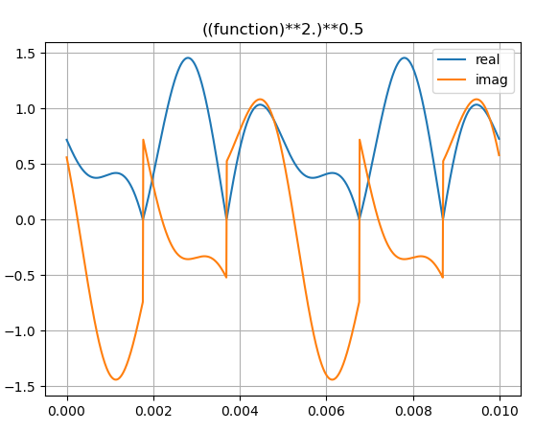

$$A≠\sqrt{A^{2}}$$

Slide 8
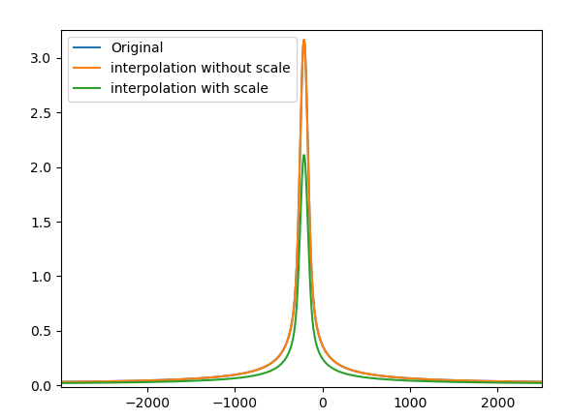
Pitfall5 Interpolation
Sum over frequency
sum0,sum0_error=10384.805669653468, 0.0
After incorrect interpolation
sum0,sum0_error=15577.260428909347, 0.0
After interpolation without the float(len(freq))/ float(len(uni_freq))
sum0,sum0_error=10384.840285939981, 0.0

