Slide 1
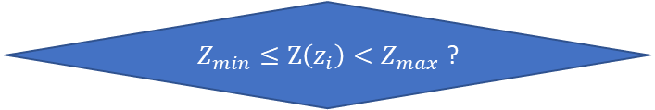
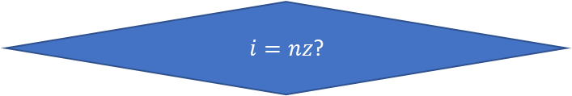



$$i=0$$
$$i=i+1$$
$Z_{min}≤Z\left(z_{i}\right)<Z_{max}$ ?
Yes
No
No
Add $z_{i}$ to the z list
$i=nz$?
Yes
Final z list

Slide 2
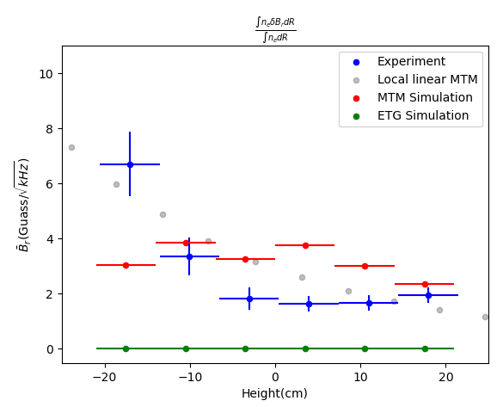
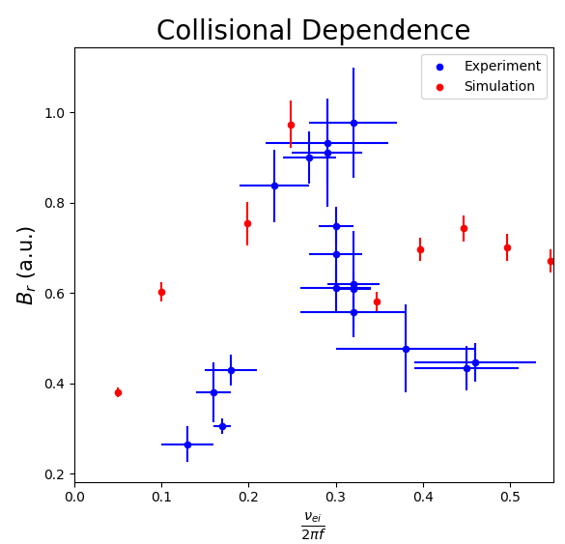
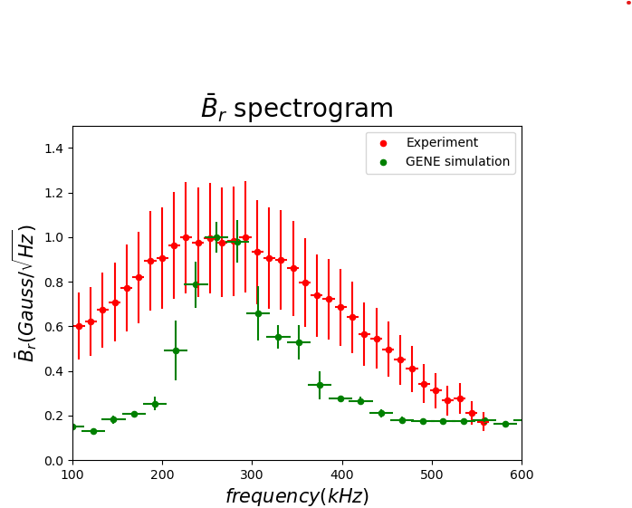
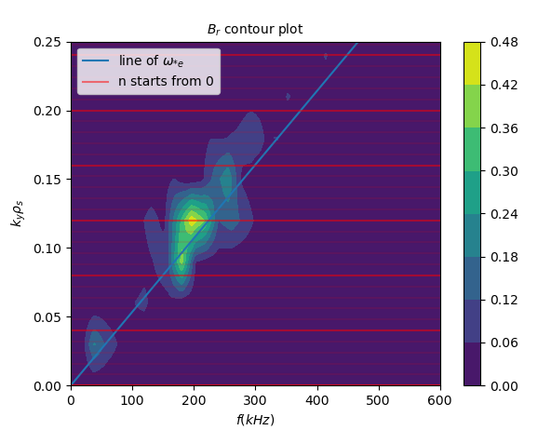



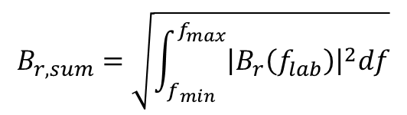


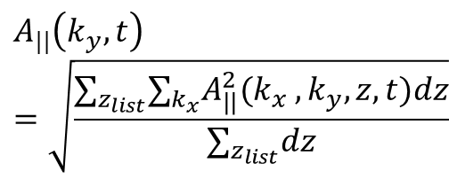




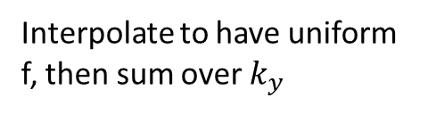
$$A_{||}(k_{x} ,k_{y},z,t)$$
$$A_{||}\left(k_{y},t\right)=\sqrt{\frac{{∑_{z_{list}}∑}_{k_{x}}A_{||}^{2}(k_{x} ,k_{y},z,t)dz}{∑_{z_{list}}dz}}$$
$$A_{||}(k_{y},t)$$
$$B_{r}\left(k_{y},t\right)= {k_{y}A}_{||}(k_{y},t)$$
Scan through height
Scan through collisionality
$$B_{r}(k_{y},t)$$
$$B_{r,sum}$$
Calculate Spectral density $B_{r}(k_{y},f)$
$$B_{r}(k_{y},f_{plasma})$$
$$B_{r,sum}=\sqrt{\int_{f_{min}}^{f_{max}}{{\left|B_{r}\left(f_{lab}\right)\right|}^{2}df}}$$
$$f_{lab}=f_{plasma}+f_{doppler}$$
$$B_{r}(k_{y},f_{lab})$$
$$B_{r}(f_{lab})$$
Interpolate to have uniform f, then sum over $k_{y}$
Contour plot
Spectrogram
Notes:
https://github.com/scipy/scipy/blob/v1.6.0/scipy/signal/spectral.py#L158-L288

Slide 3
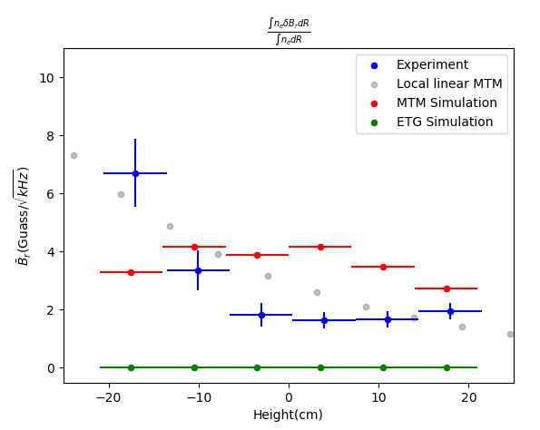
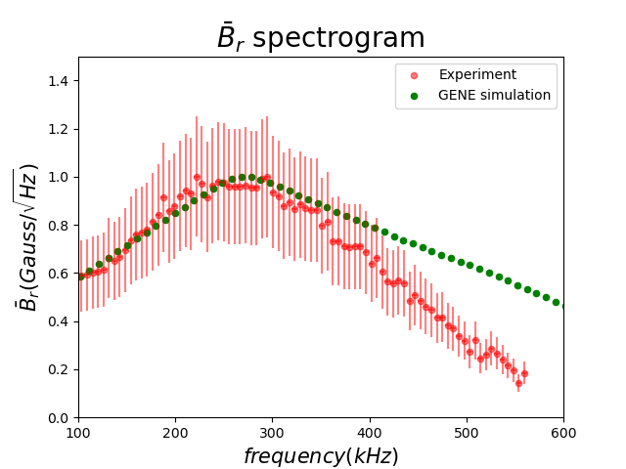
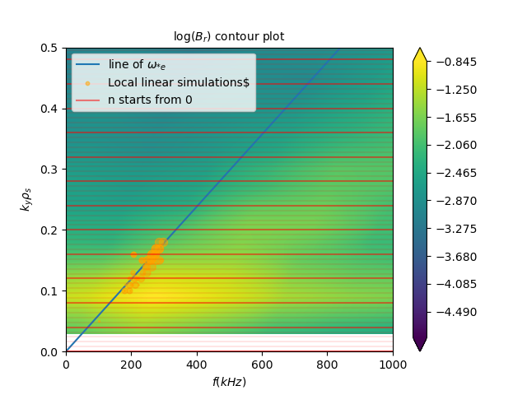

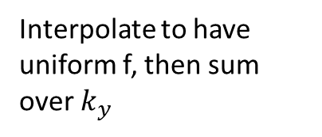

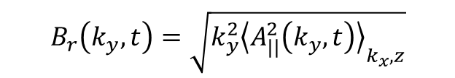



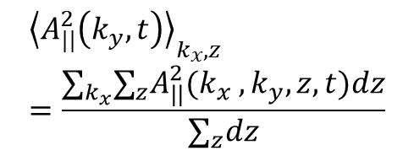


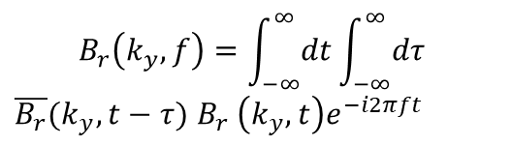
$$A_{||}(k_{x} ,k_{y},z,t)$$
$${\left\langle A_{||}^{2}\left(k_{y},t\right)\right\rangle }_{k_{x}, z}=\frac{∑_{k_{x}}{∑_{z}A}_{||}^{2}(k_{x} ,k_{y},z,t)dz}{∑_{z}dz}$$
$${\left\langle A_{||}^{2}\left(k_{y},t\right)\right\rangle }_{k_{x}, z}$$
$$B_{r}\left(k_{y},t\right)=\sqrt{k_{y}^{2}{\left\langle A_{||}^{2}\left(k_{y},t\right)\right\rangle }_{k_{x}, z}}$$
Scan through height
Scan through collisionality
$$B_{r}(k_{y},t)$$
$$B_{r,sum}$$
$$B_{r}\left(k_{y},f\right)=\int_{−∞}^{∞}{dt}\int_{−∞}^{∞}{dτ}$$
$\overline{B_{r}}(k_{y},t−τ)$ $B_{r}$ $\left(k_{y},t\right)e^{−i2πft}$
$$B_{r,sum}=\sqrt{\int_{f_{min}}^{f_{max}}{{\left|B_{r}\left(f_{lab}\right)\right|}^{2}df}}$$
$$B_{r}(k_{y},f_{plasma})$$
$$f_{lab}=f_{plasma}+f_{doppler}$$
$$B_{r}(k_{y},f_{lab})$$
$$B_{r}(f_{lab})$$
Interpolate to have uniform f, then sum over $k_{y}$
Spectrogram
Contour plot
Notes:
https://github.com/scipy/scipy/blob/v1.6.0/scipy/signal/spectral.py#L158-L288

