Slide 1

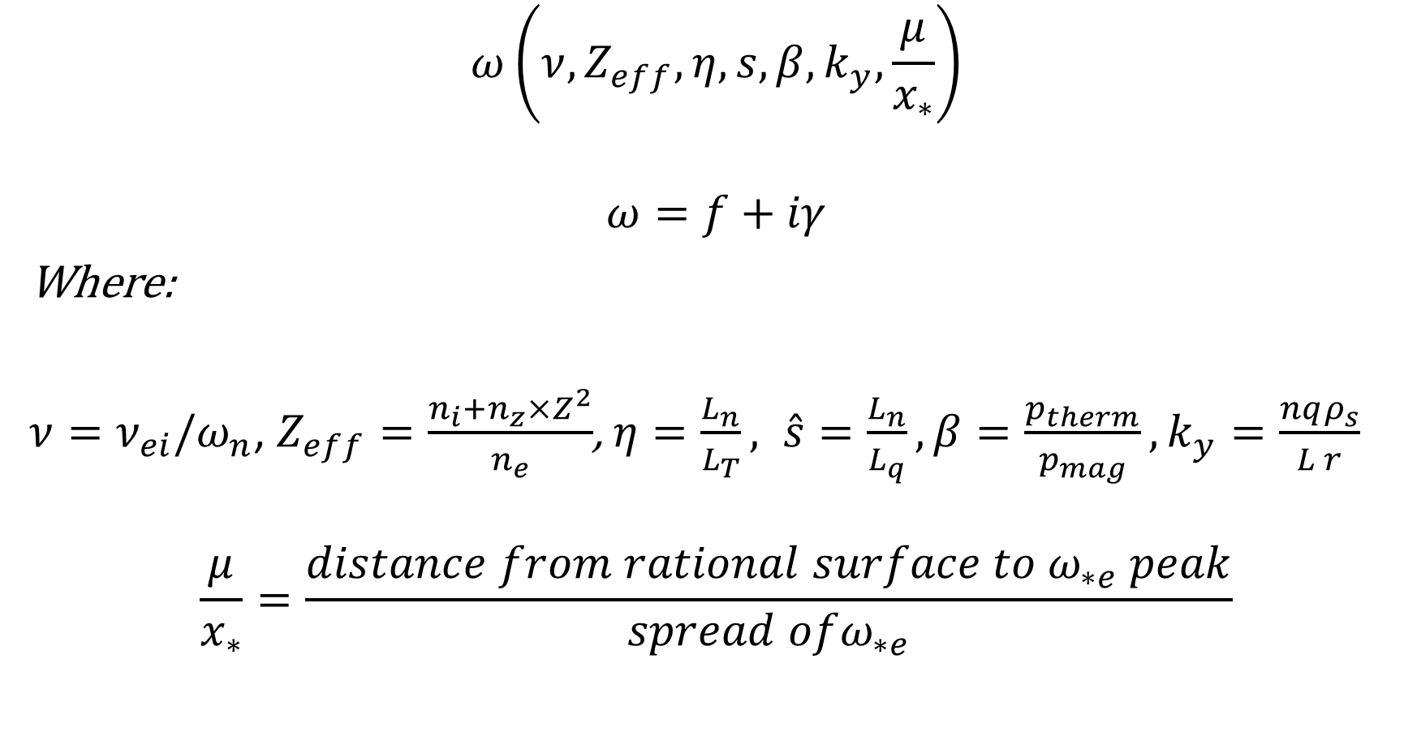
Parameter dependents
$$ω\left(ν,Z_{eff},η,s,β,k_{y},\frac{μ}{x_{∗}}\right)$$
$$ω=f+iγ$$
Where:
$ν=ν_{ei}/ω_{n}$, $Z_{eff}=\frac{n_{i}+n_{z}×Z^{2}}{n_{e}}$, $η=\frac{L_{n}}{L_{T}}, \hat{s}=\frac{L_{n}}{L_{q}}, β=\frac{p_{therm}}{p_{mag}}, k_{y}=\frac{nqρ_{s}}{L r}$
$$\frac{μ}{x_{∗}}=\frac{distance from rational surface to ω_{∗e} peak}{spread ofω_{∗e}}$$

Slide 2
Dataset from CORI simulations
Unstable: 300,000
Stable: 600,000

Slide 3
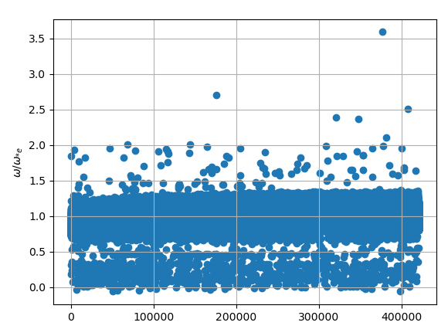

Slide 4
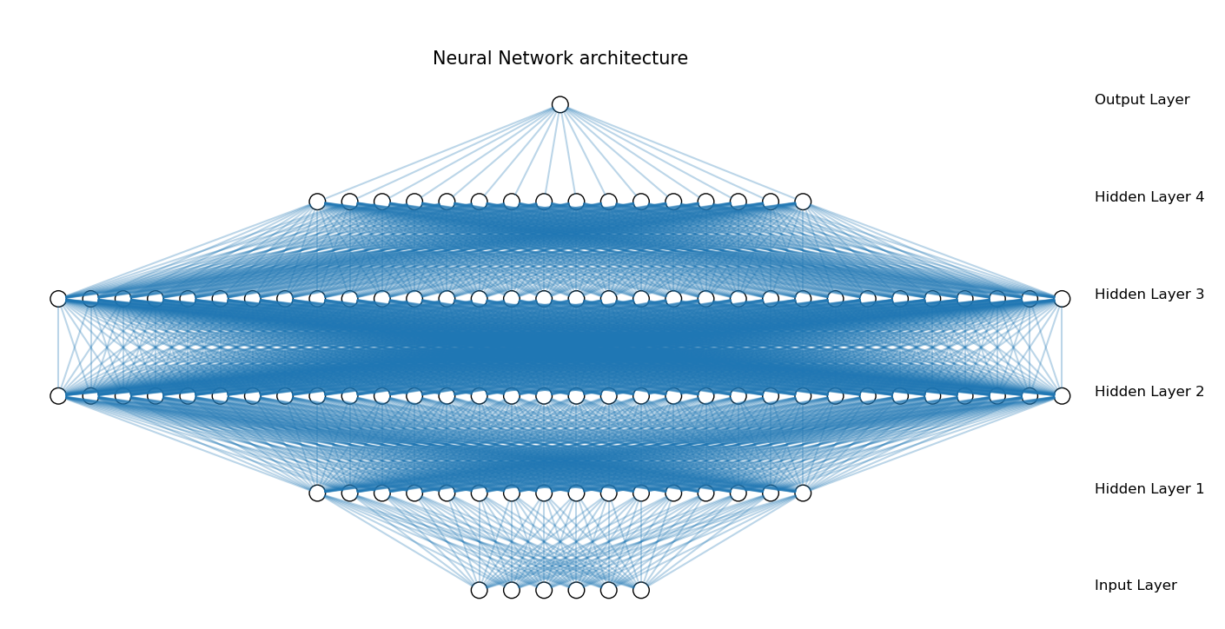
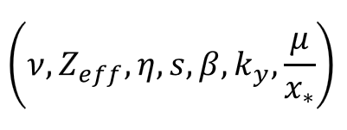
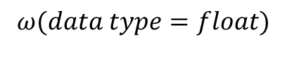
$$ω(data type=float)$$

Slide 5

$$γ(data type=boolean)$$

Slide 6
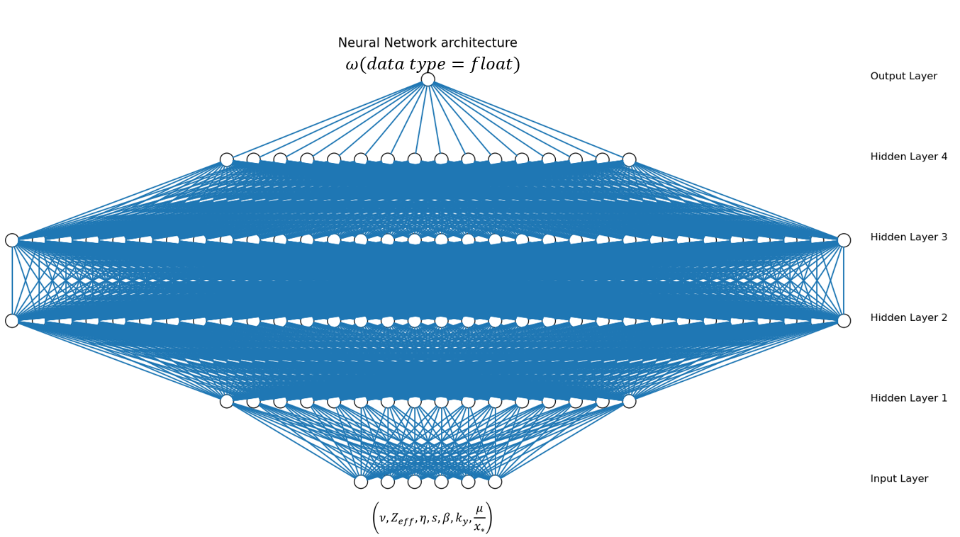
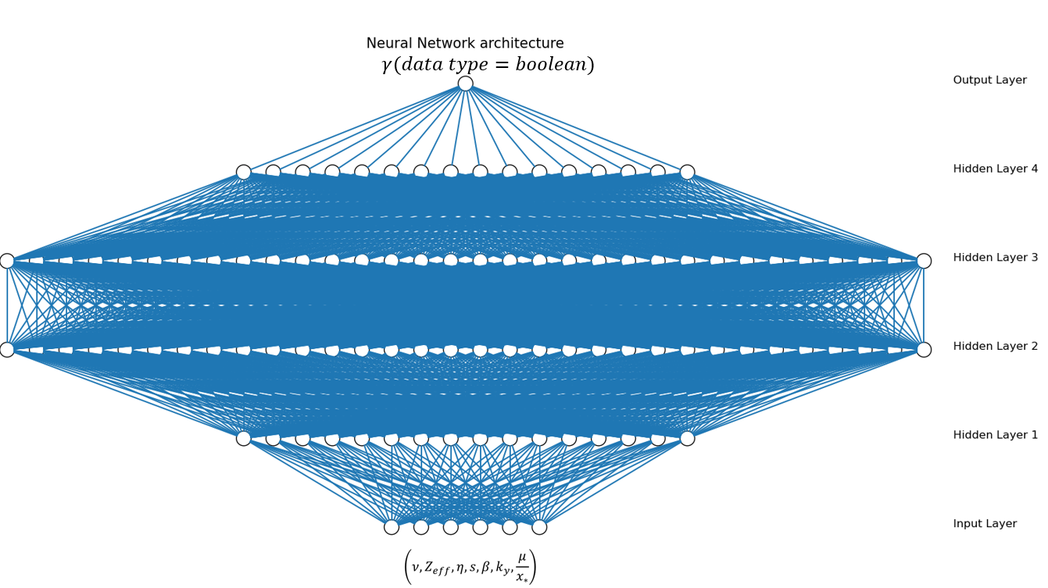


$$Frequency$$
Stable/unstable
$$unstable MTM frequencies$$

Slide 7
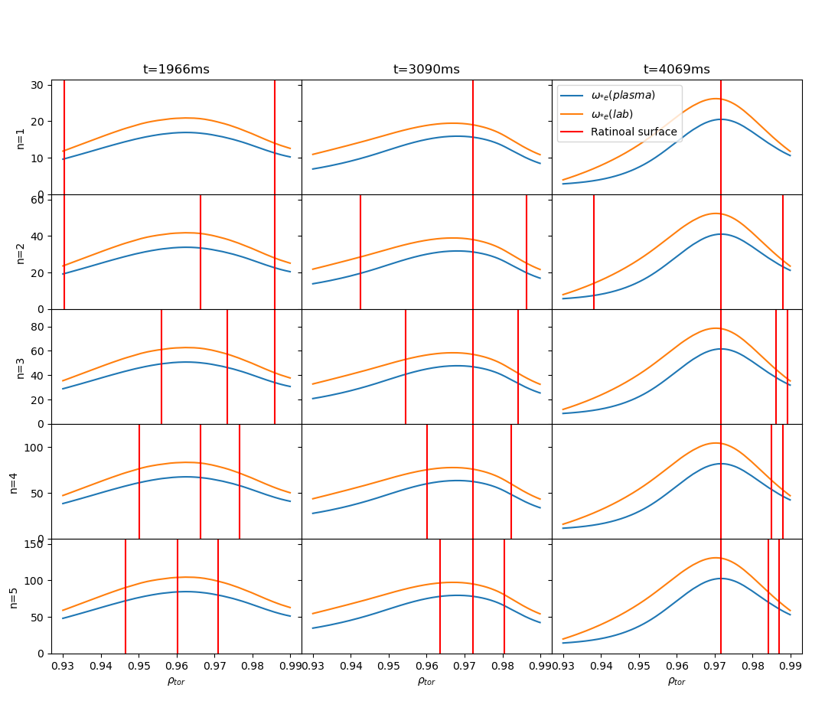
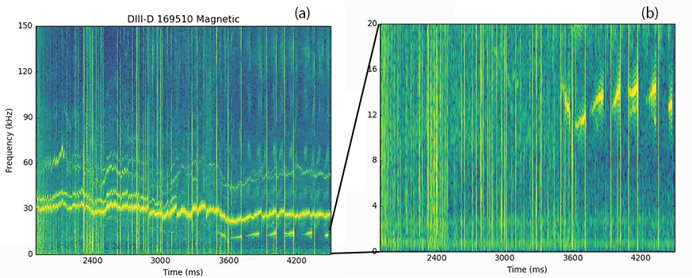
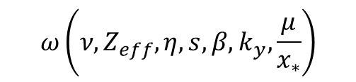
$$ω\left(ν,Z_{eff},η,s,β,k_{y},\frac{μ}{x_{∗}}\right)$$
Vary profile
Match with experiment?
No
Yes
Ideal profile

Slide 8
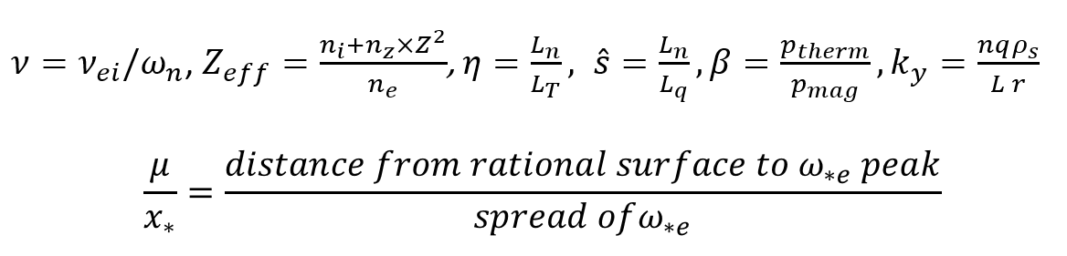

Vary profile
$n_{e}$, $T_{e}→β,x_{∗}, {η ,ω}_{n}$
$q→μ, {\hat{s},k}_{y}$
$v_{rot}→f_{Doppler}$

Slide 9
Questions
Normalization
Hyper-parameter tunning
output two different data type(float, bool)

