Slide 1

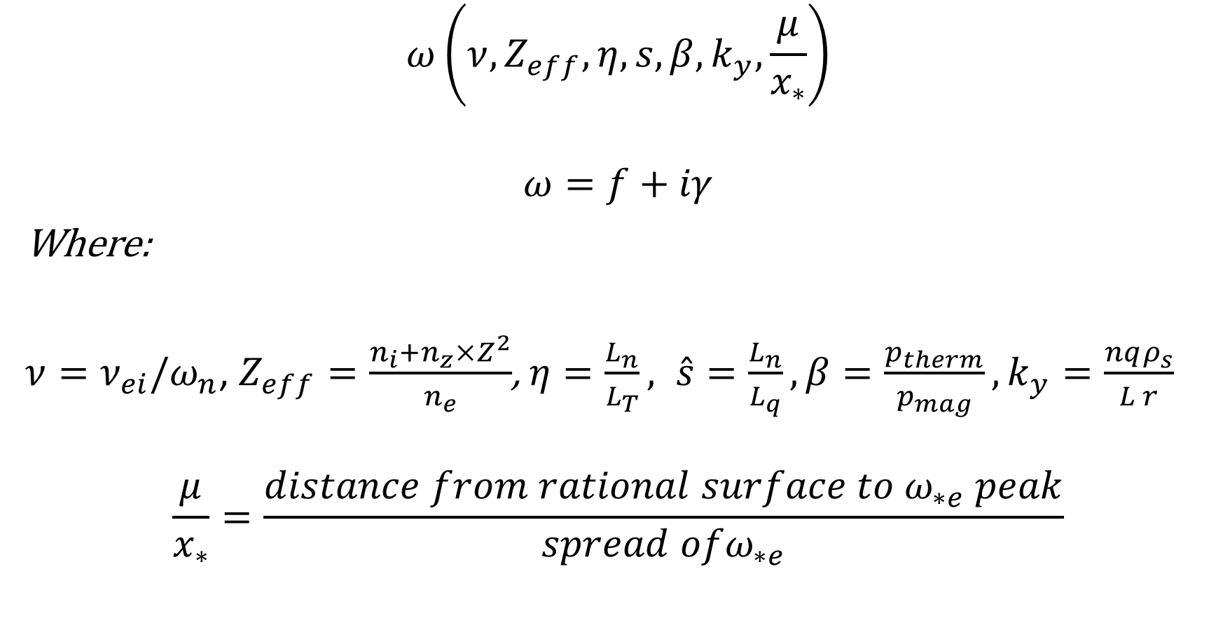
Parameter dependents
$$ω\left(ν,Z_{eff},η,s,β,k_{y},\frac{μ}{x_{∗}}\right)$$
$$ω=f+iγ$$
Where:
$ν=ν_{ei}/ω_{n}$, $Z_{eff}=\frac{n_{i}+n_{z}×Z^{2}}{n_{e}}$, $η=\frac{L_{n}}{L_{T}}, \hat{s}=\frac{L_{n}}{L_{q}}, β=\frac{p_{therm}}{p_{mag}}, k_{y}=\frac{nqρ_{s}}{L r}$
$$\frac{μ}{x_{∗}}=\frac{distance from rational surface to ω_{∗e} peak}{spread ofω_{∗e}}$$

Slide 2
Dataset from CORI simulations
Unstable: 300,000
Stable: 600,000

Slide 3
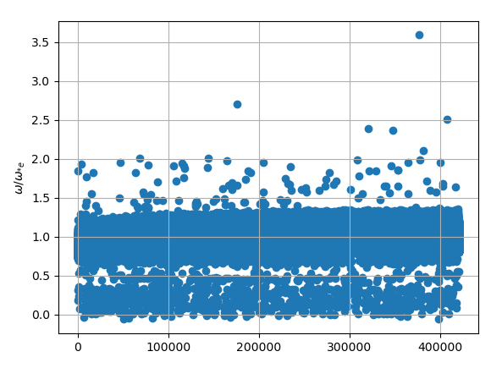

Slide 4
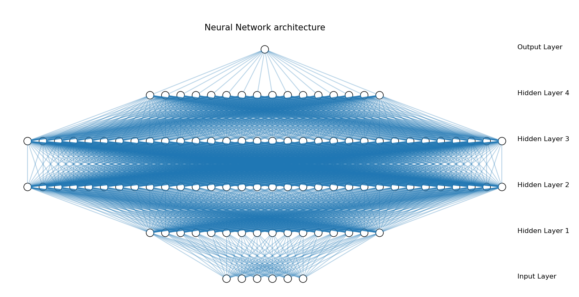
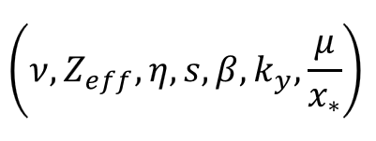
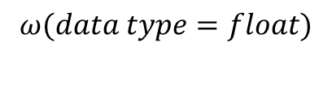
$$ω(data type=float)$$

Slide 5

$$γ(data type=boolean)$$

Slide 6
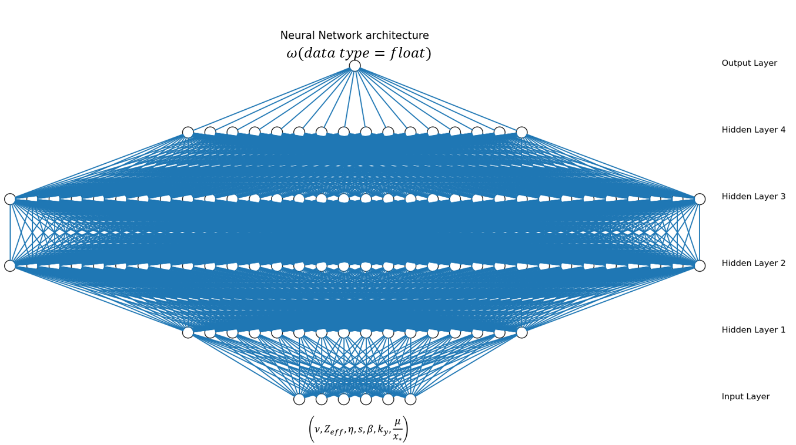
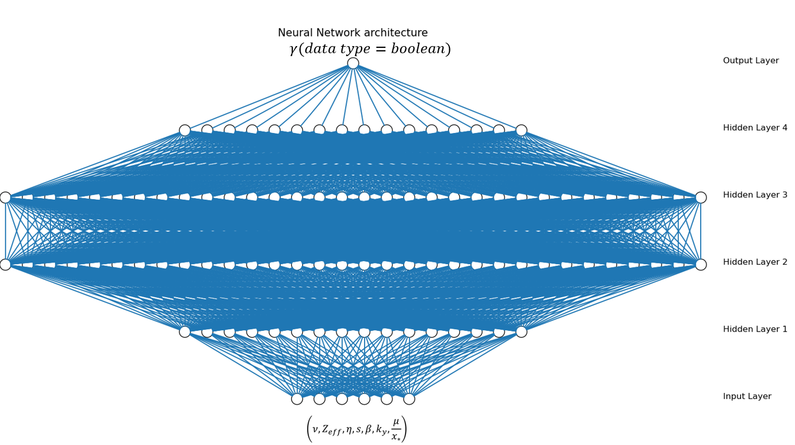


$$Frequency$$
Stable/unstable
$$unstable MTM frequencies$$

Slide 7
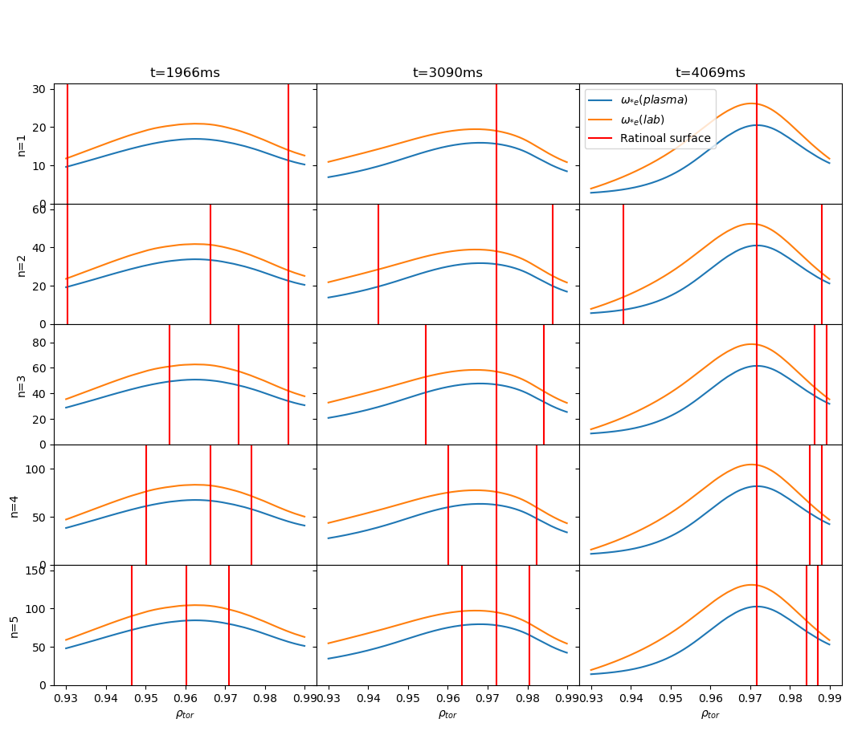
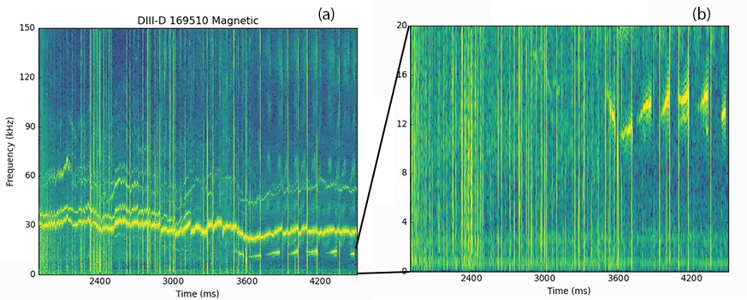
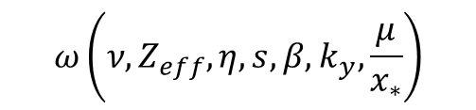
$$ω\left(ν,Z_{eff},η,s,β,k_{y},\frac{μ}{x_{∗}}\right)$$
Vary profile
Match with experiment?
No
Yes
Ideal profile

Slide 8
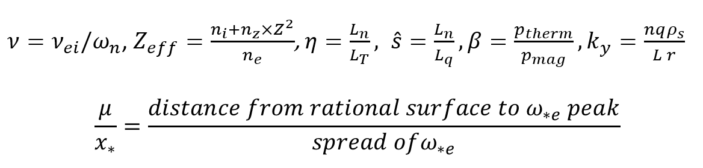

Vary profile
$n_{e}$, $T_{e}→β,x_{∗}, {η ,ω}_{n}$
$q→μ, {\hat{s},k}_{y}$
$v_{rot}→f_{Doppler}$

Slide 9
Questions
Normalization
Hyper-parameter tunning
output two different data type(float, bool)

Slide 10
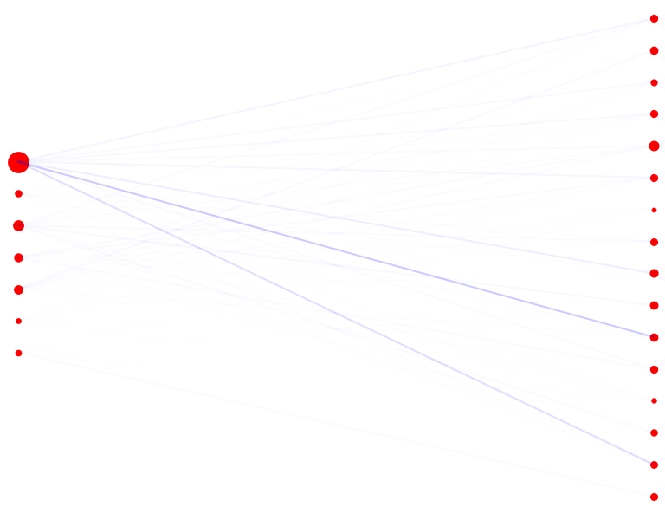
Top to bottom: nu, zeff,eta,shat,ky,mu_norm

Slide 11
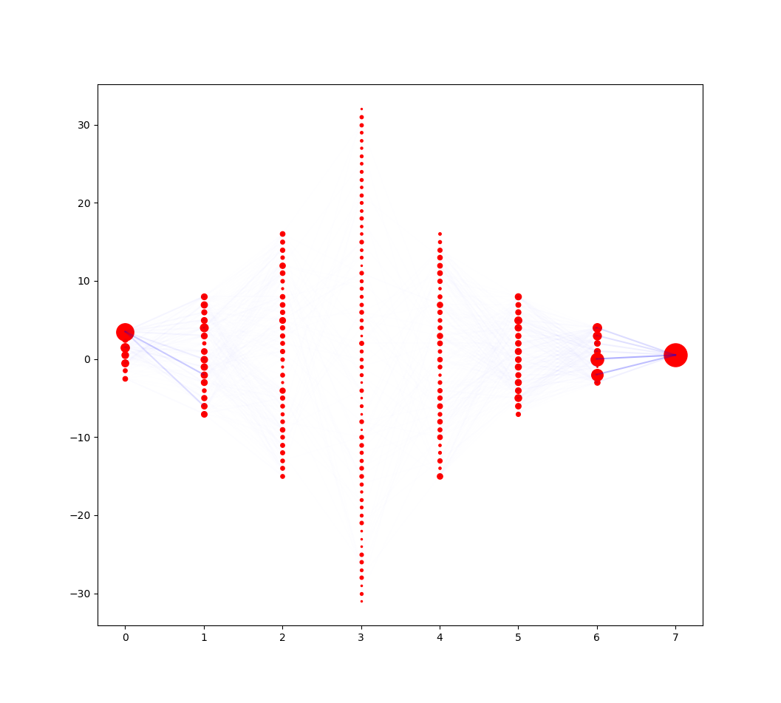

Slide 12
For stable unstable:
['nu', 'zeff', 'eta', 'shat', 'beta', 'ky', 'mu_norm'] =
[0.6086171 0.06476105 0.09443569 0.08774152 0.06328316 0.03368932 0.04747209]

Slide 13
https://stackoverflow.com/questions/43979449/higher-validation-accuracy-than-training-accurracy-using-tensorflow-and-keras

