Slide 5
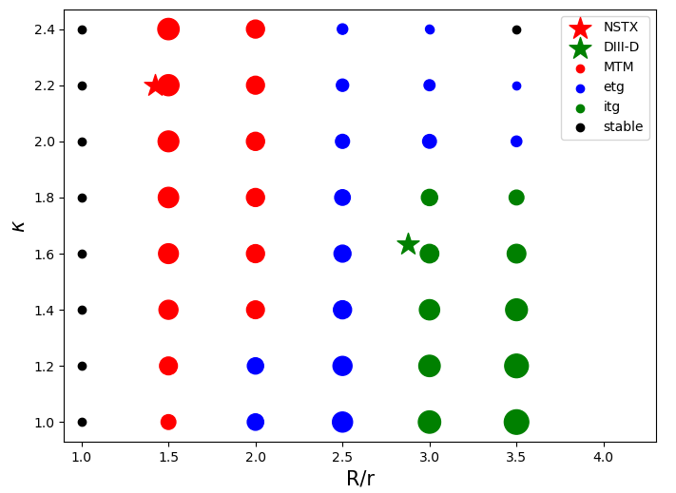
NSTX is based on discharge 132543, r/a=0.942
Notes:
/p/gyro/mcurie/NSTX_132543_scan/MTM_r0_kappa_scan

Slide 6
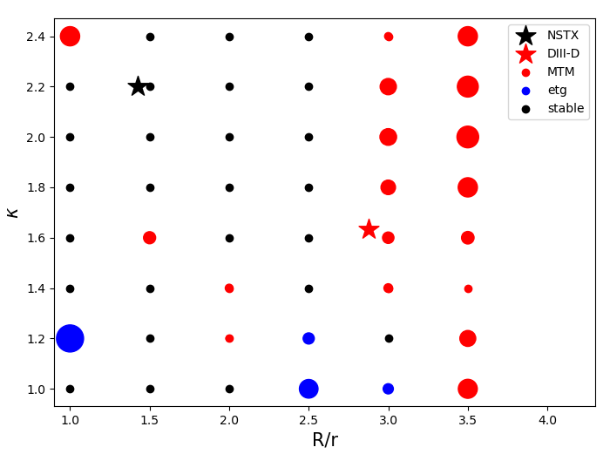
DIII-D is based on discharge 174819, r/a=0.966
Notes:
/p/gyro/mcurie/D3D_ahmed/MTM_r0_kappa_scan

Slide 7
D3D baseline
S=1.26025
NU_EE=0.666248

Slide 8
NSTX baseline
S=8.16232
NU_EE=0.239401
RMAJ=1.42322
KAPPA=2.2

Slide 9
Shat scan

Slide 10
nu scan

Slide 11
DIII-D is based on discharge 174819.03560
NSTX is based on discharge 132543

