Slide 1
A Simple yet Efficient Method for a Credit Card Upselling Prediction
Peter Romov
Solution of ECML/PKDD 2016 Discovery Challenge Task 2 “Upselling prediction”, team “Peter”

Slide 2

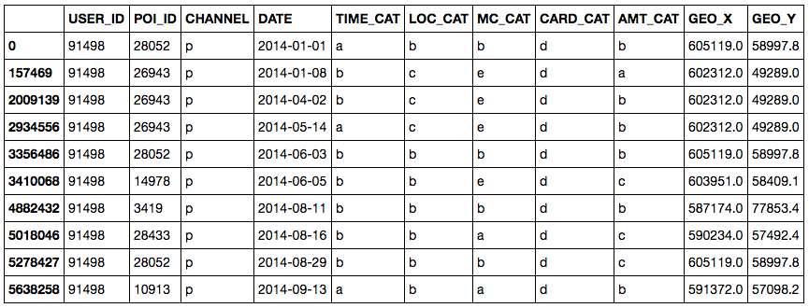
Approach
User information
Feature vector:
Personal (15)
Cards & Wealth (8)
Activeness (8)
Event counters (77)
Geo (28)
Predict target
(credit card in the future)
using XGBoost
User transactions

Slide 3

Features: User information
Card & Wealth features
Personal features
Gender
Age category
Location category
Income category
One-hot & label encoded
Number of months labeled as “1”
Number of label changes “0” -> “1” and vice versa
Last month labeled “1”

Slide 4
Features: Event counters
Two features for each category value:
Number of events integer
Ratio of events with particular value in all user events rational in [0, 1]
Categorical features in user transactions:
Type of activity (point of sale, webshop, branch)
Rounded time period (morning, daytime, evening)
Location type (capital, city, village)
Marker category of payment (7 anonymous categories)
Type of card (credit, debit)
Amount of money (low, medium, high)

Slide 5
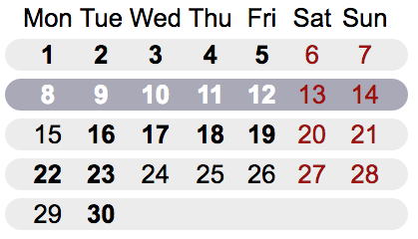
Features: Activeness
Active = at least one transaction during the period (days and weeks)
Features:
Number of active / inactive periods
Ratio of active periods

Slide 6
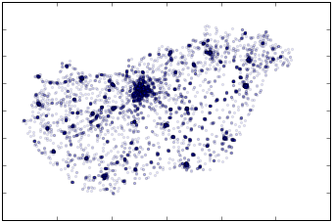
Features: Geo location
Geo-features of one transaction:
coordinates
distance to the center (Budapest)
horizontal angle of location wrt the center
angle
dist
Aggregation of transaction geo-features:
min, max
mean, std
percentiles (20%, 50%, 80%)

Slide 7
Tuning learning parameters
Validation: 10x stratified shuffle split on learning (90%) and validation (10%)
Parameters to tune
tree depth
learning rate
number of trees in ensemble
scheme of filling the missing values
number of unimportant features to exclude
Decision
Marginal improvement in validation score (about 0.005 with big variance)
Biased validation scheme (because of year-to-year changes)
Final submission: XGBoost model with default learning parameters (Occam’s Razor principle) 100 trees, max depth = 3, learning rate = 0.1

Slide 8
Feature evaluation
Cross-validation AUC score: 0.7213 (stratified shuffle train/test split)
Feature group | AUC change after removing feature group | AUC only features from the group
Personal | -0.0322 | 0.6615
Cards & Wealth | -0.0137 | 0.5653
Event counters | -0.0019 | 0.6738
Activeness | -0.0012 | 0.6419
Geo location | -0.0004 | 0.6318
Feature vector:
Personal (15)
Cards & Wealth (8)
Activeness (8)
Event counters (77)
Geo (28)

Slide 9
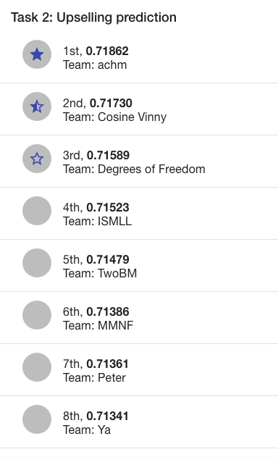
That’s it!
Solution source code:
https://github.com/romovpa/ecmlpkdd2016-otp-bank-upselling

