Slide 1
Char-CNN文本分类
分享人—刘冲

Slide 2
相关资源
Text Understanding from Scratch
Character-level Convolutional Networks for Text Classification
http://blog.csdn.net/column/details/14944.html
https://github.com/naivechen/CoderPai/tree/master/charcnn

Slide 3
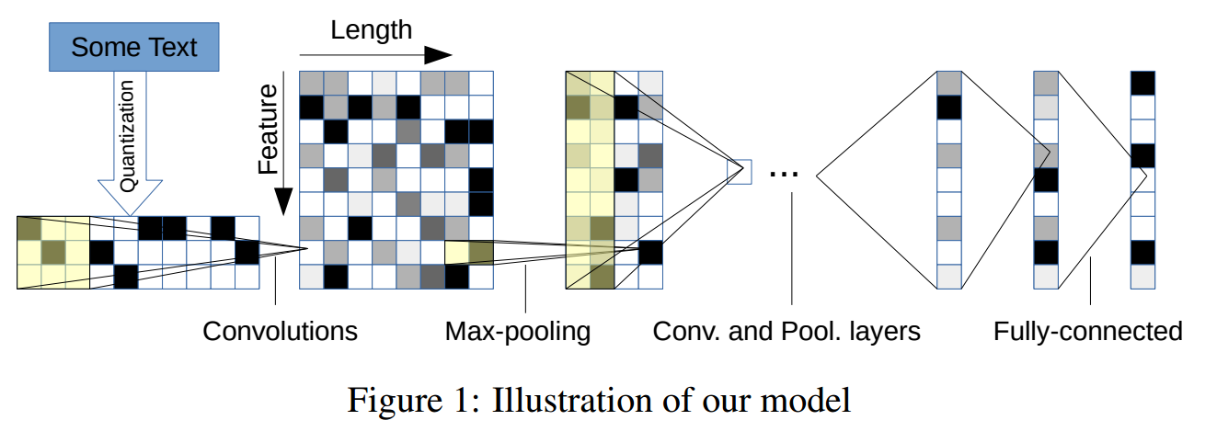
模型架构
69*1014
256*1008
256*336

Slide 4
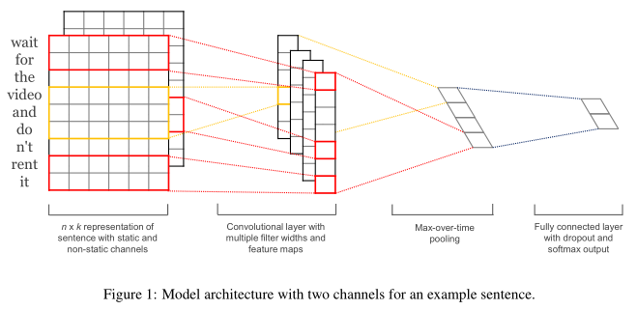
https://arxiv.org/abs/1408.5882

Slide 5
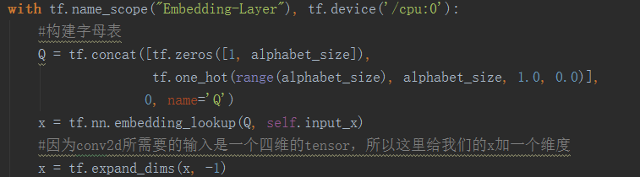
字符编码层
字符表：
将每一个字符转化为one-hot格式编码，此外，再加上一个全零向量。
所以vocab_size为70，每一个转化为长度为69的向量。
最终的look_up表为70*69的矩阵：

Slide 6
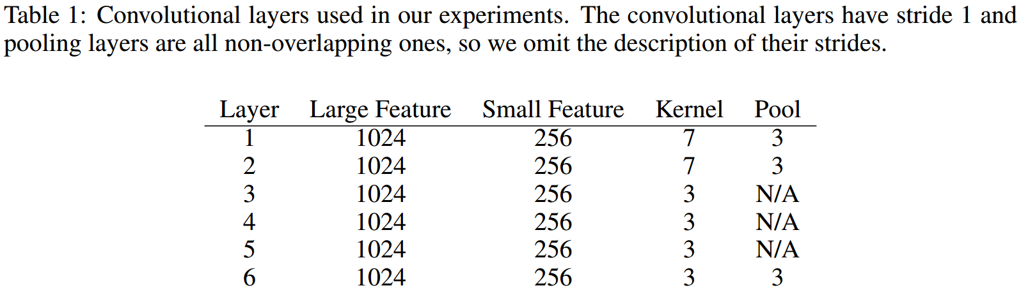
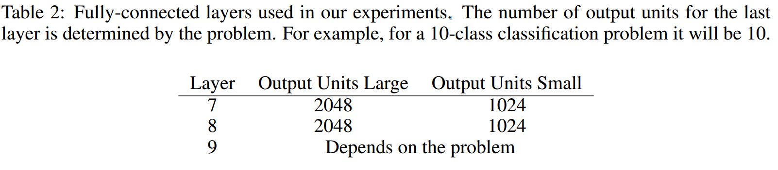
卷积-池化层

Slide 7
卷积层输入 卷积核shape | 卷积层输出shape | 池化层输出
[128, 1014, 69, 1] [7, 69, 1, 256] | [128, 1008, 1, 256] | [128, 336, 1, 256]
[128, 336, 256, 1] [7, 256, 1, 256] | [128, 330, 1, 256] | [128, 110, 1, 256]
[128, 110, 256, 1] [3, 256, 1, 256] | [128, 108, 1, 256] | **
[128, 108, 256, 1] [3, 256, 1, 256] | [128, 106, 1, 256] | **
[128, 106, 256, 1] [3, 256, 1, 256] | [128, 104, 1, 256] | **
[128, 104, 256, 1] [3, 256, 1, 256] | [128, 102, 1, 256] | [128, 34, 1, 256]
Reshape层/全连接层
Reshape [128, 34*256]
Full-contect1 [128, 1024]
Full-connect2 [128, 1024]
Out-layer [128, 4]

Slide 8
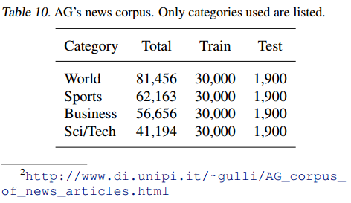
数据集和预处理
"3","Fears for T N pension after talks","Unions representing workers at Turner Newall say they are 'disappointed' after talks with stricken parent firm Federal Mogul.“
fears for t n pension after talks Unions representing workers at turner newall say they are 'disappointed' after talks with stricken parent firm federal mogul.
[6, 5, 1, 18, 19, ……,13, 15, 7, 21, 12]
0, 0, 1
0, 0, 0
0, 0, 0
0, 0, 0
0, 1, 0
1, 0, 0
0, 0, 0
.
.
.
.
每一行有三项，第一项是类别，第二项是title，第三项是描述，将二三项连接起来作为训练文本数据；
设置每条训练数据的字符长度最大为1014，所以最终每个样本数据会被转化为1014*69的矩阵传入神经网络

Slide 9
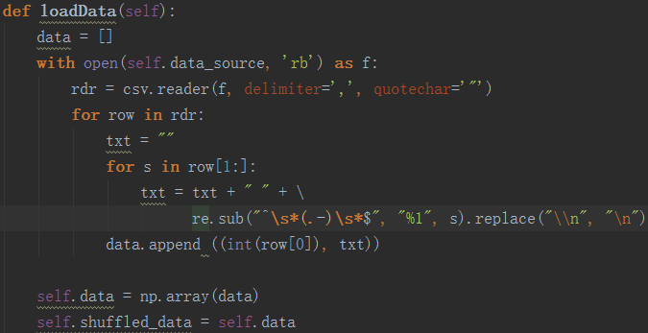
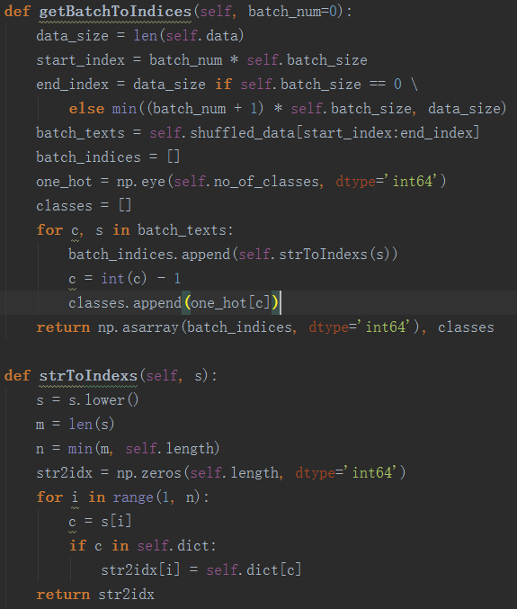
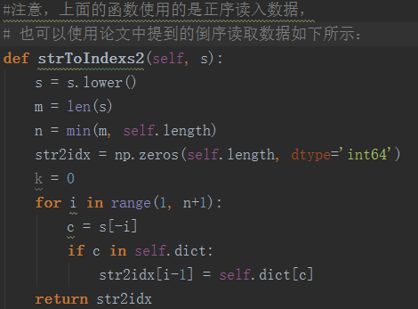
数据集和预处理
https://github.com/brmson/dataset-sts

Slide 10
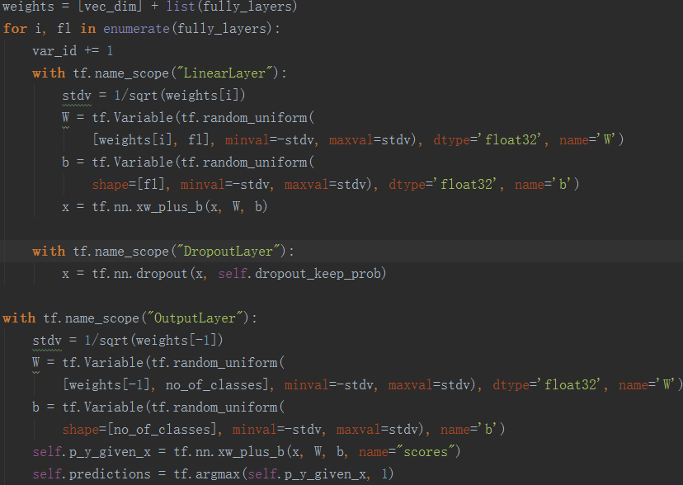
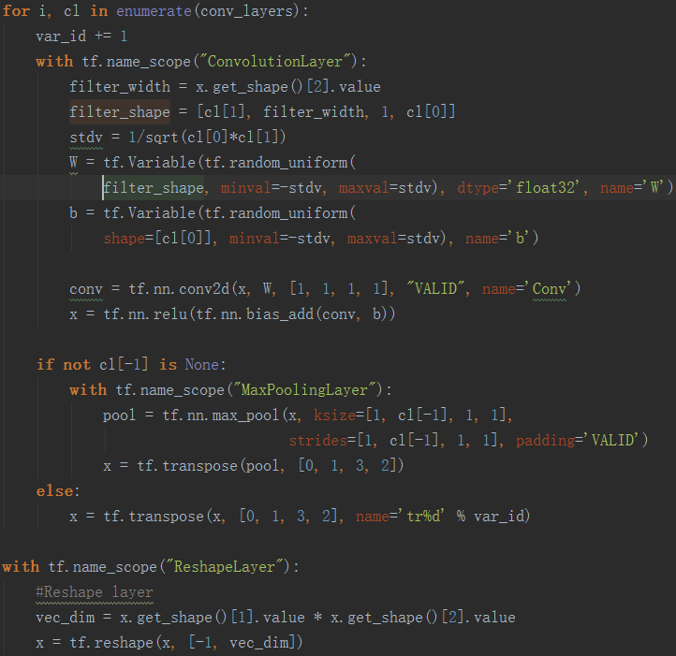
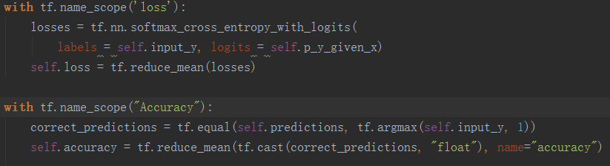
模型构建--tf

Slide 11
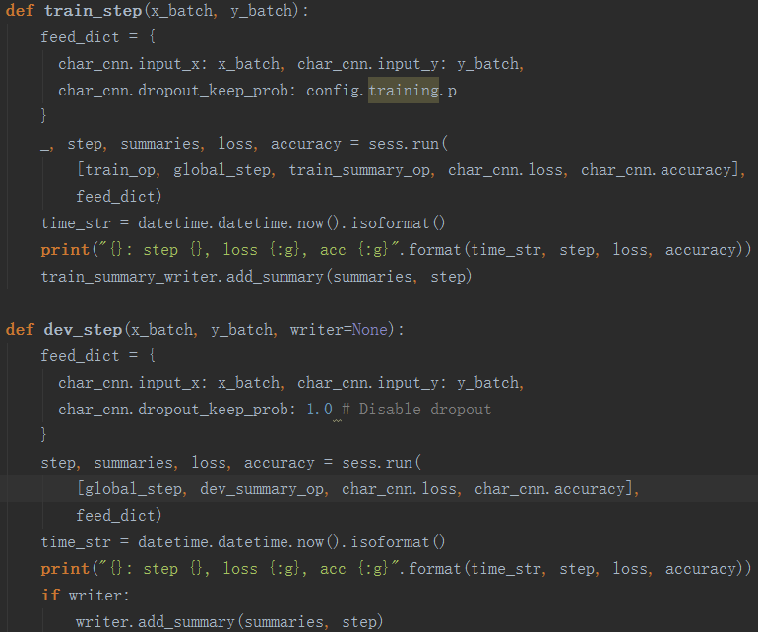
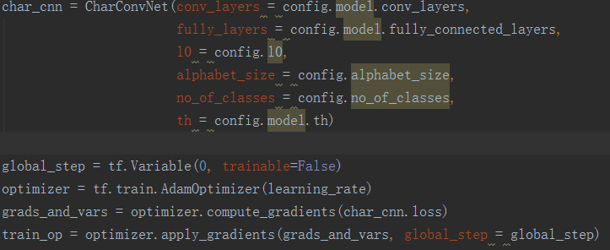
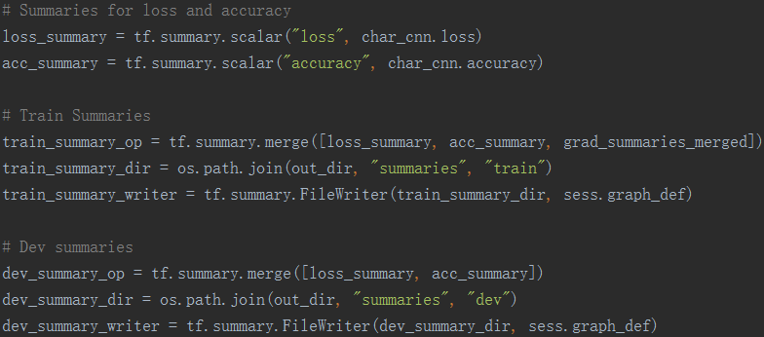
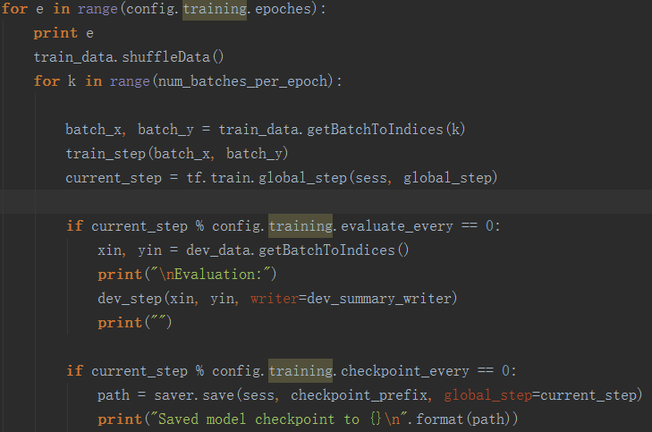
模型训练
https://github.com/dennybritz/cnn-text-classification-tf

Slide 12
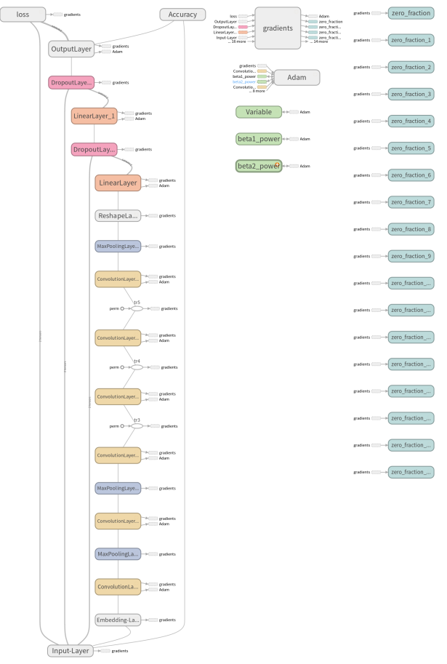
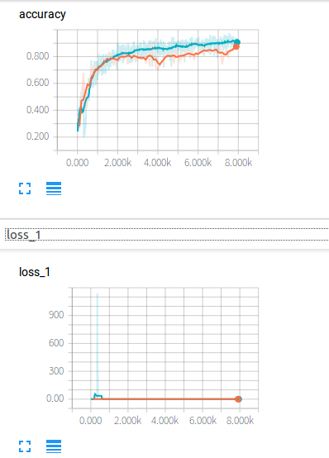
结果分析

Slide 13
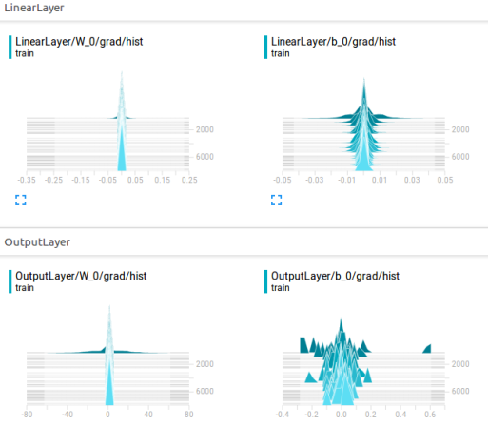
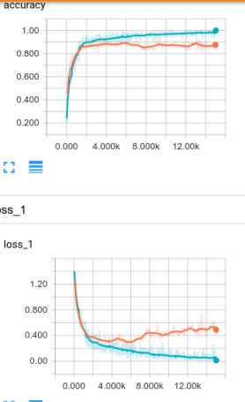
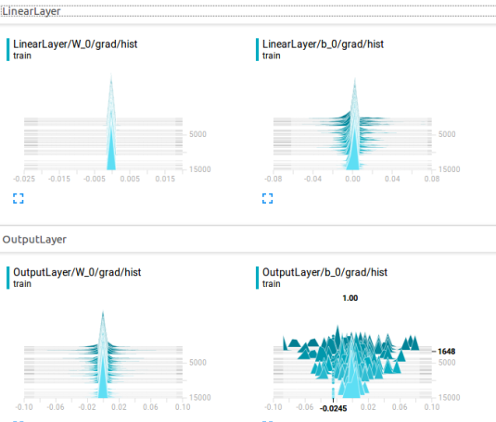

Slide 14
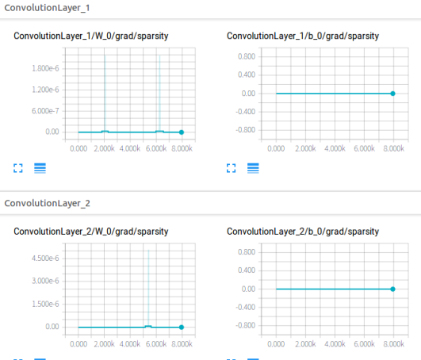
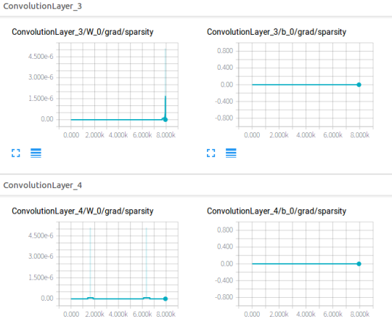
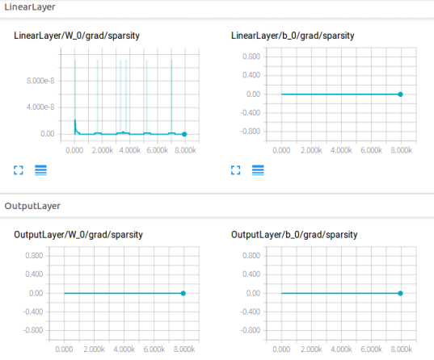
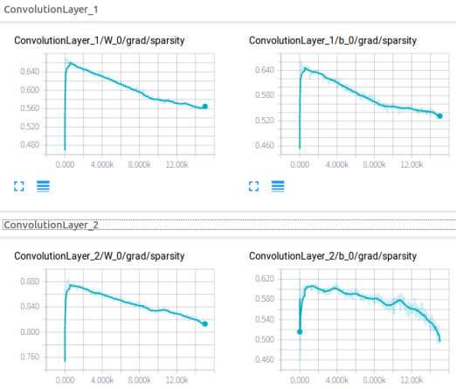
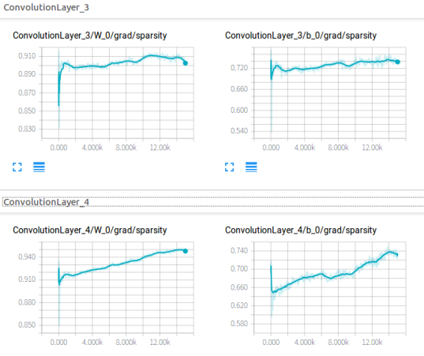
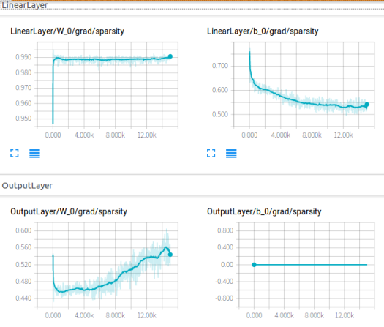

Slide 15
其他
1，本篇论文的研究意义
2，CNN与NLP领域的一些看法

Slide 16
谢谢收看

