Slide 1

Herramientas computacionales: el arte de la programación
TC1001S.101

Slide 2
Dictionaries
Creating a Dictionary
phonebook = {'Chris':'555-1111', 'Katie':'555-2222', 'Joanne':'555-3333’}
phonebook
{'Chris': '555-1111', 'Joanne': '555-3333', 'Katie': '555-2222'}
Retrieving a Value from a Dictionary
phonebook['Chris']
'555-1111'
Python programming

Slide 3
Dictionaries
Using the in and not in Operators to Test for a Value in a Dictionary
if 'Chris' in phonebook:
print(phonebook['Chris'])
555-1111
Adding Elements to an Existing Dictionary
phonebook = {'Chris':'555-1111', 'Katie':'555-2222', 'Joanne':'555-3333’}
phonebook['Joe'] = '555-0123’
phonebook['Chris'] = '555-4444’
phonebook
{'Chris': '555-4444', 'Joanne': '555-3333', 'Joe': '555-0123', 'Katie': '555-2222'}
Python programming

Slide 4
Dictionaries
Deleting Elements
phonebook
{'Chris': '555-1111', 'Joanne': '555-3333', 'Katie': '555-2222’}
del phonebook['Chris’]
phonebook
{'Joanne': '555-3333', 'Katie': '555-2222’}
Using the for Loop to Iterate over a Dictionary
for key in phonebook:
print(key, phonebook[key])
Chris 555-1111
Joanne 555-3333
Katie 555-2222
Python programming

Slide 5
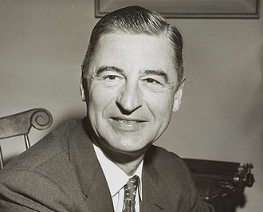
Dr. Seuss
Theodor Seuss Geisel March 2, 1904 – September 24, 1991) was an American children's author and cartoonist. He is known for his work writing and illustrating more than 60 books under the pen name Dr. Seuss
His work includes many of the most popular children's books of all time, selling over 600 million copies and being translated into more than 20 languages by the time of his death.^{[7]}

Slide 6
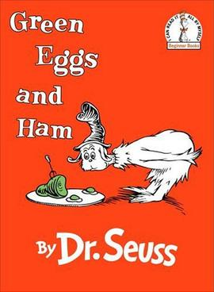
Dr. Seuss
Green Eggs and Ham is a children's book by Dr. Seuss, first published on August 12, 1960. As of 2019, the book has sold 8 million copies worldwide.
Green Eggs and Ham is one of Seuss's "Beginner Books", written with very simple vocabulary for beginning readers. The vocabulary of the text consists of just 50 words and was the result of a bet between Seuss and Bennett Cerf, Dr. Seuss's publisher,that Seuss (after completing The Cat in the Hat using 236 words) could not complete an entire book without exceeding that limit. The 50 words are Out of the 50 words, "anywhere" is the only word used that has more than one syllable.

