Slide 1

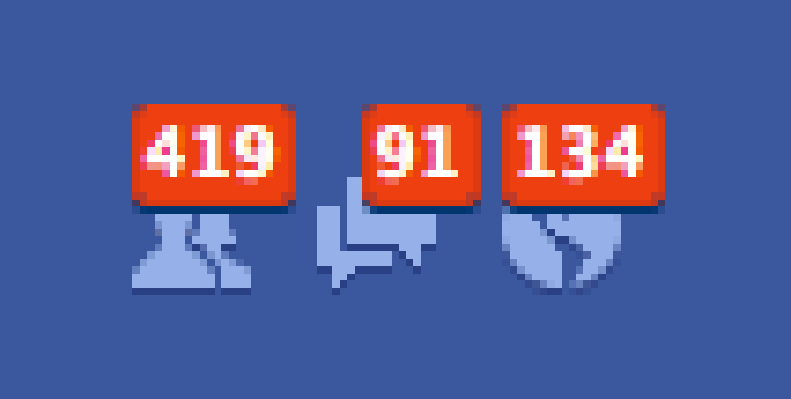
NOTIFICATIONS
a) Types
b) Email Plug-ins and Velocity
c) Test Plugin
d) Creating New Notifications
Nikhil Sharma
Skype : nikhil.sharma788
nikhils@jbilling.com

Slide 2

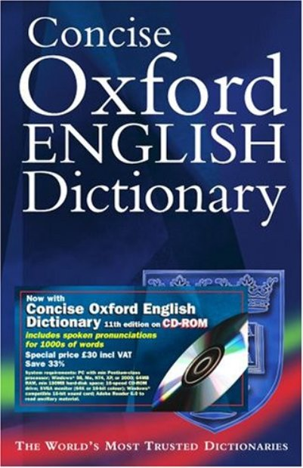
Notifications: What is it?
According to Dictionary
1. the act of notifying
2. a formal announcement
3. something that notifies;
a notice

Slide 3

Why do we need it ?
Notes:
1. In jBilling, notifications are something which gets triggered after a major event has occurred. Like Invoice, Order, Payment or User creation.
2. In jBilling we have various notification categories.
Like Invoice, Order, Payment, User
3. Under each category, we have that type of notification which is generally an email but can also be a pdf file, etc.
4. In an email notification, we have a flag indicating whether it is active or not, the email's subject, the email's body in text or html.

Slide 4
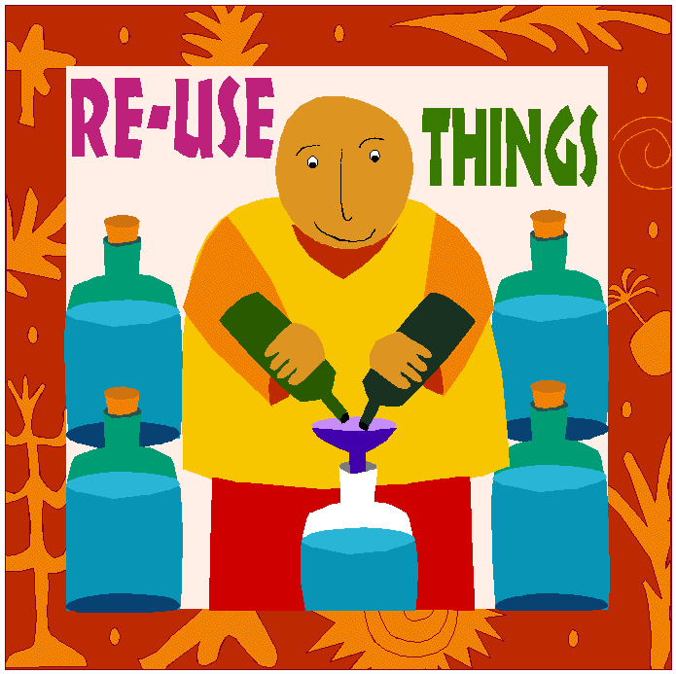
I Want To Make Notifications Generic
Notes:
We obviously want to make the notification as generic as possible and for that we use velocity scripting as the script to write most of the email body in.

Slide 5

How do I do it ??
Hint :
Notes:
MAKING NOTIFICATIONS GENERIC: USE VELOCITY

Slide 6
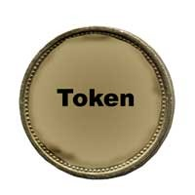
What will velocity provide ??
Guess : Direction ? No..
Notes:
We call the variables available as parameters to us on the gsp page as tokens. We can see the list of tokens available on the R.H.S. Of the notification page.

Slide 7

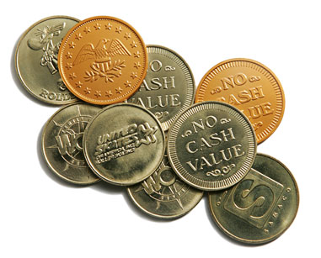
Token Types :
Plain Vanilla VS Objects
Notes:
1. Mostly, the tokens are straightforward. For ex: first name. To use any token in the email body of an invoice notification page just click on the token and thats it. Next time, the notification is triggered, in this case when the invoice is generated, the token will be replaced by its corresponding value that was passed as parameter from the program.
2. Other types of tokens which are present are suppose invoiceDTO token. That token as the name says is an InvoiceDTO object. As we all know, once we have a InvoiceDTO object we can basically print anything about the invoice.

Slide 8

HOW DO I USE VELOCITY SCRIPTING
Notes:
1. Velocity scripting is like using groovy. It follows a similar syntax. The ${} convention works as expected and prints the value contained in the object.

Slide 9
Some Velocity Syntax
a) Comments
b) Getters
c) If / ElseIf / Else
d) Foreach Loop

Slide 10
Some Velocity Syntax (Continued..)
a) Comments - ## This is a single line comment.
b) Getters
$customer.getAddress()
$purchase.getTotal()

Slide 11
Some Velocity Syntax (Continued..)
c) if/else if
#if( $foo ) Velocity!
#end
#if( $foo < 10 )
<strong>Go North</strong>
#elseif( $foo == 10 )
<strong>Go East</strong>
#elseif( $bar == 6 ) <strong>Go South</strong>
#else <strong>Go West</strong> #end

Slide 12
Some Velocity Syntax (Continued..)
d) Foreach Loop
<ul>
#foreach( $product in $allProducts ) <li>$product</li>
#end
</ul>

Slide 13

Configuration for Notification
1) Set up each user : First set up the user for notifications by editing the user and checking the include in notifications flag.
2) Now we can configure any type of Notification type like invoice, order, payment, etc. First check the active checkbox and then using the tokens we can write the email body.

Slide 14

TROUBLE-SHOOTING NOTIFICATIONS
IMPORTANT FOR :
AND FOR jBilling ofcourse….

Slide 15
Configuring Email-Plugin for Notification
1) The email plugins are grouped under Configuration > Plug-ins > Notification Plugins.
2) Standard Email Notification is the name of the plugin of which you have to set the parameters.

Slide 16
TROUBLESHOOTING NOTIFICATIONS
Configuration for Test Email Plugin
1) Go to Configuration > Plugins > Notifications
2) Add the Notification Task For Testing Plugin.
3) Now you can see the email which were scheduled to be sent in real will be stored in a file named emails_sent.txt.

Slide 17

STEPS TO TRIGGER A NEW NOTIFICATION
SOME Pre-requisites
There are many types of notifications , which are defined under various categories, like invoices, payments, users, custom. These are stored in the notification_category table.
b) Corresponding to each of the types there are some notifications, like payment_successful, invoice generated, etc.

Slide 18
STEPS TO TRIGGER A NEW NOTIFICATION (Continued..)
c) There are 2 main tables notification_category which tells us for which category the notification belongs for ex: Payments and notification_message_type which has the type of notification under the above category like Payment (Successful).
d) Corresponding to both tables there are entries in the international_description table.

Slide 19
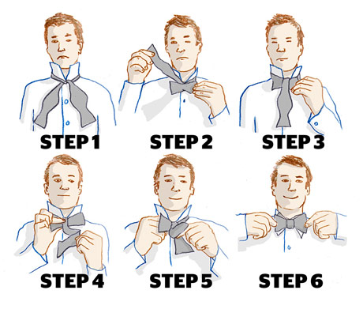
MOST INTERESTING PART: How would you write your own notification ??

Slide 20
STEPS TO TRIGGER A NEW NOTIFICATION
Basically we have 4 main steps to trigger a new notification:
1) Insert a new row in the appropriate notification_message_type via sql, if its entirely a new notification i.e. a new notification category then you need to Insert a row in the
notification_category table as well.

Slide 21
STEPS TO TRIGGER A NEW NOTIFICATION (Continued..)
2) Insert a new row into the International Description Table.
3) In the BL of the notification type, fire the event.
4) You may also have to add a method in NotificationBL.java to construct a messageDTO specific for this notification.

Slide 22
EXAMPLE: If we want to enter a new notification whose category is suppose payments
1) Insert a new notification_message_type , it has a id of 52 in jbilling_table
insert into notification_message_type(id, category_id, optlock) (23, 5, 1);
insert into international_description(table_id, foreign_id, psudo_column, language_id, content) values(52, 23, 'description',1,'Special Payment');

Slide 23
EXAMPLE (Continued..)
3) Now Fire The Event. You will have to add
your own specific MessageDTO object which
basically adds parameters which can be used
for that notification.

Slide 24
EXAMPLE (Continued..)
Note:
1) You may also have to add a method in NotificationBL.java to construct a messageDTO specific for this notification.
2) notification_message_type = 52 in jbilling_table table.

Slide 25


Slide 26


