Slide 1

Realtime Mediation
Or pre-paid billing

Slide 2

REAL TIME Scenario
“The classic business case for this is pre-paid services where a customer has a balance and can only use a service as long as the balance remains positive. Every attempt to use the service has to check if there is enough balance.”
Customer subscribes to a pre-paid plan
Customer is required to maintain an advance reducing balance
Customer must have a min. balance to make a call/purchase
validate the purchase against pre-paid balance

Slide 3
Pre-Paid
e.g. $100 Payment increments the pre-paid balance by $100. Customer can be prevented from making a purchase above $100
Dynamic
Balance
Credit Limit
e.g. $100 of Credit Limit set on a Customer’s account means, a customer is not allowed to spend above and beyond $100 without making a payment first.

Slide 4
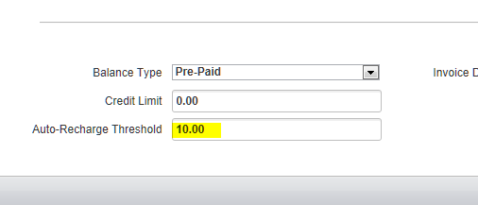
Maintaining Dynamic Balance
Manual Payment
Automatic recharge

Slide 5
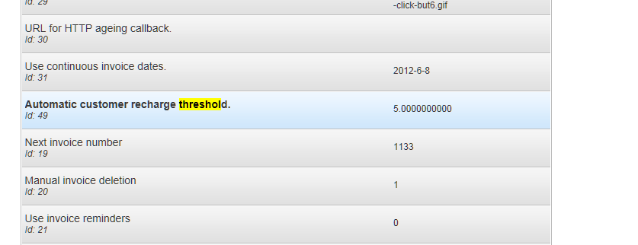
Maintaining Dynamic Balance (automatic recharge)
Pre-paid balance only
Autorechargetask
Auto recharge threshold preference

Slide 6
VALIDATE PURCHASE
Runs the mediation process for a single event, but it does not update the customer account. Instead, it checks if the customer has enough balance to purchase the charges that the event represents.
Validate against dynamic balance vis-à-vis rules
IValidatePurchaseTask
User Balance
Validate Purchase Task
Rules Validate Purchase Task

Slide 7
OTHER REAL TIME CALLS..
rateOrder/rateOrders | Will evaluate an order with pricing and item plugins without creating the order. Your application can show the order to the customer to approved it, and the create it.
getCurrentOrder | Returns the order that the mediation process is using to collect usage for a billing period.
updateCurrentOrder | Runs the mediation process for a single event, passed as an argument
validateMultiPurchase | Same as validatePurchase except that it can validate purchase for more than one items together.

Slide 8
MAIN SUBSCRIPTION
CUSTOMERS subscription period (monthly, daily, quarterly)
Next day of invoice (1 to 31)

Slide 9
IMPORTANT CONCEPTS
balance type
credit limit
automatic recharge
automatic recharge threshold

