Slide 1

Reports
Step by step Training
Author: Juan Vidal – Email: juanv@jbilling.com

Slide 2

Summary
What are reports?
Why would you need to create a report?
What do you need to know to be able to create one?
Example
Little test

Slide 3

What is a report?
iReports GUI
Database
REPORT
myReportDesign.jrxml
REPORT DATA
Jasper Reports
Report123.pdf
REPORT

Slide 4
Why would you need to create an REPORT?
This is mainly done for companies. They requests us to create a REPORT with a particular layout, logic and data in it. This varies between customers.

Slide 5
What do you need to know to be able to create one?
report types
Report directory
Gsp template
Gsp template directory
summary
Sql queries
i18n
Grails commands
Using the report

Slide 6
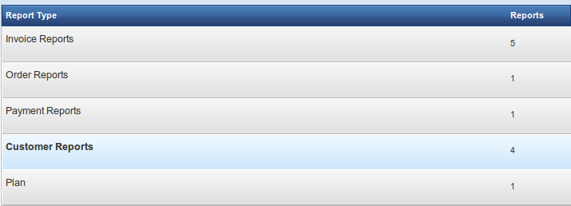
What do you need to know to be able to create one?
Report Types

Slide 7
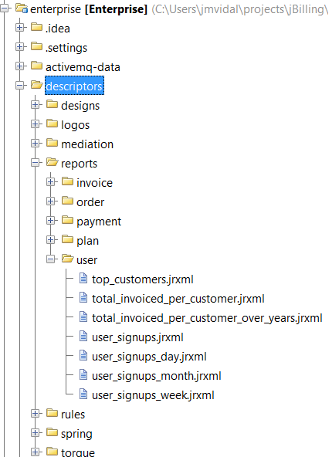
What do you need to know to be able to create one?
Report Directory
\descriptors\Reports\TYpe

Slide 8
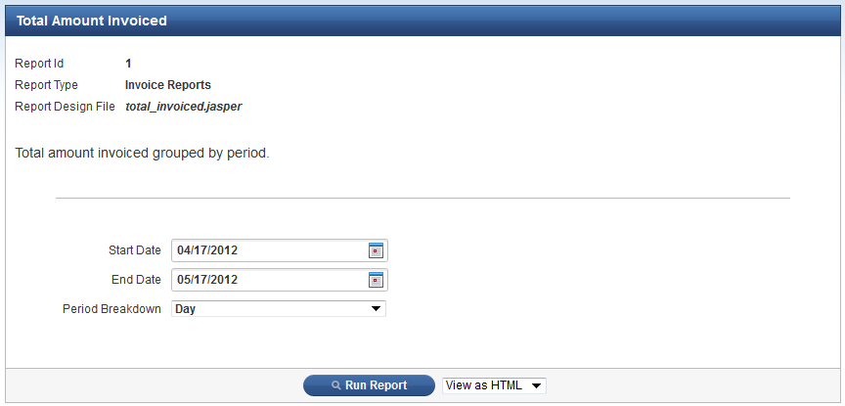
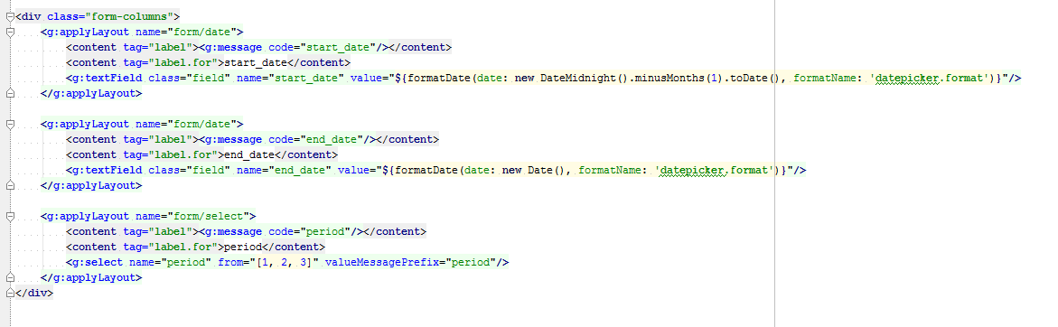
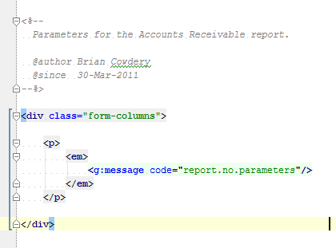
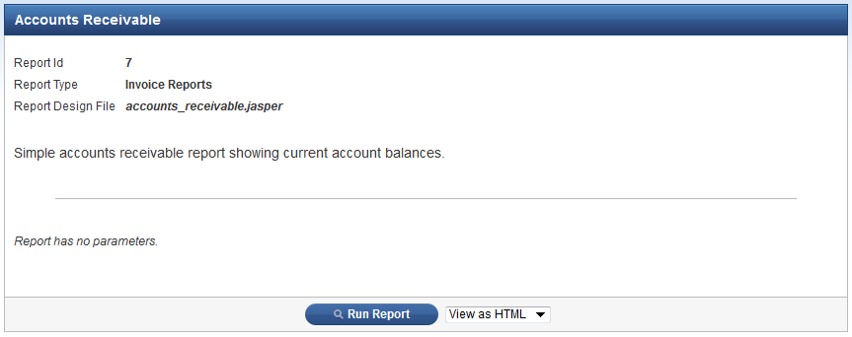
What do you need to know to be able to create one?
GSP Template
Reports with and without parameters

Slide 9
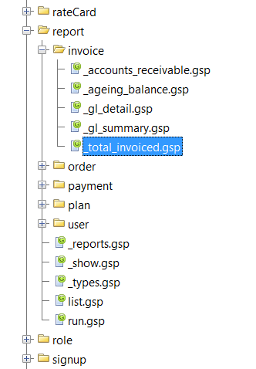
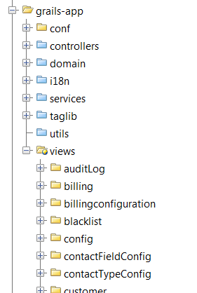
What do you need to know to be able to create one?
GSP Template Directory

Slide 10
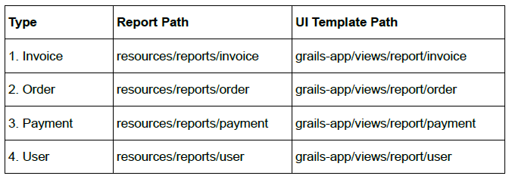
What do you need to know to be able to create one?
Summary

Slide 11
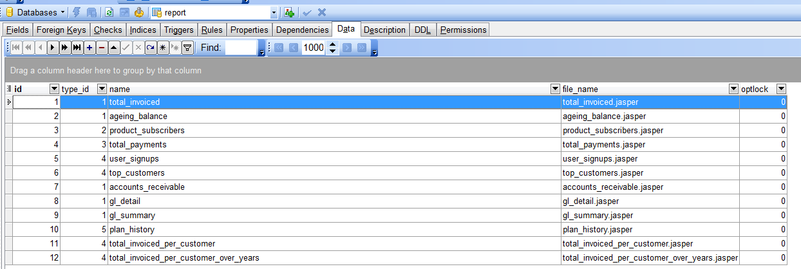
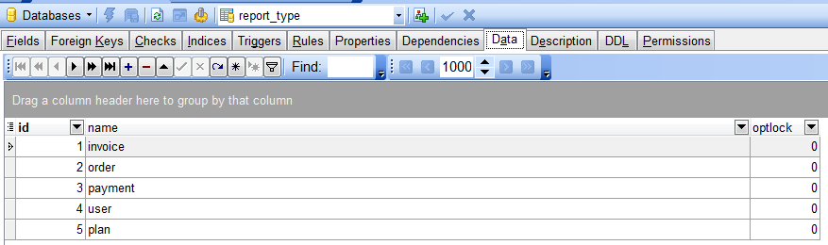
What do you need to know to be able to create one?
SQL Queries – Report Tables

Slide 12
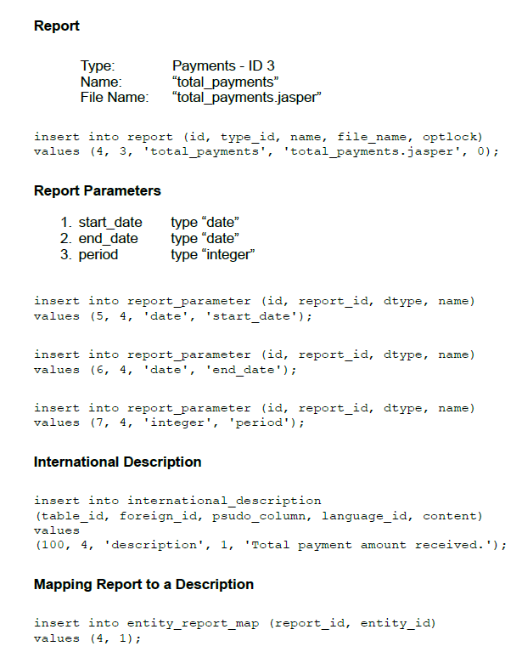
What do you need to know to be able to create one?
SQL Queries

Slide 13
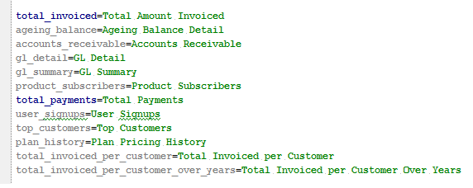
What do you need to know to be able to create one?
i18n

Slide 14
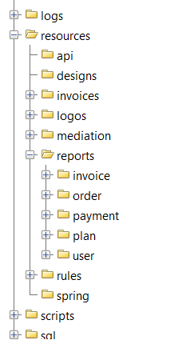
What do you need to know to be able to create one?
Grails Commands
Grails compile-reports

Slide 15
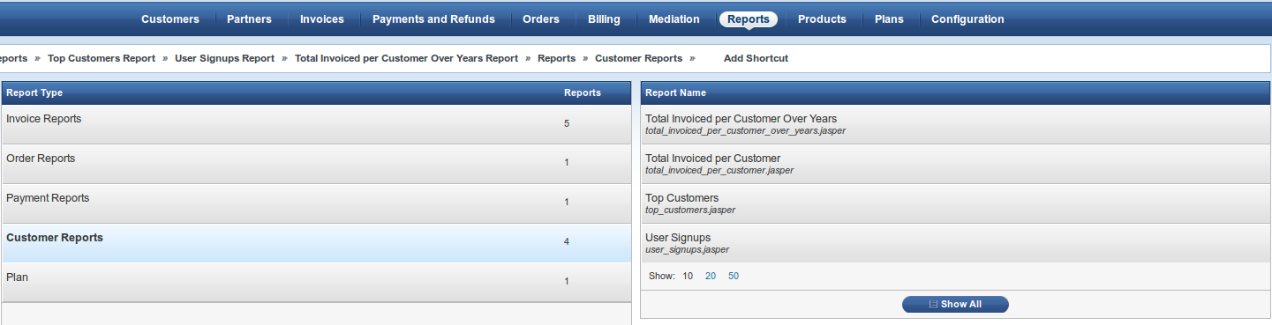
What do you need to know to be able to create one?
1
Using the Reports
Reports
3
2

Slide 16
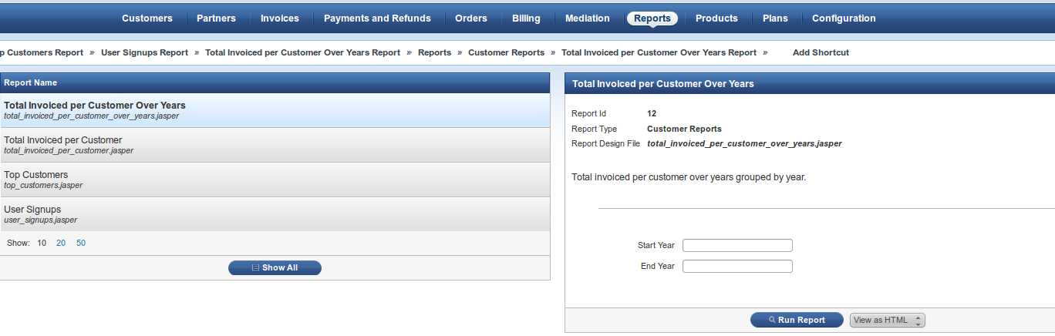
What do you need to know to be able to create one?
Using the Reports
Reports
1
3
2

Slide 17
Example
Demo jBilling

Slide 18
Test
Exercise 1
Generate a report that returns a list of created users within a given range of dates. Show the id, username and created date.

Slide 19
Questions?

Slide 20
bookmarks
Jbilling guide-> http://jbilling.com/files/jbilling_extension_guide.pdf

